Slide 1
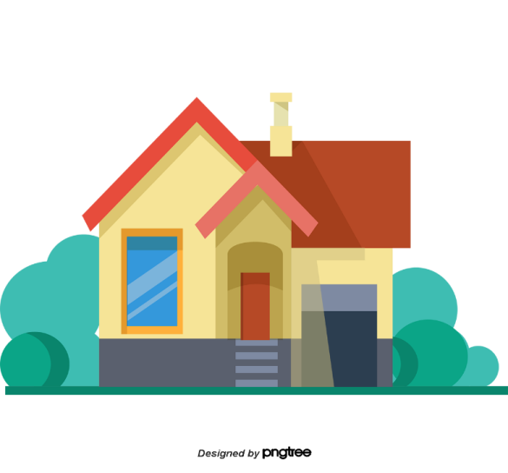
Facebook : Bùi Liễu
0968142780
My house
Unit
13
Lesson 3 (1+2+3)

Slide 2
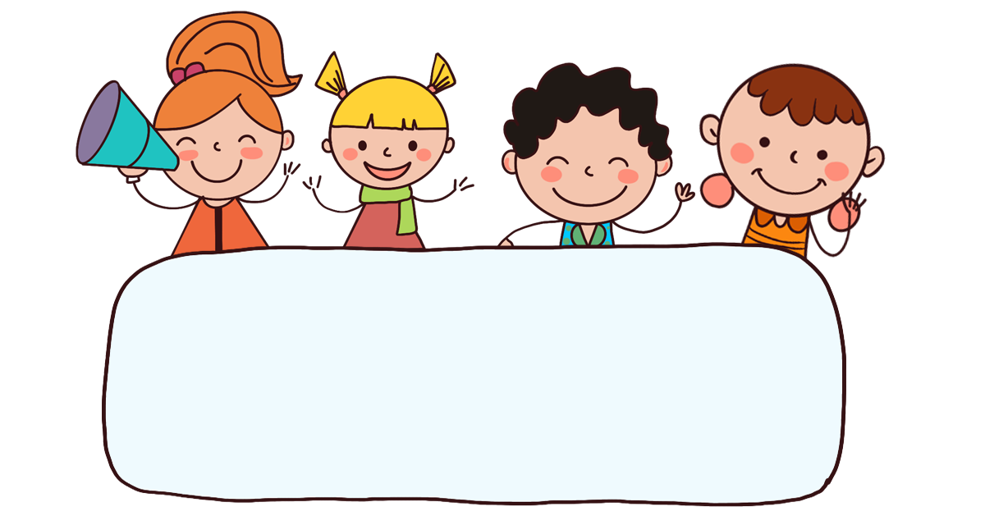
Warm up

Slide 3

Let’s play!

Slide 4


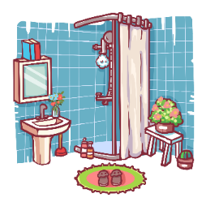
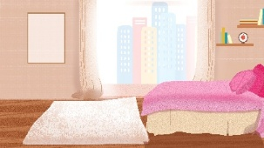

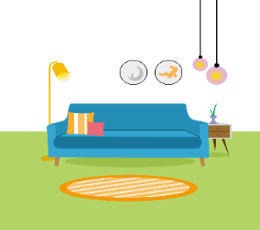
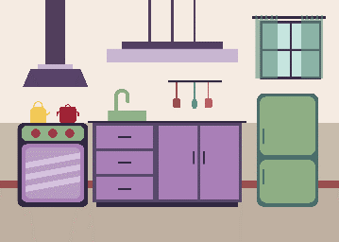

Choose the right answer.
1/12
a
b
c
d
kitchen

Slide 5
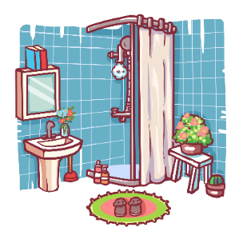


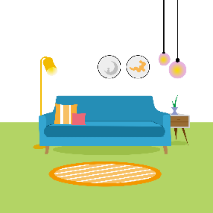
Choose the right answer.
2/12
a
b
c
d
living room

Slide 6


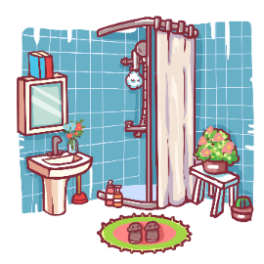
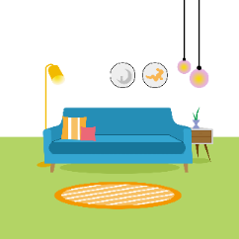
3/12
a
b
c
d
bedroom

Slide 7
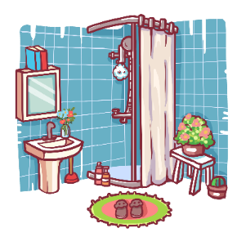

4/12
a
b
c
d
bathroom

Slide 8




5/12
a
b
c
d

Slide 9

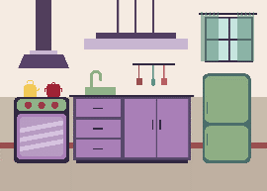
6/12
a
b
c
d

Slide 10
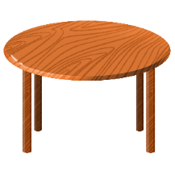
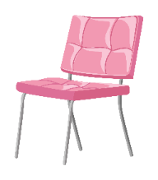
7/12
a
b
c
d

Slide 11
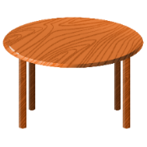
8/12
a
b
c
d

Slide 12
9/12
a
b
Where’s the kitchen?
It’s here.

Slide 13
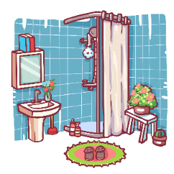
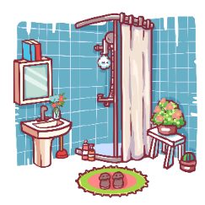
10/12
a
b
Where’s the bathroom
It’s there.

Slide 14
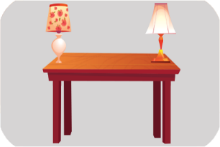
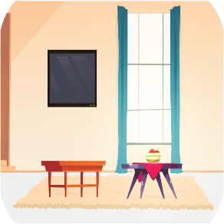
11/12
a
b
Where are the tables?
They’re in the living room.

Slide 15
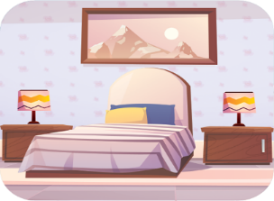
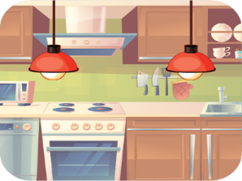

12/12
a
b
Where are the lamps?
They are in the bedroom.

Slide 16
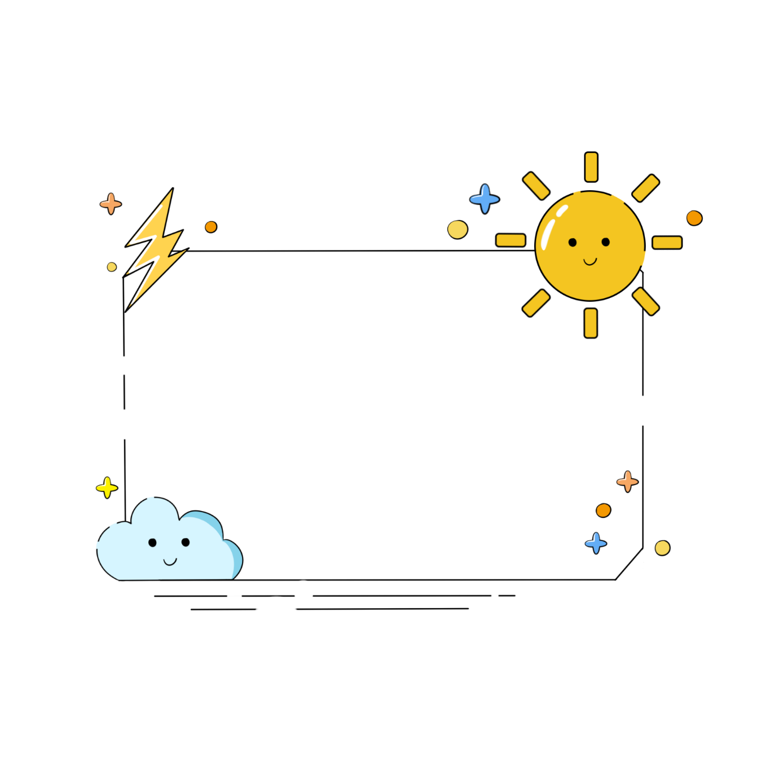
Good job!

Slide 17



Contents
Listen and repeat.
Listen and circle.
Let’s chant.

Slide 18
2. Listen and circle.
a. I like a big house. b. I like a brown house.
a. I don’t like a big house. b. I don’t like a brown house.
Fb: Bùi Liễu Powerpoint
0968142780

Slide 19

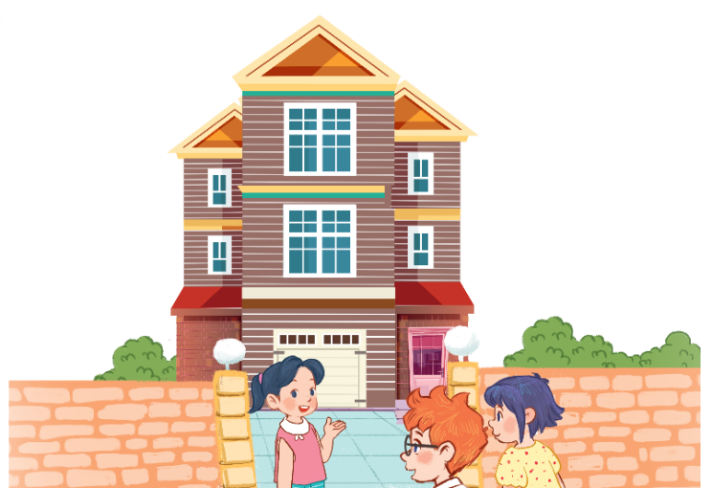








3. Let’s chant.
Big house,
big house.
It’s a big house.
It’s my big house.
Come in, please!
Brown house,
brown house.
It’s a brown house.
It’s my brown house.
Come in, please!

Slide 20

3. Let’s chant.
Big house,
big house.
It’s a big house.
It’s my big house.
Come in, please!
Brown house,
brown house.
It’s a brown house.
It’s my brown house.
Come in, please!

Slide 21
Wrap up

Slide 22


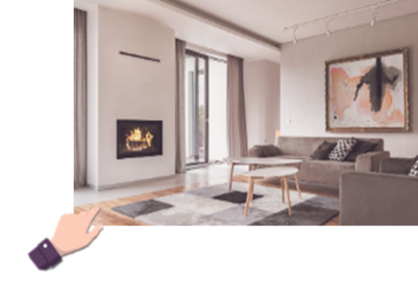
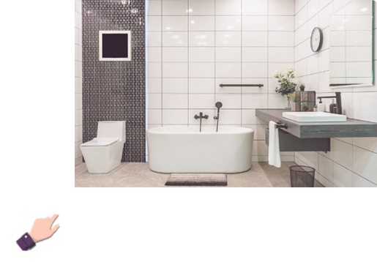
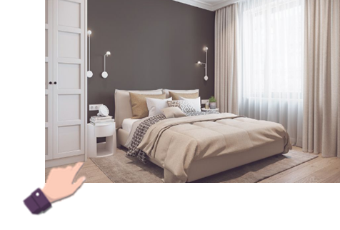
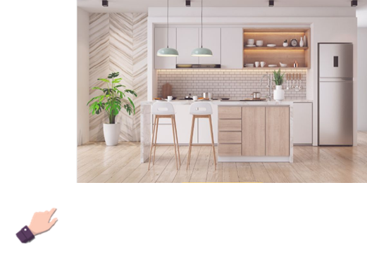
Unit 13 lesson 1
Where’s the____?
where’s = where is
it’s = it is
It’s here / there.
living room
bathroom
bedroom
kitchen

Slide 23
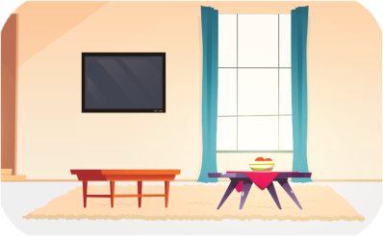
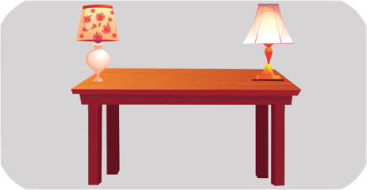
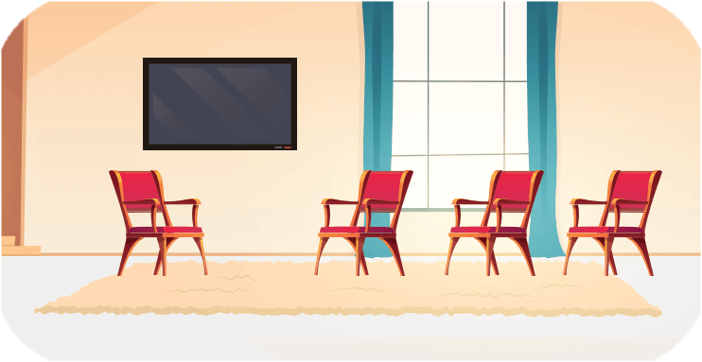
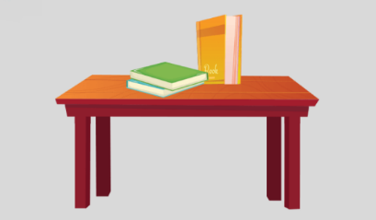
Unit 13 lesson 2
Where are the ____?
they’re = they are
They’re ______.
tables /
in the living room
lamps /
on the table
chairs /
in the living room
books /
on the table

Slide 24

Thank you!

