Slide 1
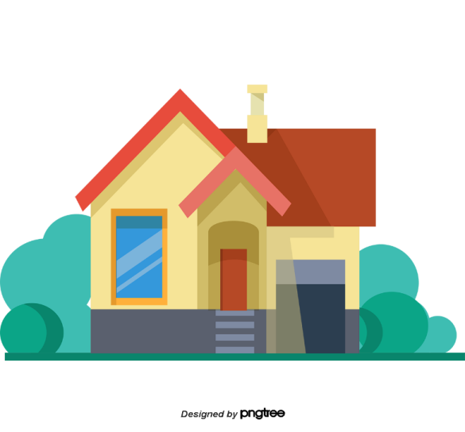
Facebook : Bùi Liễu
0968142780
My house
Unit
13
Lesson 3 (4+5+6)

Slide 2
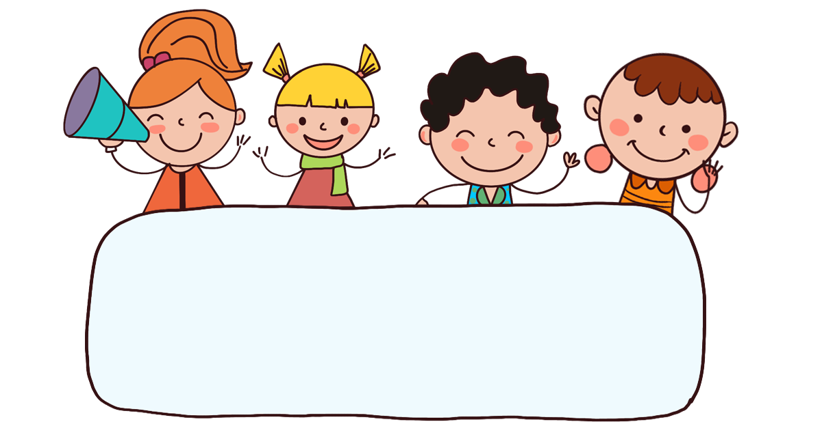
Warm up

Slide 3

Let’s play!
Can you guess?

Slide 4

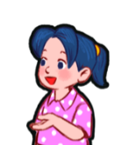
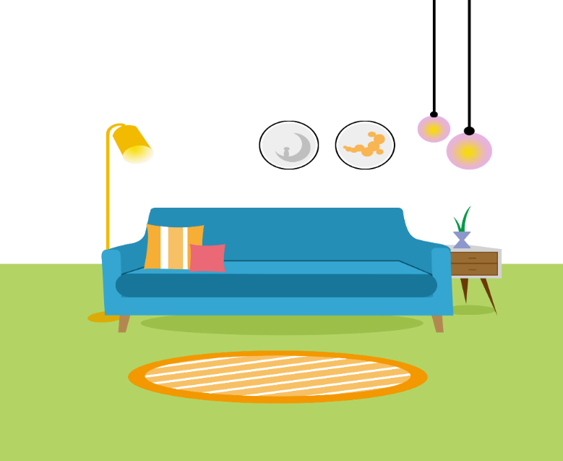
Where is the living room?
It’s here.
_______.
1/8

Slide 5
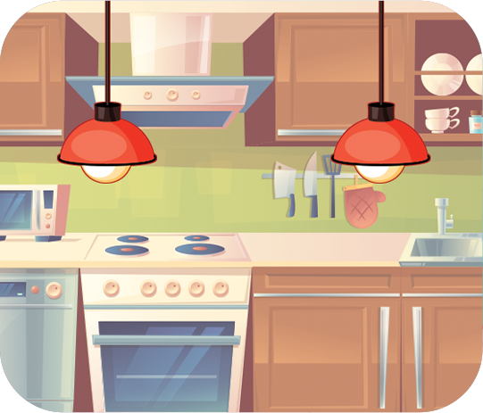
Where are the lamps?
They’re in the kitchen.
__________________.
2/8

Slide 6
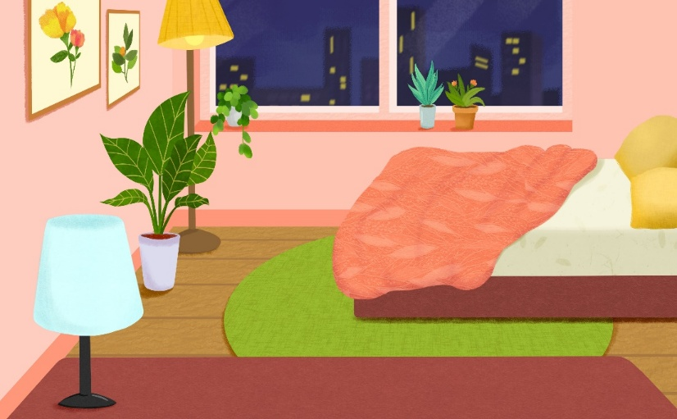
Where is the bedroom?
_______.
It’s there.
3/8

Slide 7
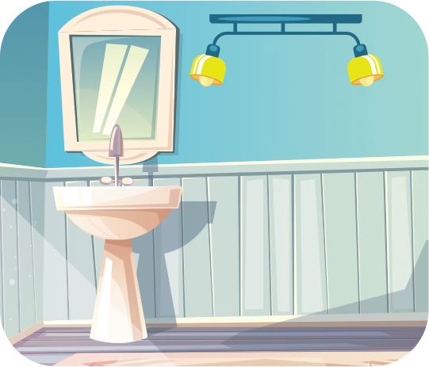
Where are the lamps?
They’re in the bathroom.
__________________.
4/8

Slide 8

Where are the books?
They’re on the table.
_____________.
5/8

Slide 9
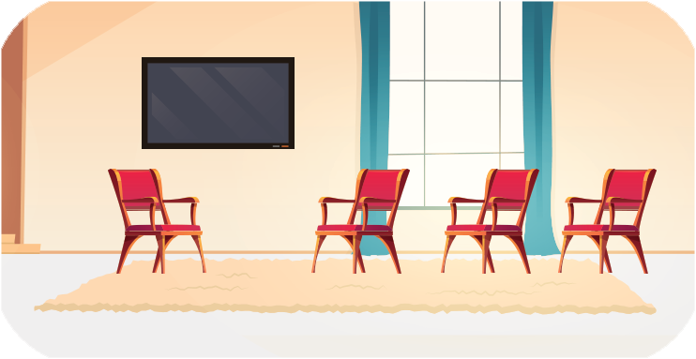
Where are the chairs?
_________________?
They’re in the living room.
6/8

Slide 10
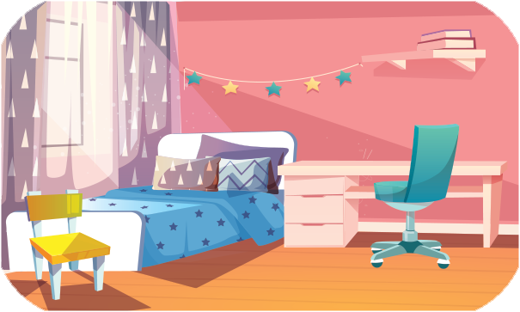
__________________?
_________________?
Where are the chairs?
They’re in the bedroom.
7/8

Slide 11
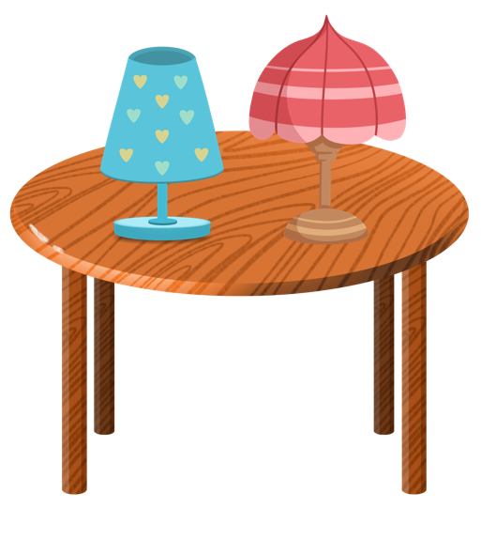
Where are the lamps?
They’re on the table.
________________.
8/8

Slide 12
Thank you!

Slide 13



Contents
Read and complete.
Let’s write.
Project.

Slide 14

4. Read and complete.
My name is Mary. Here is my house. This is the living room and this is the bedroom. That is the kitchen and that is the bathroom. The chairs and the table are in the kitchen. The books are on the table.
1
2
3
4
1. This is the living room and this is _____________.
2. That is ___________ and that is the bathroom.
3. The chairs and the table are in ______________.
4. The books are on _________.
the bedroom
the kitchen
the kitchen
the table

Slide 15
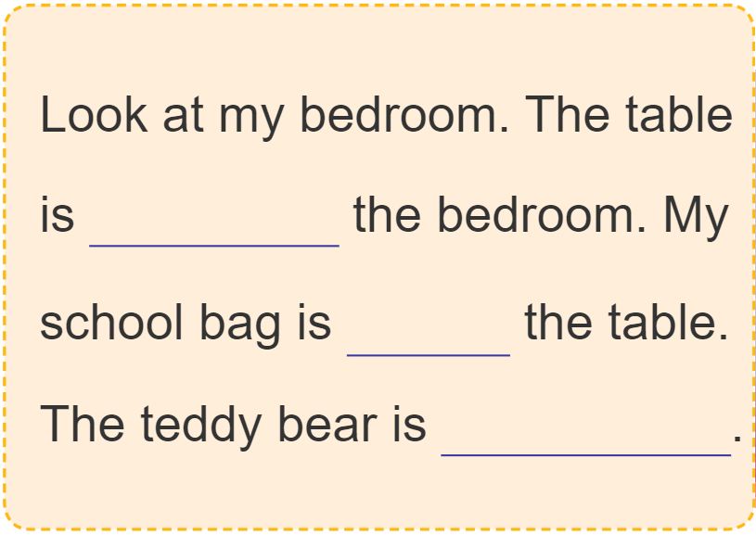
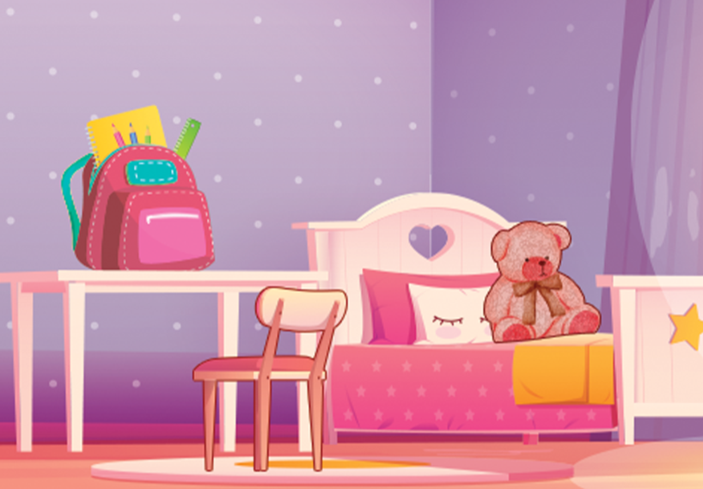
5. Let’s write.
in
on
on the bed

Slide 16
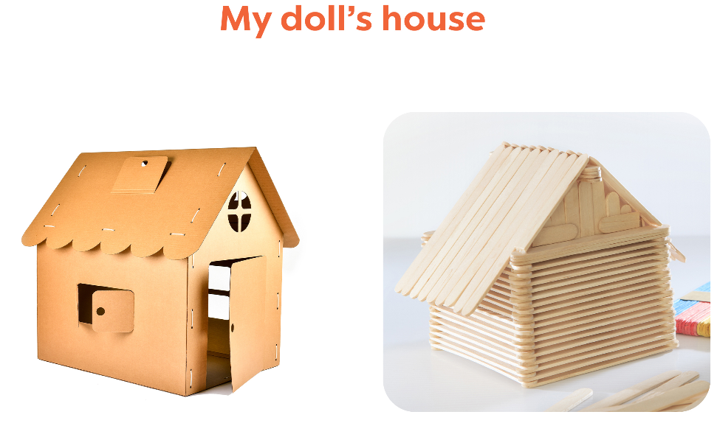
6. Project.

Slide 17
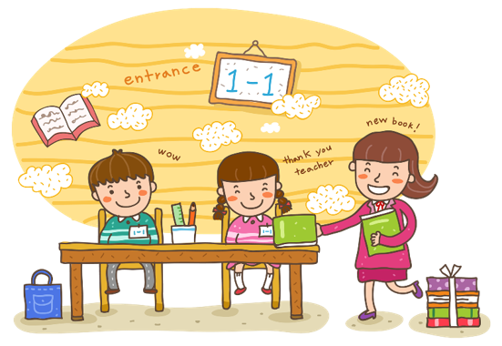
Wrap up

Slide 18


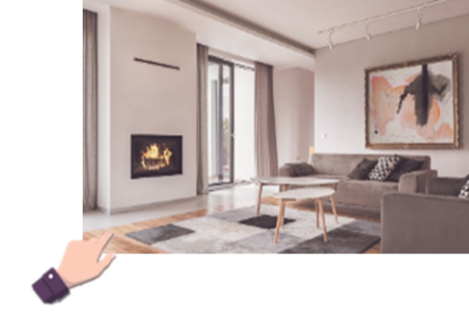
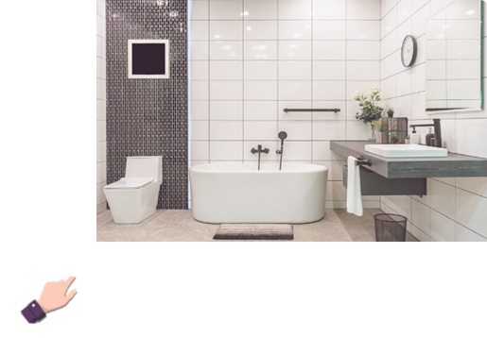
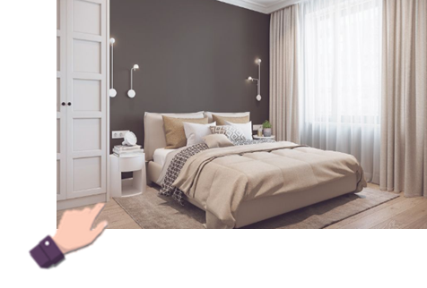
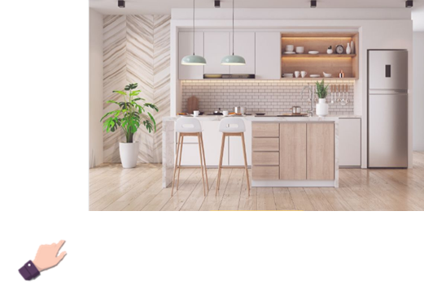
Unit 13 lesson 1
Where’s the____?
where’s = where is
it’s = it is
It’s here / there.
living room
bathroom
bedroom
kitchen

Slide 19
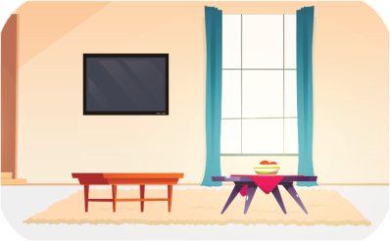
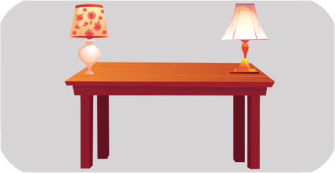
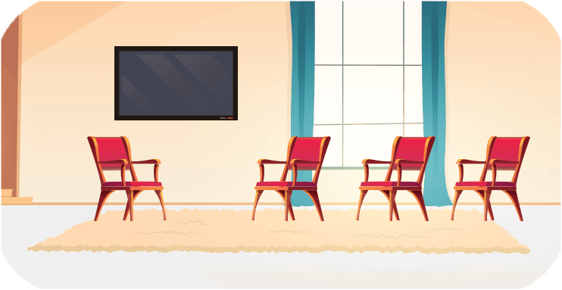
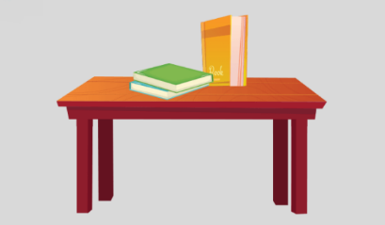
Unit 13 lesson 2
Where are the ____?
they’re = they are
They’re ______.
tables /
in the living room
lamps /
on the table
chairs /
in the living room
books /
on the table

Slide 20

Thank you!

