Slide 2








Unit 14: STAYING HEALTHY
Lesson 3 - Period 6

Slide 3





Table of contents
1
Warm-up and Review.
2
Activity 4: Read and complete.
3
Activity 5: Let’s write.
4
Activity 6: Project.
5
Fun corner and Wrap-up.

Slide 4




01
Warm-up and Review

Slide 5





Let’s chant.
Does he play football once a week?
Yes, he does. Yes, he does.
Does he do judo twice a week?
No, he doesn’t. No, he doesn’t.
Does she eat apples once a day?
Yes, she does. Yes, she does.
Does she eat mangoes twice a day?
No, she doesn’t. No, she doesn’t.

Slide 6
02
Activity 1
Read and circle.

Slide 7

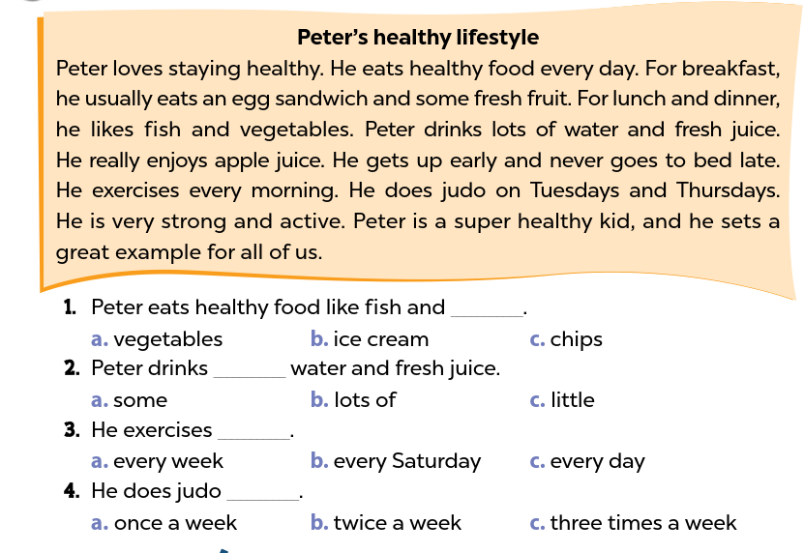

Look and read.
Notes:
Step 1: Tell pupils the goal of the activity and explain that they should read the text and complete sentences by choosing the correct option. Check comprehension.

Slide 8
Model sentence 1.
Notes:
Step 2: Do sentence 1 as an example. First, have pupils read the gapped sentence and three options. Then, have pupils find the information about what the food Peter eats in the text. Ask where in the text they can find the information. Explain that pupils need to find the word fish in the reading and read the words after that to find the information. Choose the correct option to complete sentence 1.

Slide 9
Read and circle.
Notes:
Step 3: Set a time limit for pupils to do the task independently. Go around the classroom and offer help where necessary.

Slide 10
Swap your book.
Notes:
Step 4: Get pupils to swap their books with a partner and check their answers before checking as a class. Have students read the sentence in the reading text that helps them find the correct information. For example, he likes fish and vegetables. Peter drinks lots of water and fresh juice. He does morning exercise every day. He does judo twice a week.

Slide 11
03
Activity 2
Let’s write.

Slide 12


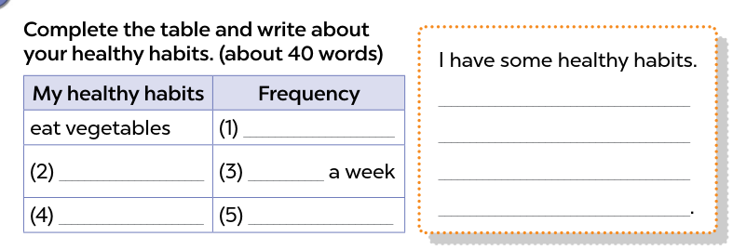


Look and say.
Notes:
Step 1: Tell the class the goal of the activity and explain that they should read and write three sentences about their healthy habits to complete the table. Check comprehension.

Slide 13
Let’s write.
Notes:
Step 2: Have pupils read the first column and elicit some activities they usually do to stay healthy in the morning. Then have them write the answer in the gap.
Step 3: Give pupils time to complete the table independently. Go around the classroom and offer help where necessary.

Slide 14

Swap your book.
I eat vegetables every day. My favourite vegetables are carrots and tomatoes. I like drinking fresh juice. I drink orange juice twice
a week. I play basketball three times a week. I want to stay healthy
every day
drink orange juice
twice
play basketball
three times a week
Notes:
Step 4: Get pupils to swap their books with a partner and check their answers before checking as a class.

Slide 15
04
Activity 3
Project

Slide 16



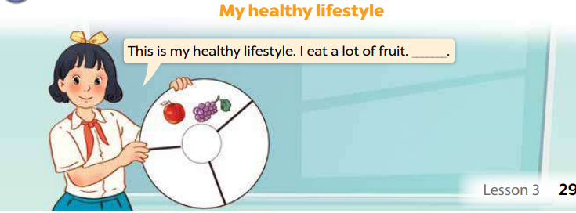


Ask and answer
Notes:
Step 2: Have pupils work in groups to practise their presentation. Go around the classroom and offer help where necessary.

Slide 17
Work in groups
Notes:
Step 1: Tell pupils about the goal of the activity. Restate the steps in the project. Explain that they have prepared a healthy habit circle. In the healthy habit circle, there is information about what they eat, drink and do to stay healthy. Ask them to show their healthy habit circle and share it to their friends.

Slide 18
Presentation
Notes:
Step 3: Invite a few pupils to show their healthy habit circle and give presentations in front of the class. Praise good performances.

Slide 19
05
Wrap-up

Slide 20











LUCKY BALLOONS

Slide 21



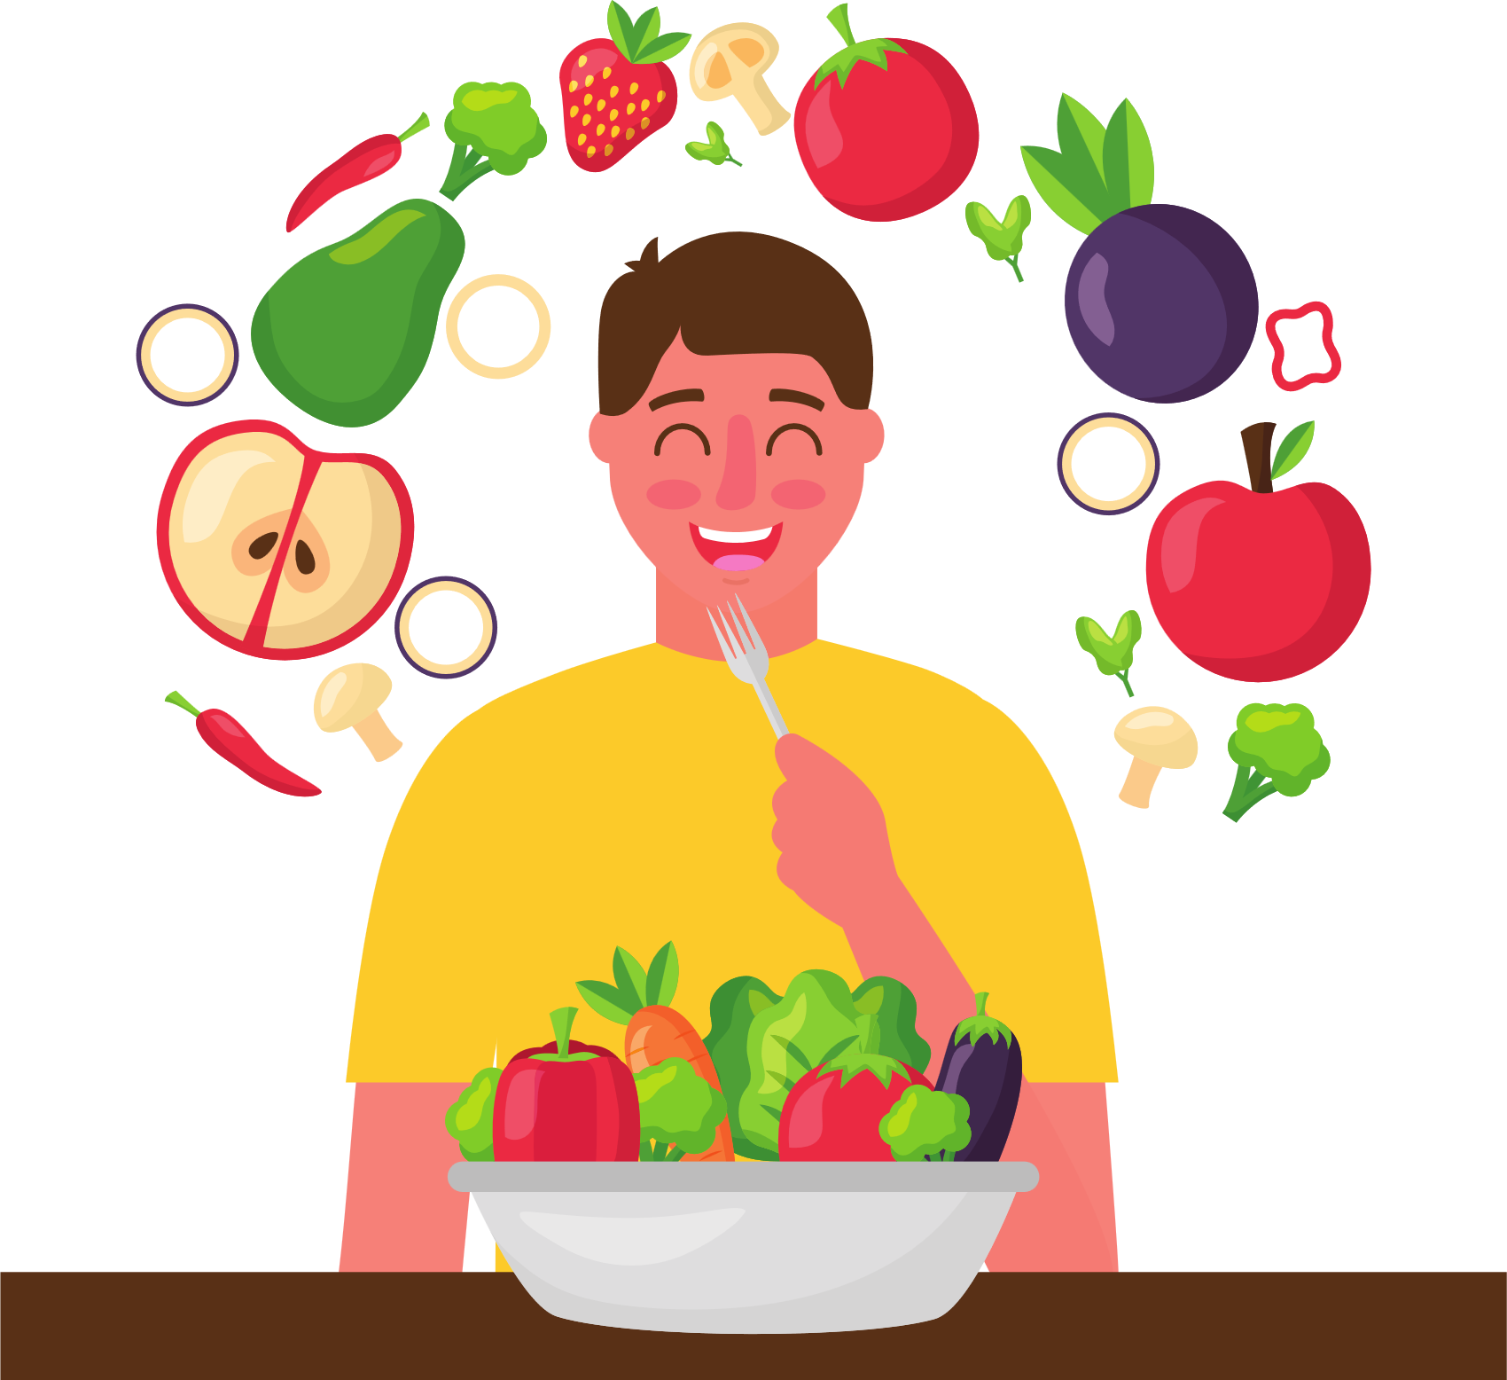



How does he stay healthy?
How often does he ______?

Slide 22

How does he stay healthy?
How often does he ______?

Slide 23

How does he stay healthy?
How often does he ______?

Slide 24

How does she stay healthy?
How often does she ______?

Slide 25

How does she stay healthy?
How often does she ______?

Slide 26

How does he stay healthy?
How often does he ______?

Slide 27



Great Job!

Slide 28
Website: hoclieu.vn
Fanpage: https://www.facebook.com/tienganhglobalsuccess.vn/

