Slide 1





Slide 4
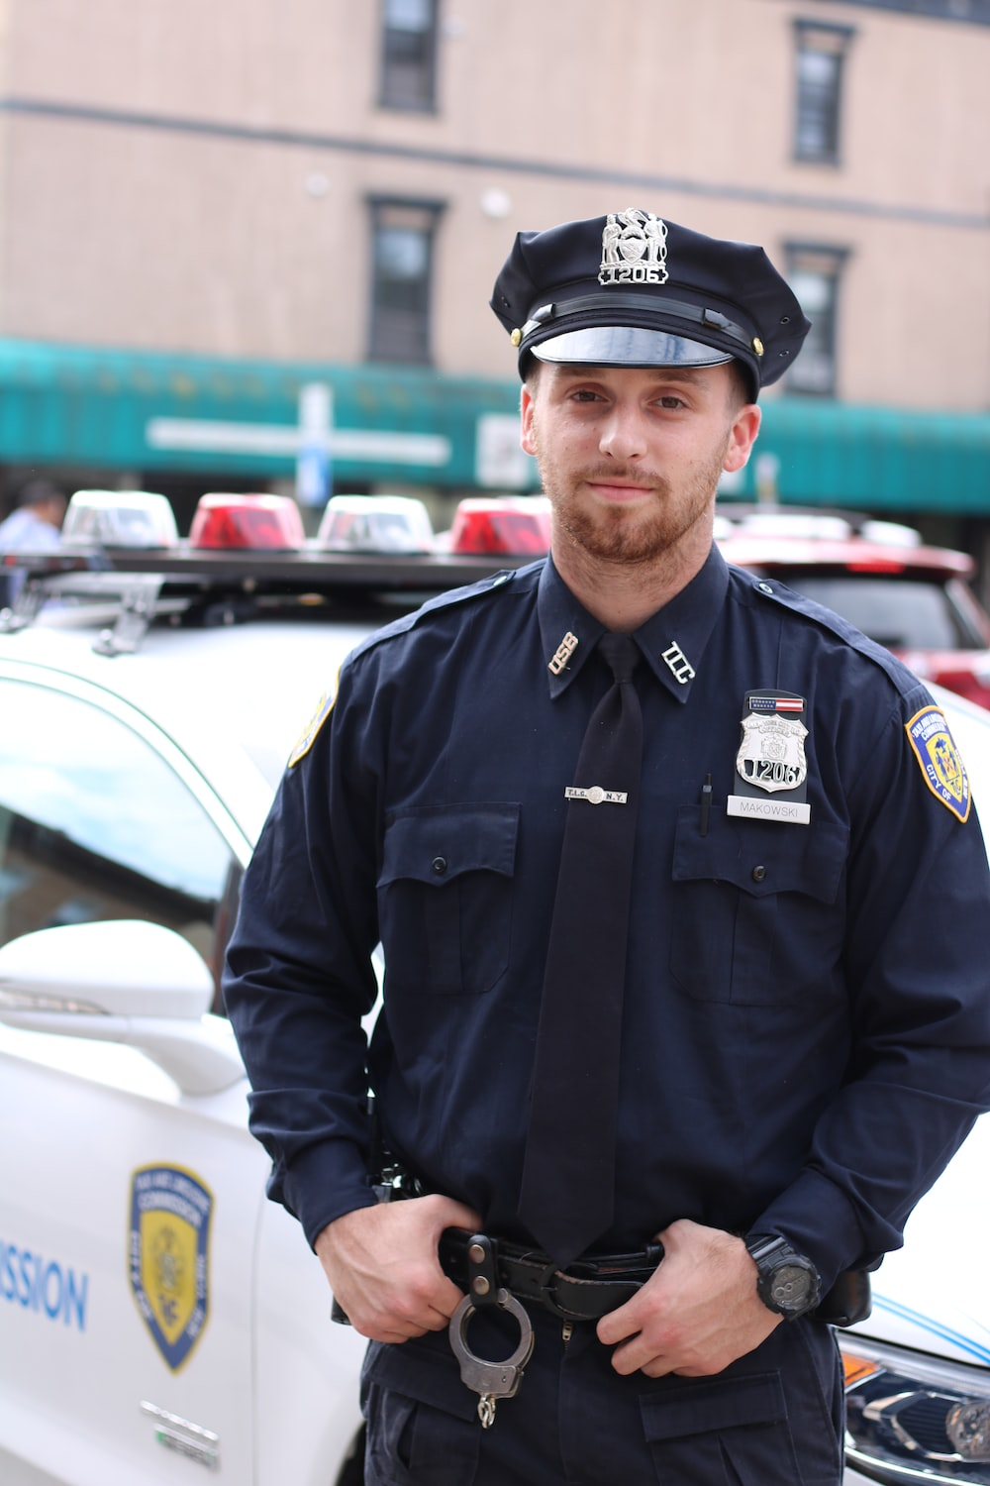
What does he do?
He’s a policeman.

Slide 5
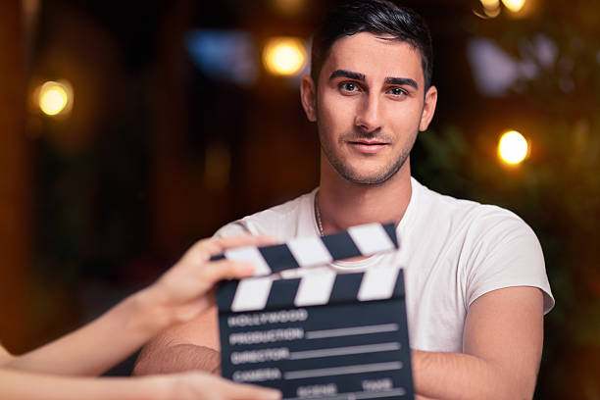
What does he do?
He’s an actor.

Slide 6
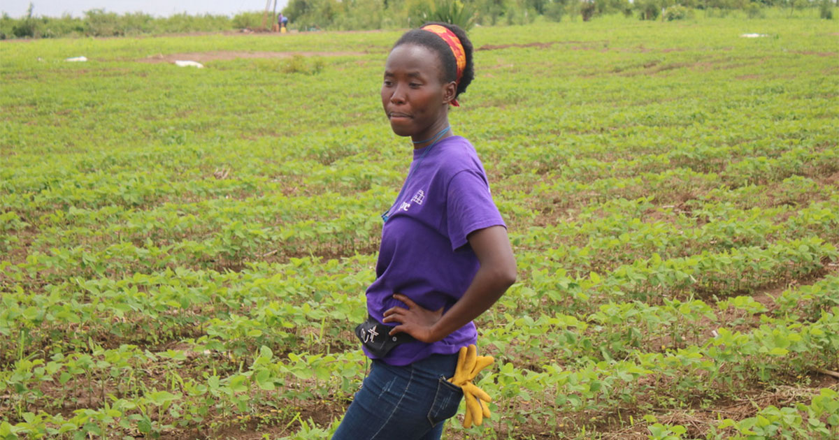
What does she do?
She’s a farmer.

Slide 7

What does she do?
She’s an office worker.

Slide 8
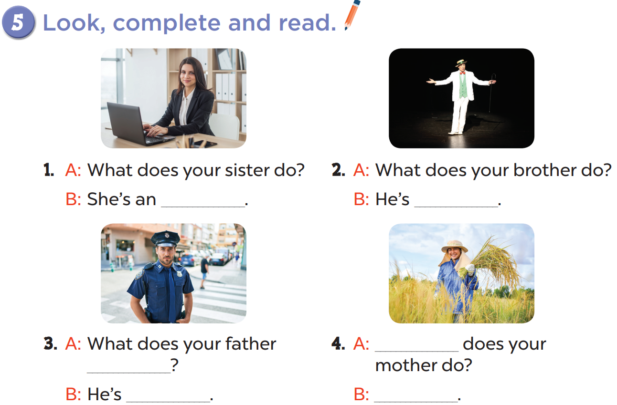

Slide 9
office worker
an actor
What
do
a policeman
She’s a farmer

Slide 10

Watch the video!
Notes:
https://www.youtube.com/watch?v=r6Oxqyd5qUw&t=4s

