Slide 1





Slide 4
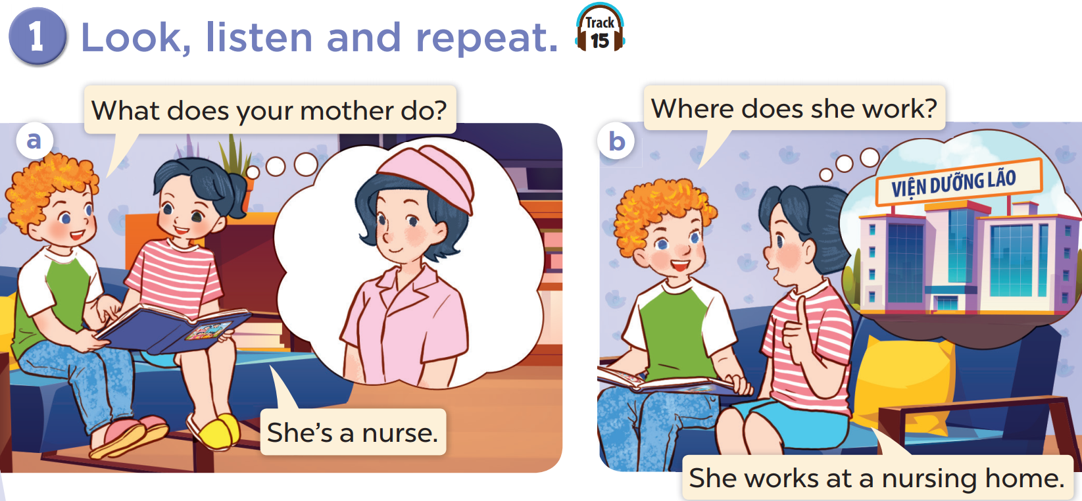

Slide 5
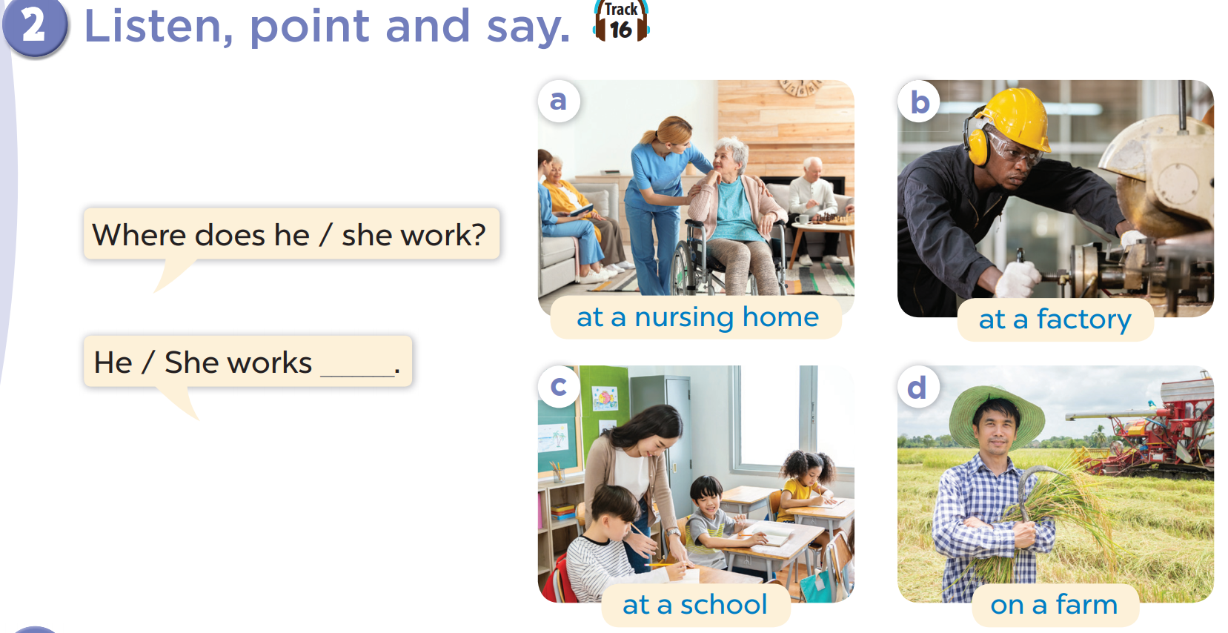


Slide 6
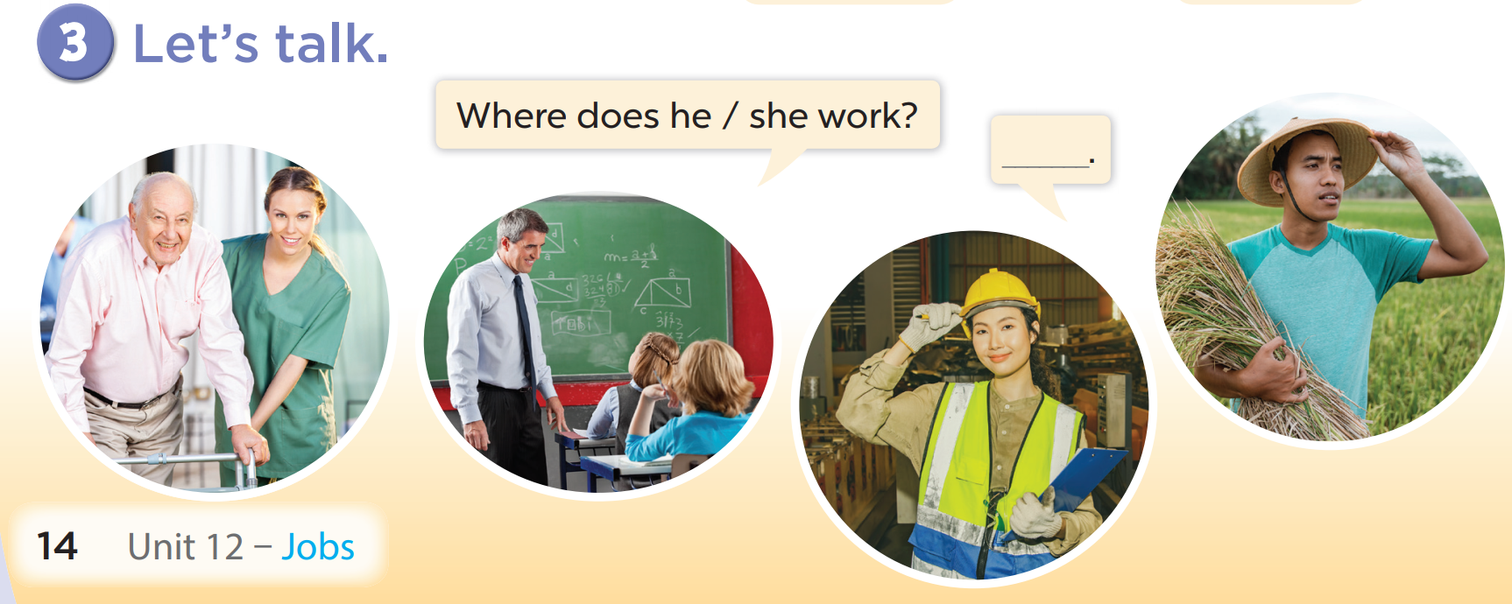

Slide 8
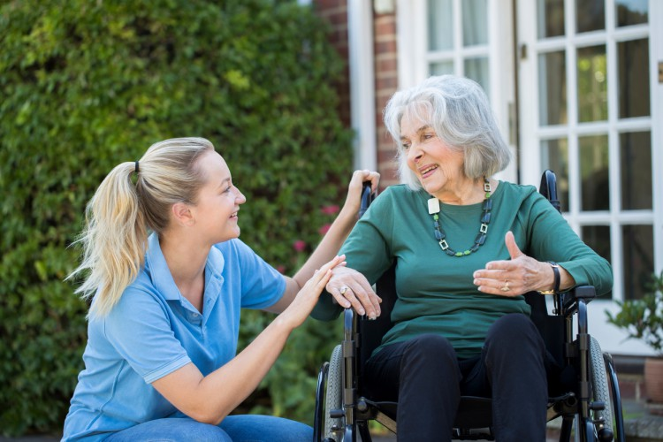
Where does she work?
She works at a nursing home.

Slide 9
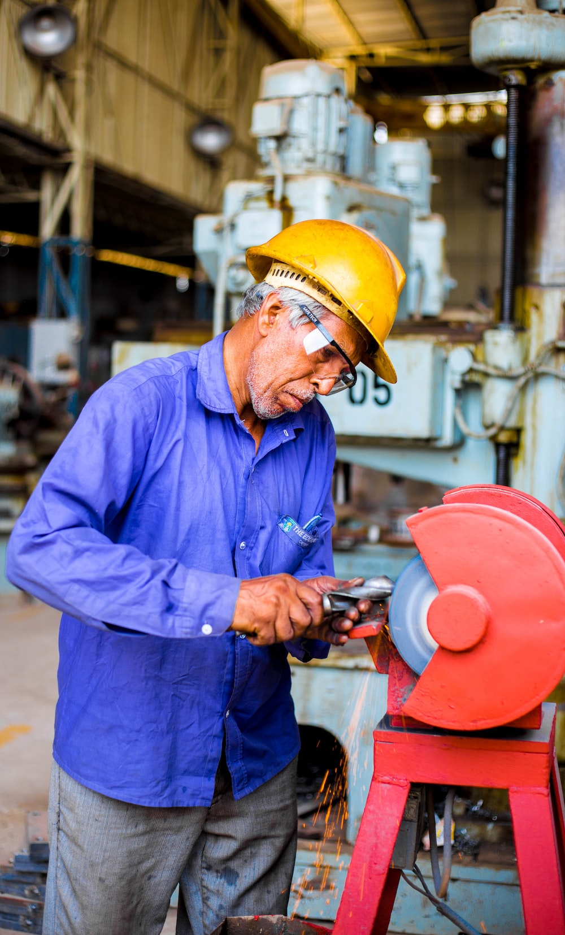
Where does he work?
He works at a factory.

Slide 10

Where does he work?
He works at a school.

Slide 11
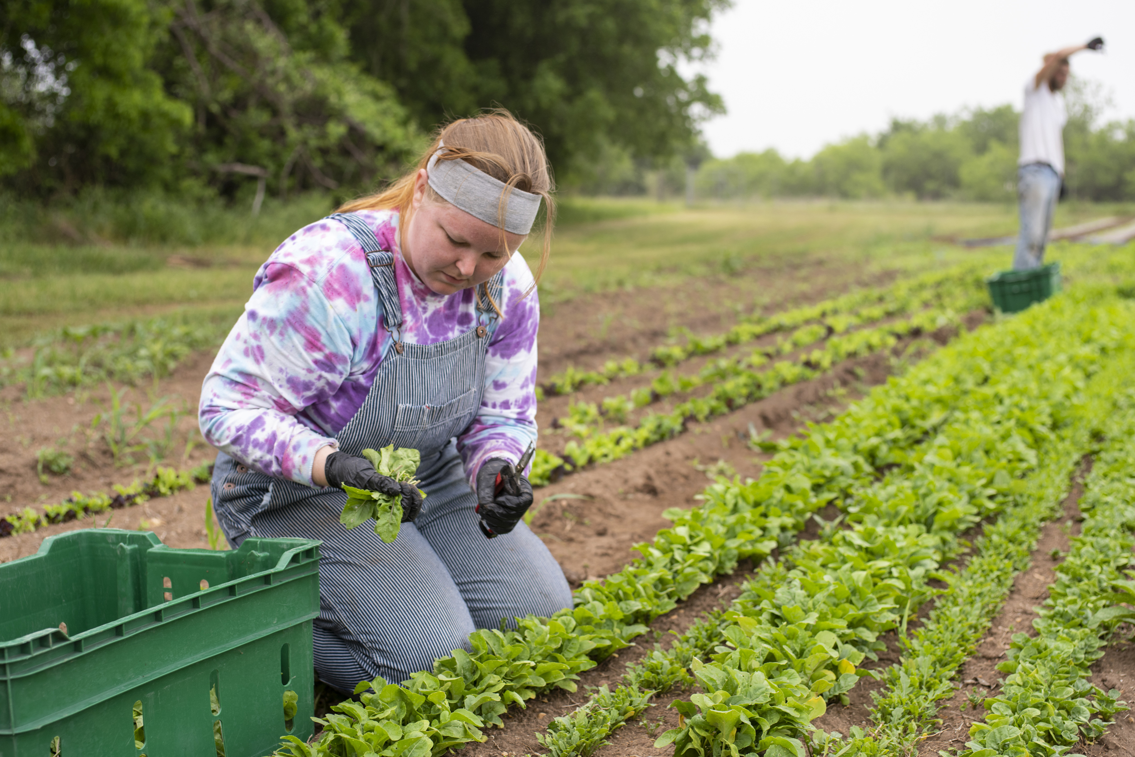
Where does she work?
She works on a farm.

