Slide 1
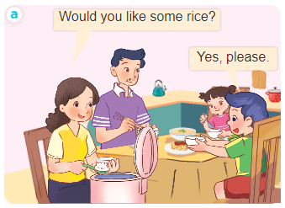
Unit 15
At the dining table
Lesson 1 (1+2+3)

Slide 2




Look, listen and repeat.
Listen, point and say.
Let’s talk.

Slide 3

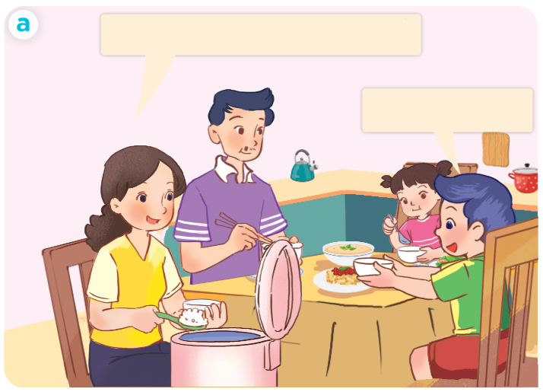
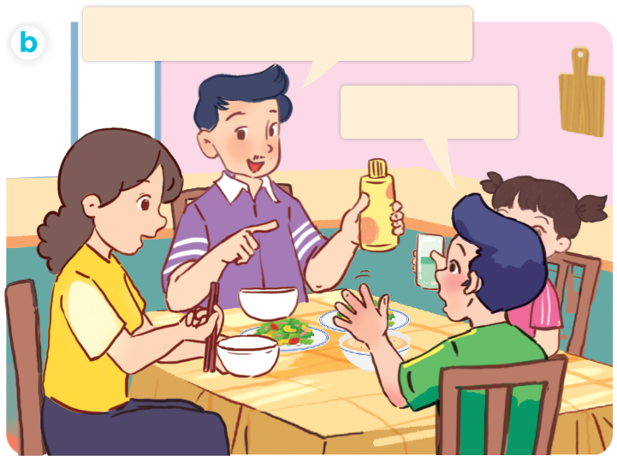
1. Look, listen and repeat.
Click on the speaker / sentences to listen.
Would you like some juice?
Would you like some rice?
Yes, please.
No, thanks.
Who are they?
What are they doing?
Where are they?

Slide 4


Slide 5
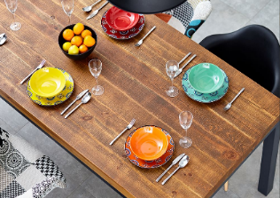
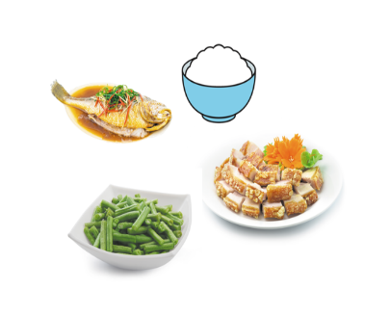

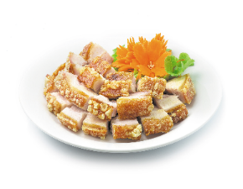

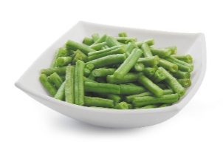

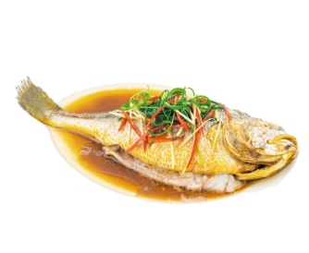
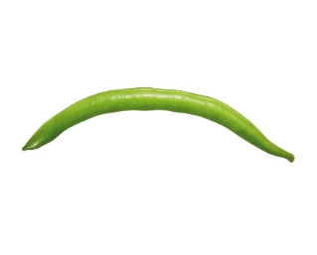
Review
dining table
food
drinks
rice
meat
fish
bean
beans
juice
some

Slide 6









1. dining table
: bàn ăn
2. food
: thức ăn / đồ ăn
3. drinks
:thức uống / đồ uống
4. fish
: cá
5. rice
: cơm
6. meat
: thịt
7. bean
: đỗ
8. beans
: đỗ
9. juice
: nước ép
10. some
: một vài, một ít

Slide 7

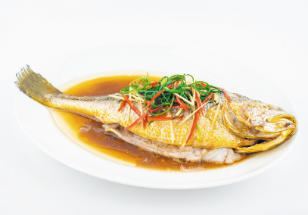





2. Listen, point and say.
a
b
Would you like some ____?
beans / yes
fish / no
Yes, please.
c
d
No, thanks.
meat / yes
juice / no

Slide 8



2. Listen, point and say.
a
Would you like some ____?
Yes, please.
No, thanks.
beans / yes
Would you like some beans?
Yes, please.
Click on the sentences to listen again.

Slide 9



2. Listen, point and say.
b
Would you like some ____?
Yes, please.
No, thanks.
fish / no
Would you like some fish?
No, thanks.

Slide 10


Slide 11
Mời ai ăn (uống) đồ ăn / nước uống.
- Would you like some ______?
+ Yes, please.
+ No, thanks.

Slide 12






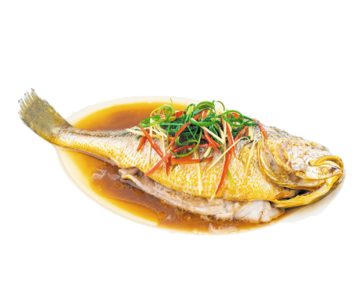
Unit 15 Lesson 1
Would you like some _____?
Yes, please.
No, thanks.
beans / yes
juice / no
fish / no
meat / yes

Slide 13
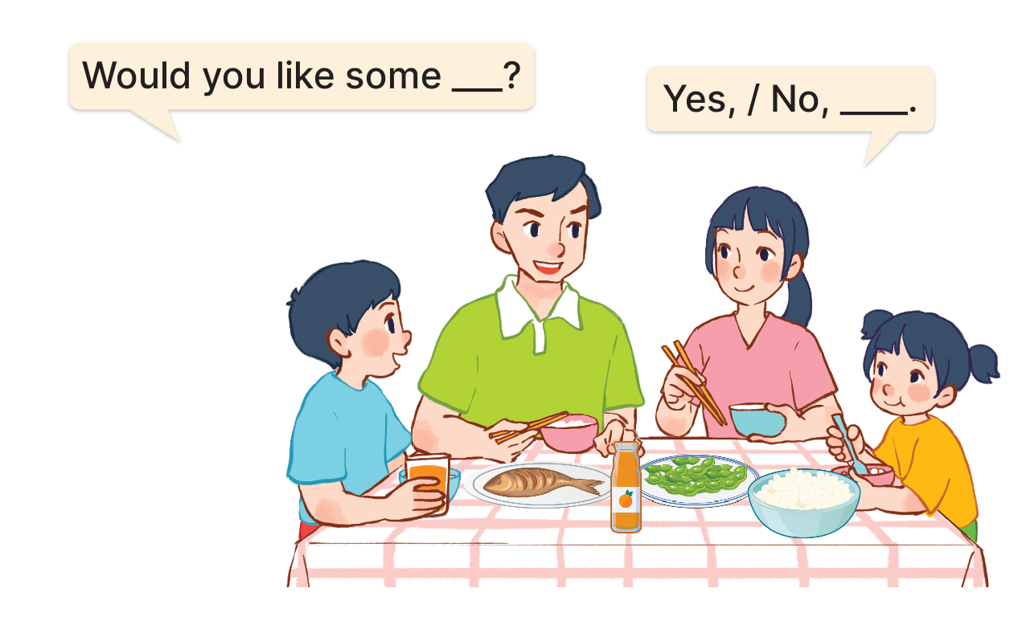
3. Let’s talk.

Slide 14

3. Let’s talk.
Would you like some ______?
juice
No, thanks
__________.

Slide 15
3. Let’s talk.
Would you like some ______?
beans
No, thanks
_________.

Slide 16

3. Let’s talk.
Would you like some ______?
fish
Yes, please
__________.

Slide 17
3. Let’s talk.
Would you like some ______?
rice
___________.
Yes, please

Slide 18

Well done!

Slide 19
Wrap up

Slide 20
Unit 15 Lesson 1
Would you like some _____?
Yes, please.
No, thanks.
beans / yes
juice / no
fish / no
meat / yes

Slide 21



