Slide 1


Slide 2
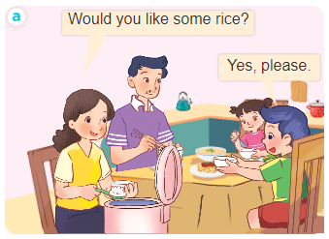
Unit 15
At the dining table
Lesson 1 (4+5+6)

Slide 3




Listen and tick.
Look, complete and read.
Let’s sing.

Slide 4

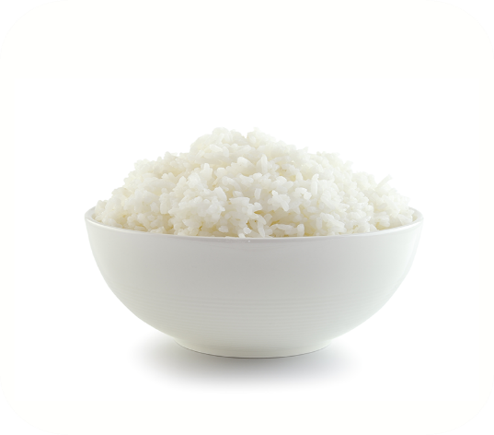
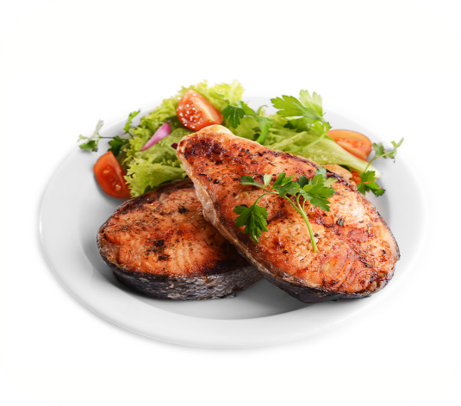


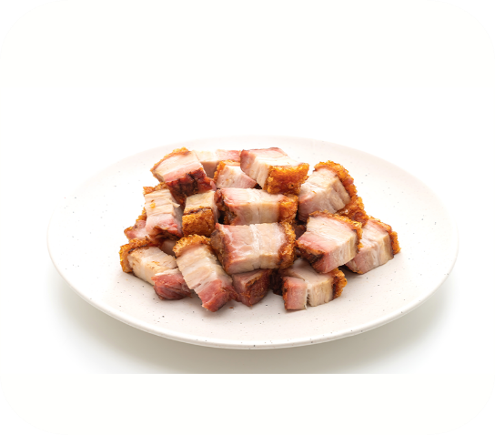
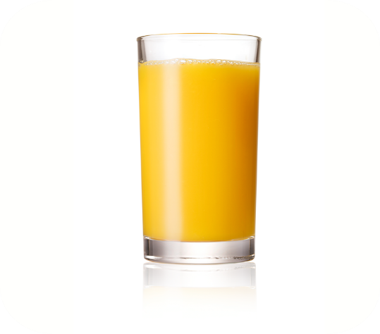

4. Listen and tick.
a
b
1
a
b
2

Slide 5
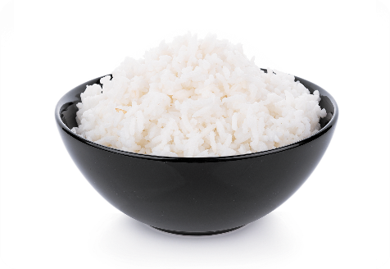
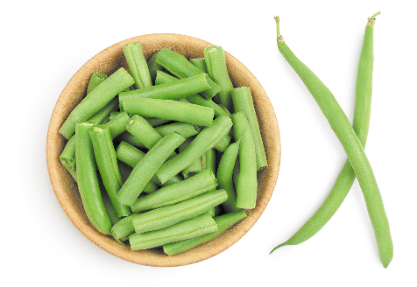
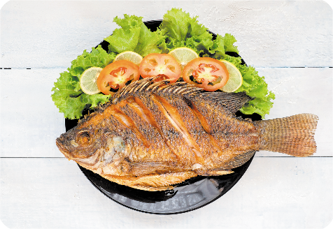
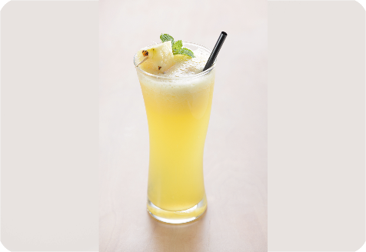
5. Look, complete and read.
rice
1. Would you like some _____?
beans
2. Would you like some ______?
3. A: Would you like some _____?
B: Yes, ________.
fish
4. A: Would you like some _____?
B: _______, thanks.
juice
please
No

Slide 6


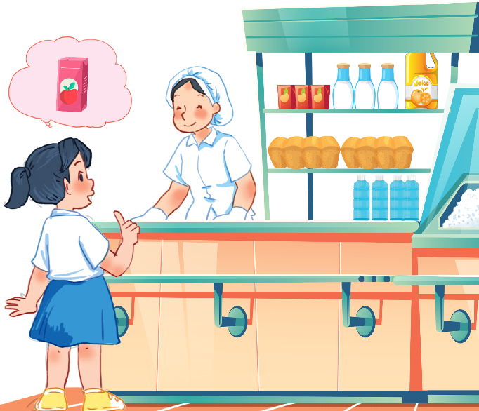




6. Let’s sing.
Would you like some …?
Would you like some rice?
No, thanks.
No, thanks.
Would you like some juice?
Yes, please.
Yes, please.

Slide 7
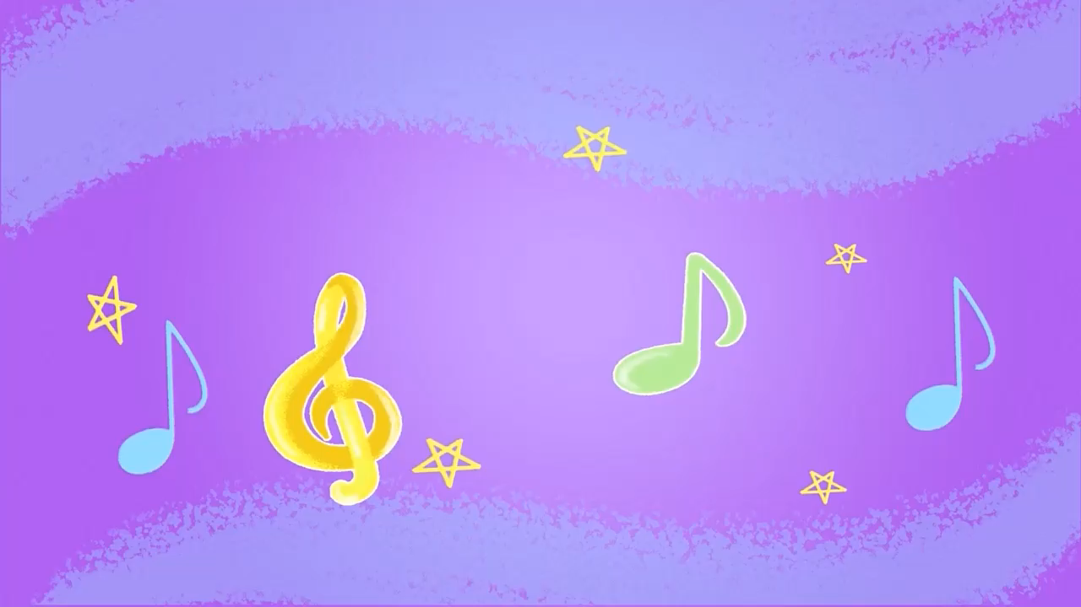
6. Let’s sing.

Slide 8

6. Let’s sing.
Would you like some …?
Would you like some rice?
No, thanks.
No, thanks.
Would you like some juice?
Yes, please.
Yes, please.

Slide 9
Wrap up

Slide 10





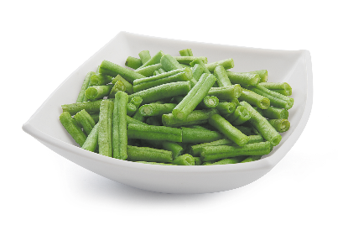
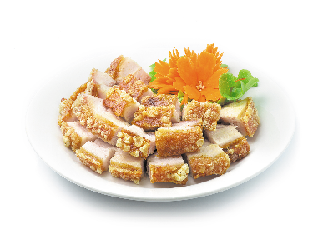
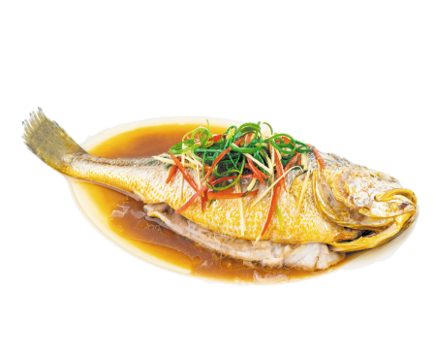
Unit 15 Lesson 1
Would you like some _____?
Yes, please.
No, thanks.
beans / yes
juice / no
fish / no
meat / yes

Slide 11



