Slide 1
Unit 15
At the dining table
Lesson 2 (1+2+3)

Slide 2
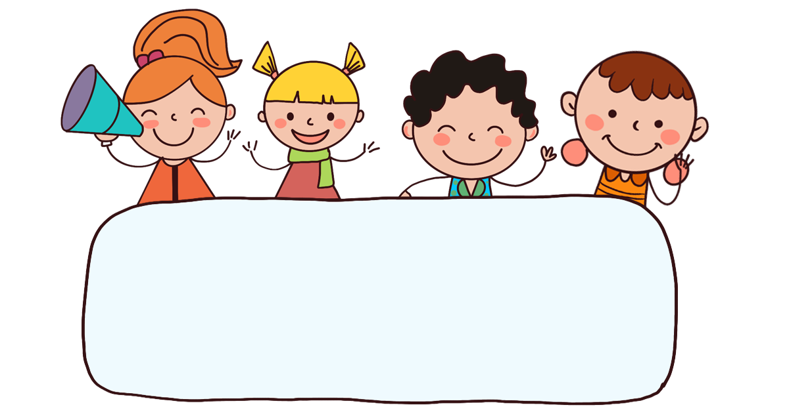
Warm-up

Slide 3

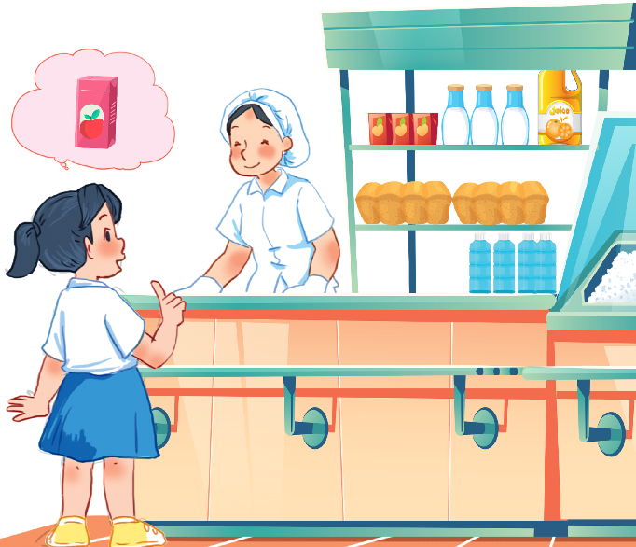
Let’s sing.
Would you like some …?
Would you like some rice?
No, thanks.
No, thanks.
Would you like some juice?
Yes, please.
Yes, please.

Slide 4



Contents
Look, listen and repeat.
Listen, point and say.
Let’s talk.

Slide 5

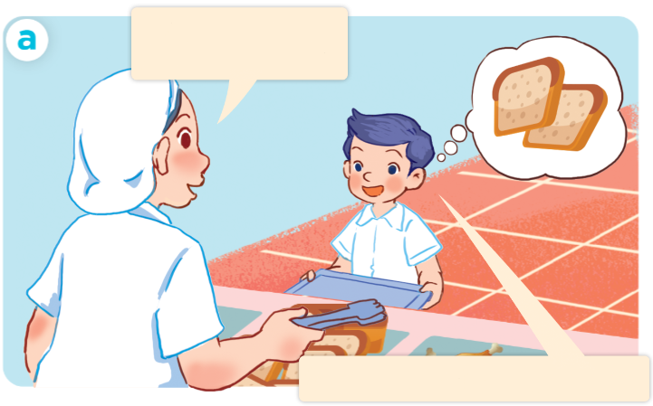
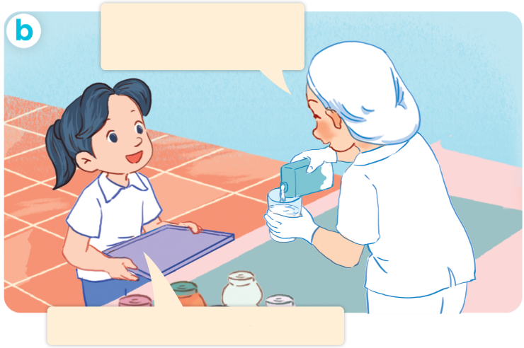
1. Look, listen and repeat.
What would you like to eat?
What would you
like to drink?
I’d like some
bread, please.
I’d like some milk, please.
Who are they?
Where are they?
What are they doing?
Click on the speaker / sentences to listen.

Slide 6
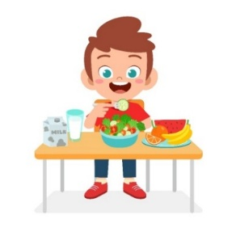
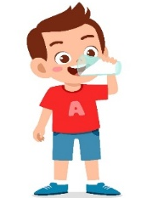

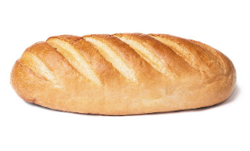
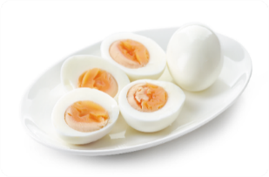
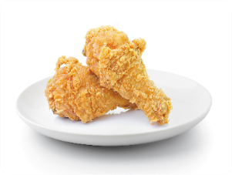


Review
eat
drink
bread
egg
eggs
chicken
water
milk

Slide 7





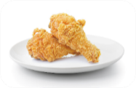


Vocabulary
1. eat
: ăn
2. drink
: uống
3. bread
: bánh mì
4. egg
: quả trứng
5. eggs
: quả trứng (số nhiều)
6. chicken
: thịt gà
7. water
: nước
8. milk
: sữa

Slide 8

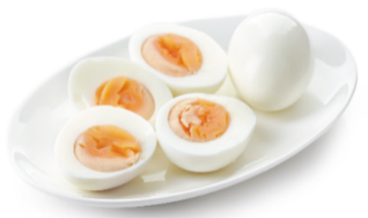
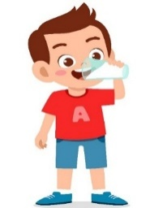

Checking vocabulary (1)
Choose the right answers.
a
b
c
d
eggs
eat
bread
_____
_____
drink
_____
_____
1
bread
2
water
3
chicken
4
milk
5
eat
6
drink
7
eggs
8
egg
Facebook: Bùi Liễu
0968142780

Slide 9

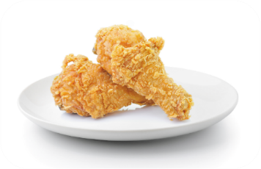


Checking vocabulary (2)
Choose the right answers.
a
b
c
d
egg
water
chiken
_____
_____
______
milk
_____
1
bread
2
water
3
chicken
4
milk
5
eat
6
drink
7
eggs
8
egg
Facebook: Bùi Liễu
0968142780

Slide 10

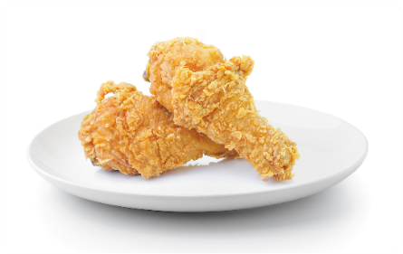

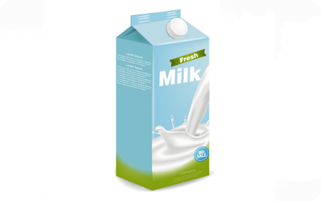
2. Listen, point and say.
a
b
What would you like to
eat / drink?
I’d like some ______,please.
eggs
chicken
c
d
I’d = I would
water
milk

Slide 11
Structures

Slide 12
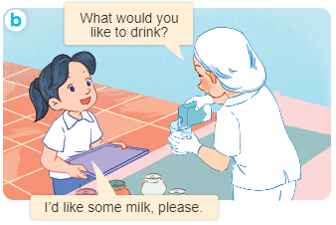
Structures
Hỏi người khác muốn ăn / uống gì.
- What would you like to eat / drink?
+ I’d like some ______, please.
I’d = I would

Slide 13


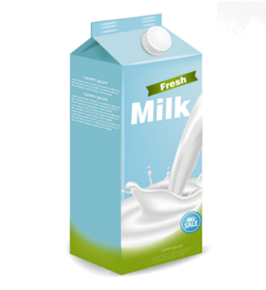



Unit 15 Lesson 2 (1+2+3)
I’d = I would
What would you like to eat / drink?
I’d like some _______, please.
eggs
milk
chicken
water

Slide 14
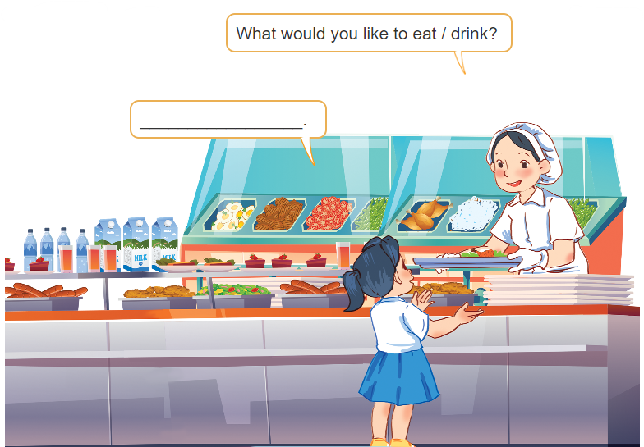
3. Let’s talk.
What would you like to eat / drink?
___________.

Slide 15
3. Let’s talk.
drink
What would you like to ______?
________________.
I’d like some water

Slide 16
3. Let’s talk.
drink
What would you like to ______?
______________.
I’d like some milk

Slide 17
3. Let’s talk.
eat
What would you like to _____?
________________.
I’d like some eggs

Slide 18
3. Let’s talk.
What would you like to ____?
eat
________________.
I’d like some meat

Slide 19
3. Let’s talk.
eat?
What would you like to _____?
__________________.
I’d like some chicken

Slide 20
3. Let’s talk.
What would you like to ____?
eat
______________.
I’d like some rice

Slide 21
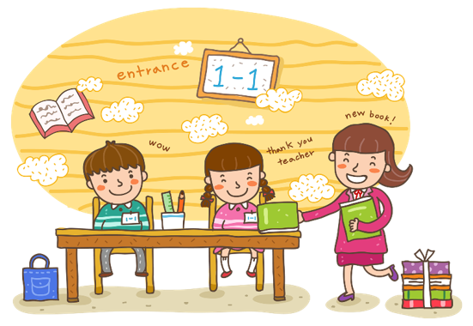
Wrap up

Slide 22
Unit 15 Lesson 2 (1+2+3)
I’d = I would
What would you like to eat / drink?
I’d like some _______, please.
eggs
milk
chicken
water

Slide 23

Thank you!

