Slide 1
Unit 15
At the dining table
Lesson 2 (4+5+6)

Slide 2



Contents
Listen and number.
Look, complete and read.
Let’s play.

Slide 3

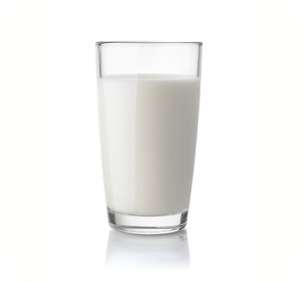

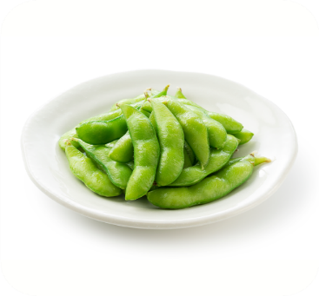
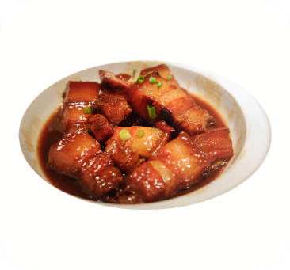




4. Listen and number.
a
b
c
d
3
4
1
2

Slide 4
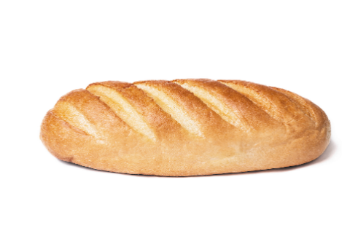
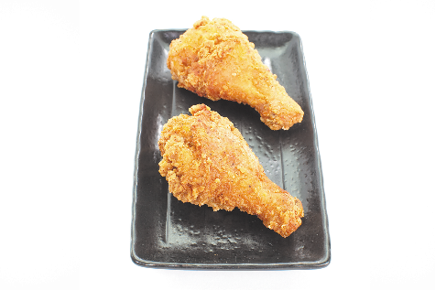
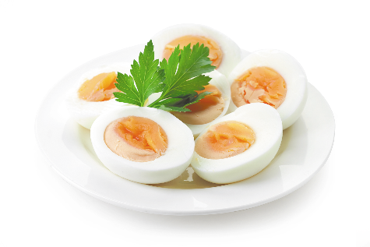
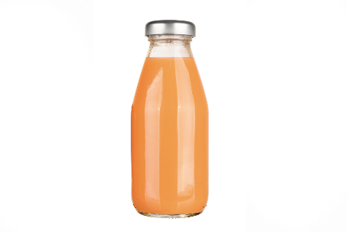
5. Look, complete and read.
bread
chicken
1. I’d like some ______, please.
2. I’d like some _______, please.
3. A: What would you like to eat?
B: I’d like some ______, please.
4. A: What would you like to drink?
B: I’d like some ______, please.
eggs
juice

Slide 5
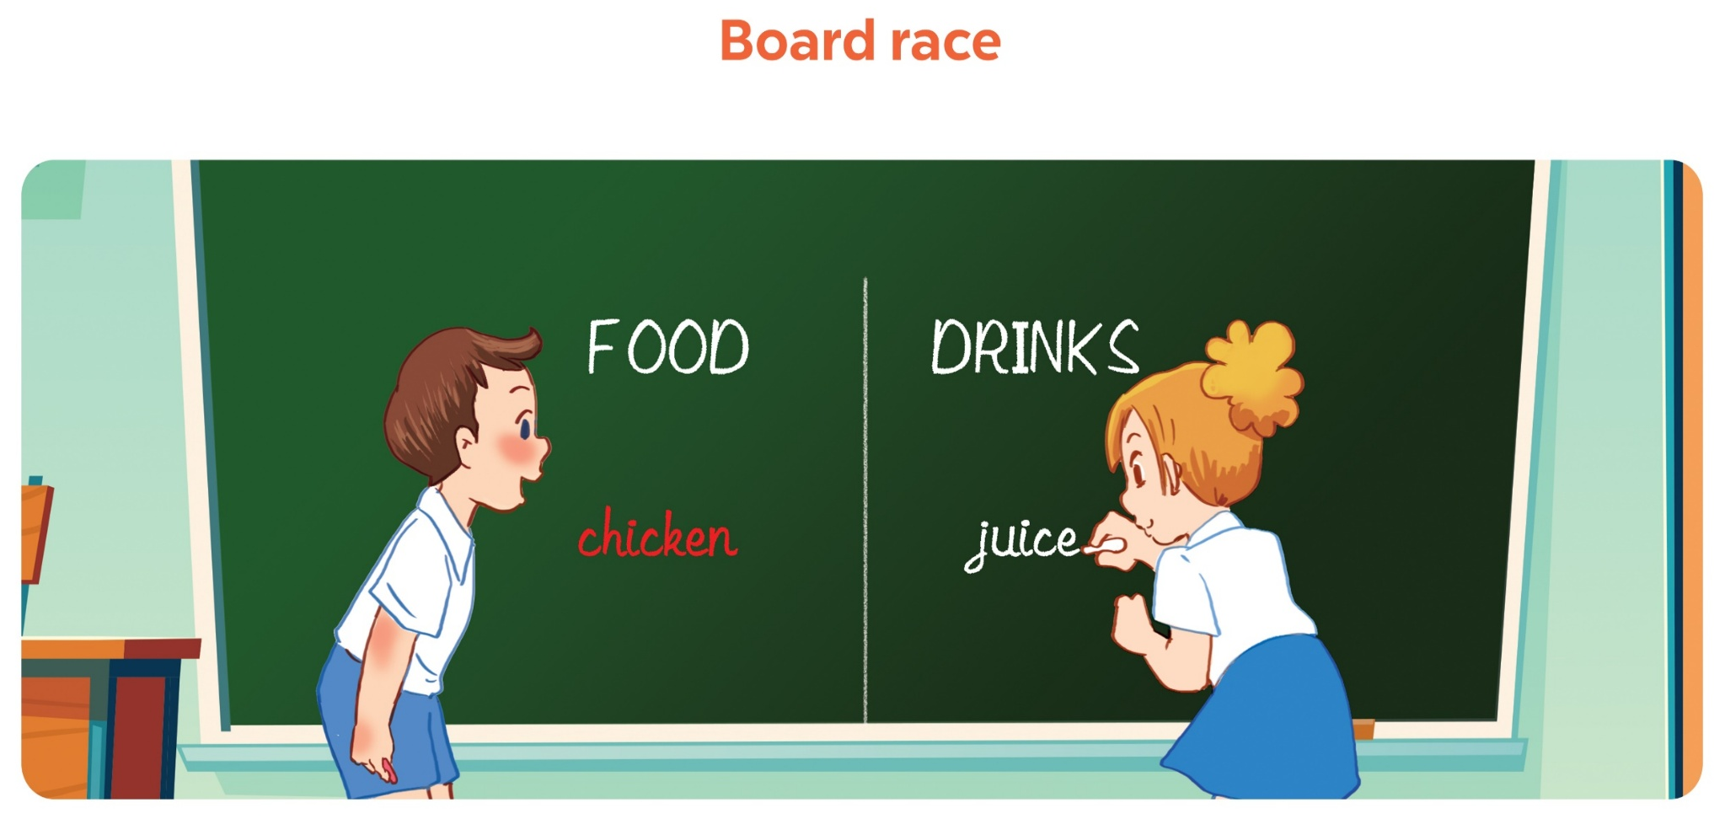
Facebook : Bùi Liễu
0968142780
6. Let’s play.

Slide 6
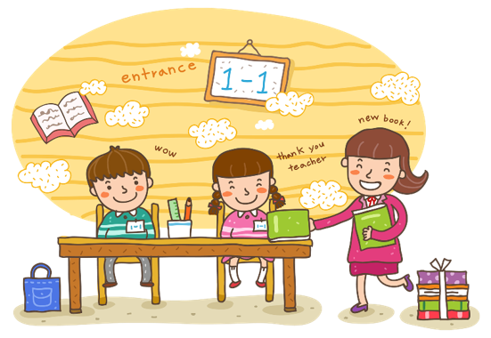
Wrap up

Slide 7


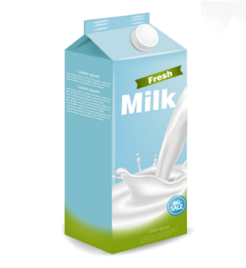
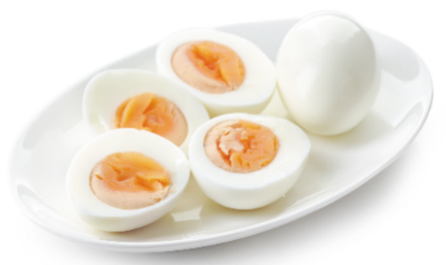
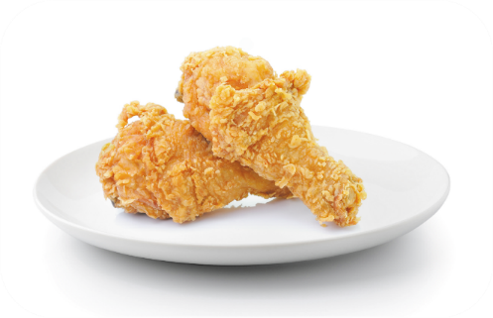

Unit 15 Lesson 2
I’d = I would
What would you like to eat / drink?
I’d like some _______, please.
eggs
milk
chicken
water

Slide 8

Thank you!

