Slide 1



Review 3
MS.Pham
0936082789
Lesson 1
Teacher: Ms Huyền Phạm

Slide 2


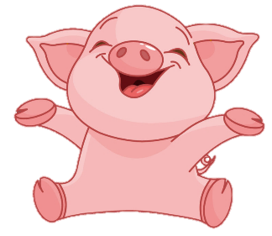
+1
Back

Slide 3

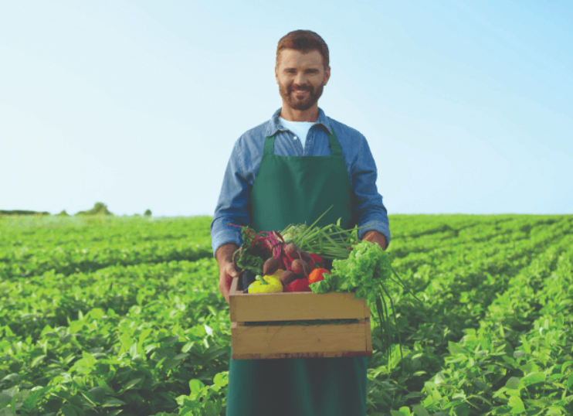

What does he do?
He is a _____.
Check
FARMER

Slide 4
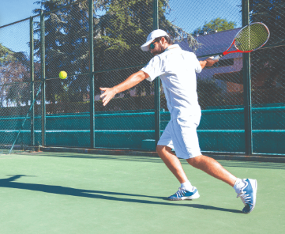
What does he do on Sundays?
He _____.
Check
PLAYS TENNIS

Slide 5
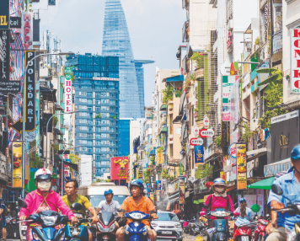
What is the street like?
He is a _____ street.
Check
BUSY

Slide 6
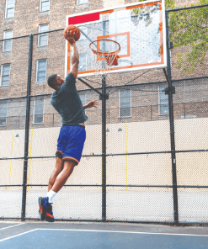
What does he look like?
He is _____.
Check
TALL

Slide 7
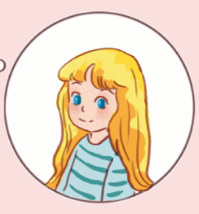
What does she look like?
She has _____ hair.
Check
LONG

Slide 8
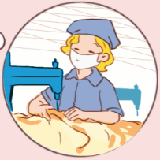
Where does she work?
She works at a _____.
Check
FACTORY

Slide 9
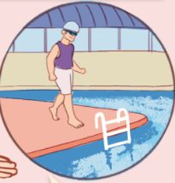
Where does he go on Saturdays?
He goes to the_____.
Check
SWIMMING POOL

Slide 10


Practice
MS.Pham
0936082789

Slide 11
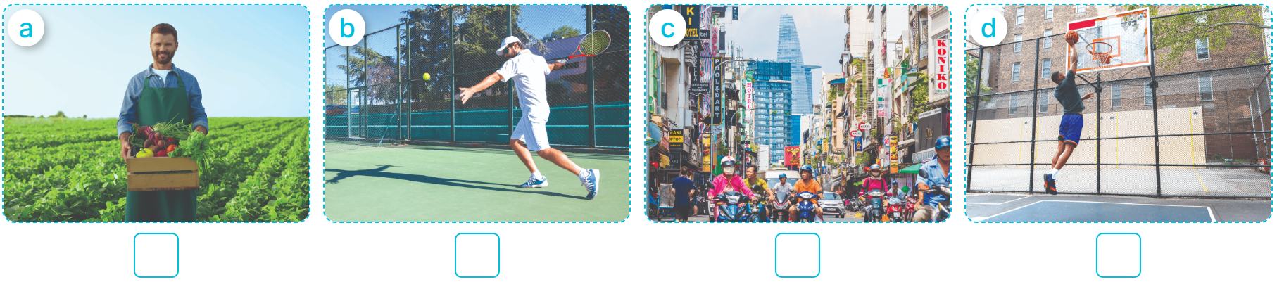

1
Listen and number.
MS.Pham
0936082789
2
4
1
3
1
2
3
4

Slide 12
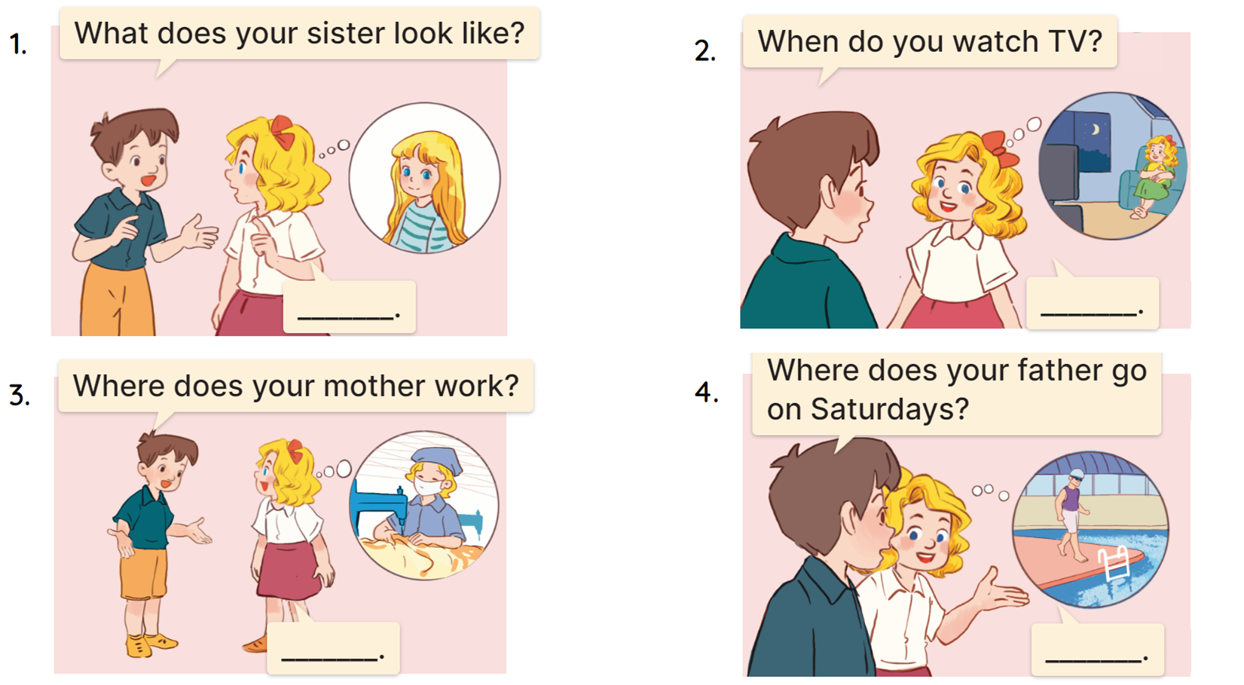
2
Ask and answer.
MS.Pham
0936082789
She has long hair.
I watch TV in the evening.
She works at a factory.
He goes to the
swimming pool.

Slide 13
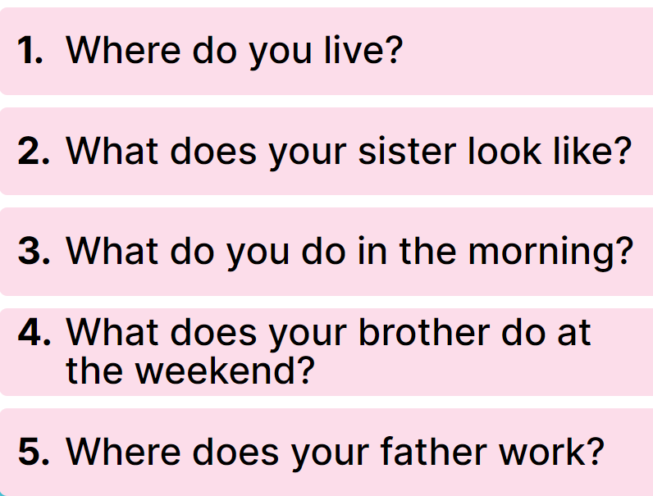
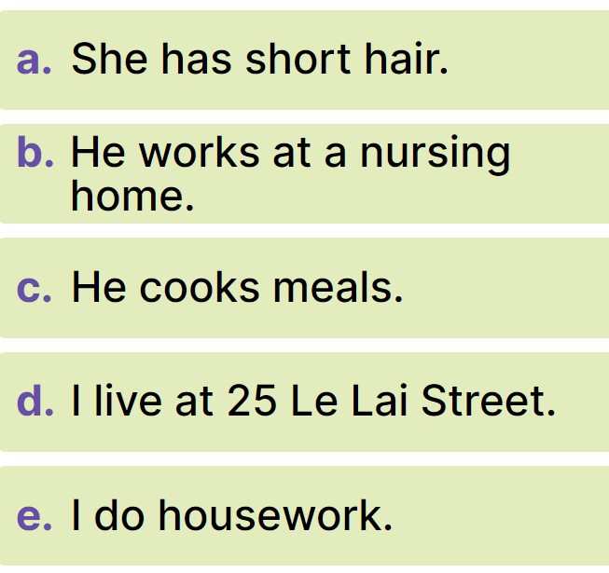
3
Read and match.
MS.Pham
0936082789

Slide 14
MS.Pham
0936082789
Thank you!

