Slide 1



Review 3
MS.Pham
0936082789
Lesson 2
Teacher: Ms Huyền Phạm

Slide 2


Warm-up
MS.Pham
0936082789

Slide 3





Odd one out
worker
factory
nursing home
farm
Next

Slide 4
Odd one out
quiet
street
noisy
busy
Next

Slide 5
Odd one out
hair
face
long
hand
Next

Slide 6
Odd one out
morning
afternoon
evening
Monday
Next

Slide 7
Odd one out
cinema
shopping centre
yoga
sports centre
Next

Slide 8
Odd one out
watch film
cook meals
do yoga
police man
Next

Slide 9
Odd one out
dishes
wash
help
clean
Next

Slide 10




Great job!
End

Slide 11
4
Read and complete.
There are three people in my family: my father, my mother and me. My father is tall. He works at a (1) factory . My mother is (2) slim . She (3) works at a school. I am a (4) pupil . In the morning and afternoon, I study at school. In the evening, I do homework and (5) watch TV.

Slide 12
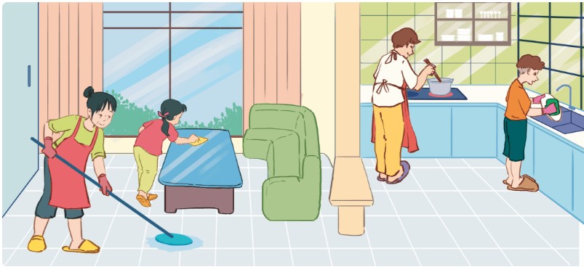
5
Listen and number.
This is my family. On Sundays, we stay at home and do many things. My father _____________. My mother _________________. My brother ________________. I _____________.
cooks meals
cleans the floor
washes the dishes
clean the tables

Slide 13
MS.Pham
0936082789
Thank you!

