Slide 1






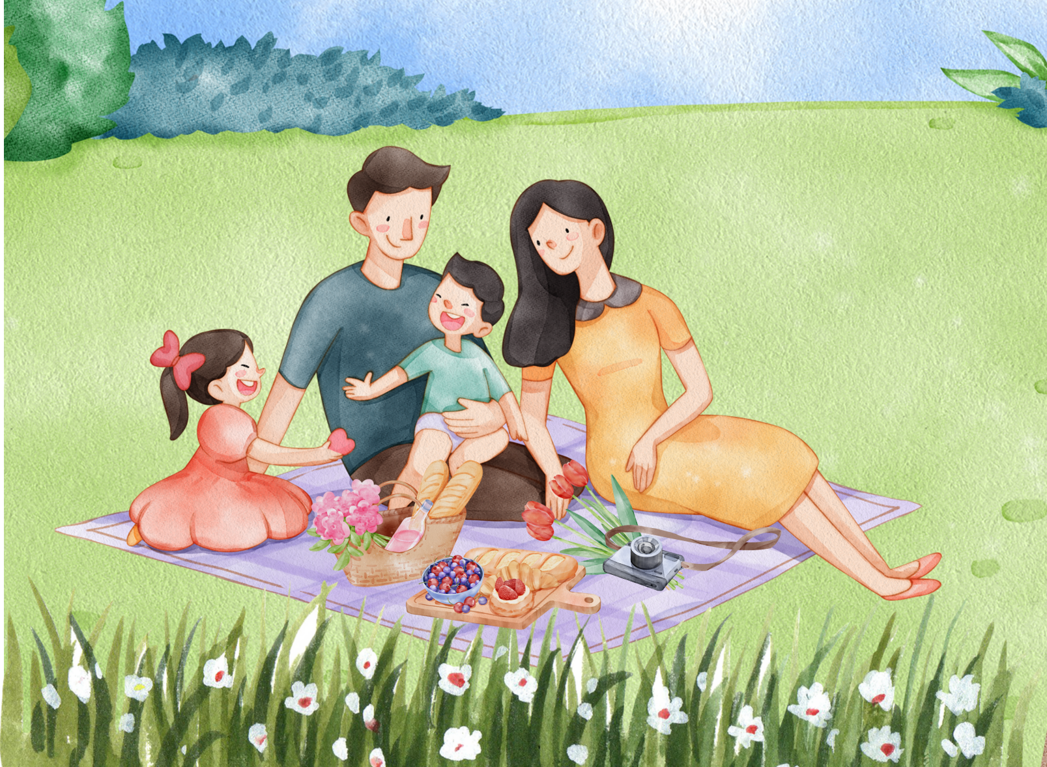


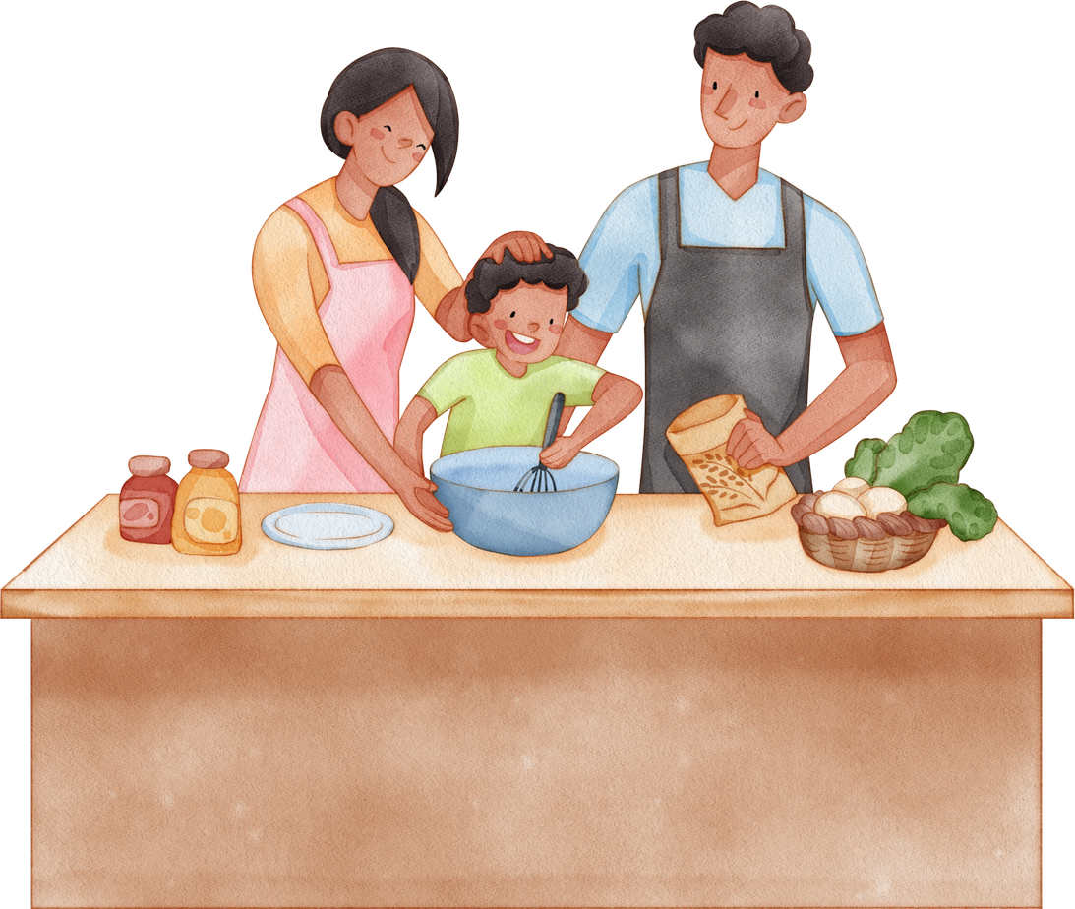
Unit 15
My family’s
weekend
Lesson 1 – Period 1

Slide 2
Warm-up
Lesson 1 – Period 1

Slide 3
Vocabulary
Lesson 1 – Period 1

Slide 4

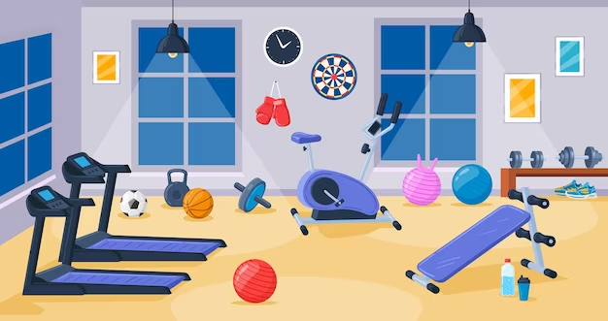

sports centre
/spɔːts ˈsɛntə/
MsPham
0936082789
Trung tâm thể thao

Slide 5
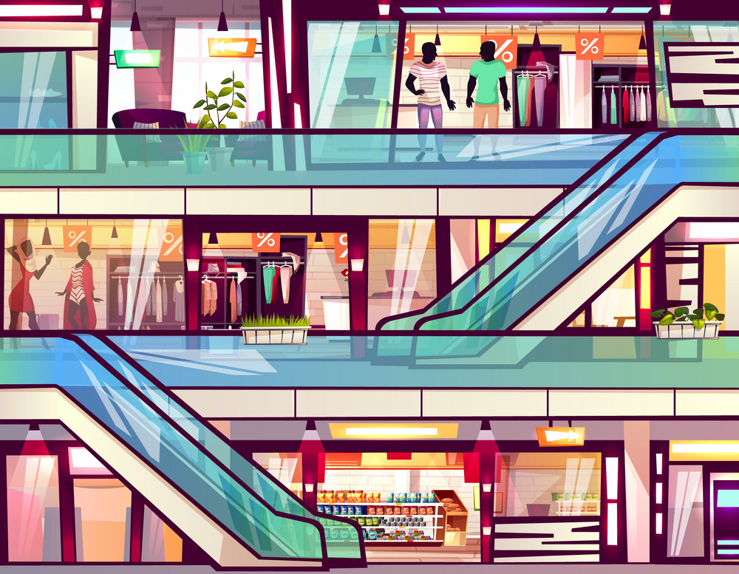
shopping centre
/ˈʃɒpɪŋ ˈsɛntə/
MsPham
0936082789
Trung tâm mua sắm

Slide 6

swimming pool
/ˈswɪmɪŋ puːl/
MsPham
0936082789
Bể bơi

Slide 7

cinema
/ˈsɪnəmə/
MsPham
0936082789
Rạp chiếu phim

Slide 8
Vocabulary
shopping centre
: Trung tâm mua sắm
MsPham
0936082789
sports centre
: Trung tâm thể thao
swimming pool
: Bể bơi
cinema
: Rạp chiếu phim

Slide 9
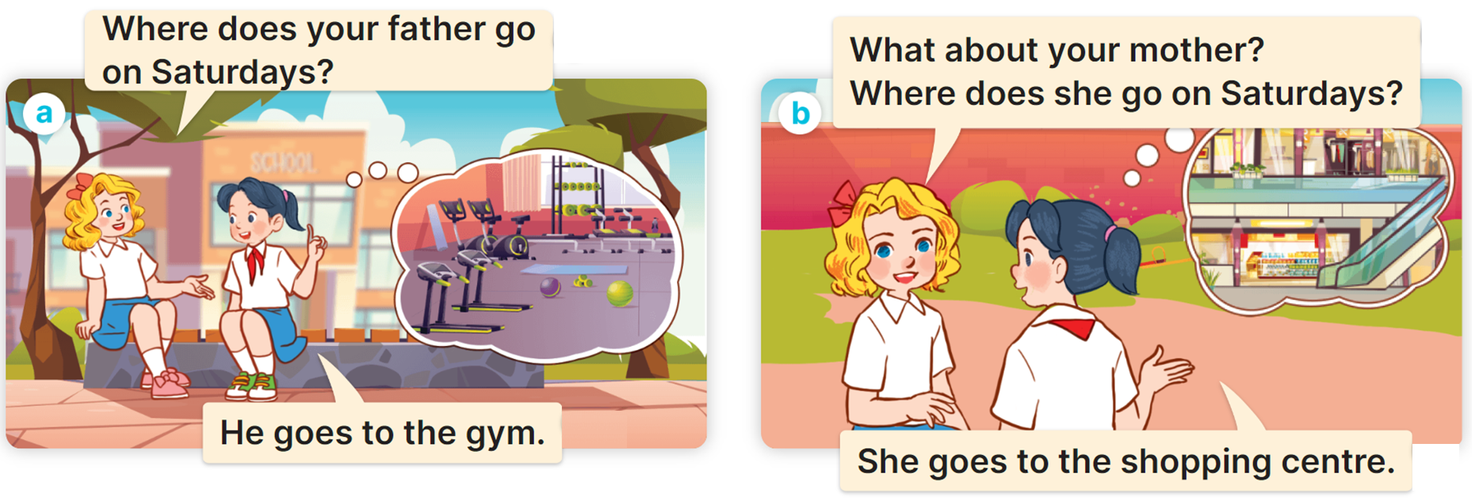

1
Look, listen and repeat.
MsPham
0936082789

Slide 10
Structure
Lesson 1 – Period 1

Slide 11
Cách hỏi một người nào đó đi đâu:
Where does she/he go on ___________?
+ thứ + s
She / He goes to the ___________.
Ex:
MsPham
0936082789

Slide 12
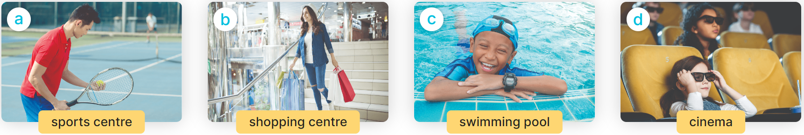
2
Listen, point and say.
MsPham
0936082789
Where does he go on Saturdays?
He goes to the sports centre.

Slide 13
2
Listen, point and say.
MsPham
0936082789
Where does she go on Saturdays?
She goes to the shopping centre.

Slide 14
2
Listen, point and say.
MsPham
0936082789
Where does he go on Saturdays?
He goes to the swimming pool.

Slide 15
2
Listen, point and say.
MsPham
0936082789
Where does she go on Saturdays?
She goes to the cinema.

Slide 16
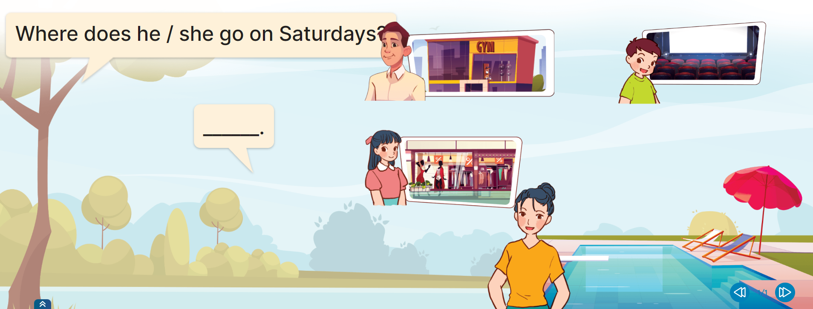
3
Let’s talk.
MsPham
0936082789

Slide 17

3
Let’s talk.
Where does he go on Saturdays?
He goes to the
sports centre.
MsPham
0936082789

Slide 18
3
Let’s talk.
Where does he go on Saturdays?
He goes to the
cinema.
MsPham
0936082789

Slide 19
3
Let’s talk.
Where does she go on Saturdays?
She goes to the
shopping centre.
MsPham
0936082789

Slide 20
3
Let’s talk.
Where does she go on Saturdays?
She goes to the
swimming pool.
MsPham
0936082789

Slide 21
3
Let’s talk.
MsPham
0936082789

Slide 22
Review
Lesson 1 – Period 1

Slide 23
Where does she/he go on Saturday?
She / He goes to the ___________.
MsPham
0936082789

Slide 24
Thank you!
Lesson 1 – Period 1

