Slide 1






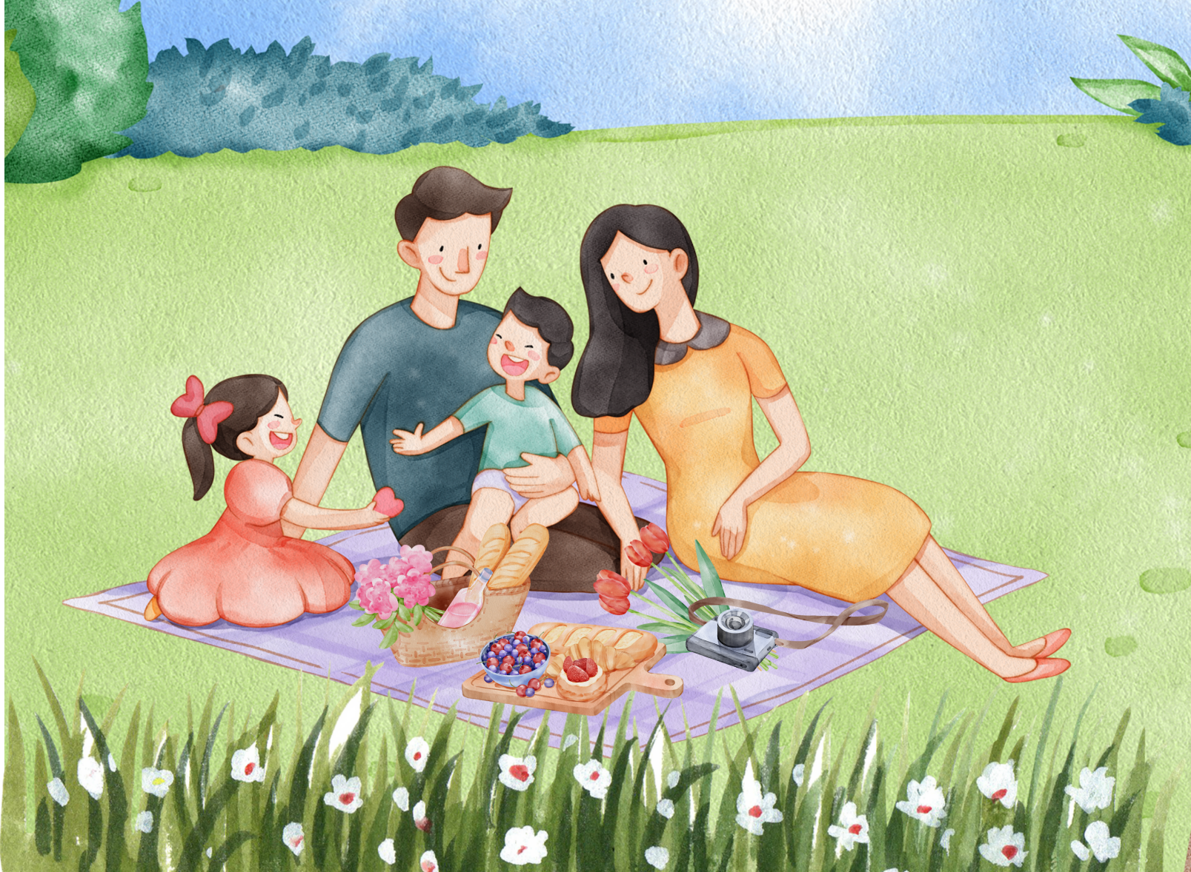


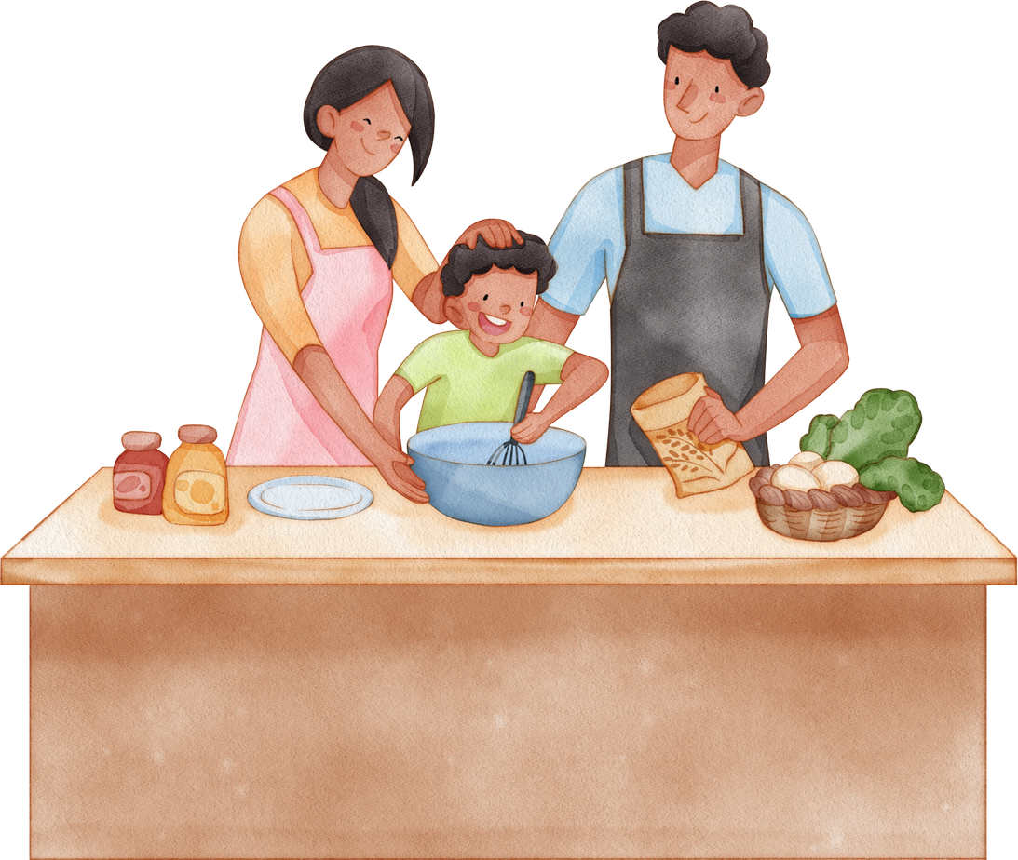
Unit 15
My family’s
weekend
Lesson 1 – Period 2

Slide 2

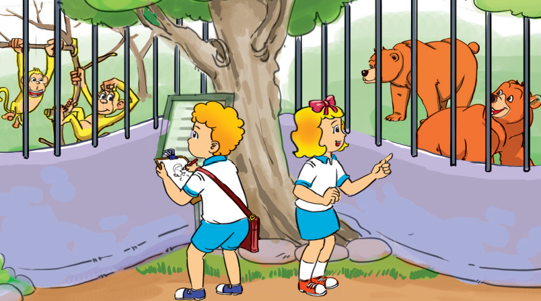


Write “he” or “she”
he
He
Where does _____ go on Saturday?
______ goes to the zoo.
MsPham
0936082789
5
check
Next

Slide 3


Write “he” or “she”
he
He
Where does _____ go on Saturday?
______ goes to the swimming pool.
MsPham
0936082789
5
check
Next

Slide 4

Write “he” or “she”
he
He
Where does _____ go on Saturday?
______ goes to the shopping centre.
MsPham
0936082789
10
check
Next

Slide 5


Write “he” or “she”
she
She
Where does _____ go on Saturday?
______ goes to the cinema.
MsPham
0936082789
5
check
Next

Slide 6




Welldone!
MsPham
0936082789
Next

Slide 7


Where does she/he go on Saturday?
She / He goes to the ___________.
MsPham
0936082789

Slide 8

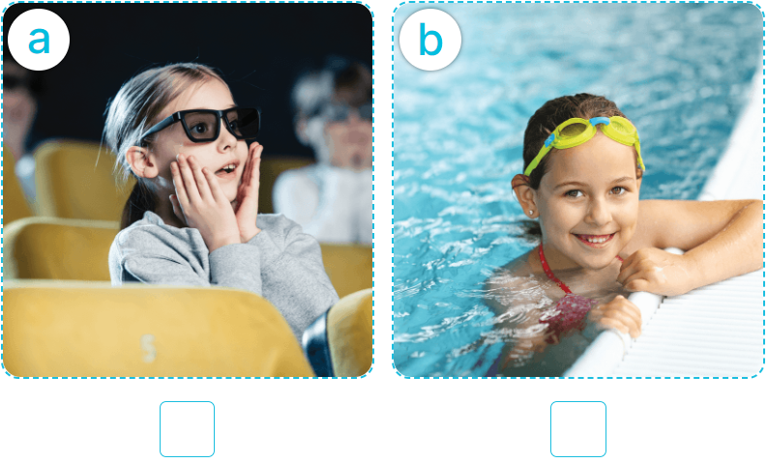
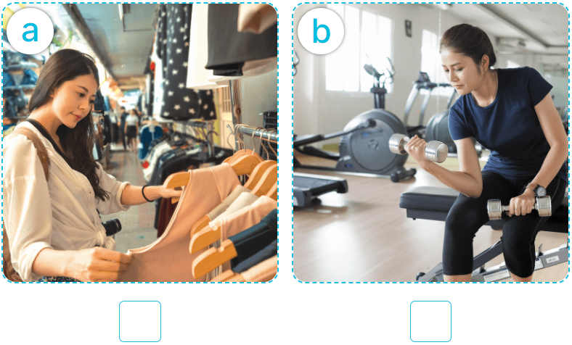
4
Listen and tick.
1
2
✓
✓

Slide 9


5
Look, complete and read.
My brother goes to the _____________ on Saturdays.
1
MsPham
0936082789
swimming pool
My sister goes to the
____________ on Saturdays.
2
cinema

Slide 10


5
Look, complete and read.
A: Where does your father go on Saturdays
B: He ______ to the ___________.
3
MsPham
0936082789
goes
sport centre
A: Where does your mother go on Saturdays
B: She ______________________.
4
goes to the shopping centre

Slide 11
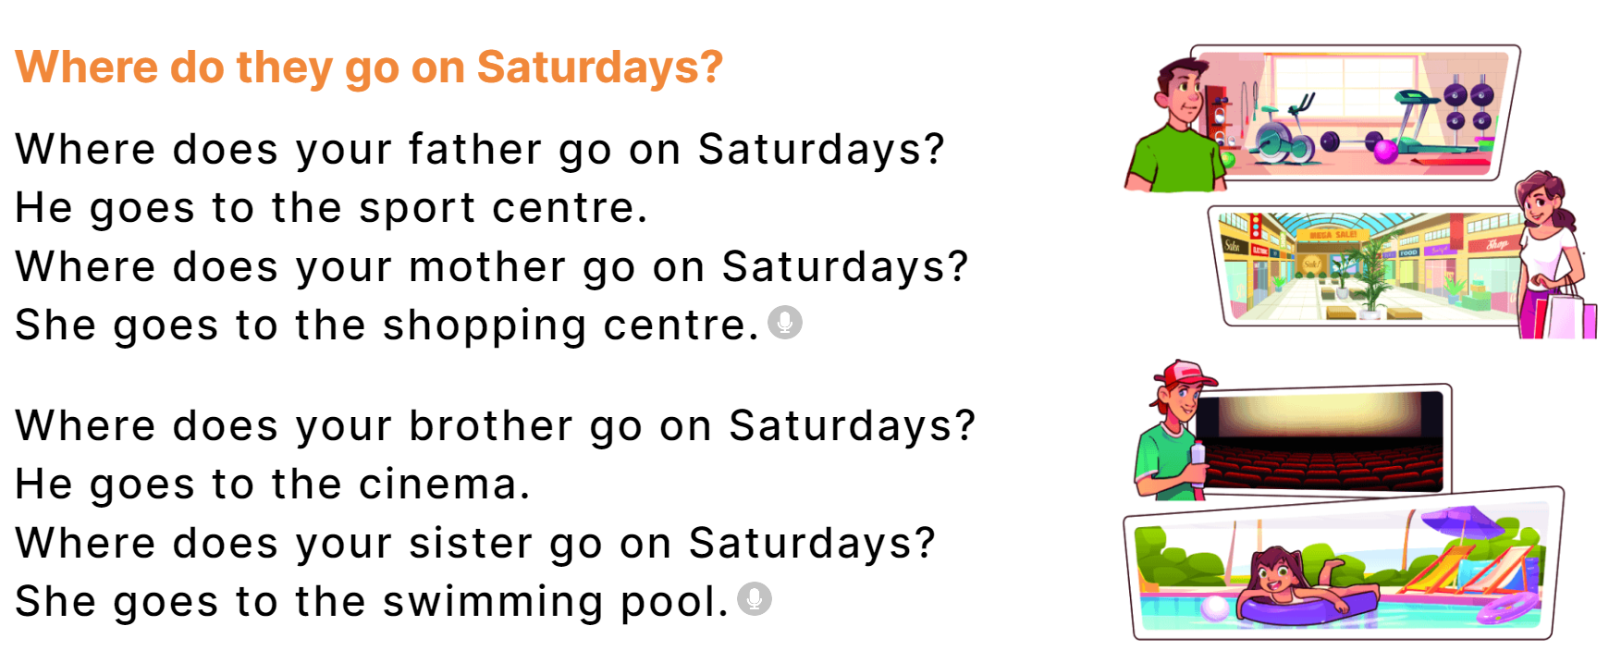
3
Let’s sing.
MsPham
0936082789

Slide 12
Thank you!
Lesson 1 – Period 1

