Slide 1






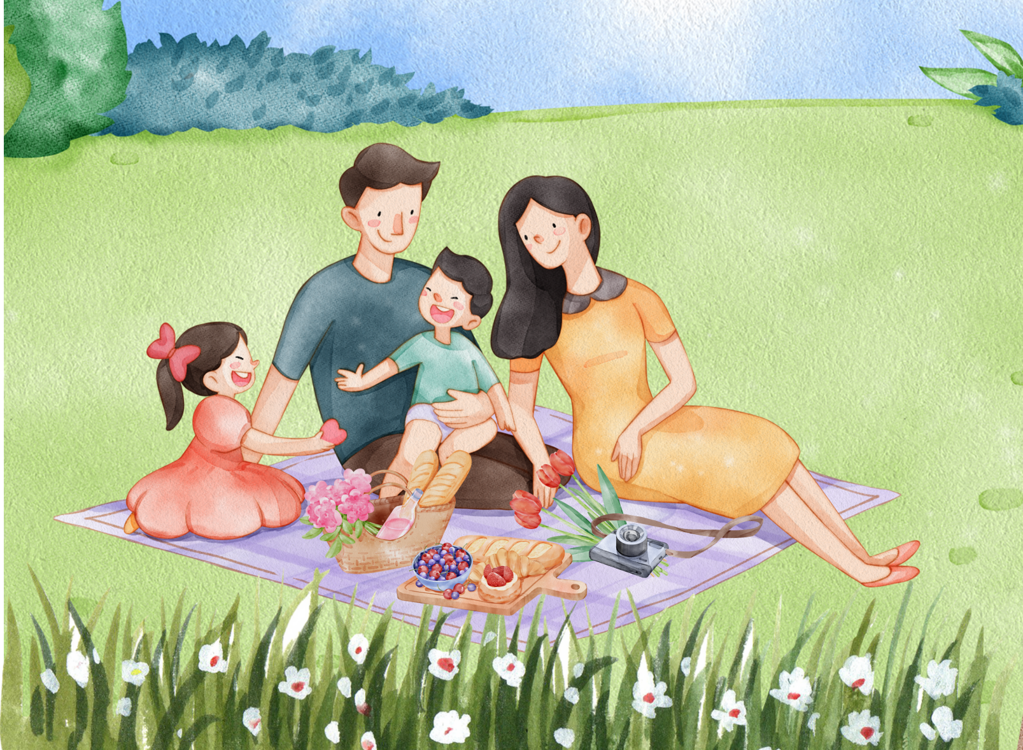

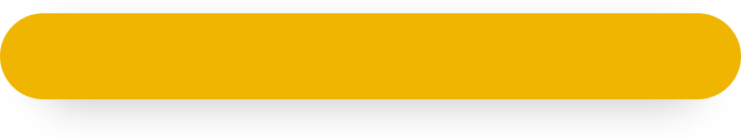
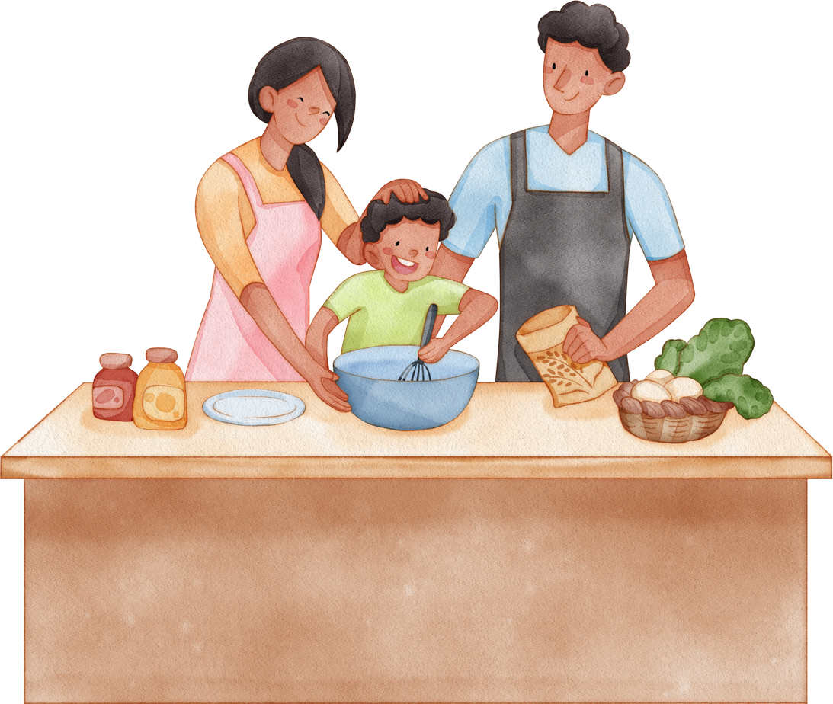
Unit 15
My family’s
weekend
Lesson 2 – Period 1

Slide 2
Warm-up
Lesson 1 – Period 1

Slide 3
Vocabulary
Lesson 1 – Period 1

Slide 4

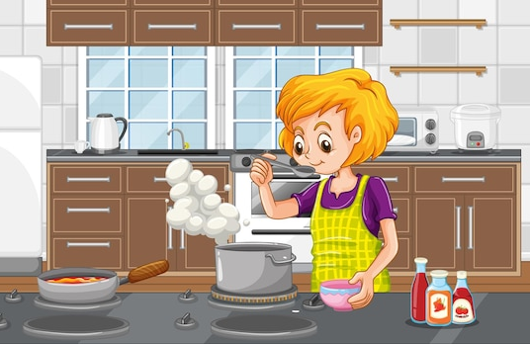

cook meals
/ˈkʊk miːls/
MsPham
0936082789
Nấu ăn

Slide 5
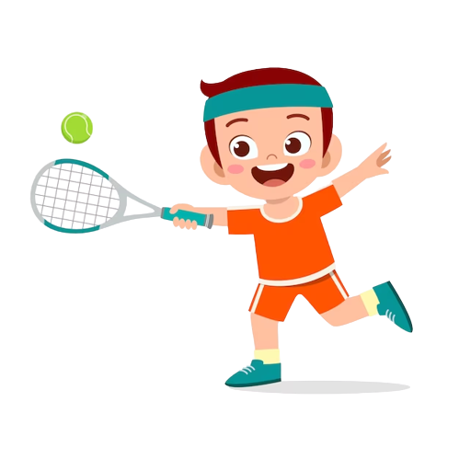
play tennis
MsPham
0936082789
/pleɪ ˈtenɪs/
Chơi quần vợt

Slide 6
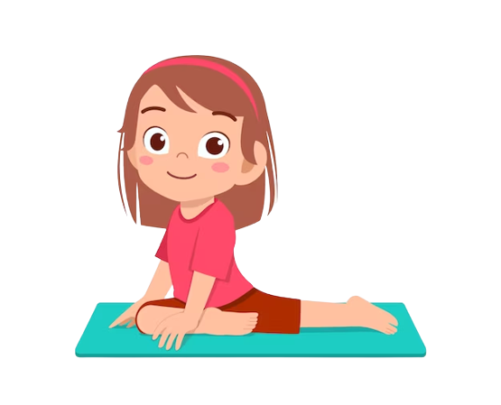
do yoga
/duː ˈjəʊɡə/
MsPham
0936082789
Tập yoga

Slide 7
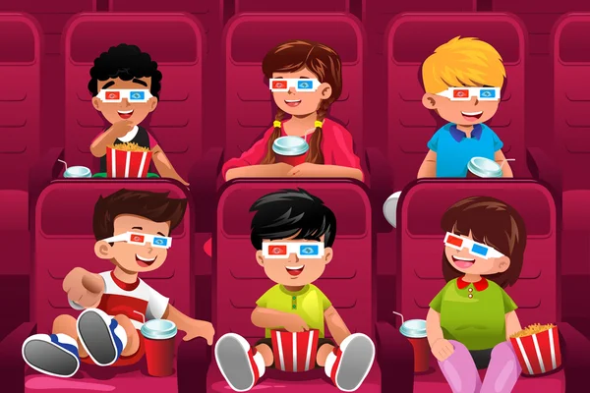
watch films
/wɒtʃ fɪlms/
MsPham
0936082789
Xem phim

Slide 8
Vocabulary
cook meals
: Nấu ăn
play tennis
: Chơi quần vợt
MsPham
0936082789
do yoga
: Tập yoga
watch films
: Xem phim

Slide 9
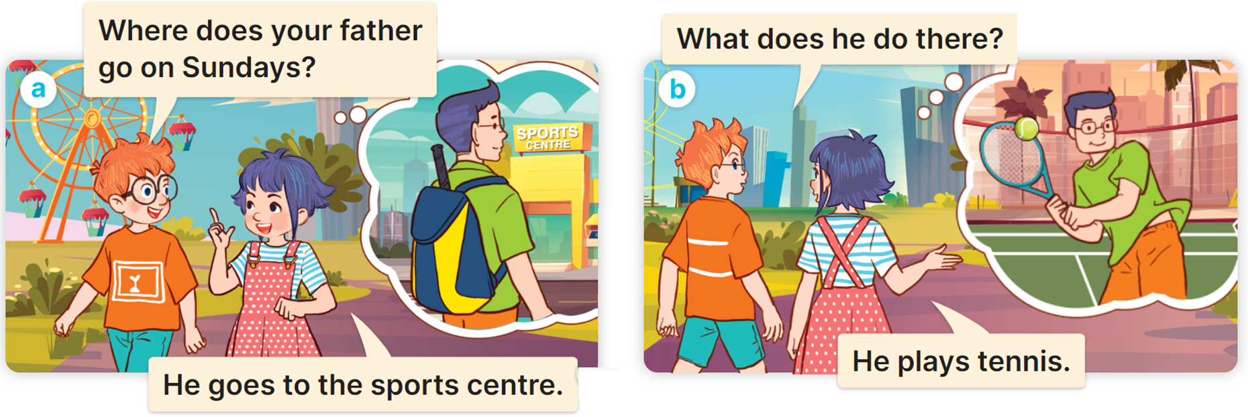

1
Look, listen and repeat.
MsPham
0936082789

Slide 10
Structure
Lesson 1 – Period 1

Slide 11
Grammar
Thêm s/es vào sau động từ (V):
Thêm s:
cook meals
→ cooks meals
play tennis
→ plays tennis
Thêm es:
go to school
→ goes to school
MsPham
0936082789
do yoga
→ does yoga
watch films
→ watches films
Thêm ies:
fly a kite
→ flies a kite
study at school
→ studies at school

Slide 12
Structure:
Cách hỏi một người nào đó làm gì vào thời gian nào:
What does she/he do on ___________?
+ thứ + s
She / He + Vs/es.
Ex:
MsPham
0936082789

Slide 13
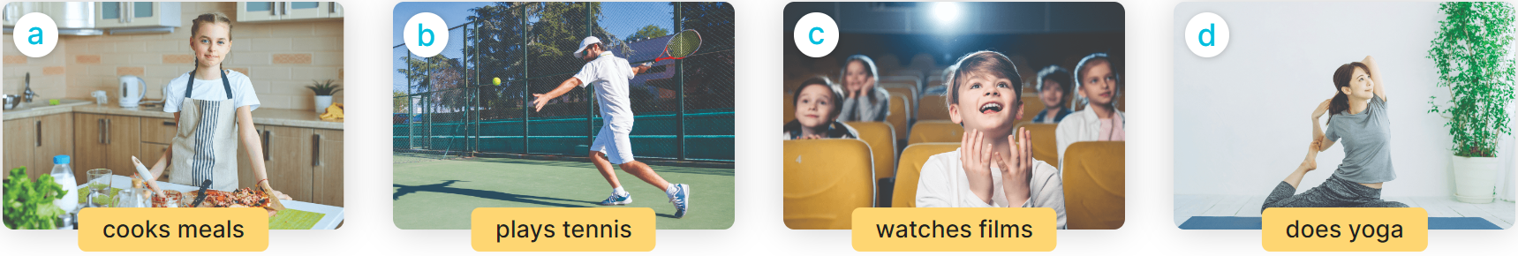
2
Listen, point and say.
What does she/he do on Sundays?
She / He _______.

Slide 14
2
Listen, point and say.
MsPham
0936082789
What does she do on Sundays?
She cooks meals.

Slide 15
2
Listen, point and say.
MsPham
0936082789
What does he do on Sundays?
He plays tennis.

Slide 16
2
Listen, point and say.
MsPham
0936082789
What does he do on Sundays?
He watches films.

Slide 17
2
Listen, point and say.
MsPham
0936082789
What does she do on Sundays?
She does yoga.

Slide 18
2
Listen, point and say.
What does she/he do on Sundays?
She / He _______.

Slide 19
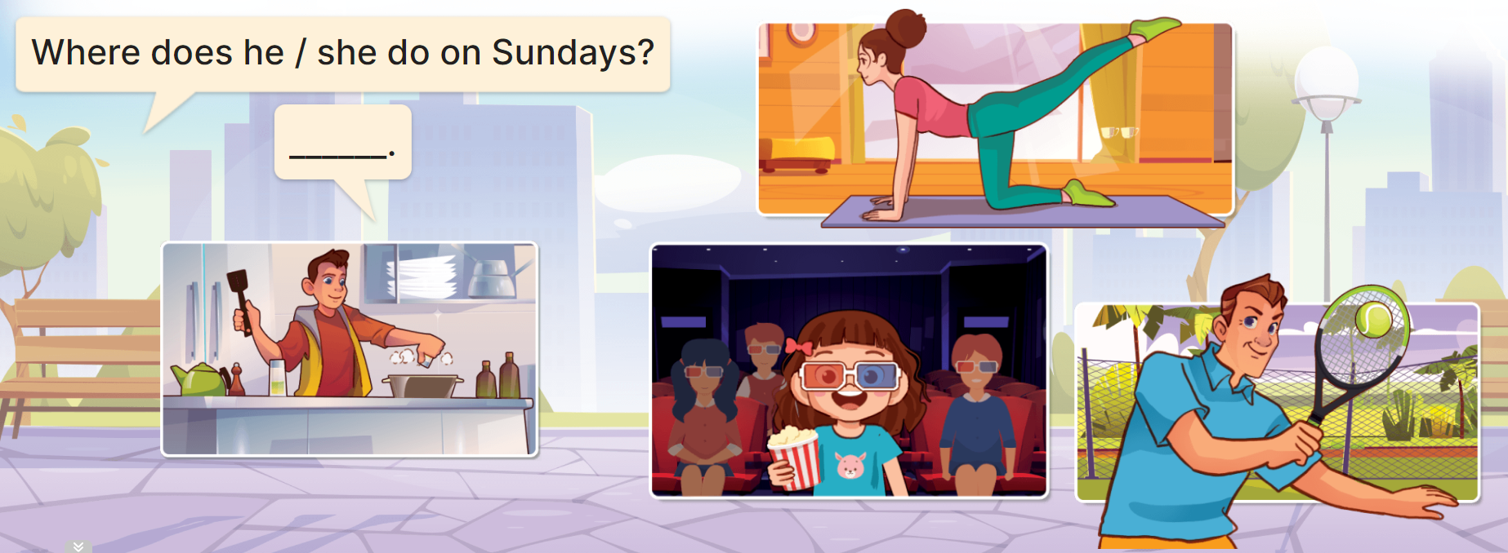

3
Let’s talk.
What does he do on Sundays?
He cooks meals.

Slide 20
3
Let’s talk.
What does she do on Sundays?
She does yoga.

Slide 21
3
Let’s talk.
What does she do on Sundays?
She watches films.

Slide 22
Review
Lesson 1 – Period 1

Slide 23
What does she/he do on Sundays?
She/ He ___________.
MsPham
0936082789

Slide 24
Thank you!
Lesson 1 – Period 1

