Slide 1






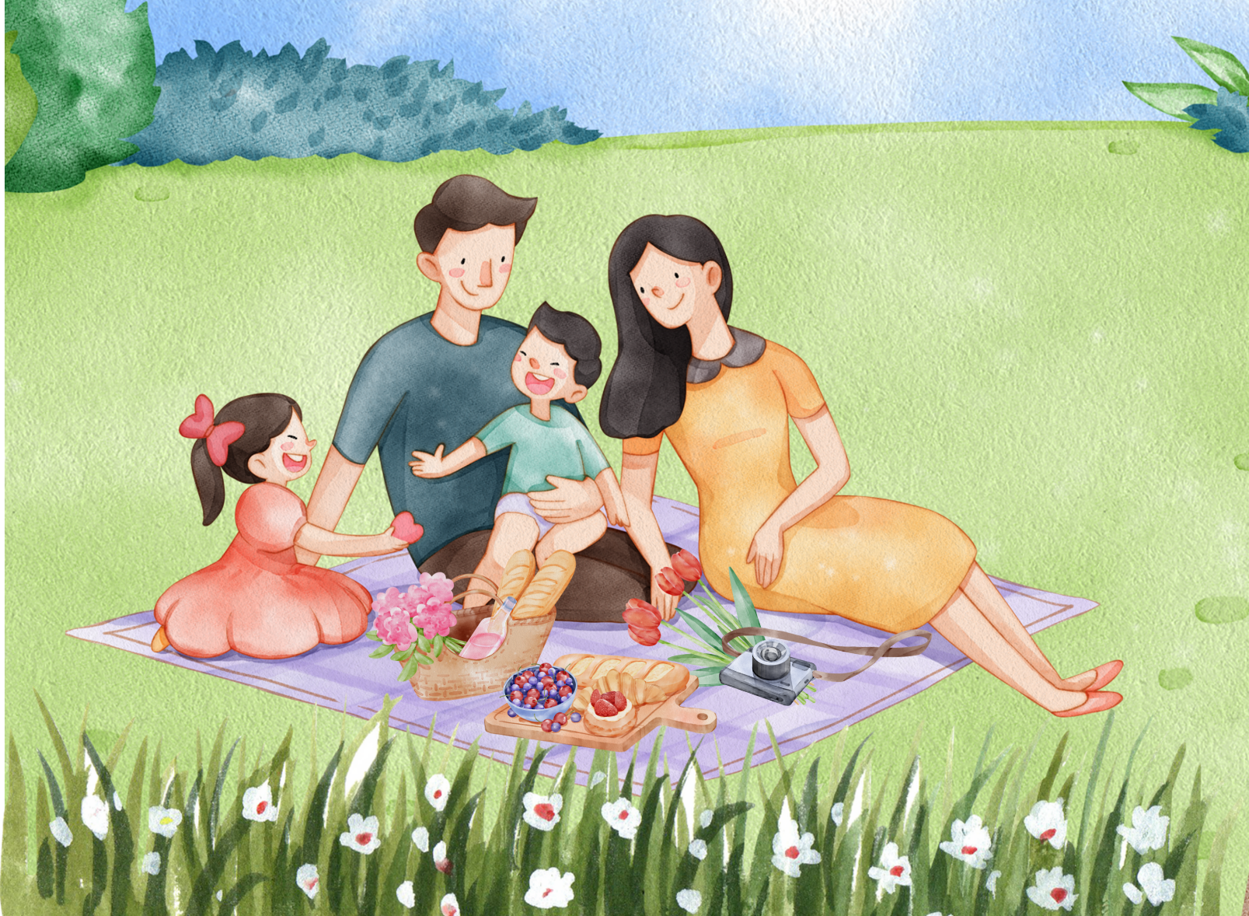
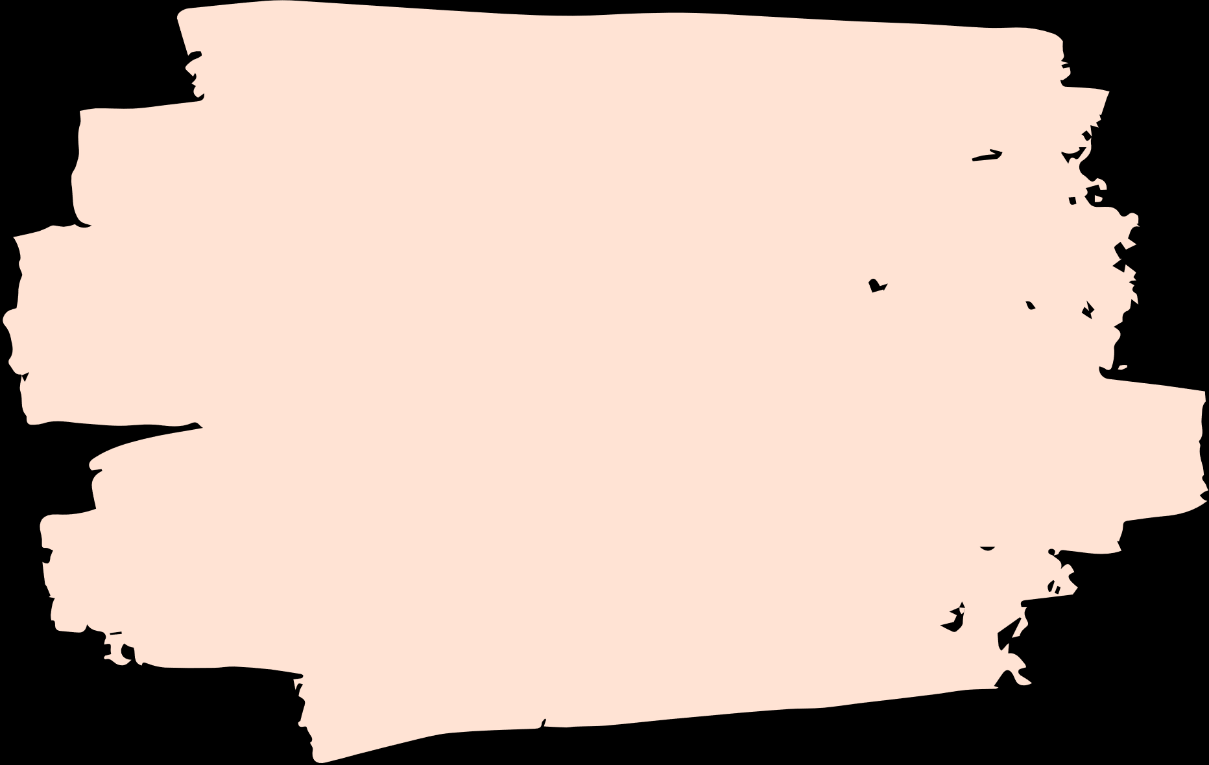

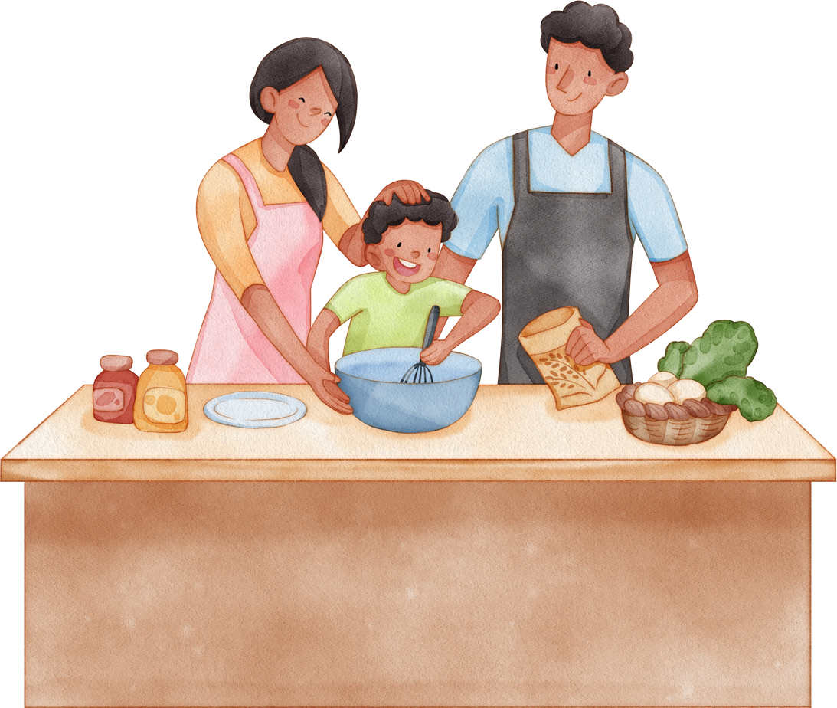
Unit 15
My family’s
weekend
Lesson 3 – Period 1

Slide 2
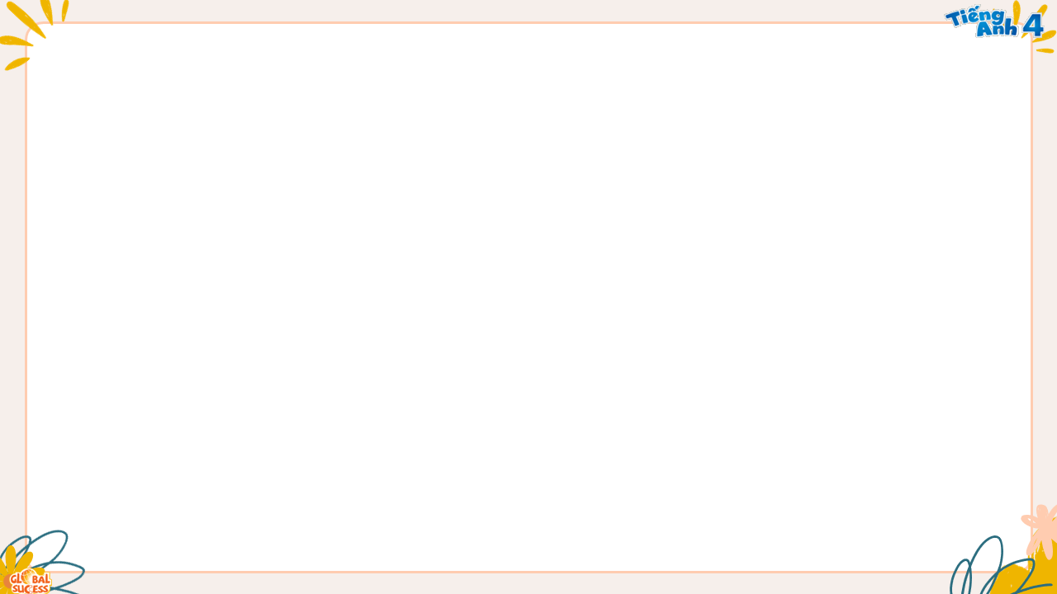
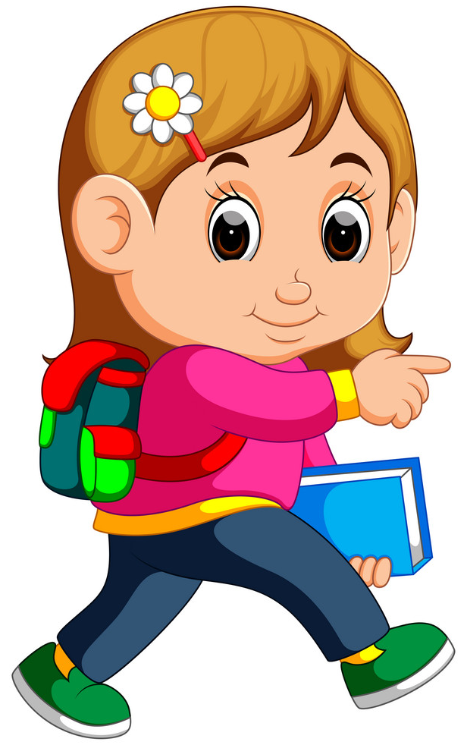
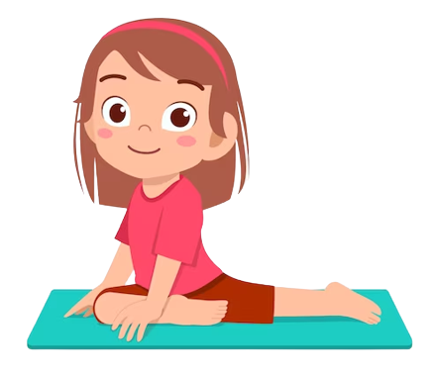

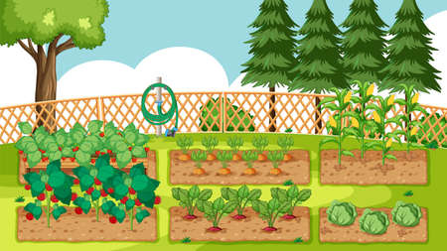
Phonics
go
g
/g/
/jes/
yoga
MsPham
0936082789
/jɔːr/
garden
/ˈjɒɡət/
Notes:
https://www.youtube.com/watch?v=8z3E7OM43gY&list=PL8_ETpRL2xNbJTjsq6q8ex0yMu7g61wrf

Slide 3

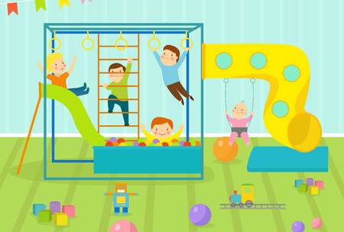
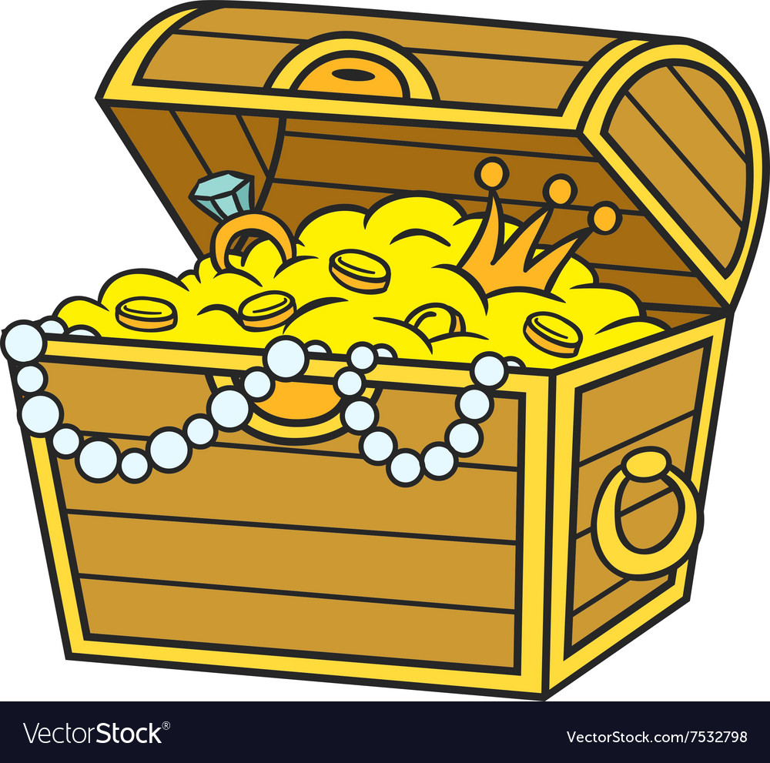
Phonics
television
s
/ʒ/
/ˈtelɪvɪʒn/
leisure centre
MsPham
0936082789
/ˈleʒə sentə(r)/
treasure
/ˈtreʒə(r)/
Notes:
https://www.youtube.com/watch?v=8z3E7OM43gY&list=PL8_ETpRL2xNbJTjsq6q8ex0yMu7g61wrf

Slide 4
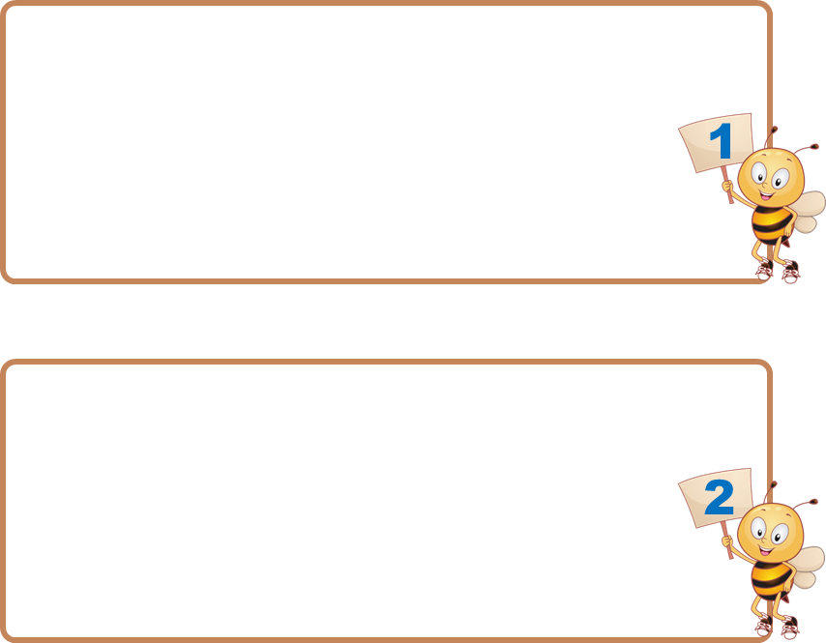


Listen and choose
s
g

Slide 5

s
g

Slide 6
s
g

Slide 7
s
g

Slide 8
s
g

Slide 9
s
g

Slide 10
s
g

Slide 11
1
Listen and repeat.
g
go
I go to the cinema on Saturdays.
MsPham
0936082789
MsPham
0936082789
s
television
We watch television on Sundays.

Slide 12
2
Listen and circle.
1. I _______ on Saturdays.
a. watch television
b. go to the cinema
c. go to the shopping centre
2. They _______ on Sundays.
a. go to the sports centre
b. watch television
c. watch films on television
MsPham
0936082789

Slide 13
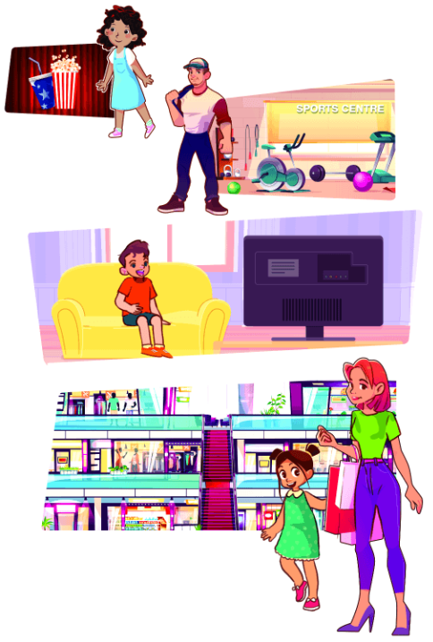
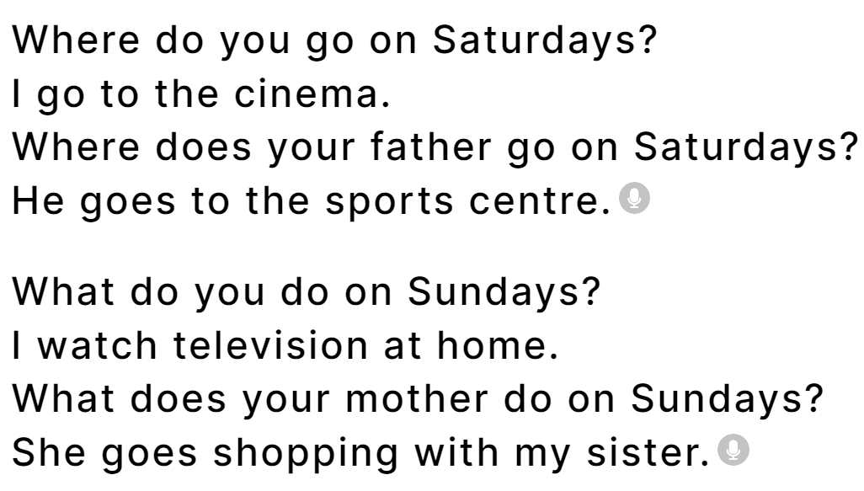
3
Let’s chant.

Slide 14
Thank you!
Lesson 1 – Period 1

