Slide 2





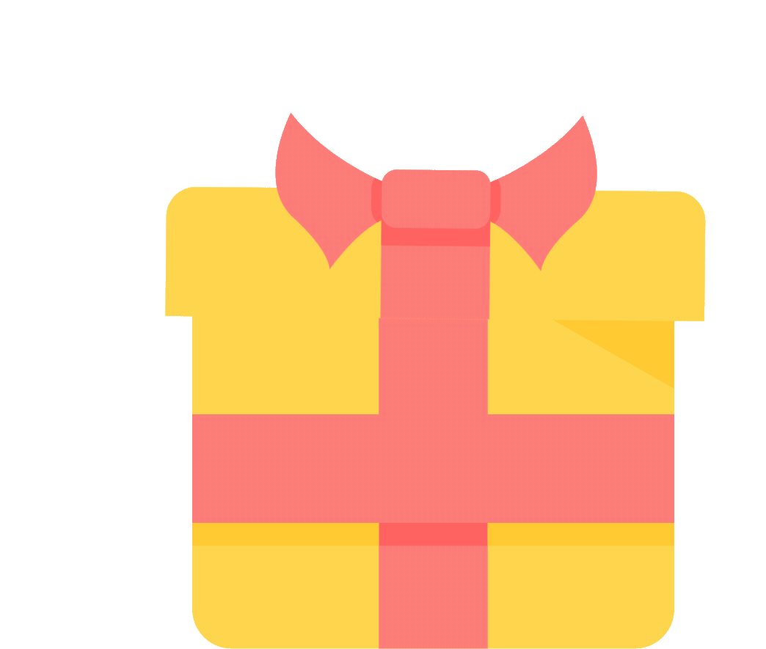

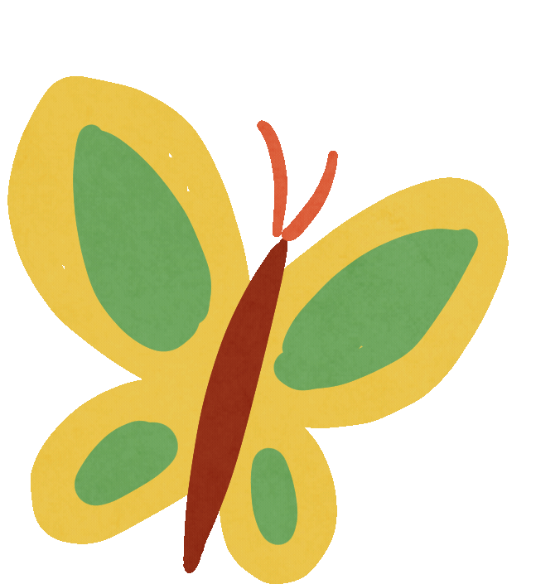


You’ve got a gift!!!
Notes:
Have each pair choose a butterfly, then ask and answer with the question.
Click to show the question and answer as the answer key.
Click the blue butterfly at the top right to back to the Butterflies slide.

Slide 3



Ask and answer about the picture.
What will you do
On Sports Day?
We’ll play badminton.
Notes:
Have each pair choose a butterfly, then ask and answer with the question.
Click to show the question and answer as the answer key.
Click to show the score after pupils give the correct question and answer.
Click the blue butterfly at the top right to back to the Butterflies slide.

Slide 4
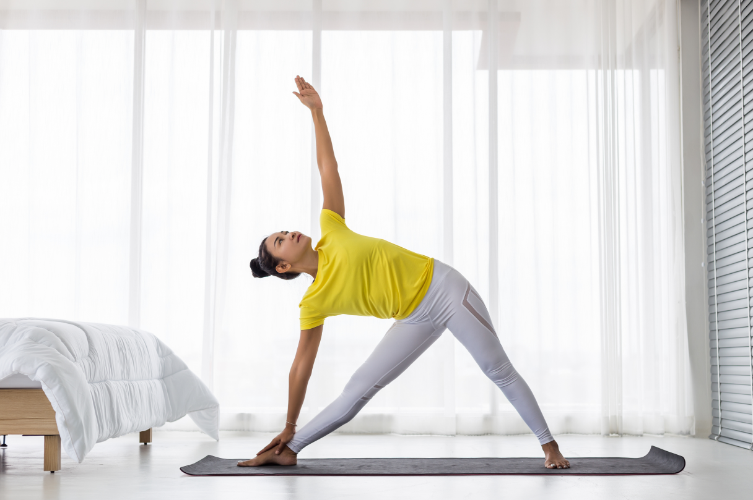

Ask and answer about the picture.
How does she
stay healthy?
She does morning exercise.
Notes:
Have each pair choose a butterfly, then ask and answer with the question.
Click to show the question and answer as the answer key.
Click to show the score after pupils give the correct question and answer.
Click the blue butterfly at the top right to back to the Butterflies slide.

Slide 5
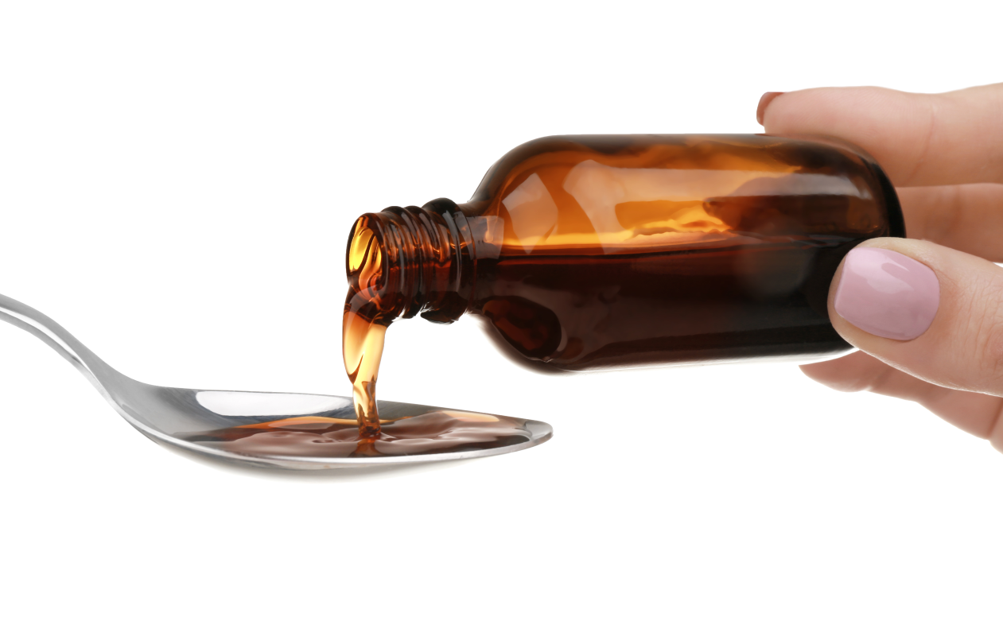

Ask and answer about the picture.
You should take
some medicine.
Thanks for your advice.
Notes:
Have each pair choose a butterfly, then ask and answer with the question.
Click to show the question and answer as the answer key.
Click to show the score after pupils give the correct question and answer.
Click the blue butterfly at the top right to back to the Butterflies slide.

Slide 6


Good Job!
Congratulations!

Slide 7


2.
Activity 1
Listen and circle a, b or c.
LET'S START!

Slide 8

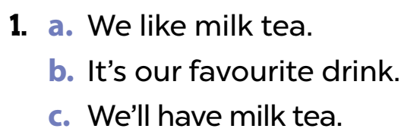
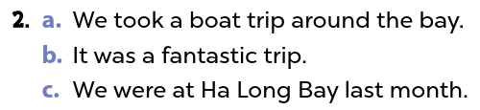
Look and read aloud.
Notes:
Step 1: Draw pupils’ attention to the first set of suggested answers. Have them read the answer options. Check comprehension.

Slide 9
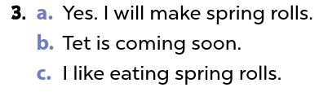
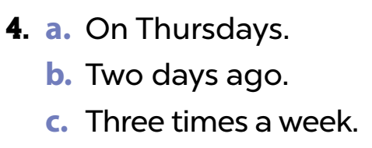
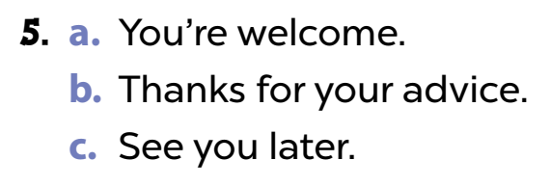
Look and read aloud.
Notes:
Step 1: Draw pupils’ attention to the first set of suggested answers. Have them read the answer options. Check comprehension.

Slide 10
Listen and circle a, b or c.
Notes:
Step 2: Play the recording for Question 1. Play the recording again for pupils to do the task. Play the recording a third time for pupils to check their answers.

Slide 11
Listen and circle a, b or c.
Notes:
Step 3: Repeat Steps 1 and 2 for the rest of the questions.

Slide 12
Listen and circle a, b or c.
Notes:
Then check answers as a class. Write the correct answers on the board.
Step 5: Play the recording for pupils to double-check their answers.
*Key: 1. c, 2. a, 3. a, 4. c, 5. b

Slide 13
Listen and circle a, b or c.
Notes:
Then check answers as a class. Write the correct answers on the board.
Step 5: Play the recording for pupils to double-check their answers.
*Key: 1. c, 2. a, 3. a, 4. c, 5. b

Slide 14
Listen and circle a, b or c.
Notes:
Then check answers as a class. Write the correct answers on the board.
Step 5: Play the recording for pupils to double-check their answers.
*Key: 1. c, 2. a, 3. a, 4. c, 5. b

Slide 15
Listen and circle a, b or c.
Notes:
Then check answers as a class. Write the correct answers on the board.
Step 5: Play the recording for pupils to double-check their answers.
*Key: 1. c, 2. a, 3. a, 4. c, 5. b

Slide 16
Website: hoclieu.vn
Fanpage: https://www.facebook.com/tienganhglobalsuccess.vn/

