Slide 2






Let’s learn
REVIEW 3
Period 3 – Extension Activities

Slide 3

TABLE OF CONTENTS
Warm-up and Review
Activity 1: Look, read and colour.
Activity 2: Look and write.
Activity 3: Write and say.
Fun corner and Wrap-up

Slide 4

1.
Warm-up and Review
LET'S START!

Slide 5




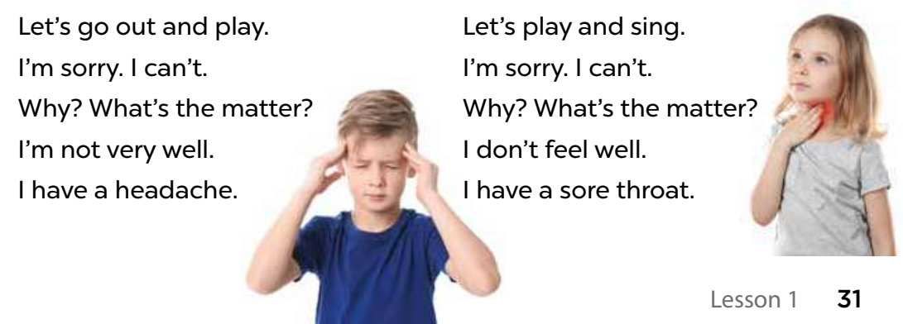


Sing and clap your hands.

Slide 6

Good Job!
Congratulations!

Slide 7
2.
Activity 1
Look, read and colour.
LET'S START!

Slide 8

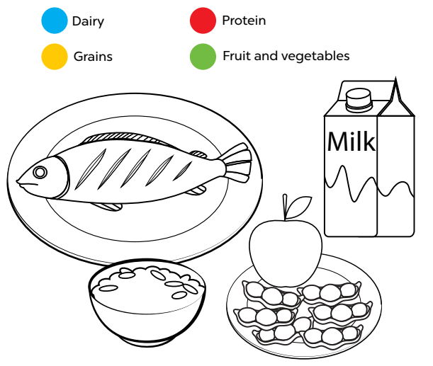
Listen and answer.
Notes:
Step 1: Tell the class the goal of this activity: They need to identify the food types by colouring in the picture, according to the key above. Check comprehension.

Slide 9
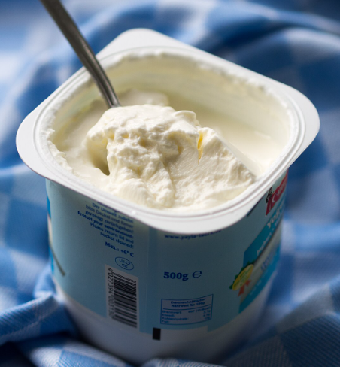
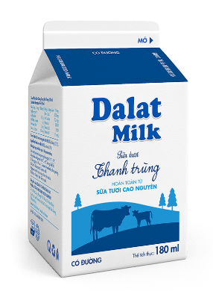
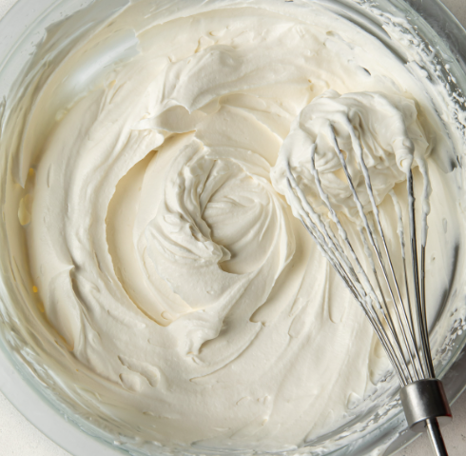
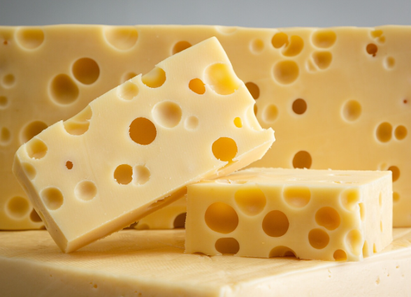
Look and say.
yogurt
milk
Dairy
cheese
cream
Notes:
Step 2: Write the four food types given in the activity on the board. Have pupils say them aloud and elicit some examples of each food type. Draw pupils’ attention to the key and have them identify the colours. Ask questions to check comprehension, such as What colour is protein? (red) and What colour should bread be? (yellow).

Slide 10
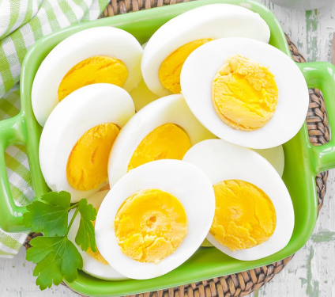
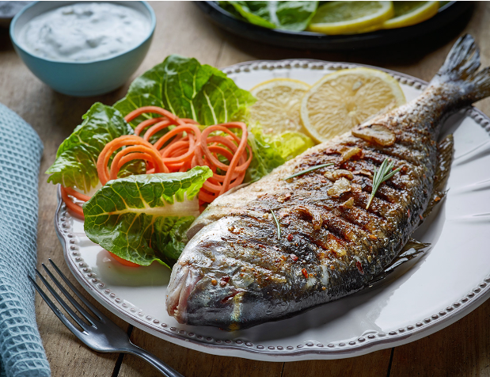
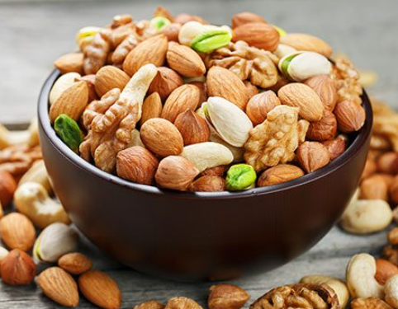
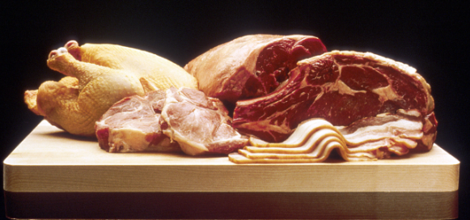
Look and say.
eggs
Protein
fish
meat
nuts
Notes:
Step 2: Write the four food types given in the activity on the board. Have pupils say them aloud and elicit some examples of each food type. Draw pupils’ attention to the key and have them identify the colours. Ask questions to check comprehension, such as What colour is protein? (red) and What colour should bread be? (yellow).

Slide 11
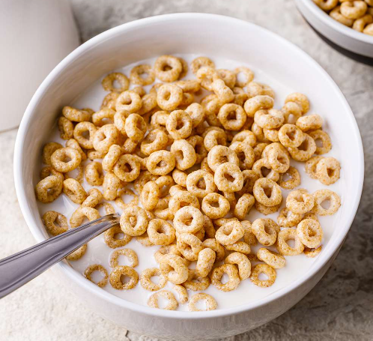
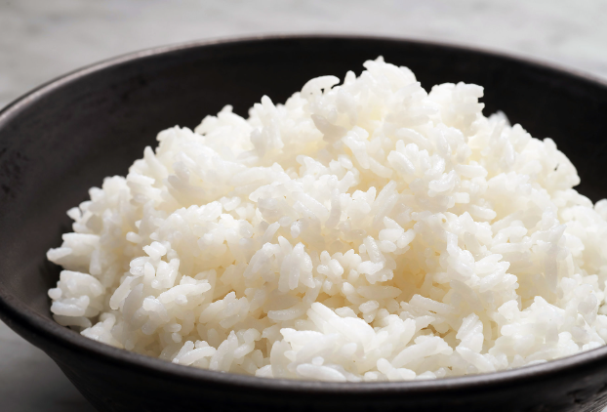
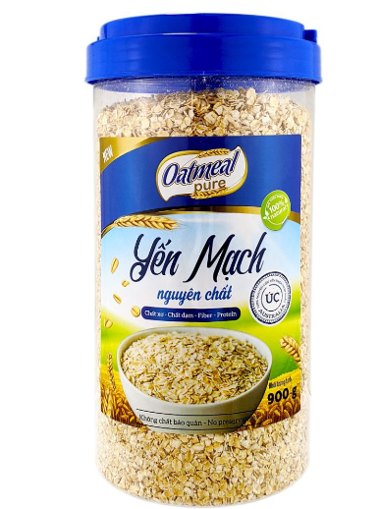
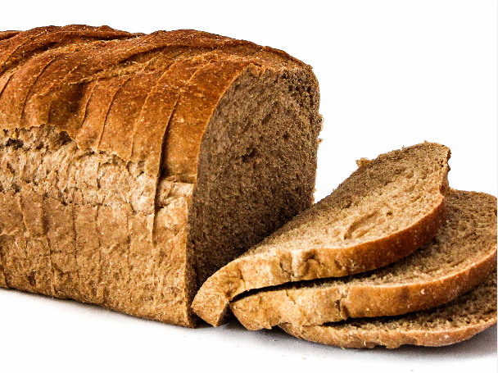
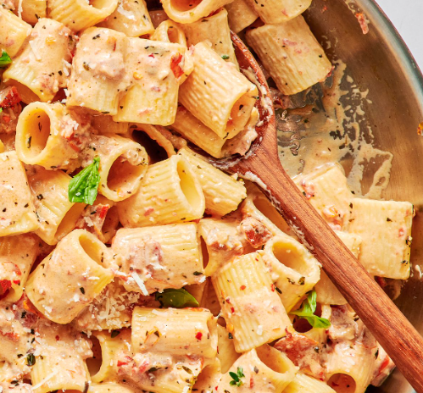
Look and say.
cereals
Grains
rice
bread
pasta
oatmeal
Notes:
Step 2: Write the four food types given in the activity on the board. Have pupils say them aloud and elicit some examples of each food type. Draw pupils’ attention to the key and have them identify the colours. Ask questions to check comprehension, such as What colour is protein? (red) and What colour should bread be? (yellow).

Slide 12
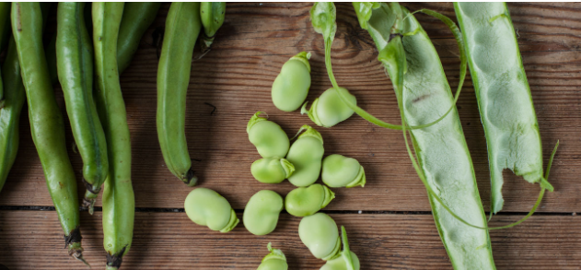
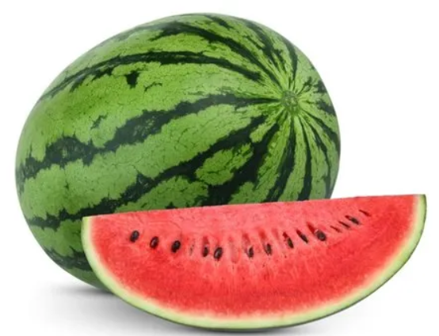
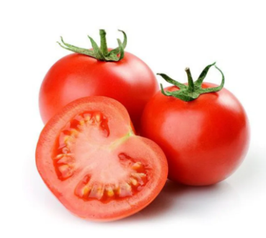
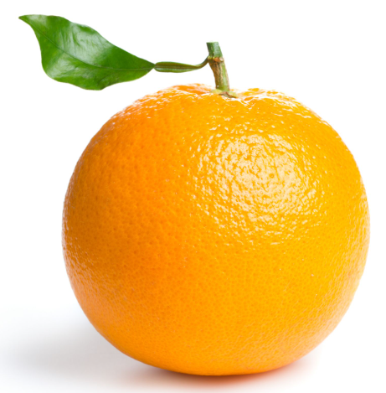
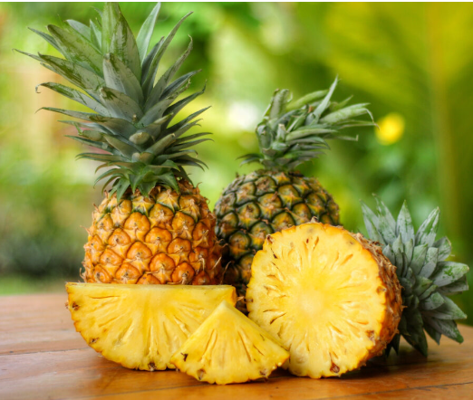
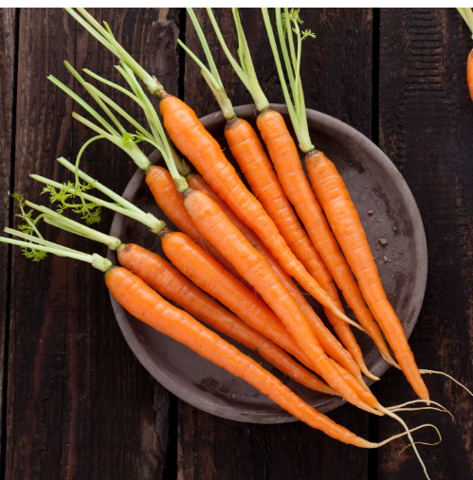
Look and say.
beans
Fruits and Vegetables
watermelon
tomatoes
orange
pineapples
carrots
Notes:
Step 2: Write the four food types given in the activity on the board. Have pupils say them aloud and elicit some examples of each food type. Draw pupils’ attention to the key and have them identify the colours. Ask questions to check comprehension, such as What colour is protein? (red) and What colour should bread be? (yellow).

Slide 13

Look and say.
Notes:
Point at each food / drink and have pupils say its name. Correct pronunciation where necessary.

Slide 14
Look and say.
Notes:
Point at each food / drink and have pupils say its name. Correct pronunciation where necessary.

Slide 15
Look, read and colour.
Notes:
Step 3: Make sure that pupils each have access to blue, red, yellow and green crayons. Put pupils into pairs and have them decide which colour each food / drink item should be. Remind them that they need to colour the food and drink with corresponding colours that match their types. Set a time for pupils to complete the activity independently.

Slide 16
Good Job!
Congratulations!

Slide 17
3.
Activity 2
Look and write.
LET'S START!

Slide 18
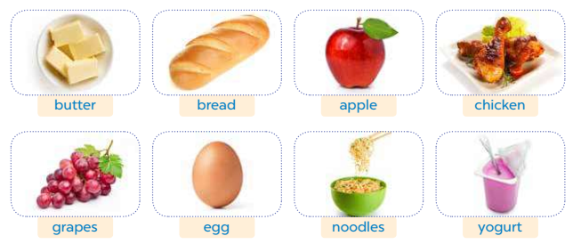
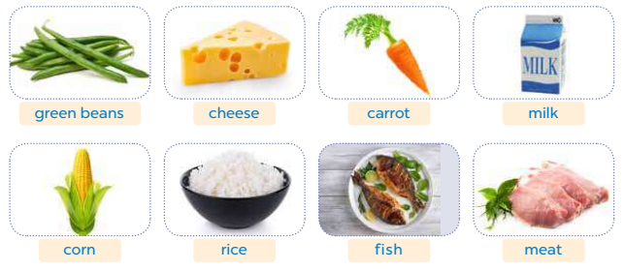
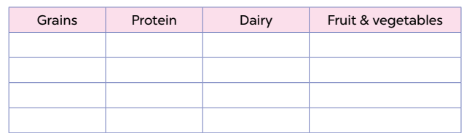
Look and listen.
Notes:
Step 1: Tell the class the goal of this activity: They need to categorise the foods by writing the names of the food and drink items in the correct columns of the table. Check comprehension.

Slide 19
Look and say.
Grains
Protein
Diary
Fruits
& Vegetables
Notes:
Step 2: Write the table on the board and have pupils say the four headings aloud.

Slide 20
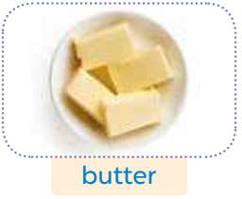
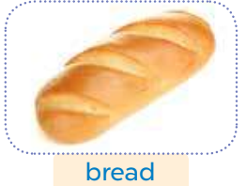
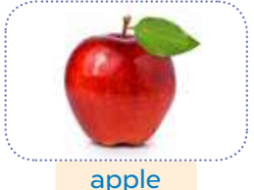
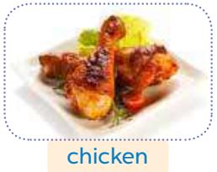
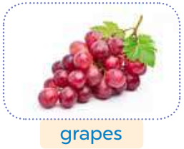
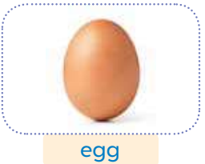
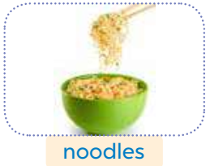
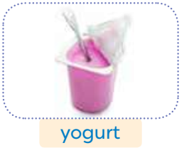
Look and say.
Notes:
Draw pupils’ attention to the pictures and have them say the names of the food / drink items aloud. Correct their pronunciation where necessary. Ask questions to check comprehension, such as What’s this? and Is this protein or grains?

Slide 21
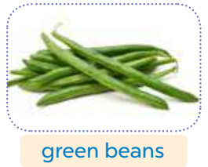
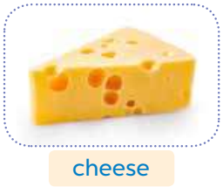
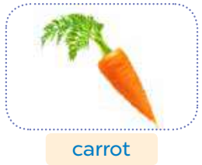
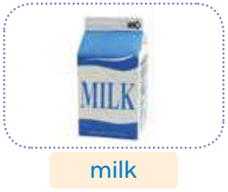
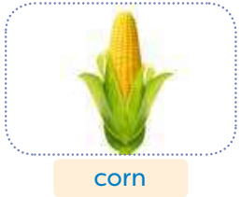
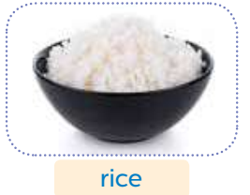
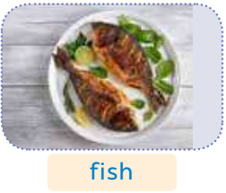
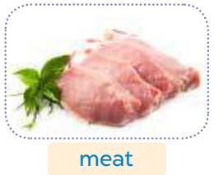
Look and say.
Notes:
Draw pupils’ attention to the pictures and have them say the names of the food / drink items aloud. Correct their pronunciation where necessary. Ask questions to check comprehension, such as What’s this? and Is this protein or grains?

Slide 22
Look and write.
butter
Notes:
Do the first word “butter” as an example.
Step 3: Set a time limit for pupils to complete the activity. Have them complete the table independently.

Slide 23

Swap your books and check your answers.
Notes:
Then check answers in pairs.

Slide 24
Look and write.
bread
butter
Notes:
Step 4: Check answers as a class by pointing to the pictures and having pupils call out the correct food type. As they do so, complete the table on the board.

Slide 25
Look and write.
bread
butter
apple
Notes:
Step 4: Check answers as a class by pointing to the pictures and having pupils call out the correct food type. As they do so, complete the table on the board.

Slide 26
Look and write.
bread
chicken
butter
apple
Notes:
Step 4: Check answers as a class by pointing to the pictures and having pupils call out the correct food type. As they do so, complete the table on the board.

Slide 27
Look and write.
bread
chicken
butter
apple
grapes
Notes:
Step 4: Check answers as a class by pointing to the pictures and having pupils call out the correct food type. As they do so, complete the table on the board.

Slide 28
Look and write.
bread
chicken
butter
apple
eggs
grapes
Notes:
Step 4: Check answers as a class by pointing to the pictures and having pupils call out the correct food type. As they do so, complete the table on the board.

Slide 29
Look and write.
bread
chicken
butter
apple
noodles
eggs
grapes
Notes:
Step 4: Check answers as a class by pointing to the pictures and having pupils call out the correct food type. As they do so, complete the table on the board.

Slide 30
Look and write.
bread
chicken
butter
apple
noodles
eggs
yogurt
grapes
Notes:
Step 4: Check answers as a class by pointing to the pictures and having pupils call out the correct food type. As they do so, complete the table on the board.

Slide 31
Look and write.
bread
chicken
butter
apple
noodles
eggs
yogurt
grapes
green beans
Notes:
Step 4: Check answers as a class by pointing to the pictures and having pupils call out the correct food type. As they do so, complete the table on the board.

Slide 32
Look and write.
bread
chicken
butter
apple
noodles
eggs
yogurt
grapes
cheese
green beans
Notes:
Step 4: Check answers as a class by pointing to the pictures and having pupils call out the correct food type. As they do so, complete the table on the board.

Slide 33
Look and write.
bread
chicken
butter
apple
noodles
eggs
yogurt
grapes
cheese
green beans
carrot
Notes:
Step 4: Check answers as a class by pointing to the pictures and having pupils call out the correct food type. As they do so, complete the table on the board.

Slide 34
Look and write.
bread
chicken
butter
apple
noodles
eggs
yogurt
grapes
corn
cheese
green beans
milk
carrot
Notes:
Step 4: Check answers as a class by pointing to the pictures and having pupils call out the correct food type. As they do so, complete the table on the board.

Slide 35
Look and write.
bread
chicken
butter
apple
noodles
eggs
yogurt
grapes
corn
cheese
green beans
rice
milk
carrot
Notes:
Step 4: Check answers as a class by pointing to the pictures and having pupils call out the correct food type. As they do so, complete the table on the board.

Slide 36
Look and write.
bread
chicken
butter
apple
noodles
eggs
yogurt
grapes
corn
fish
cheese
green beans
rice
milk
carrot
Notes:
Step 4: Check answers as a class by pointing to the pictures and having pupils call out the correct food type. As they do so, complete the table on the board.

Slide 37
Look and write.
bread
chicken
butter
apple
noodles
eggs
yogurt
grapes
corn
fish
cheese
green beans
rice
meat
milk
carrot
Notes:
Step 4: Check answers as a class by pointing to the pictures and having pupils call out the correct food type. As they do so, complete the table on the board.

Slide 38
Presentation!!!!
bread
chicken
butter
apple
noodles
eggs
yogurt
grapes
corn
fish
cheese
green beans
rice
meat
milk
carrot
Notes:
Step 5: Invite a few pupils to the front of the class and have them present their work to the class. Ask questions about the table, e.g. What is cheese? (Cheese is dairy.), What are noodles? (Noodles are grains.).

Slide 39
Good Job!
Congratulations!

Slide 40
4.
Activity 3
Write and say.
LET'S START!

Slide 41

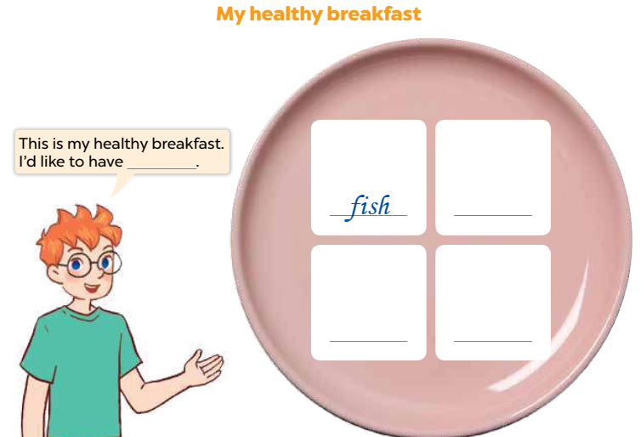
Listen and think.
My healthy breakfast
Notes:
Step 1: Tell the class that they are going to create a healthy breakfast and present it to the class. They need to think of four food and drink items to create the breakfast.

Slide 42

Listen and say.
My healthy breakfast
milk
Notes:
Step 2: Draw pupils’ attention to the picture and have them identify the bowl and the blank spaces. Tell them they will need to write the food and drink items in the spaces. Have a pupil identify Ben and read his speech bubble aloud.

Slide 43
Listen and answer.
What do you usually eat for breakfast?
cereals
milk
eggs
cheese
Notes:
Step 3: Ask pupils what they usually eat for breakfast. Make a list of their answers on the board. Ask Is this food/drink healthy? And allow pupils to respond. If they identify an unhealthy item, ask them for a healthy replacement.

Slide 44
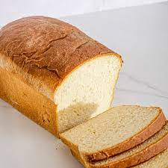
Listen and answer.
What do you usually eat for breakfast?
bread
yogurt
rice
meat
orange
fish
Notes:
Step 3: Ask pupils what they usually eat for breakfast. Make a list of their answers on the board. Ask Is this food/drink healthy? And allow pupils to respond. If they identify an unhealthy item, ask them for a healthy replacement.

Slide 45
Draw and write.
My healthy breakfast
milk
Notes:
Step 4: Have pupils create their healthy breakfast by writing down the food and drink items. If time allows, encourage pupils to draw their breakfasts.

Slide 46
Swap your books and check your answers.
Notes:
Step 5: Have pupils check their answers in pairs. Go around the classroom to check that the foods/drinks used are healthy and that the words are spelt correctly.

Slide 47
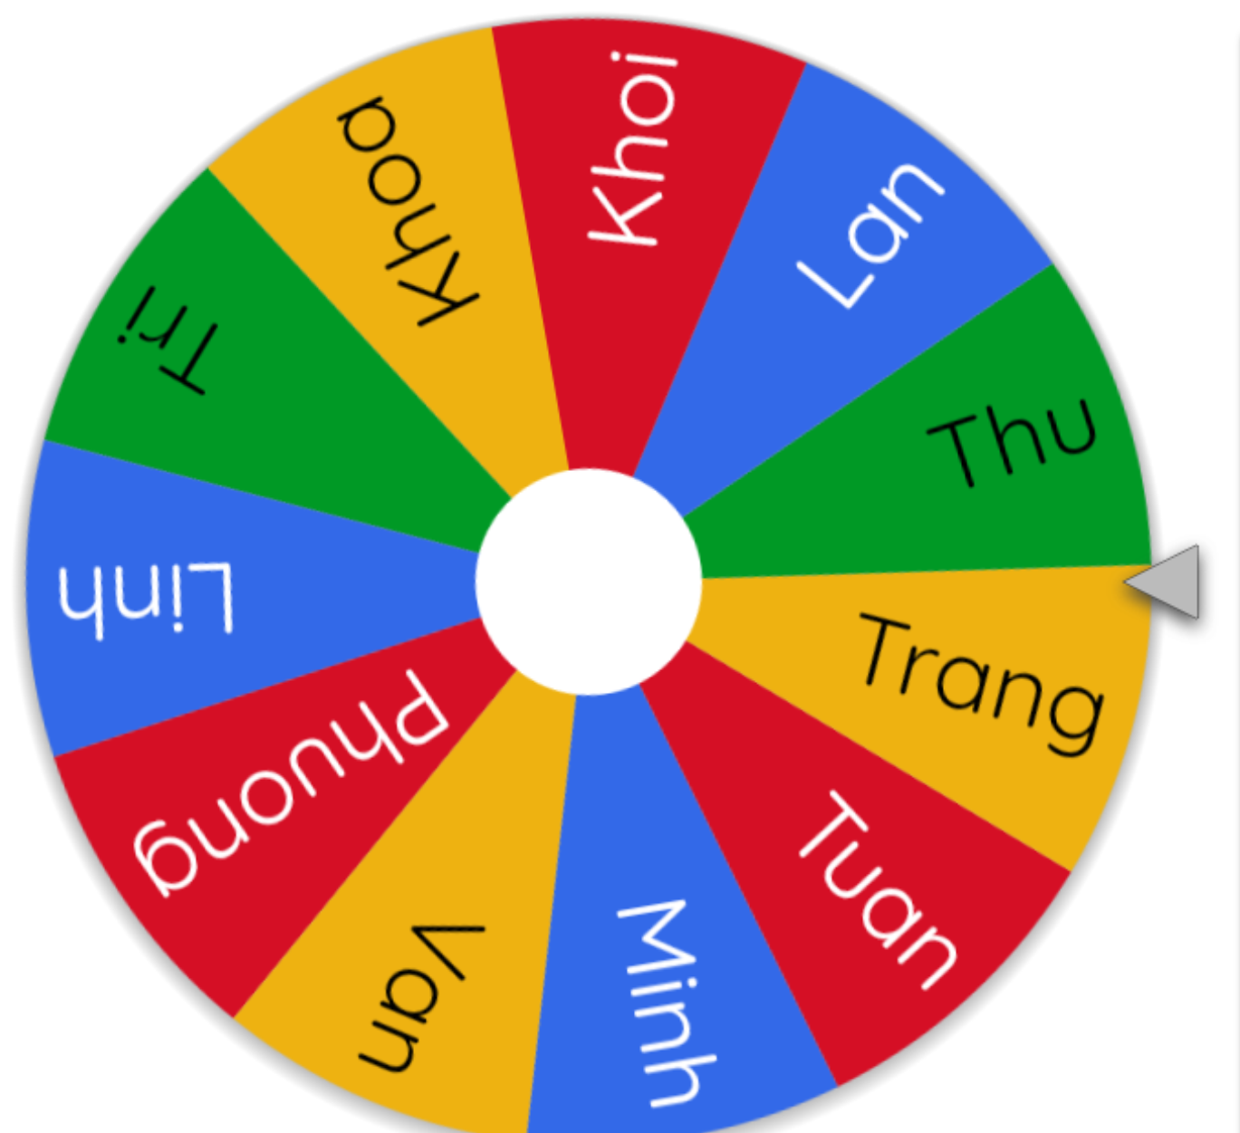
Share in the front.
Notes:
Invite a few pupils to share their healthy breakfasts with the class. Model your own healthy breakfast, if necessary, e.g. This is my healthy breakfast. I’d like to have bread, an egg and an apple.
Use this link to choose the pupils: https://wheelofnames.com/

Slide 48

Share in your groups.
Notes:
Put pupils into groups of four and have them present their healthy breakfasts to each other. Monitor and provide support if necessary.

Slide 49
Create your LUNCH and DINNER.
My healthy lunch
My healthy dinner
Notes:
Extension: Have pupils create a healthy lunch and dinner and present them to the class.

Slide 50
Good Job!
Congratulations!

Slide 51
5.
Fun corner and Wrap-up
LET'S START!

Slide 52
KIM’S GAME
LET'S START!
Notes:
- Divide the class into two teams. Say “You are going to play a memory game.”
- Display many words and phrases on the board. Give pupils two minutes to memorise these words and phrases.
e.g. butter, bread, apple, chicken, grapes, egg, noodles, yogurt, green beans, cheese, carrot, milk, water, apple juice, corn, rice, fish, meat, orange juice,
- Turn the word cards face down on the board. In their teams, the pupils try to write down and draw as many words and pictures as they can remember.
- Check the answers as the class.
- Count the points for each team and announce the winner. The team with the most points wins. The winning team must then correctly pronounce all the words and phrases.

Slide 53

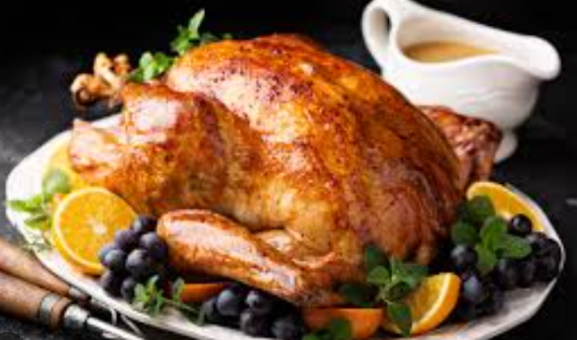
KIM’S GAME
START
FINISH
Notes:
Click START to play the game.

Slide 54
KIM’S GAME
Notes:
Answer key

Slide 55
KIM’S GAME
START
FINISH
Notes:
Click START to play the game.

Slide 56
KIM’S GAME
Notes:
Answer key

Slide 57
Good Job!
Congratulations!

Slide 58
Website: hoclieu.vn
Fanpage: https://www.facebook.com/tienganhglobalsuccess.vn/

