Slide 1





Unit 16
weather
Lesson 1 – Period 1

Slide 2




Warm-up

Slide 3

Vocabulary
MsPham
0936082789

Slide 4

Vocabulary
rainy
/ˈreɪni/
MsPham
0936082789
Có mưa

Slide 5

Vocabulary
windy
/ˈwɪndi/
MsPham
0936082789
Có gió

Slide 6

Vocabulary
sunny
/ˈsʌni/
MsPham
0936082789
Có nắng

Slide 7

Vocabulary
cloudy
/ˈklaʊdi/
MsPham
0936082789
Có mây

Slide 8
Vocabulary
weather
/ˈweðə(r)/
MsPham
0936082789
Thời tiết

Slide 9
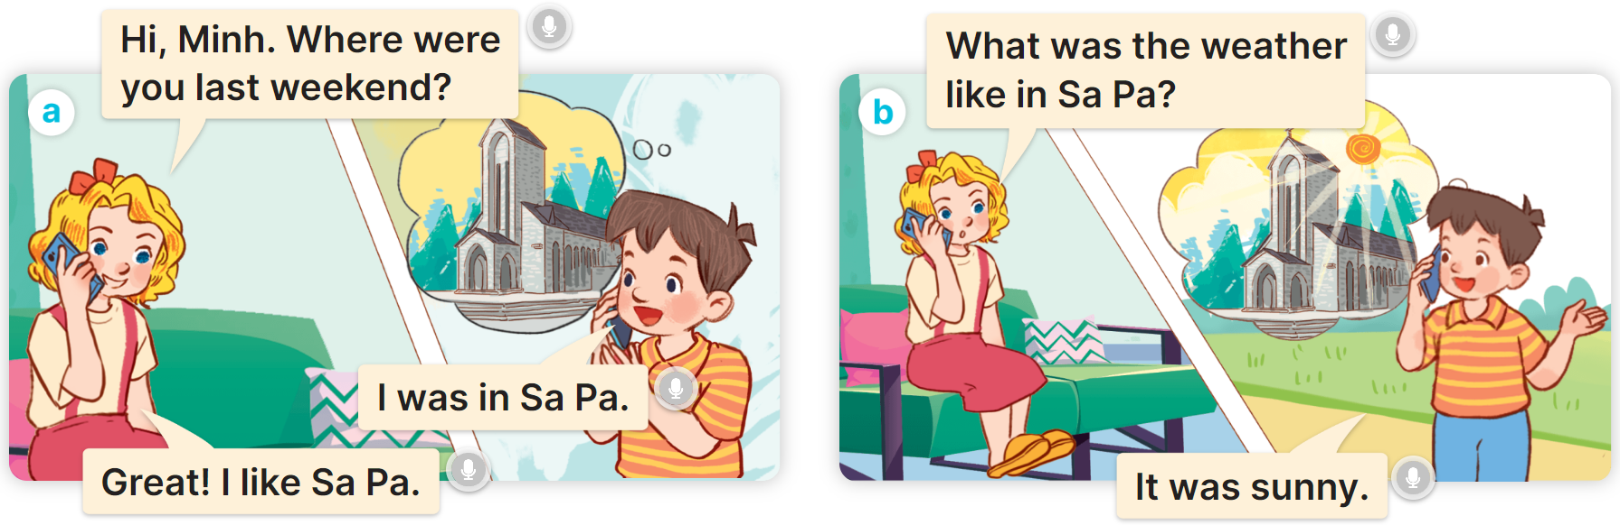

1
Look, listen and repeat.
MsPham
0936082789

Slide 10
Structure
MsPham
0936082789

Slide 11
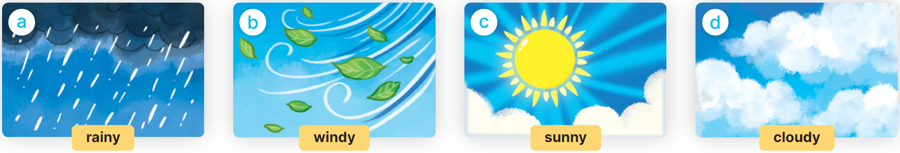
What was the weather like last weekend?
2
Listen, point and say.
It was ________.
rainy
windy
sunny
cloudy

Slide 12


2
Listen, point and say.
MsPham
0936082789
rainy
What was the weather like last weekend?
It was rainy.

Slide 13


2
Listen, point and say.
MsPham
0936082789
windy
What was the weather like last weekend?
It was windy.

Slide 14
2
Listen, point and say.
MsPham
0936082789
sunny
What was the weather like last weekend?
It was sunny.

Slide 15
2
Listen, point and say.
MsPham
0936082789
cloudy
What was the weather like last weekend?
It was cloudy.

Slide 16
What was the weather like last weekend?
2
Listen, point and say.
It was ________.
rainy
windy
sunny
cloudy

Slide 17






Click hình chú Thỏ hoặc chú Rùa khi chọn đáp án.
Notes:
Ms Huyền Phạm - 0936.082.789 – YOUTUBE: MsPham. Facebook: Dạy và học cùng công nghệ.

Slide 18

What was the weather like last weekend?
It was ________.
windy
rainy
Notes:
Ms Huyền Phạm - 0936.082.789 – YOUTUBE: MsPham. Facebook: Dạy và học cùng công nghệ.

Slide 19
What was the weather like last weekend?
It was ________.
sunny
windy
Notes:
Ms Huyền Phạm - 0936.082.789 – YOUTUBE: MsPham. Facebook: Dạy và học cùng công nghệ.

Slide 20
What was the weather like last weekend?
It was ________.
cloudy
windy
Notes:
Ms Huyền Phạm - 0936.082.789 – YOUTUBE: MsPham. Facebook: Dạy và học cùng công nghệ.

Slide 21

Notes:
Ms Huyền Phạm - 0936.082.789 – YOUTUBE: MsPham. Facebook: Dạy và học cùng công nghệ.

Slide 22
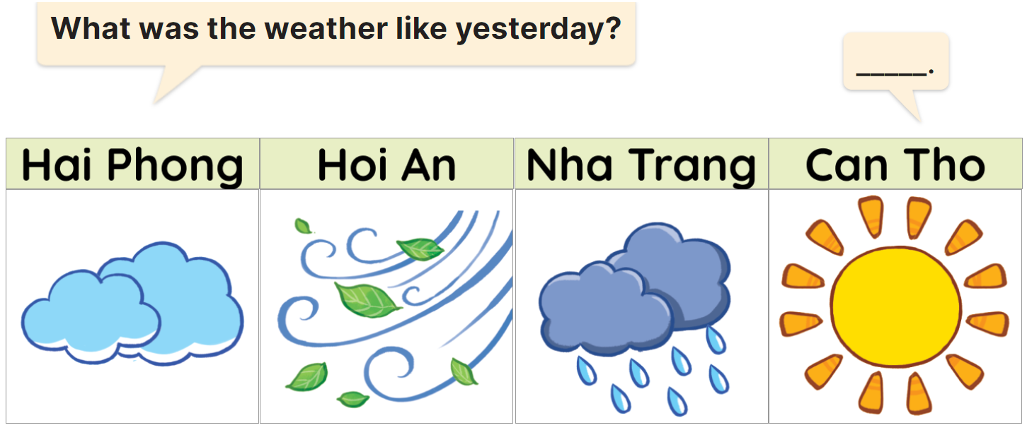
3
Let’s talk.
It’s was________.
cloudy
windy
rainy
sunny

Slide 23

Review
MsPham
0936082789

Slide 24
What was the weather like last weekend?
MsPham
0936082789
It was _______.
MsPham
0936082789
rainy
windy
sunny
cloudy

Slide 25
Thank you!

