Slide 1





Unit 16
weather
Lesson 1 – Period 2

Slide 2




Warm-up

Slide 3


Review
MsPham
0936082789

Slide 4





What was the weather like last weekend?
MsPham
0936082789
It was _______.
MsPham
0936082789
rainy
windy
sunny
cloudy

Slide 5
Practice
MsPham
0936082789

Slide 6


MsPham
0936082789
4
Listen and number.
MsPham
0936082789
2
4
3
1
1
2
3
4

Slide 7
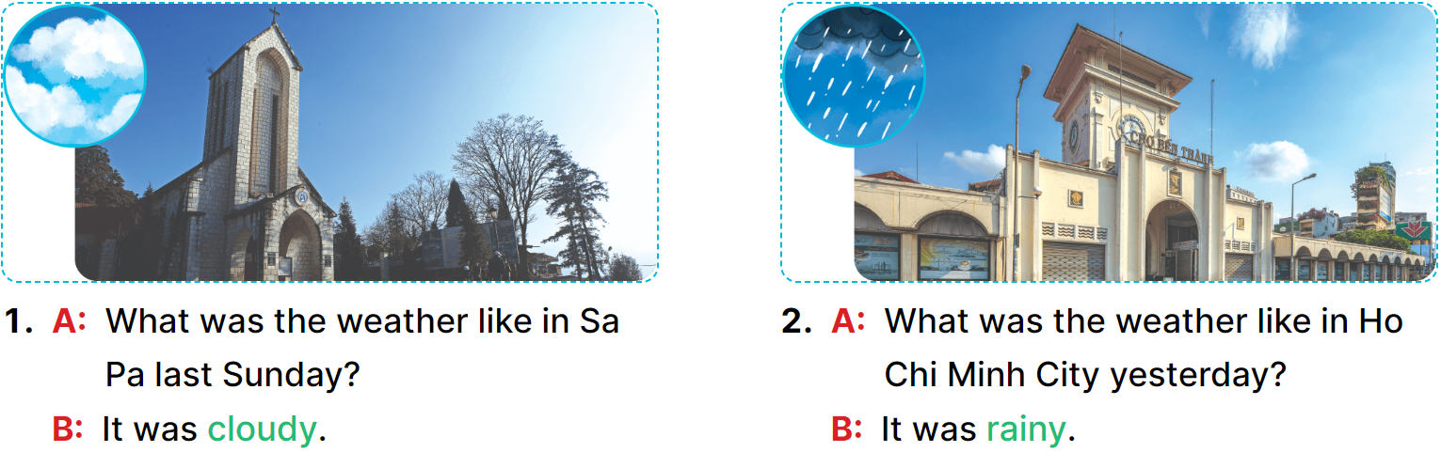
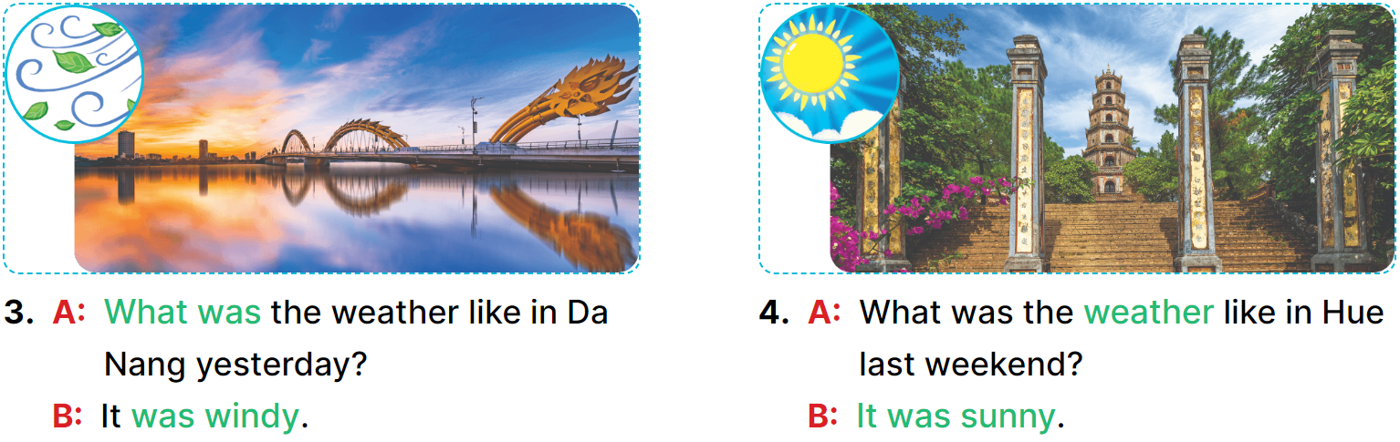
MsPham
0936082789
5
Look, complete and read.
__________.
__________.
_____
____
__________.
__________.

Slide 8
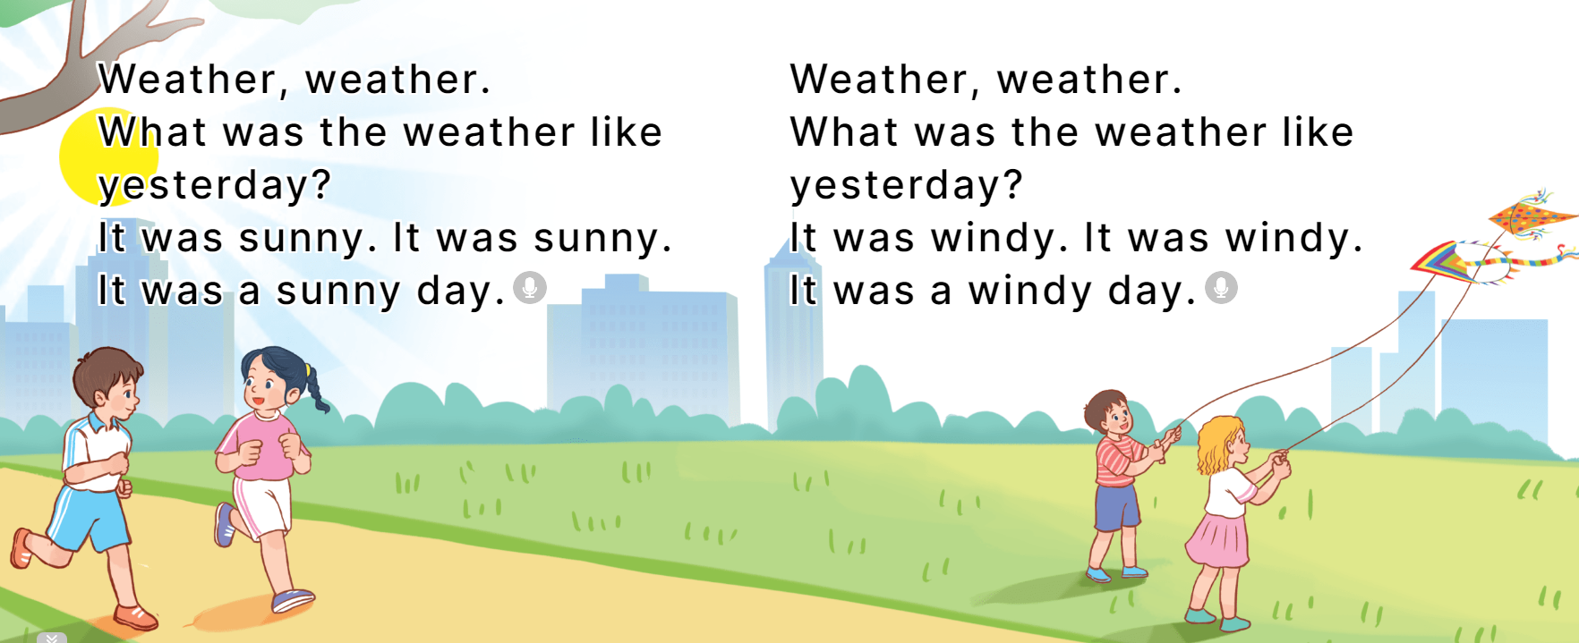
6
Let’s sing.
MsPham
0936082789

Slide 9
Review
MsPham
0936082789

Slide 10
What was the weather like last weekend?
MsPham
0936082789
It was _______.
MsPham
0936082789
rainy
windy
sunny
cloudy

