Slide 1





Unit 16
weather
Lesson 2 – Period 1

Slide 2
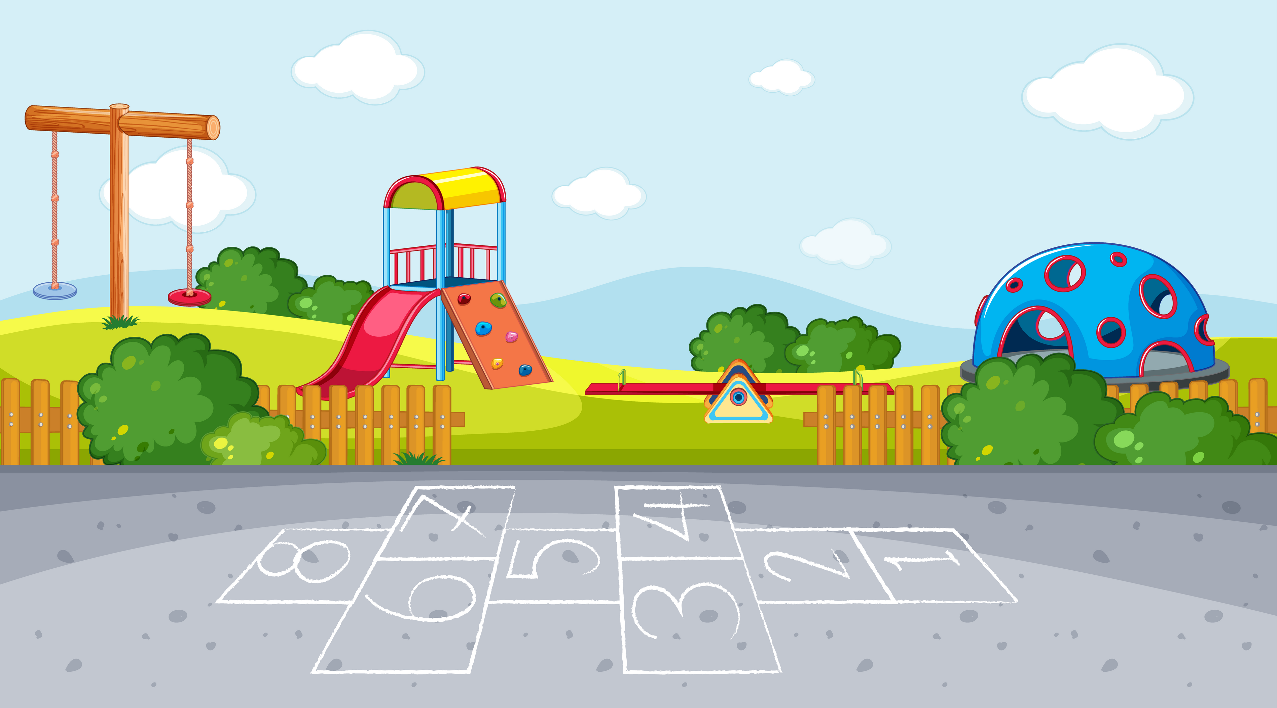



Warm-up

Slide 3
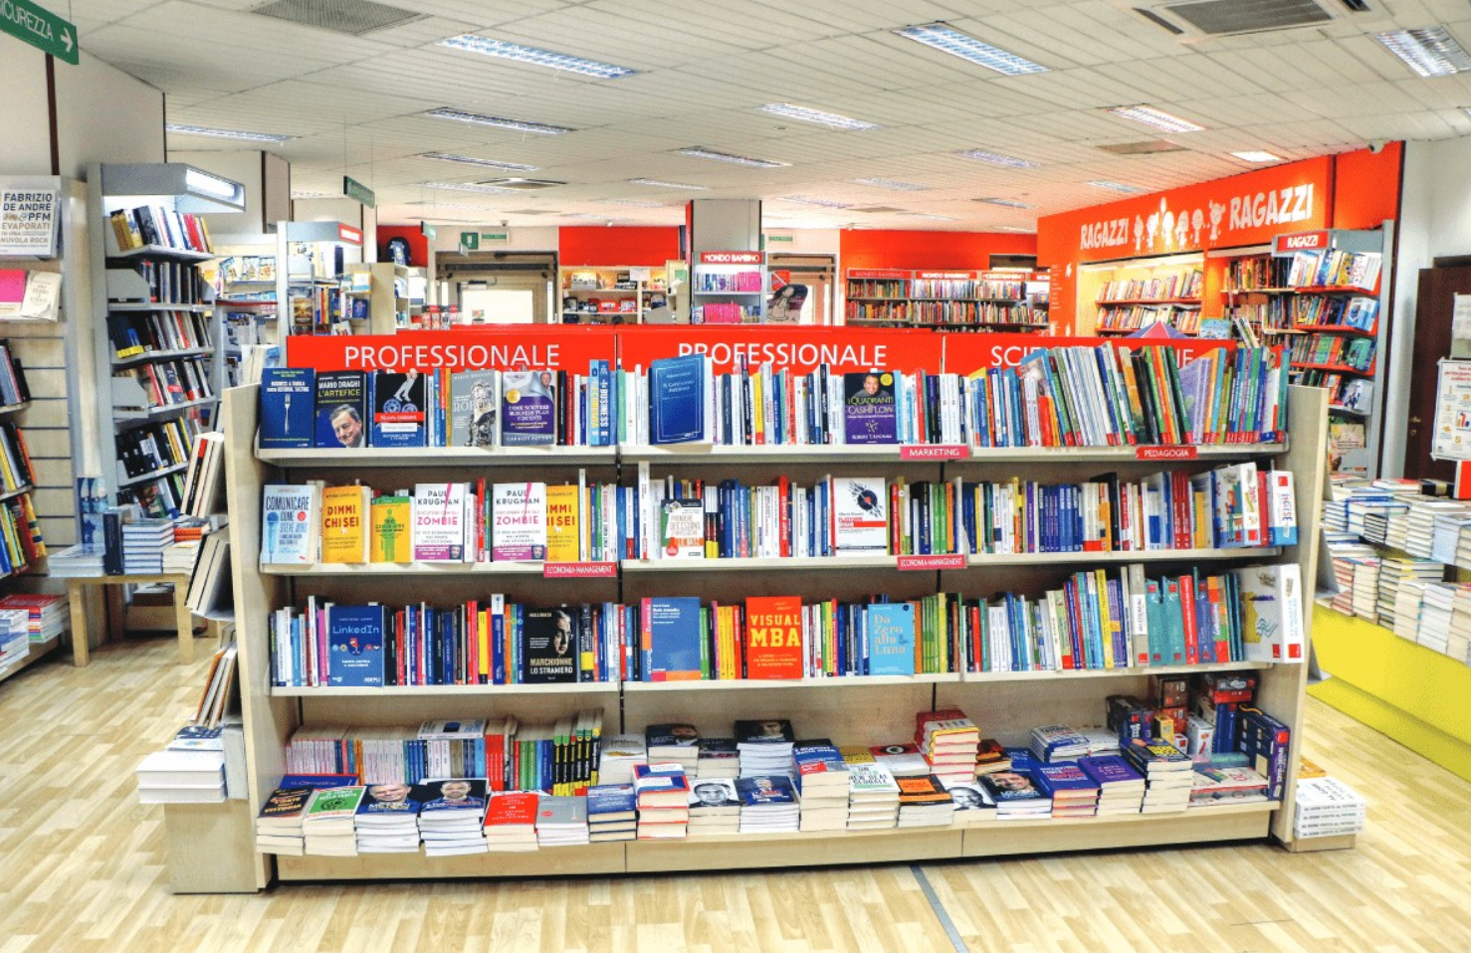
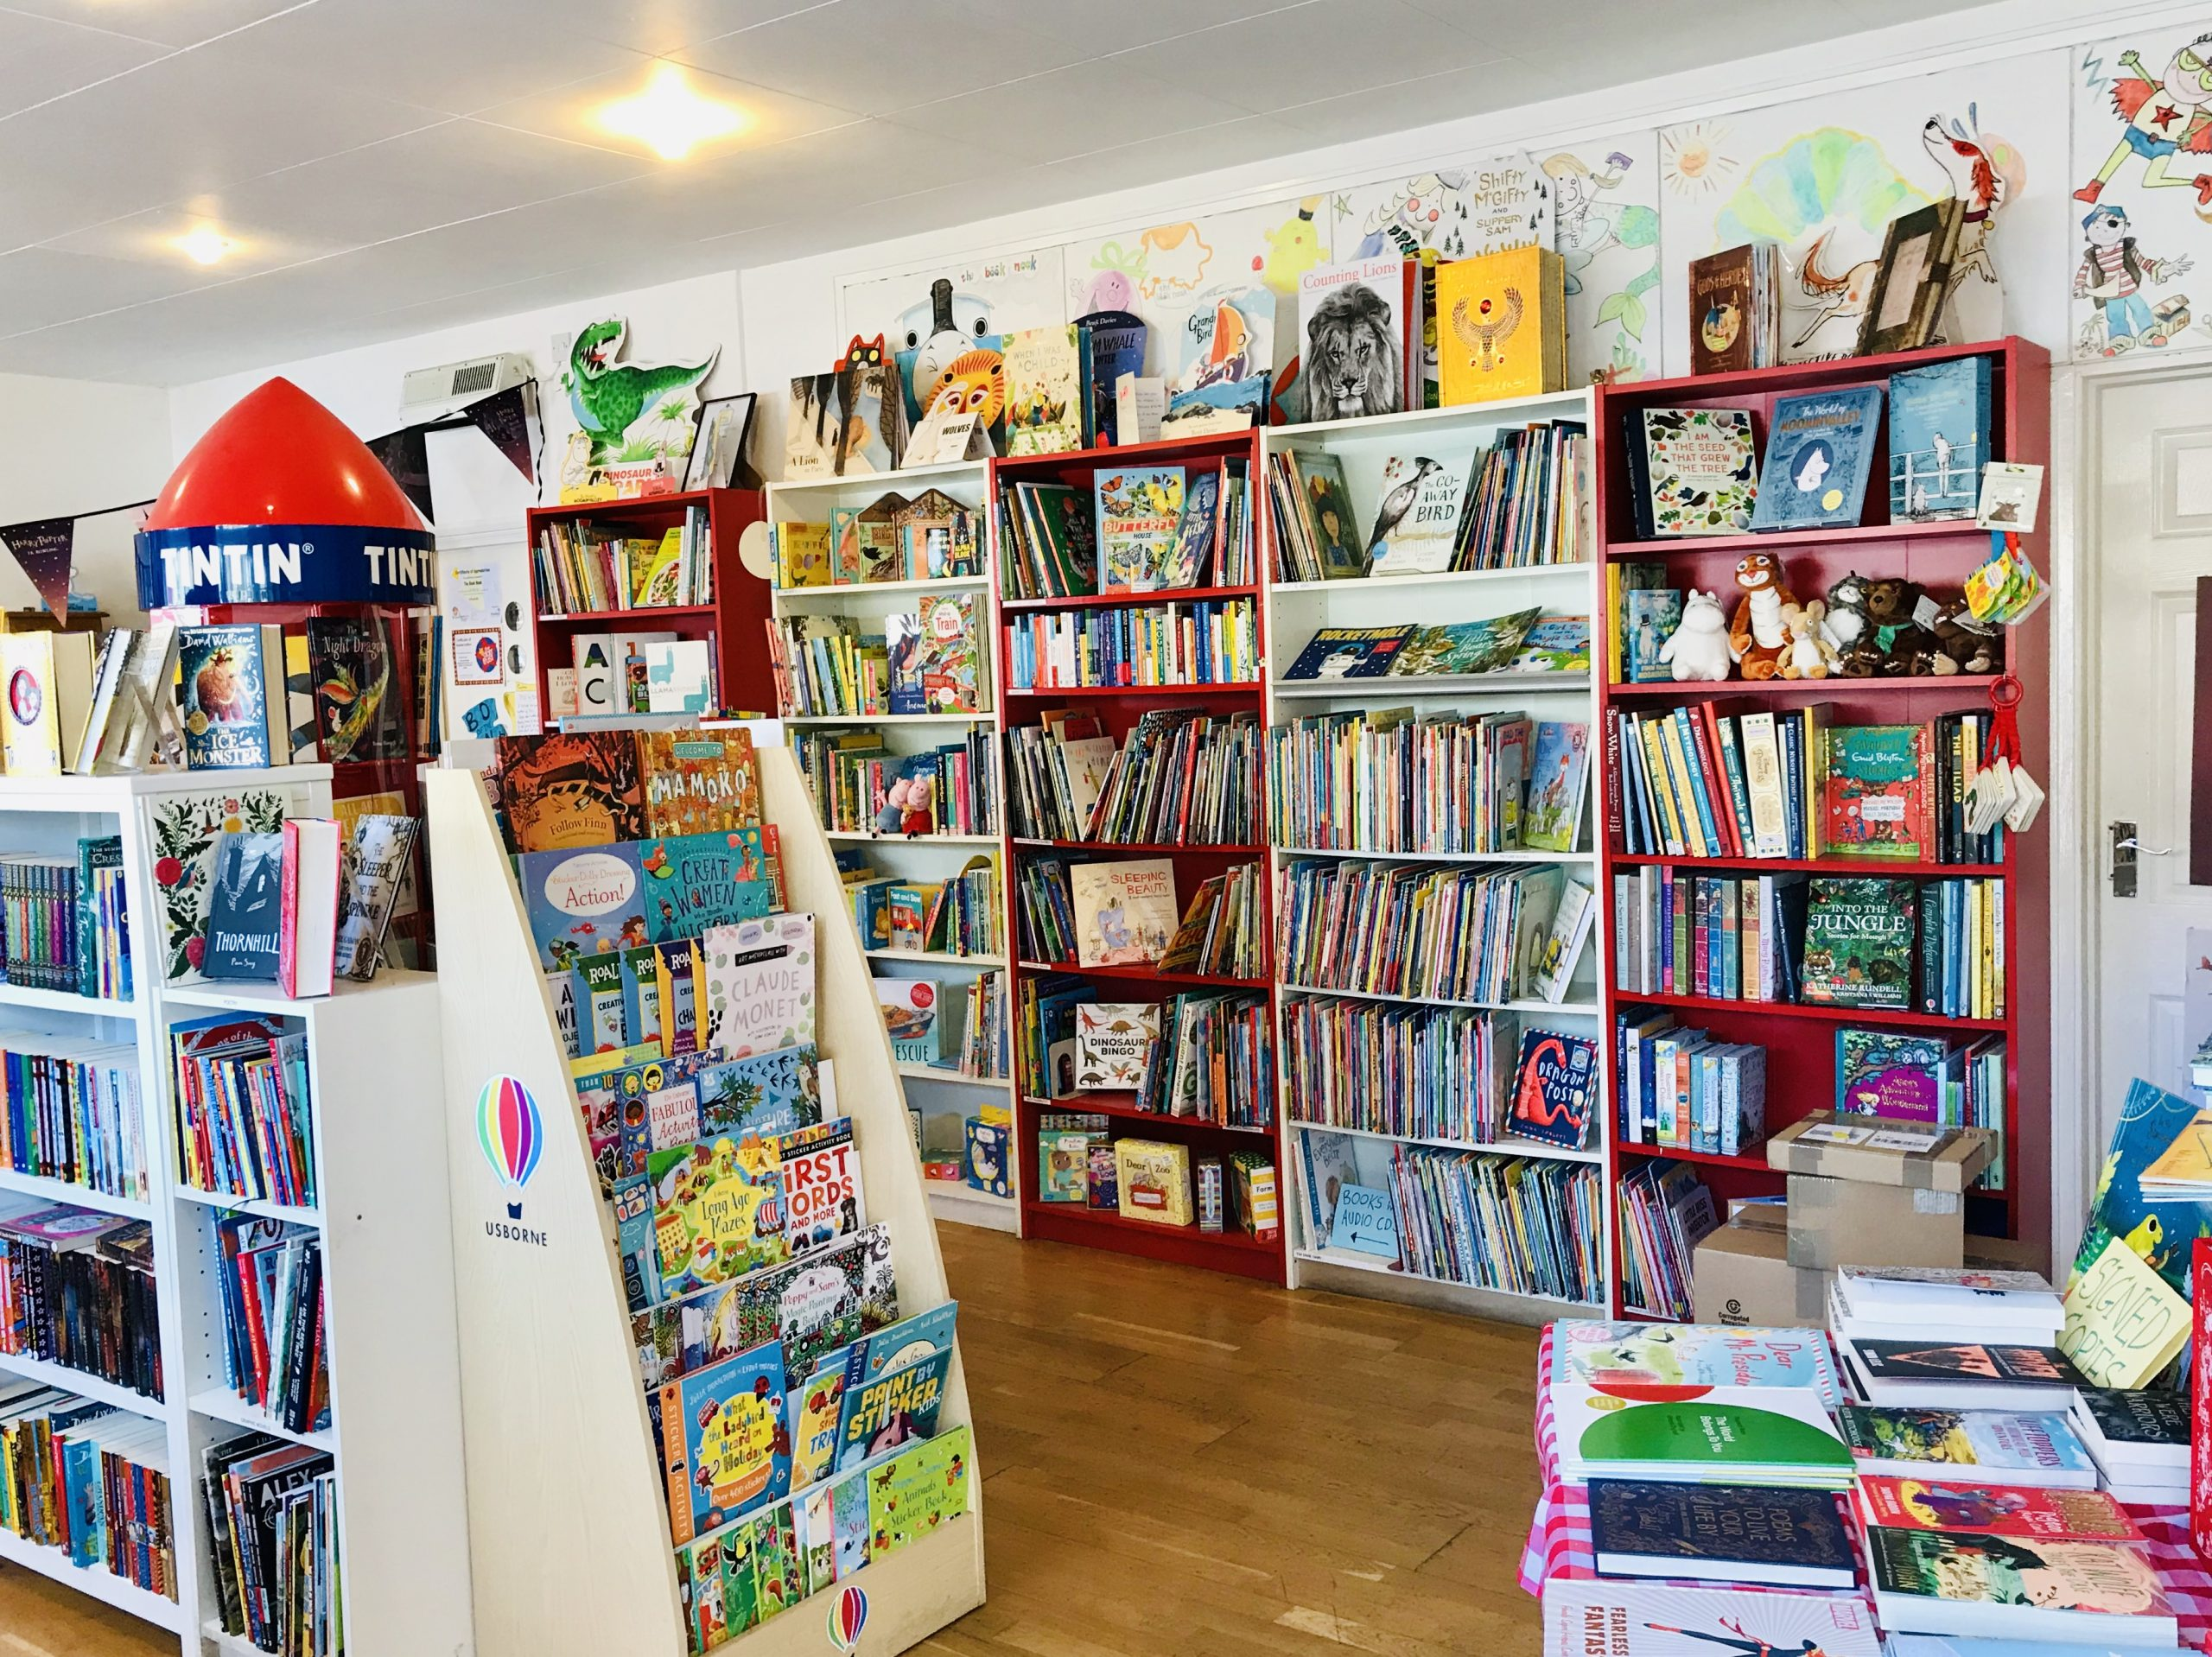

Vocabulary
bookshop
/ˈbʊkʃɒp/
MsPham
0936082789
Hiệu sách

Slide 4
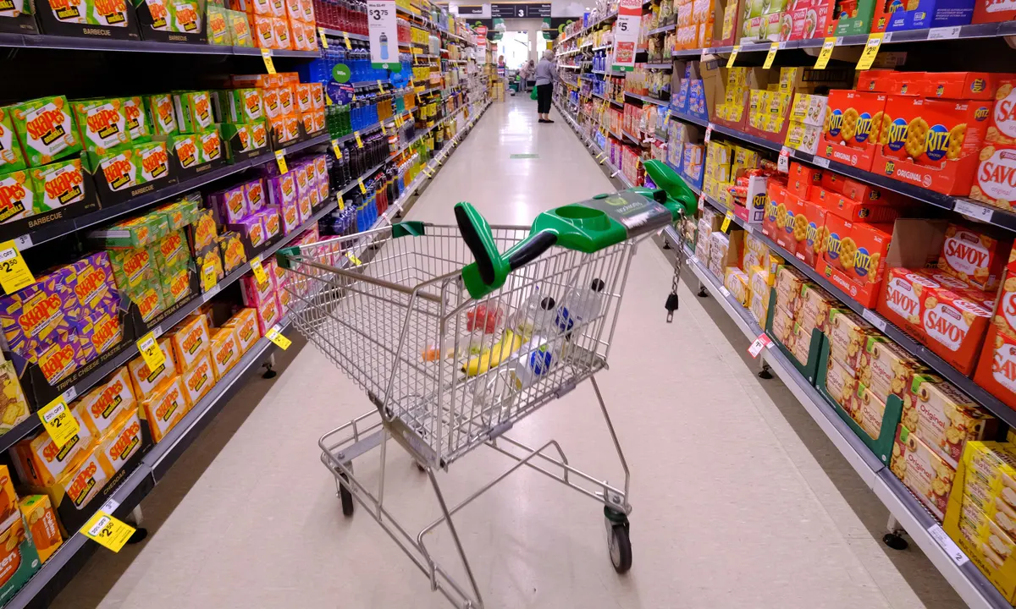
Vocabulary
supermarket
/ˈsuːpəmɑːkɪt/
MsPham
0936082789
Siêu thị

Slide 5
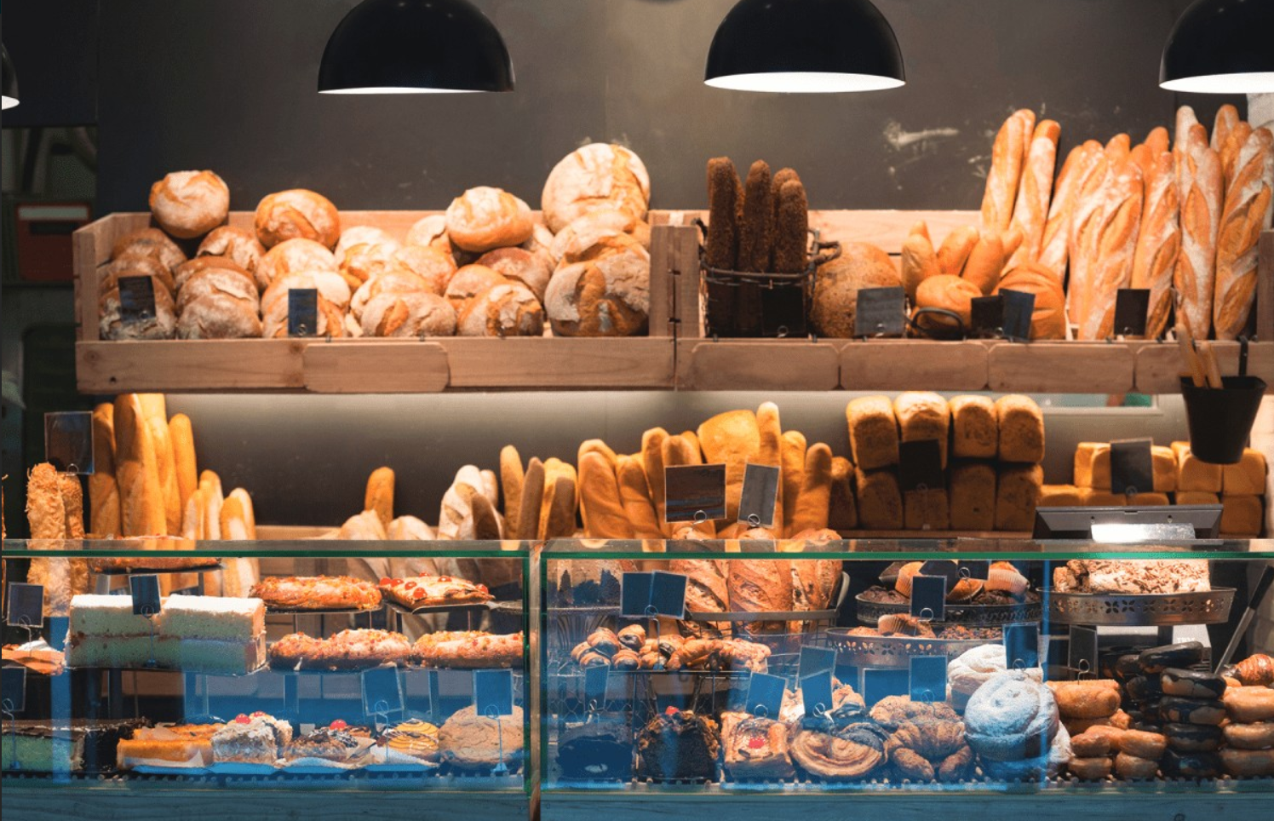
Vocabulary
bakery
/ˈbeɪkəri/
MsPham
0936082789
Hiệu bánh mì

Slide 6
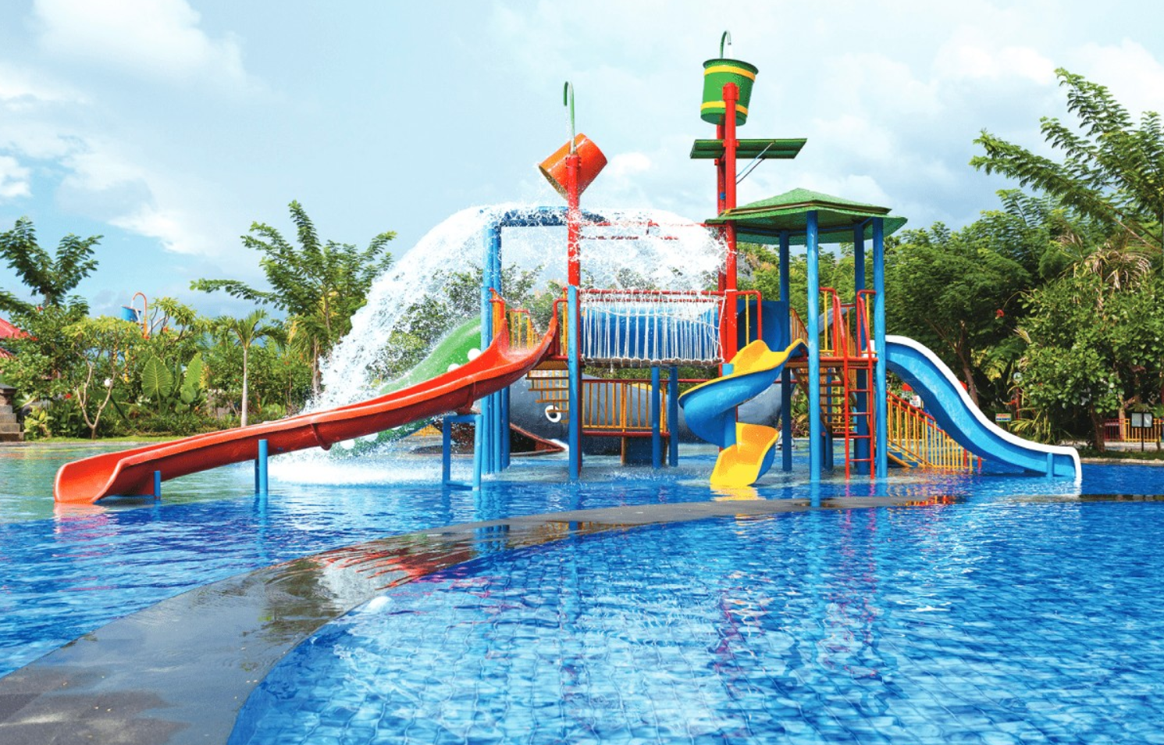
Vocabulary
water park
/ˈwɔːtə pɑːk/
MsPham
0936082789
Công viên nước

Slide 7
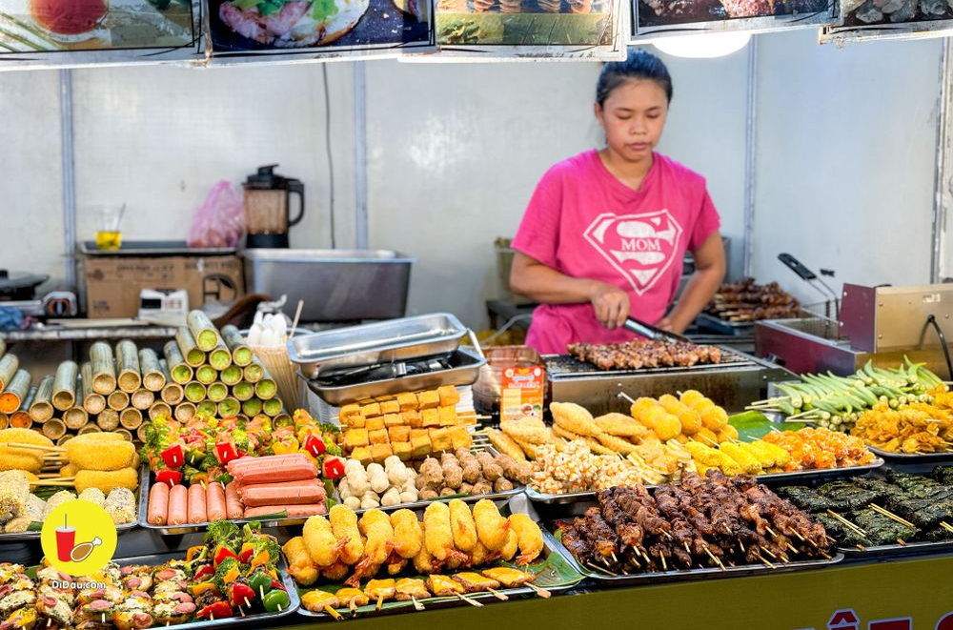
Vocabulary
food stall
: Gian hàng thực phẩm
bookshop
: Hiệu sách
supermarket
: Siêu thị
MsPham
0936082789
bakery
: Hiệu bánh mì
water park
: Công viên nước

Slide 8
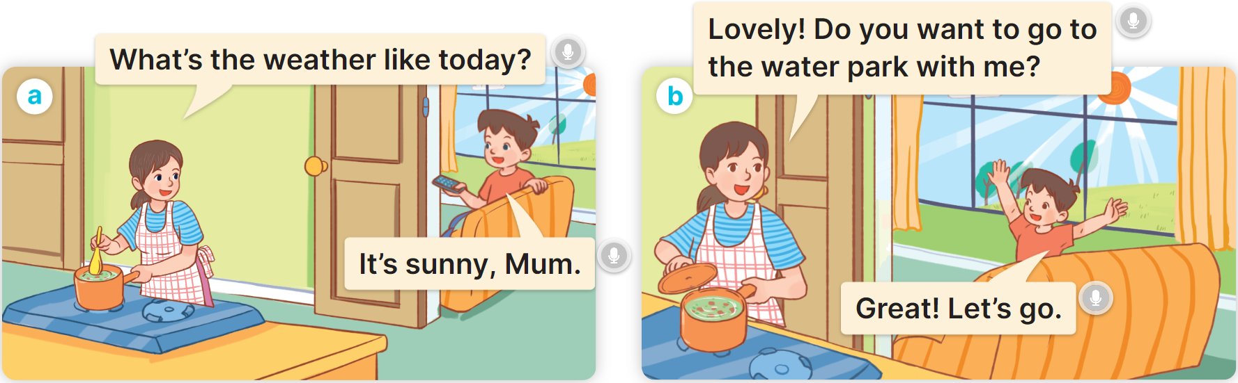

1
Look, listen and repeat.
MsPham
0936082789

Slide 9
Structure
MsPham
0936082789

Slide 10



1
Cách hỏi ai đó muốn đi tới đâu không:
Do you want to go to the __________?
(Bạn có muốn đi
_______ không?)
Great! Let’s go.
(Tuyệt quá! Cùng đi nào.)
Sorry. I can’t.
(Xin lỗi. Tớ không thể đi được.)
Ex:
MsPham
0936082789

Slide 11
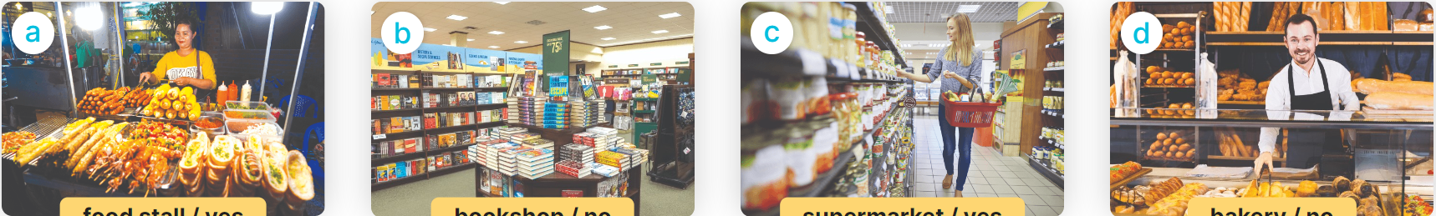
2
Listen, point and say.
Do you want to go to the __________?
Great! Let’s go.
Sorry. I can’t.
MsPham
0936082789
food stall/yes
bookshop/no
supermarket/yes
bakery/no

Slide 12


2
Listen, point and say.
MsPham
0936082789
food stall/yes
Do you want to go to the food stall?
Great! Let’s go.

Slide 13

2
Listen, point and say.
MsPham
0936082789
bookshop/no
Do you want to go to the bookshop?
Sorry. I can’t.

Slide 14
2
Listen, point and say.
MsPham
0936082789
supermarket/yes
Do you want to go to the supermarket?
Great! Let’s go.

Slide 15
2
Listen, point and say.
MsPham
0936082789
bakery/no
Do you want to go to the bakery?
Sorry. I can’t.

Slide 16
2
Listen, point and say.
Do you want to go to the __________?
Great! Let’s go.
Sorry. I can’t.
MsPham
0936082789
food stall/yes
bookshop/no
supermarket/yes
bakery/no

Slide 17












Ms Huyền Phạm
0936.082.789
Ms Huyền Phạm
0936.082.789
Ms Huyền Phạm
0936.082.789
Ms Huyền Phạm - 0936.082.789 – YOUTUBE: MsPham. Facebook: Dạy và học cùng công nghệ.
Ms Huyền Phạm
0936.082.789
Notes:
Ms Huyền Phạm - 0936.082.789 – YOUTUBE: MsPham. Facebook: Dạy và học cùng công nghệ.

Slide 18
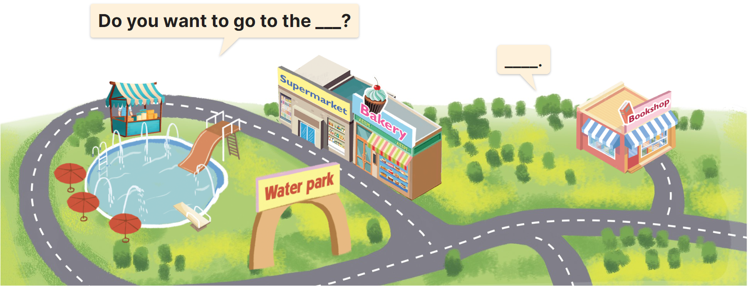
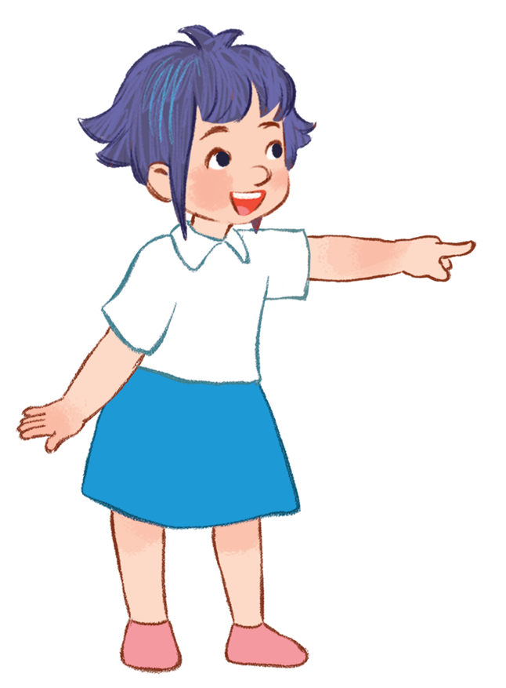
3
Let’s talk.
Do you want to go to the bakery?
Sorry. I can’t.
Great! Let’s go.
MsPham
0936082789

Slide 19
3
Let’s talk.
Do you want to go to the bookshop?
Sorry. I can’t.
Great! Let’s go.
MsPham
0936082789

Slide 20
3
Let’s talk.
Do you want to go to the food stall?
Sorry. I can’t.
Great! Let’s go.
MsPham
0936082789

Slide 21
3
Let’s talk.
MsPham
0936082789

Slide 22

Review
MsPham
0936082789

Slide 23
Great! Let’s go.
Do you want to go to the _________?
MsPham
0936082789
Sorry. I can’t.
MsPham
0936082789
food stall
water park
bakery
supermarket
bookshop

Slide 24
Thank you!

