Slide 1
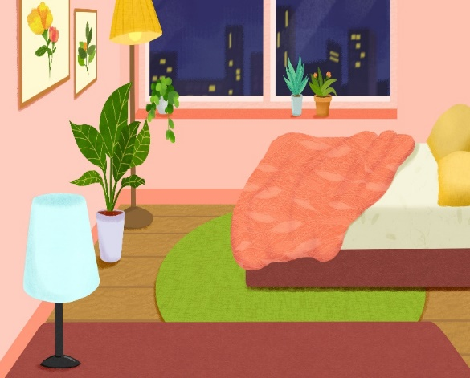
My bedroom
Unit 14
Lesson 1 (1+2+3)

Slide 2

Warm-up

Slide 3

Let’s play!

Slide 4

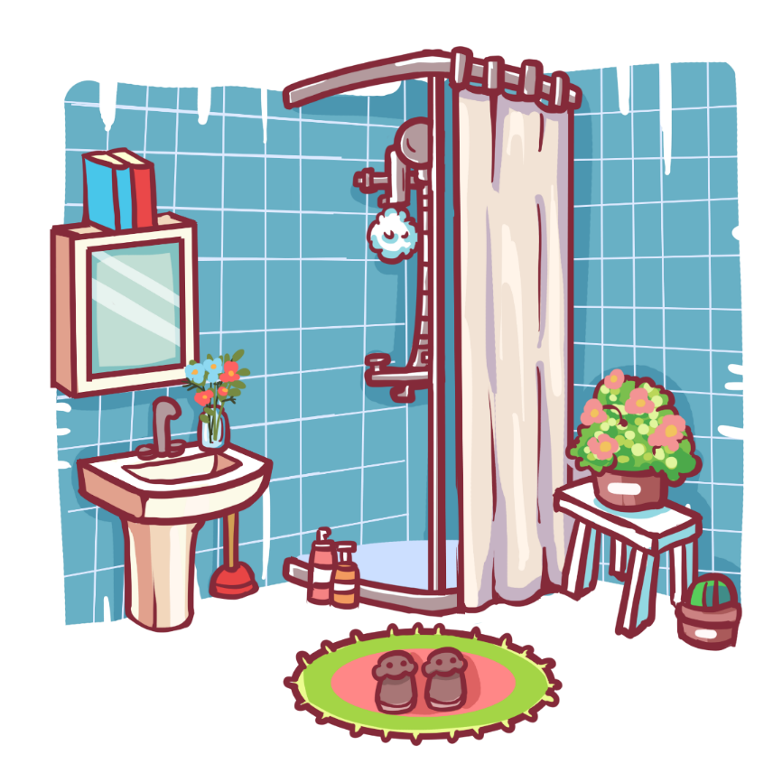
Click chuột lần thứ 1 để di chuyển ống nhòm.
Click chuột lần thứ 2 để hiển thị đáp án.
Can you guess?
Facebook : Bùi Liễu
0968142780
bathroom

Slide 5
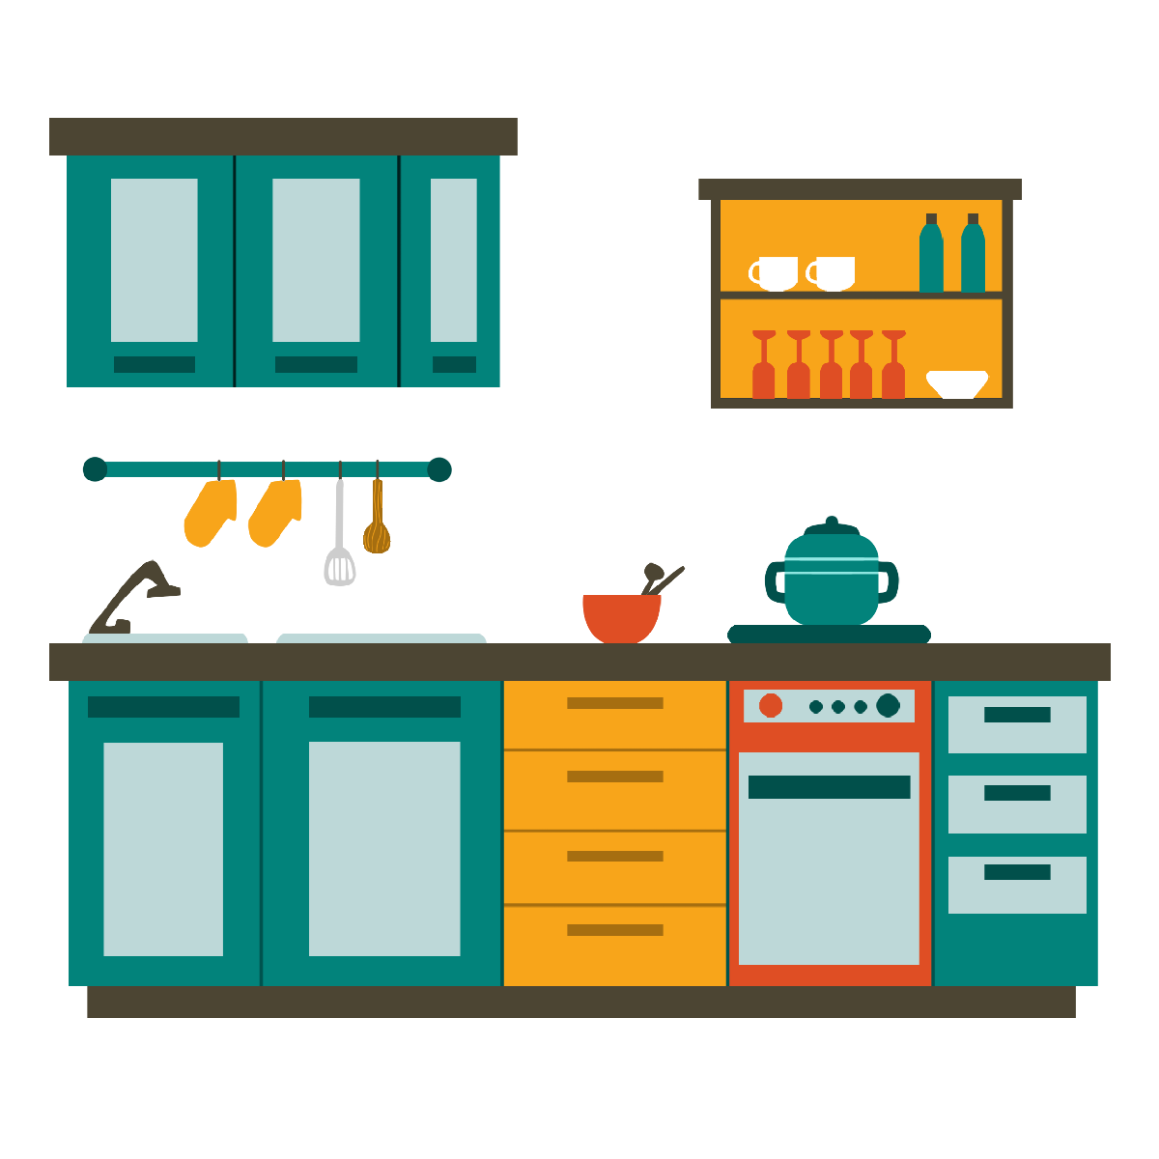
Can you guess?
kitchen

Slide 6
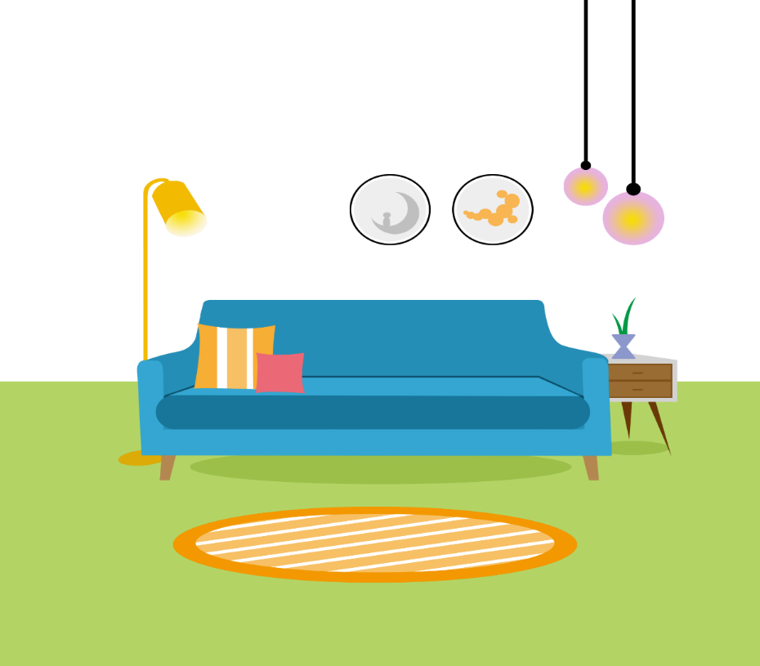
Can you guess?
Facebook : Bùi Liễu
0968142780
living room

Slide 7
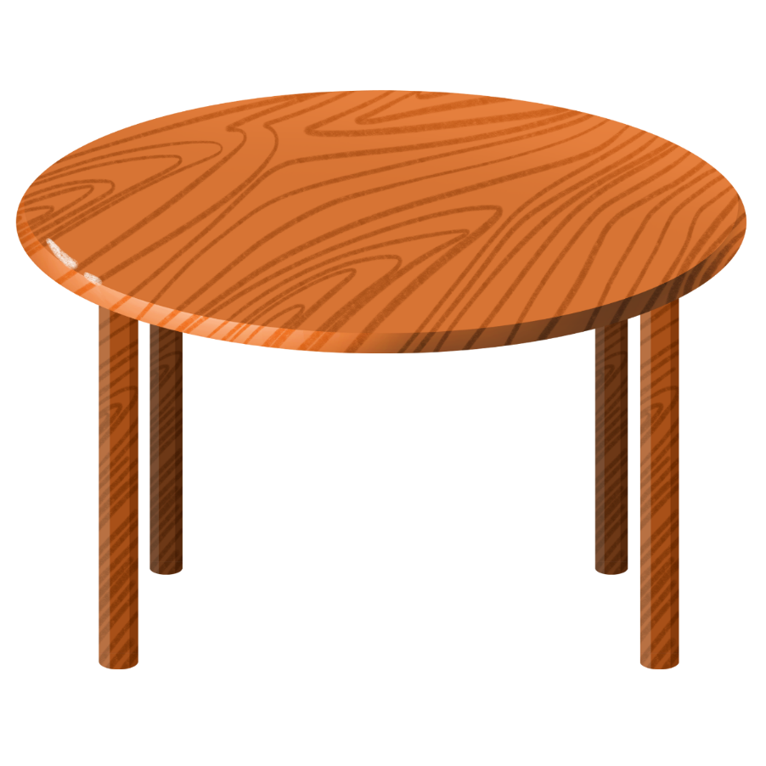
Can you guess?
table

Slide 8
Well done!

Slide 9



Contents
Look, listen and repeat.
Listen, point and say.
Let’s talk.

Slide 10

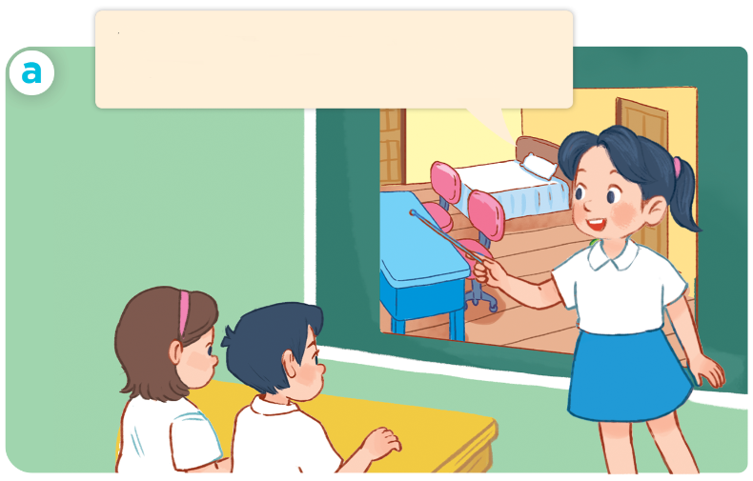
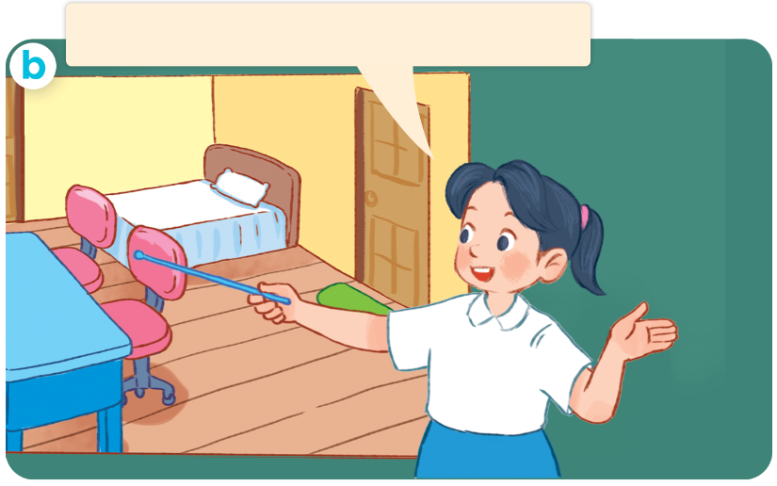
1. Look, listen and repeat.
This is my bedroom.
There’s a desk in the room.
There are two chairs
in the room.
Who are they?
Where are they?
What are they doing?
Click on the speaker / sentences to listen.

Slide 11
Vocabulary

Slide 12
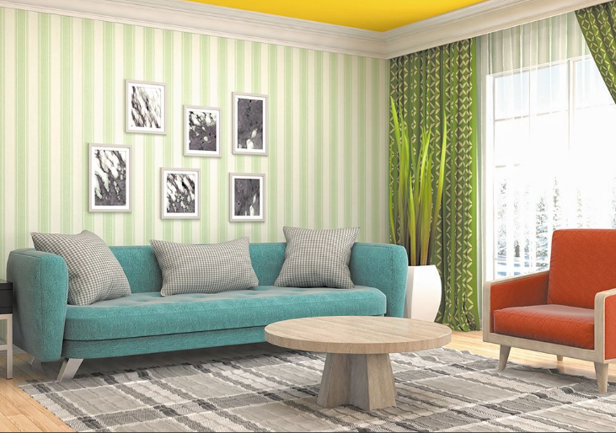
Vocabulary
room
/ruːm/
(căn) phòng
Click on the English word to listen again.

Slide 13
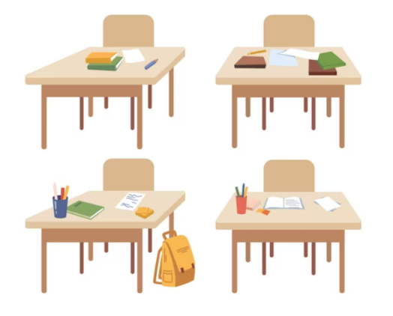
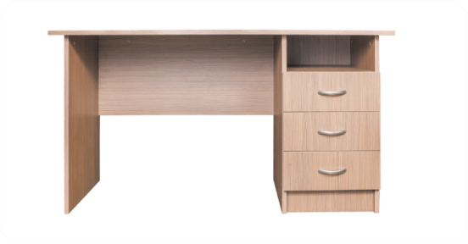
Vocabulary
desk
desks
/desk/
/desks/
cái bàn (học sinh)
những cái bàn (học sinh)

Slide 14
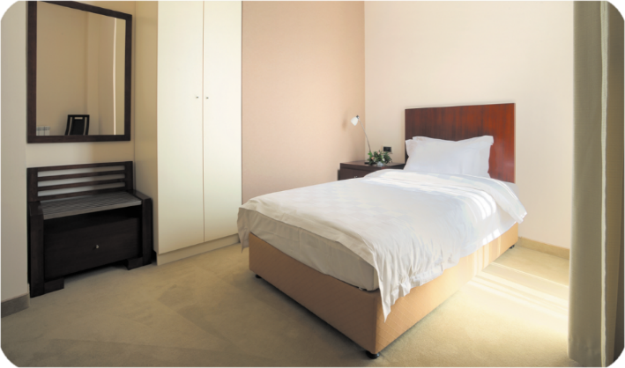
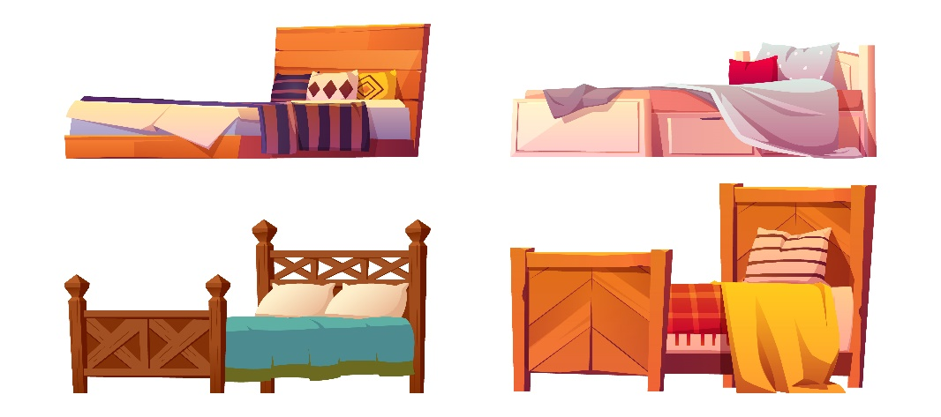
bed
beds
/bed/
/bedz/
cái giường
những cái giường

Slide 15

door
doors
/dɔːr/
/dɔːrz/
cái cửa
những cái cửa

Slide 16
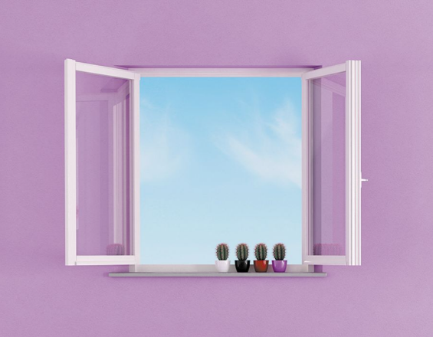
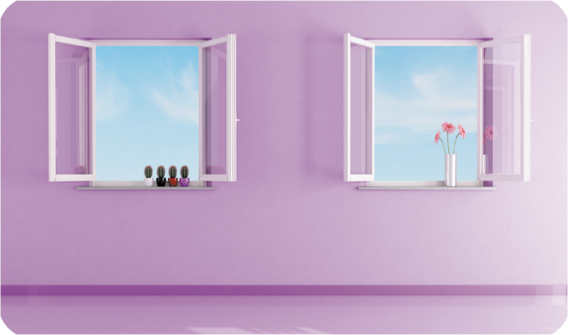
window
windows
/ˈwɪn.dəʊ/
/ˈwɪn.dəʊz/
cửa sổ
các cửa sổ

Slide 17
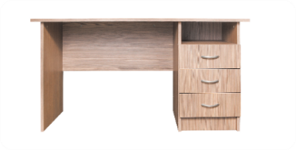


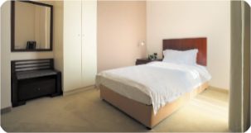




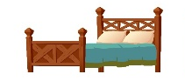
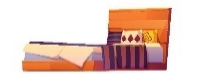
Review
desk
bed
door
window
room
desks
beds
doors
windows

Slide 18

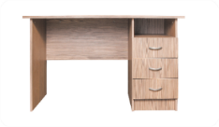
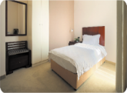


Vocabulary
1. room
2. desk
desks
3. bed
beds
4. door
doors
5. window
windows

Slide 19

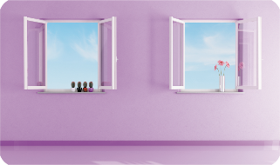



Checking vocabulary
Choose the right answers
1
2
3
4
5
desk
bed
room
_____
windows
doors
_____
_____
_____
_____
a
windows
desk
c
bed
d
doors
e
room
b

Slide 20


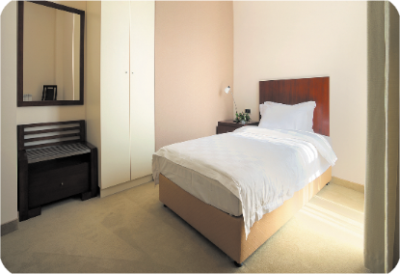

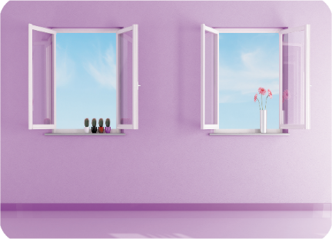
2. Listen, point and say.
a
b
There’s ____ in the room.
a desk
a bed
There are ____ in the room.
c
d
there’s = there is
two doors
two windows

Slide 21
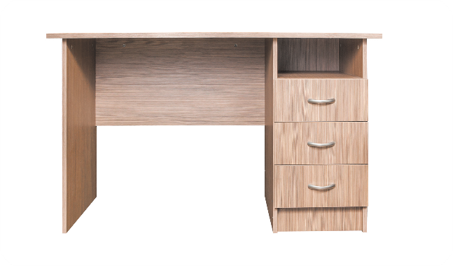

2. Listen, point and say.
a
There’s ____ in the room.
There are ____ in the room.
a desk
There’s a desk in the room.
Click on the sentences to listen again.

Slide 22
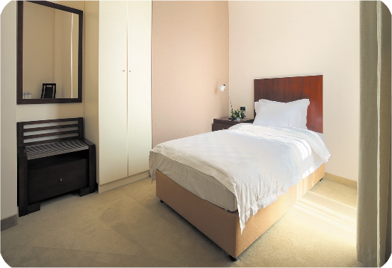

2. Listen, point and say.
b
There’s ____ in the room.
There are ____ in the room.
a bed
There’s a bed in the room.

Slide 23

2. Listen, point and say.
c
There’s ____ in the room.
There are ____ in the room.
two doors
There are two doors in the room.

Slide 24

2. Listen, point and say.
d
There’s ____ in the room.
There are ____ in the room.
two windows
There are two windows in the room.

Slide 25
Structures

Slide 26
Structures
Cách nói về số lượng đồ vật ở trong phòng.
- There’s + vật số ít + in the room.
- There are + vật số nhiều + in the room.
Ex:
There is a desk.
There is a bed.
There are two doors. There are two windows.
( Có 1 ____ ở trong phòng.)
(Có _______ ở trong phòng.)
there’s = there is

Slide 27

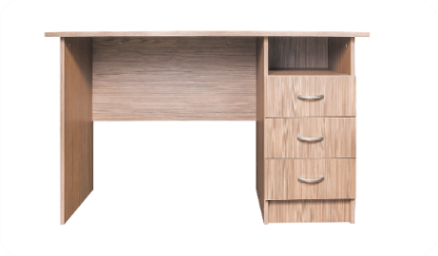

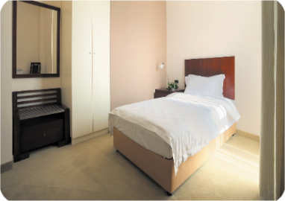

Unit 14 Lesson 1 (1+2+3)
There’s _____ in the room.
there’s = there is
There are _____ in the room.
a desk
two windows
a bed
two doors

Slide 28
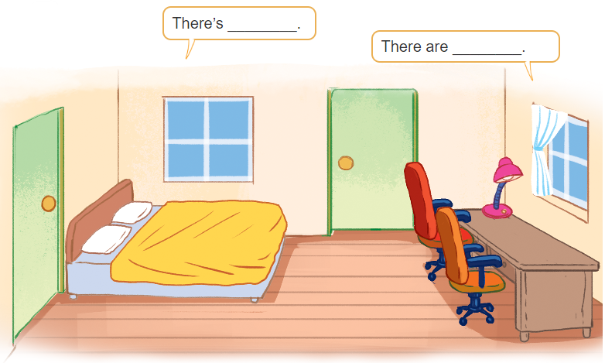
3. Let’s talk
There’s __________.
There are _________.

Slide 29
3. Let’s talk
There’s __________.
There are __________.
two doors

Slide 30
3. Let’s talk
There’s __________.
There are ___________.
two windows

Slide 31
3. Let’s talk
There’s ________.
a bed
There are ___________.

Slide 32
3. Let’s talk
There’s __________.
There are ___________.
two chairs

Slide 33
3. Let’s talk
There’s ________.
a desk
There are ___________.

Slide 34
3. Let’s talk
There’s ________.
a lamp
There are ___________.

Slide 35

Wrap up

Slide 36
Unit 14 Lesson 1 (1+2+3)
There’s _____ in the room.
there’s = there is
There are _____ in the room.
a desk
two windows
a bed
two doors

Slide 37

Thank you!

