Slide 1
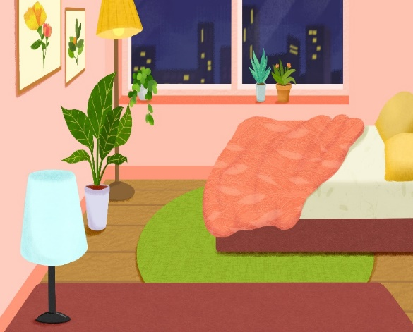
My bedroom
Unit 14
Lesson 1 (4+5+6)

Slide 2
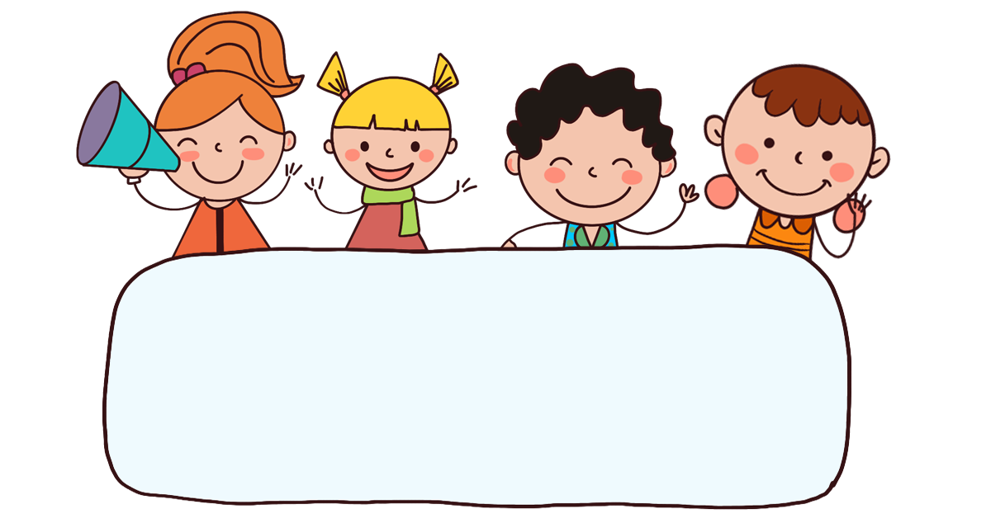
Warm-up

Slide 3

Let’s play!

Slide 4





START

Slide 5


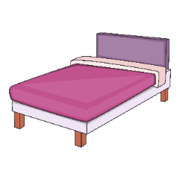
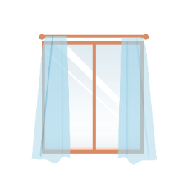
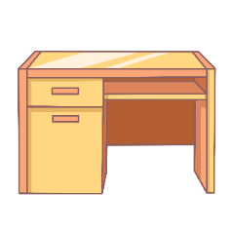

desk
A.
B.
C.

Slide 6

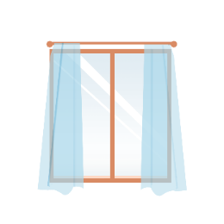
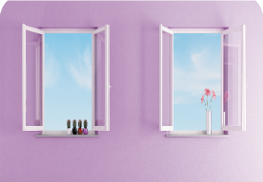
window
A.
B.
C.

Slide 7



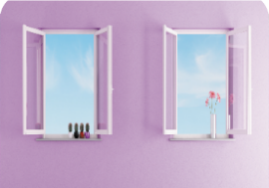

A.
B.
C.

Slide 8
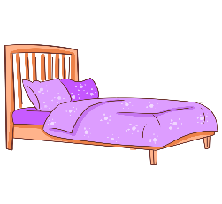

A.
B.
C.

Slide 9
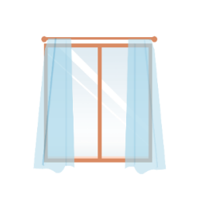
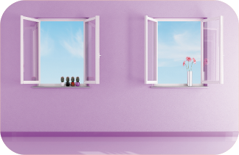

A.
B.
C.

Slide 10

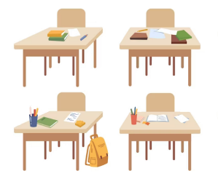

A.
B.
C.

Slide 11

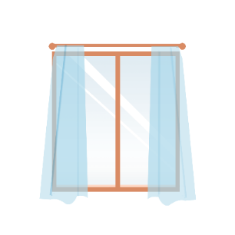
A. There’s a window in the room.
B. There are two windows in the room.

Slide 12
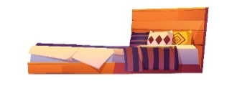

_____ two beds in the room.
A. There are
B. There is

Slide 13
_______ a door in the room.
A. There are
B. There is

Slide 14
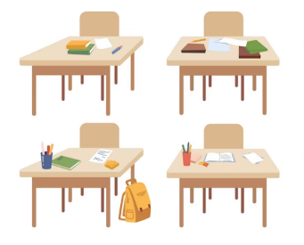
There are four ____ in the room.
A. windows
B. desks
C. beds

Slide 15
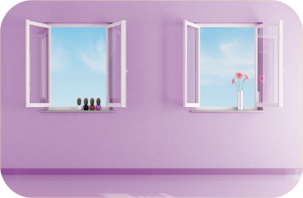
A. True
B. False
Next

Slide 16
A. True
B. False

Slide 17


Well done!
Notes:
Facebook : Bùi Liễu 0968142780

Slide 18



Contents
Listen and tick.
Look, complete and read.
Let’s play.

Slide 19
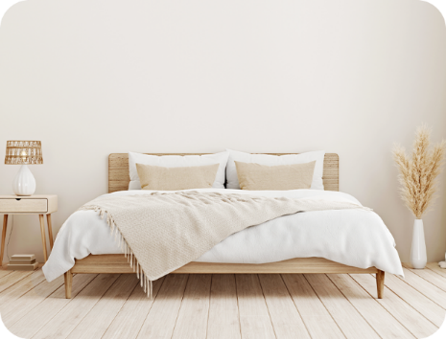
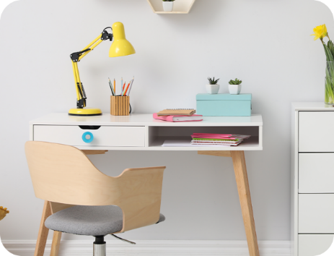

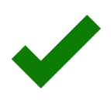
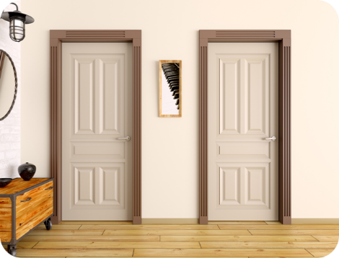
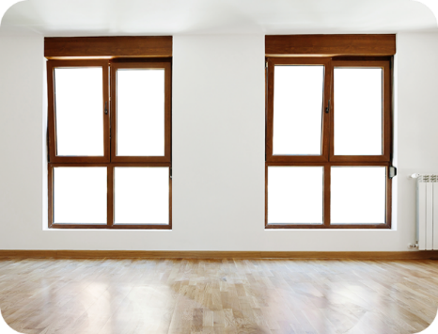

4. Listen and tick.
a
b
1.
a
b
2.

Slide 20
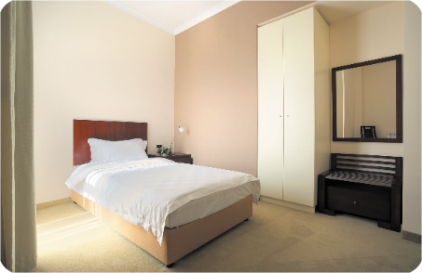
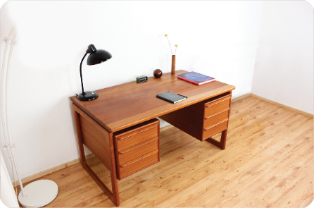
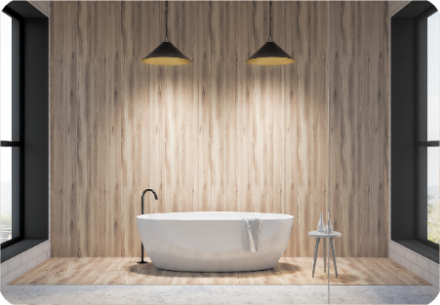
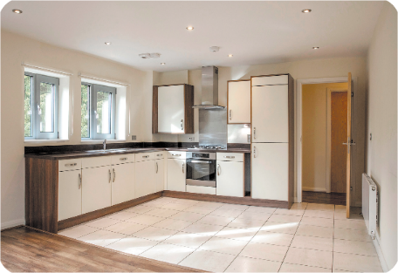
5. Look, complete and read.
1. There’s a ____
in the bedroom.
2. There’s ______
in the living room.
bed
a desk
3. There are two _____
in the bathroom.
4. There are __________
in the kitchen.
lamps
two windows

Slide 21
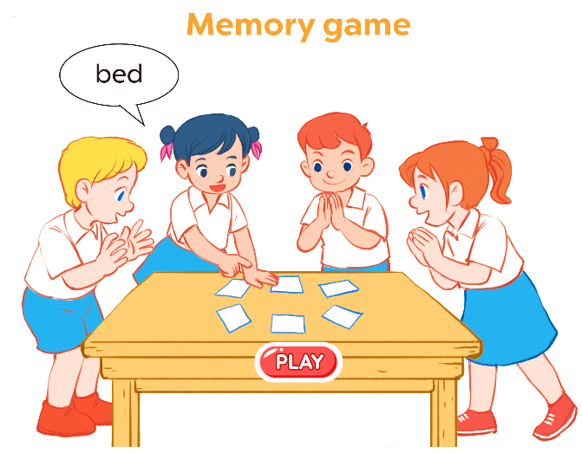
6. Let’s play.

Slide 22
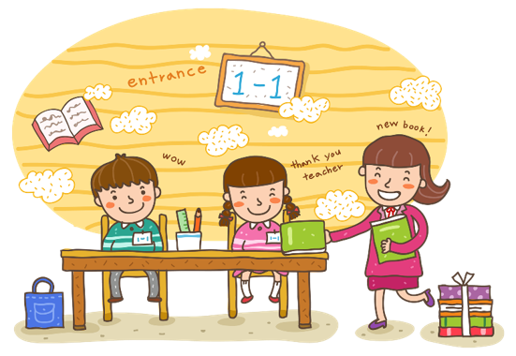
Wrap up

Slide 23

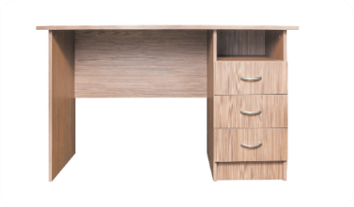

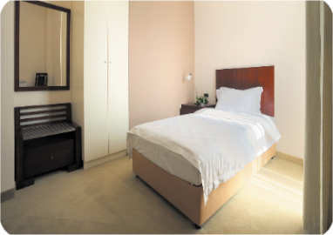

Unit 14 Lesson 1
There’s _____ in the room.
there’s = there is
There are _____ in the room.
a desk
two windows
a bed
two doors

Slide 24

Thank you!

