Slide 1
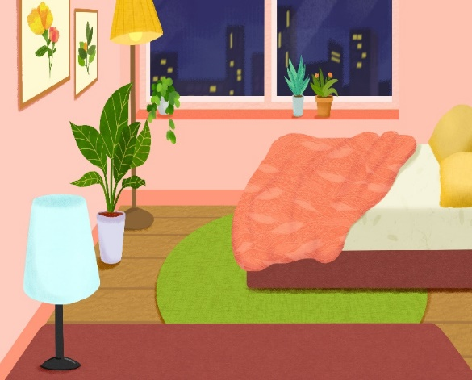
My bedroom
Unit 14
Lesson 2 (1+2+3)

Slide 2

Warm-up

Slide 3
Let’s play!

Slide 4



Contents
Look, listen and repeat.
Listen, point and say.
Let’s talk.

Slide 5

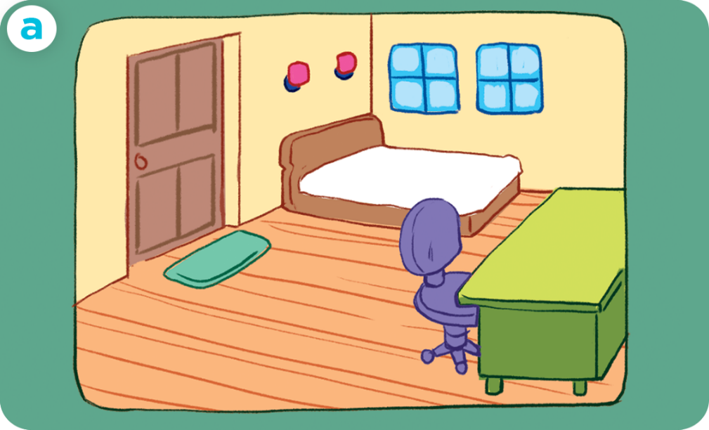
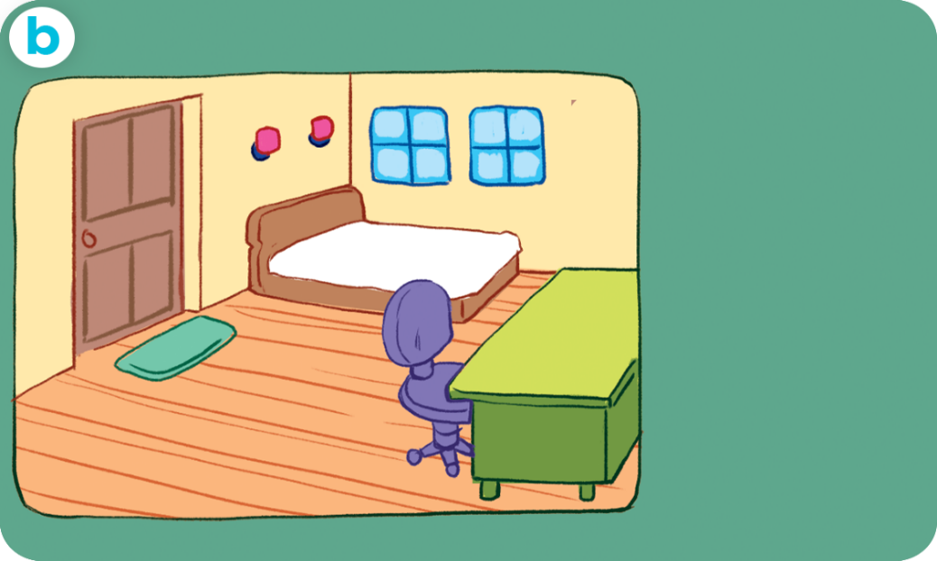
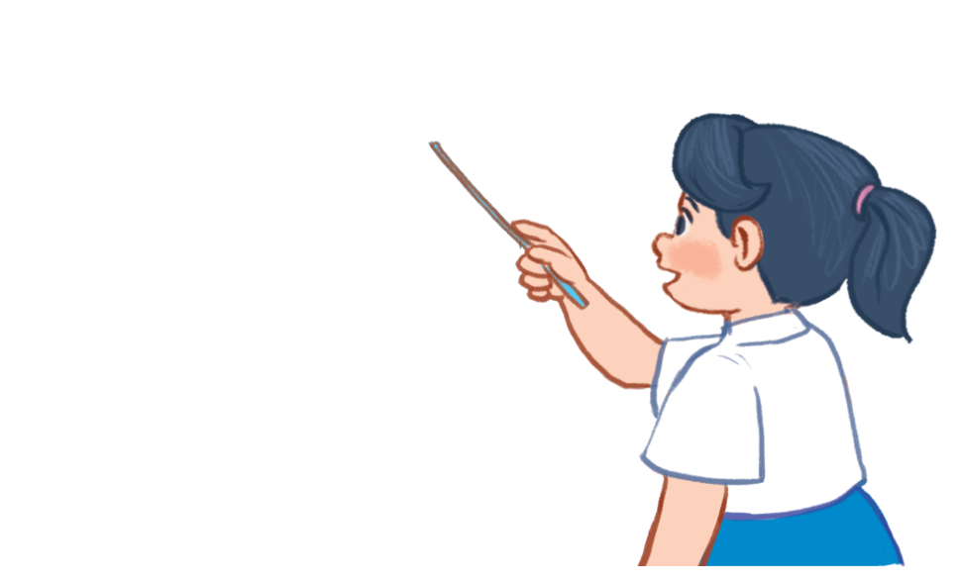
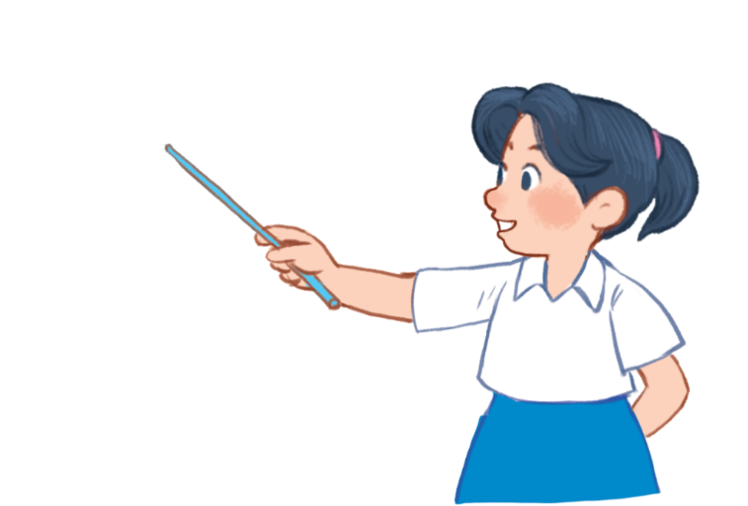
1. Look, listen and repeat.
This is my bedroom.
The door is big.
And look! The windows are small.
What is she doing?
Where is she?
Who is she?
Click on the speaker / sentences to listen.

Slide 6
Vocabulary

Slide 7

Vocabulary
big
/bɪɡ/
to, lớn
Click on the English word to listen again.

Slide 8
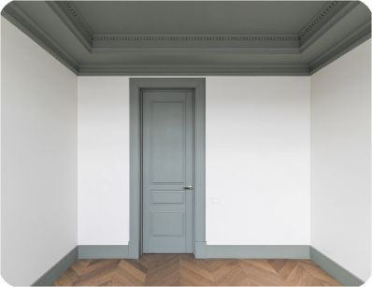
small
/smɔːl/
nhỏ, bé

Slide 9
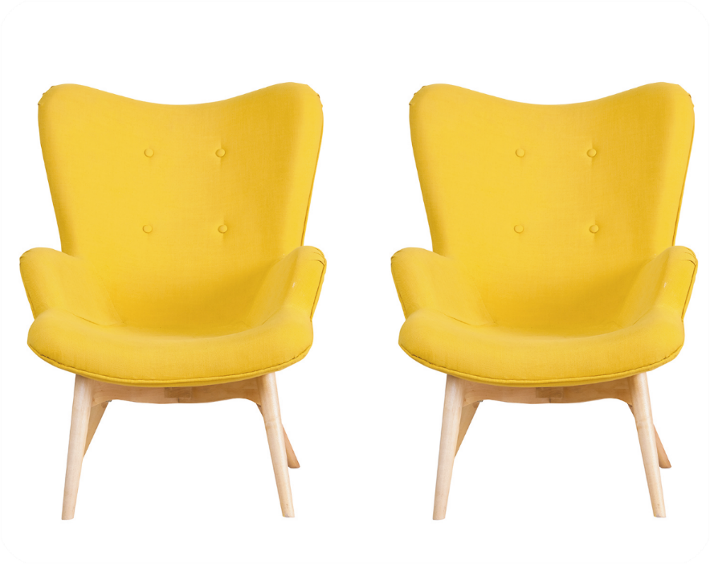
new
/njuː/
mới

Slide 10
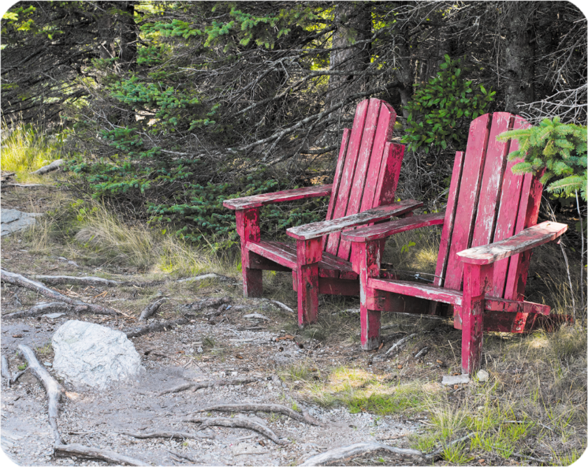
old
/əʊld/
cũ

Slide 11


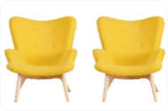

Vocabulary
1. big
: to, lớn
2. small
: nhỏ, bé
3. new
: mới
4. old
: cũ

Slide 12

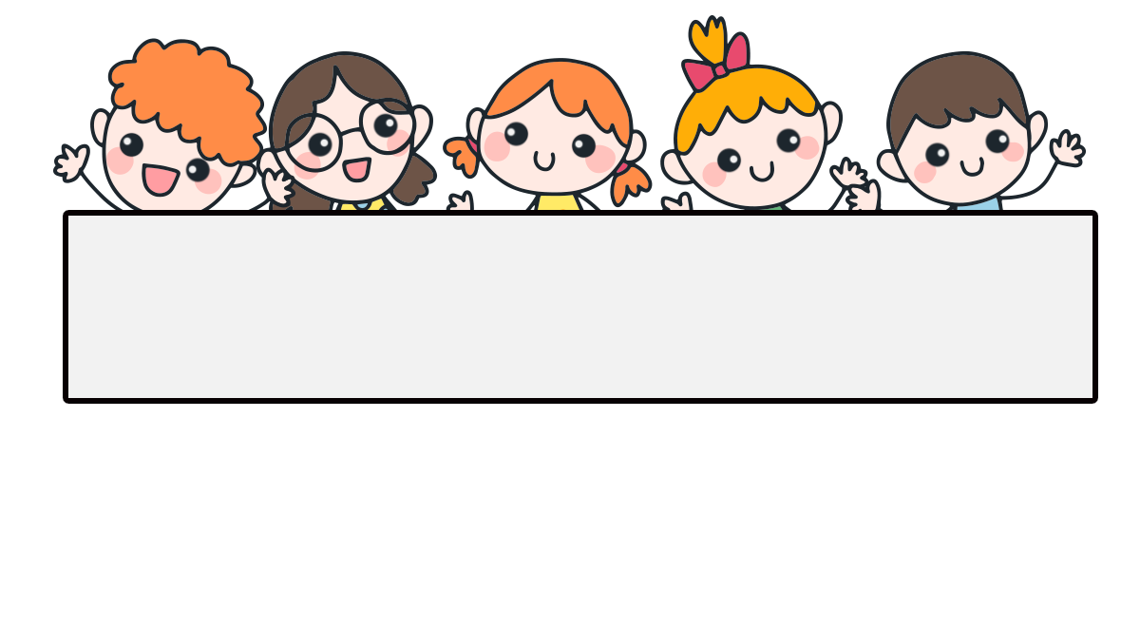
Checking vocabulary

Slide 13
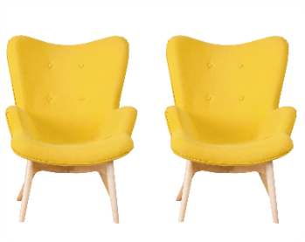
Can you guess?
new

Slide 14

Can you guess?
big

Slide 15
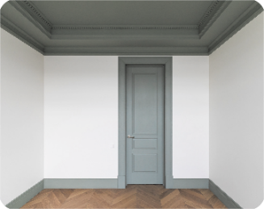
Can you guess?
small

Slide 16
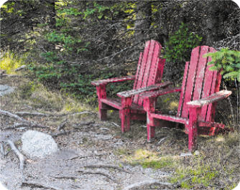
Can you guess?
old

Slide 17
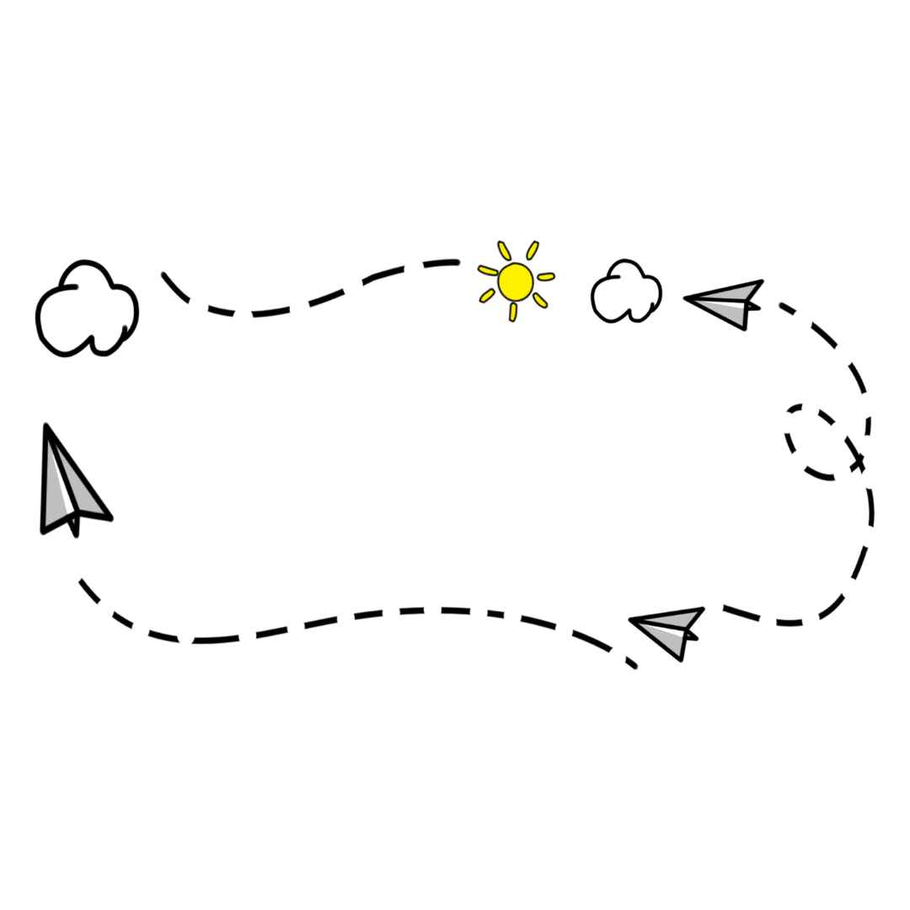
Well done!

Slide 18


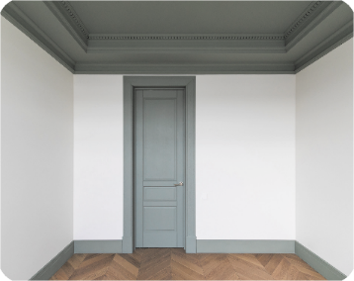
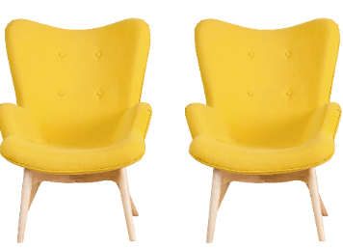

2. Listen, point and say.
a
b
The ____ is ______.
door / big
door / small
The ____ are _____.
c
d
chairs / new
chairs / old

Slide 19


2. Listen, point and say.
a
The ____ is ______.
The ____ are _____.
door / big
The door is big.
Click on the sentences to listen again.

Slide 20
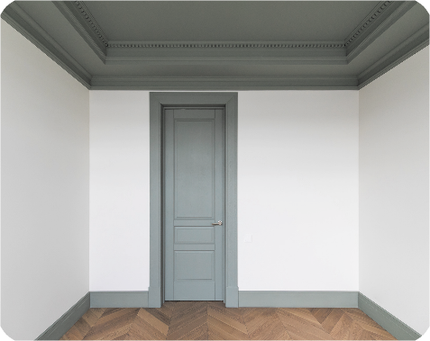

2. Listen, point and say.
b
The ____ is ______.
The ____ are _____.
door / small
The door is small.

Slide 21
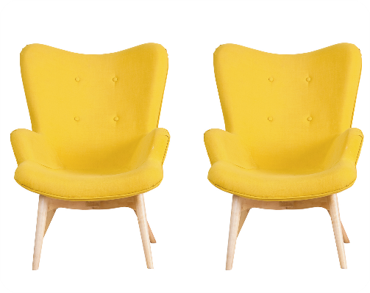

2. Listen, point and say.
c
The ____ is ______.
The ____ are _____.
chairs / new
The chairs are new.

Slide 22
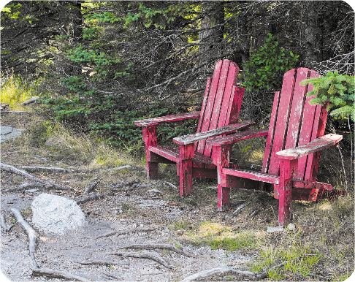

2. Listen, point and say.
d
The ____ is ______.
The ____ are _____.
chairs / old
The chairs are old.

Slide 23
Structures

Slide 24
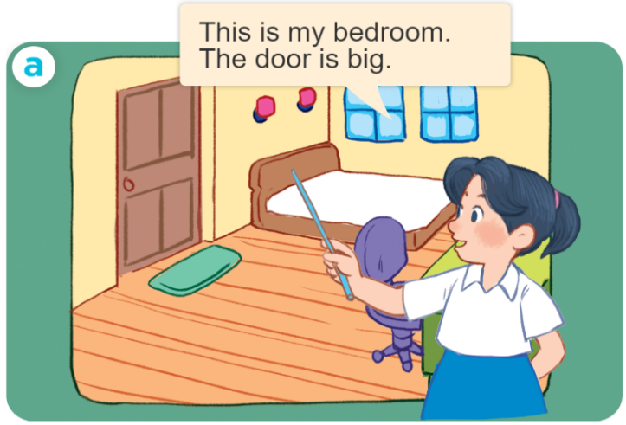
Structures
Cách miêu tả đồ vật ở trong phòng.
- The _____ is _______.
- The _____ are ______.
Example:

Slide 25



Unit 14 Lesson 2 (1+2+3)
The _____ is _________.
The ______ are ________.
door / big
chairs / old
door / small
chairs / new

Slide 26
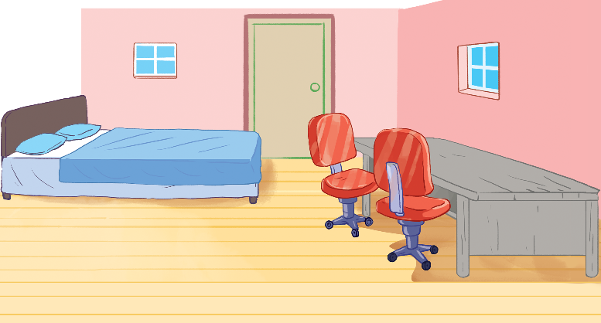
3. Let’s talk.
The _______ are _____.
The ____ is ___.

Slide 27
3. Let’s talk.
The _______ are _____.
The ____ is ___.
bed big

Slide 28
3. Let’s talk.
The _______ are _____.
The ____ is ___.
windows small

Slide 29
3. Let’s talk.
The _______ are _____.
The ____ is ___.
door big

Slide 30
3. Let’s talk.
The ______ are ____.
The ____ is ___.
chairs new

Slide 31
3. Let’s talk.
The _____ are _____.
The ____ is ___.
desk old

Slide 32
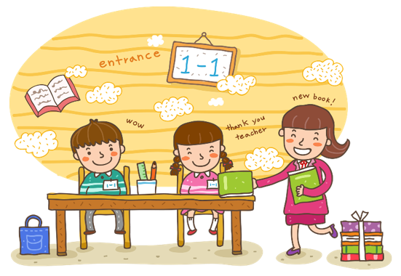
Wrap up

Slide 33
Unit 14 Lesson 2 (1+2+3)
The _____ is _________.
The ______ are ________.
door / big
chairs / old
door / small
chairs / new

Slide 34

Facebook : Bùi Liễu
0968142780
Thank you!

