Slide 1
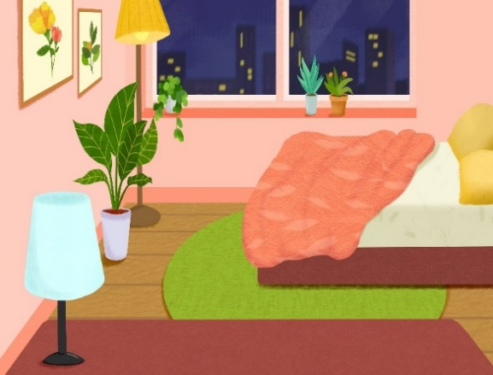
My bedroom
Unit 14
Lesson 2 (4+5+6)

Slide 2
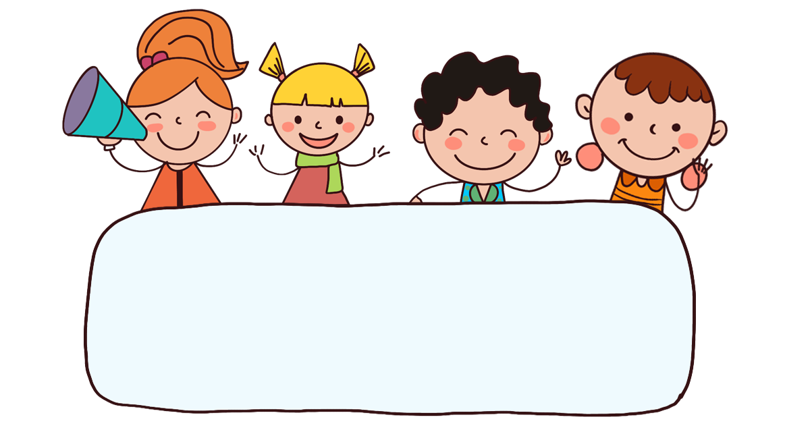
Warm-up

Slide 3
Let’s play!
Lucky number

Slide 4

Well done!

Slide 5



Contents
Listen and number.
Look, complete and read.
Let’s sing.

Slide 6

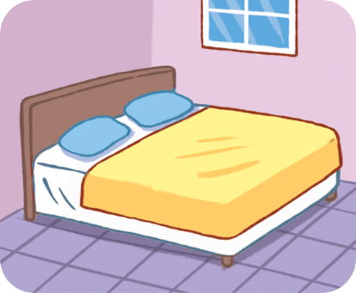
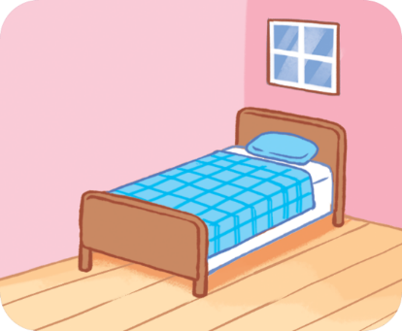
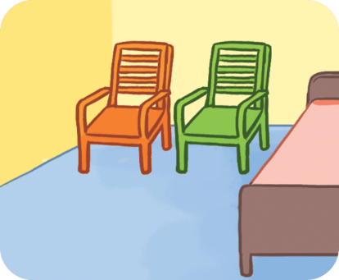
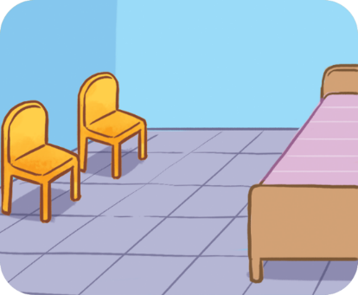




4. Listen and number.
a
b
c
d
2
1
3
4

Slide 7
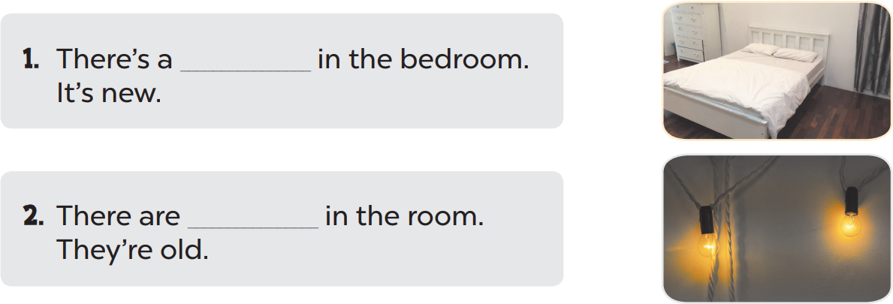
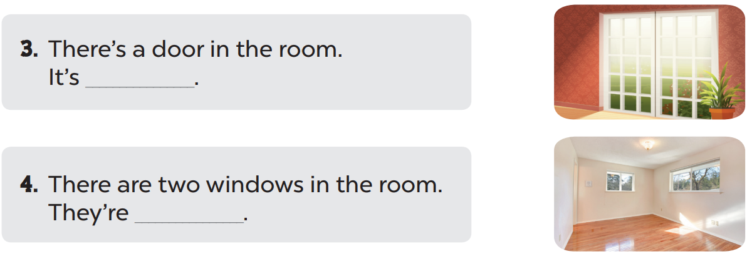
5. Look, complete and read.
bed
1. There’s a ______ in the bedroom.
It’s new.
2. There are __________ in the bedroom.
They’re old.
two lamps
3. There’s a door in the room.
It’s _________.
big
4. There are two windows in the room.
They’re ________.
small

Slide 8

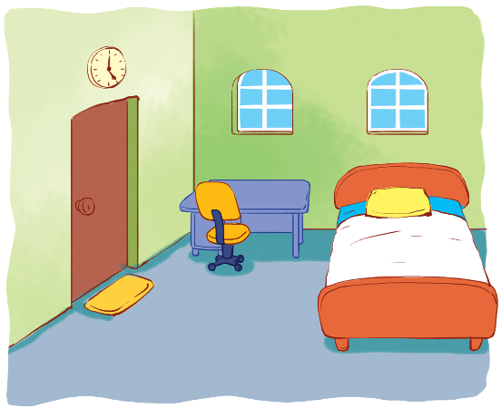





6. Let’s sing.
My bedroom
There’s a bed in my bedroom.
It’s new.
It’s new.
The bed is new.
There are two windows in my bedroom.
They’re small.
They’re small.
The windows are small.

Slide 9
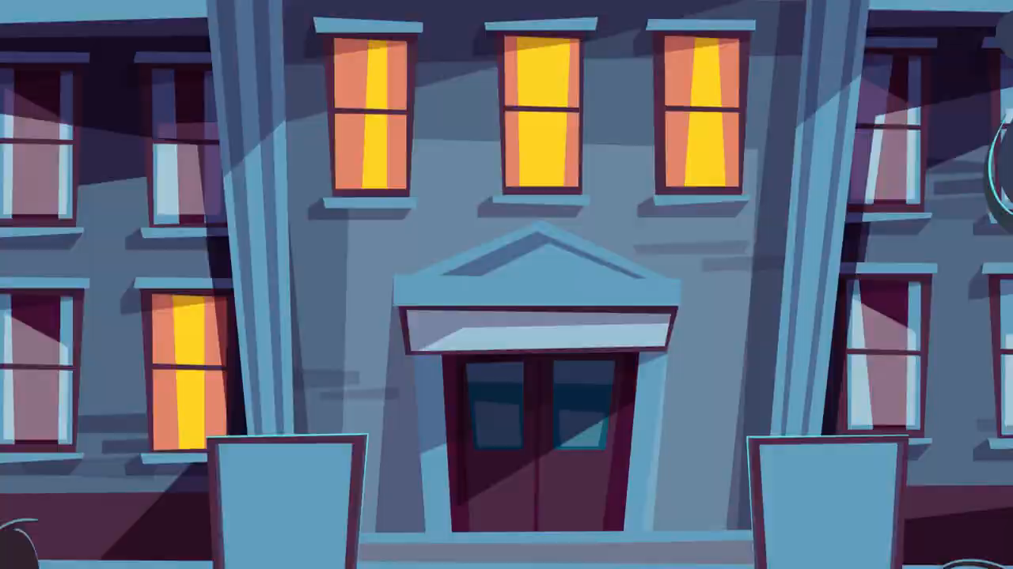
6. Let’s sing.

Slide 10

6. Let’s sing.
My bedroom
There’s a bed in my bedroom.
It’s new.
It’s new.
The bed is new.
There are two windows in my bedroom.
They’re small.
They’re small.
The windows are small.

Slide 11



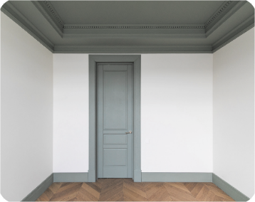
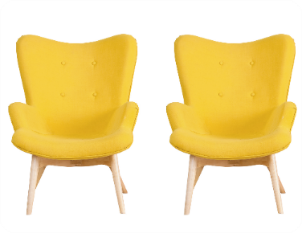
Unit 14 Lesson 2
The _____ is _________.
The ______ are ________.
door / big
chairs / old
door / small
chairs / new

Slide 12
Thank you!

