Slide 1
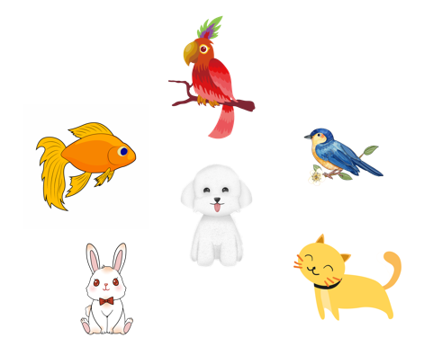
Unit 16
My pets
Lesson 1 (1+2+3)

Slide 2



Contents
Look, listen and repeat.
Listen, point and say.
Let’s talk.

Slide 3
Vocabulary

Slide 4




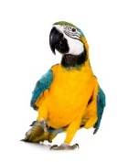
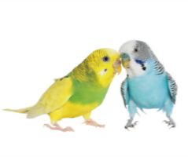
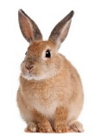
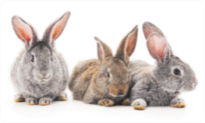
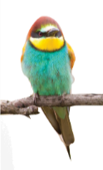
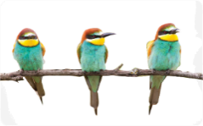
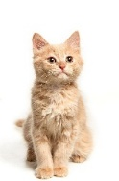
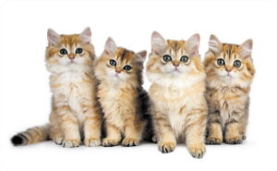
Vocabulary
1. pets
: các con thú cưng
2. dog
dogs
3. parrot
parrots
4. rabbit
rabbits
5. bird
birds
6. cat
cats

Slide 5




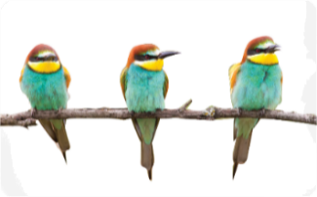
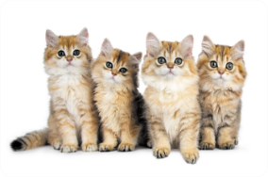

Match
1
2
3
4
5
6
pets
dogs
rabbit
parrot
cats
birds
a
b
c
d
e
f

Slide 6

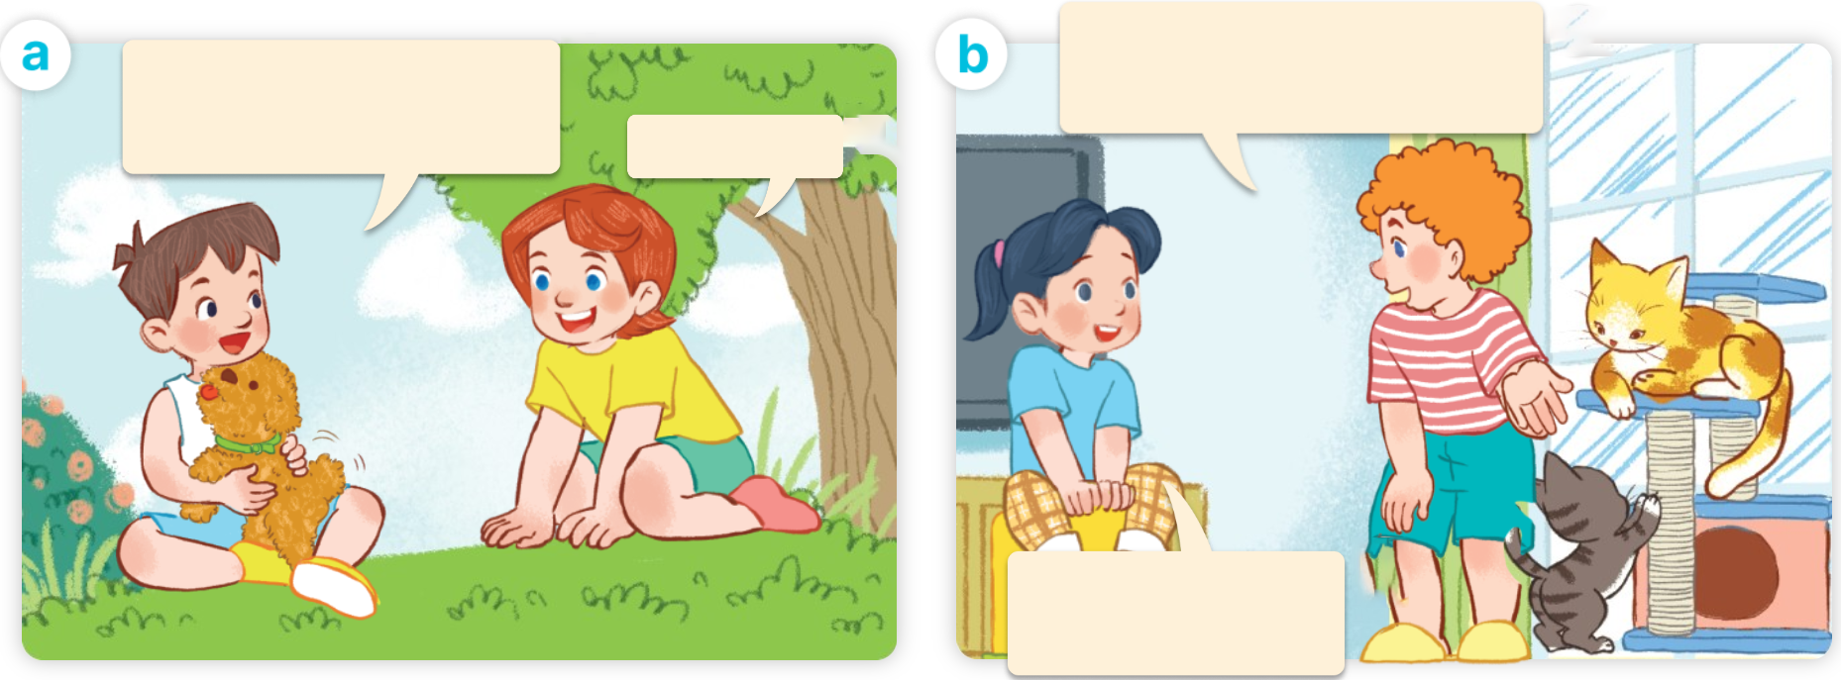
1. Look, listen and repeat.
Click on the speaker / sentences to listen.
I have two cats.
Do you have any cats?
I have a dog.
Do you have any dogs?
Yes, I do.
No, I don’t.
I have one dog.
Who are they?
What are they doing?
Where are they?

Slide 7







2. Listen, point and say.
a
b
Do you have any _____?
birds / yes
parrots / no
Yes, I do.
c
d
No, I don’t.
rabbits / yes
cats / no
don’t = do not

Slide 8
Structures

Slide 9



2. Listen, point and say.
Do you have any _____?
a
Yes, I do.
No, I don’t.
birds / yes
Do you have any birds?
Yes, I do.
Click on the sentences to listen again.

Slide 10


Structures
Cách hỏi bạn có loại thú cưng nào không.
I have a dog.
Do you have any dogs?
Yes, I do.
- Do you have any _____?
+ Yes, I do.
+ No, I don’t.

Slide 11
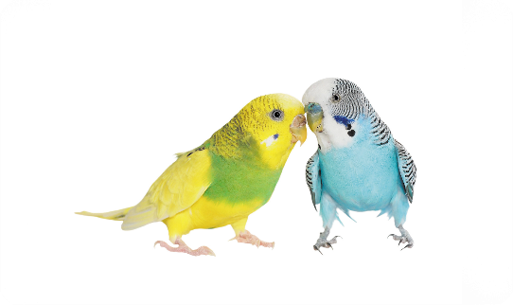


2. Listen, point and say.
Do you have any _____?
b
Yes, I do.
No, I don’t.
parrots / no
Do you have any parrots?
No, I don’t.

Slide 12



2. Listen, point and say.
c
Do you have any _____?
Yes, I do.
No, I don’t.
rabbits / yes
Do you have any rabbits?
Yes, I do.

Slide 13


2. Listen, point and say.
d
Do you have any _____?
Yes, I do.
No, I don’t.
cats / no
Do you have any cats?
No, I don’t.

Slide 14


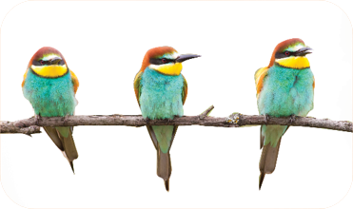
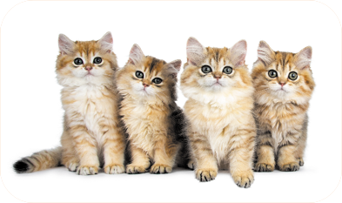
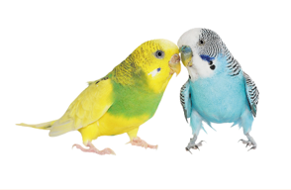
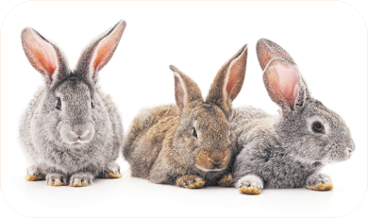
Unit 16 lesson 1
Do you have any ______?
Yes, I do.
don’t = do not
No, I don’t.
birds / yes
cats / no
parrots / no
rabbits / yes

Slide 15
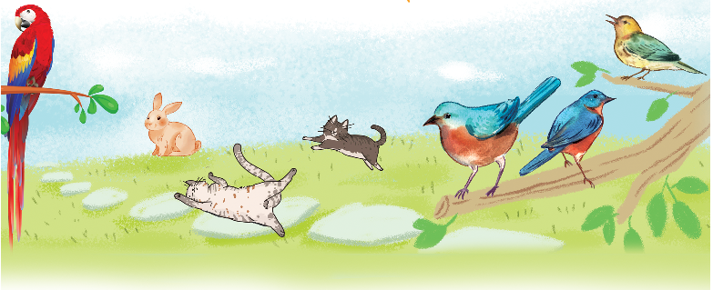
3. Let’s talk.
Do you have any ______?
Yes, / No, _____.

Slide 16

3. Let’s talk.
Do you have any ______?
parrots
__________.
No, I don’t

Slide 17
3. Let’s talk.
3. Let’s talk.
Do you have any ______?
rabbits
__________.
No, I don’t

Slide 18

3. Let’s talk.
Do you have any ______?
cats
__________.
Yes, I do

Slide 19
3. Let’s talk.
Do you have any ______?
birds
__________.
Yes, I do

Slide 20
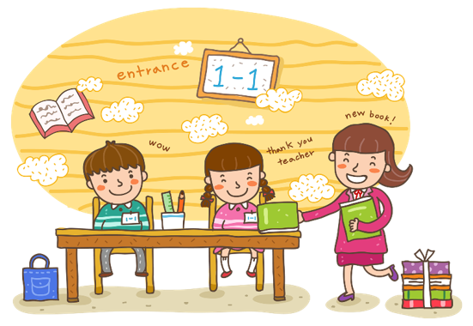
Wrap up

Slide 21

Thank you!

