Slide 1
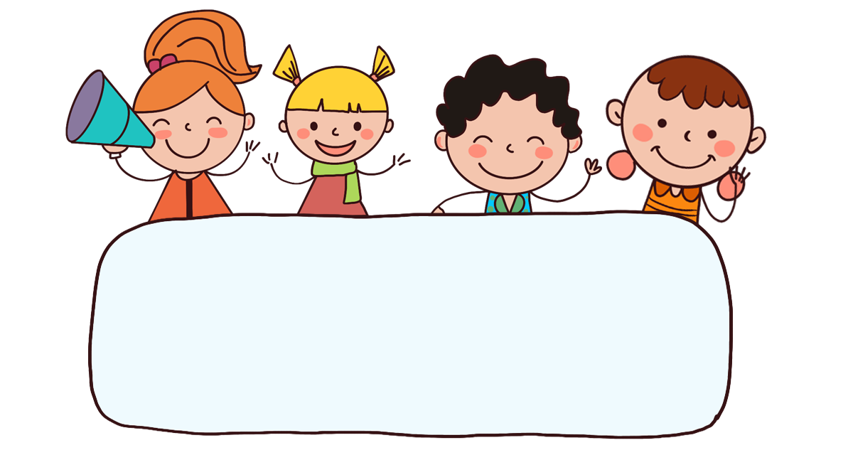
Let’s play!

Slide 2







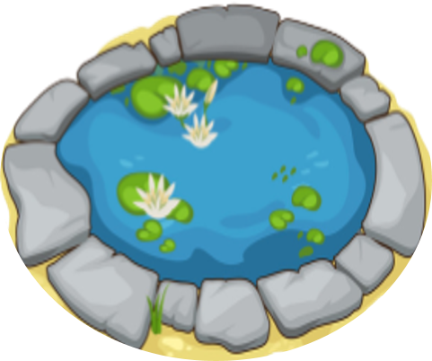
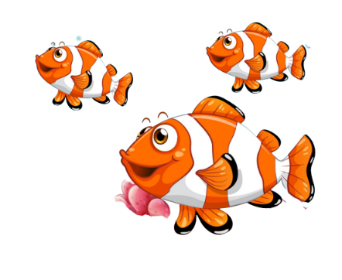
FEEDING GOLDFISH
Mỗi câu trả lời đúng là
CÂU THẦN CHÚ giúp cá Vàng
ngoi lên mặt nước nhận thức ăn.
Nào chúng mình cùng giúp
bạn nhỏ cho cá Vàng ăn nhé!
START

Slide 3

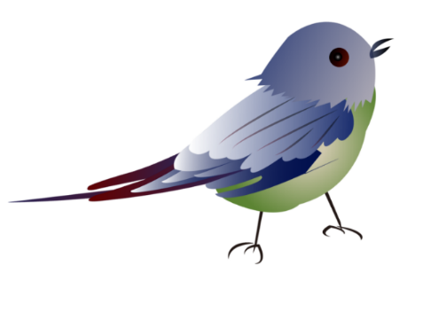
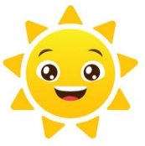

b__d
Next
A. ir
B. at
C. it

Slide 4

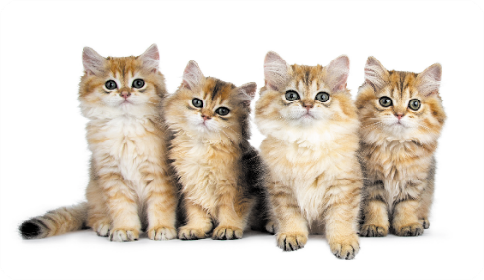
Do you have any cats?
Next
A. Yes, I do.
B. No, I don’t.

Slide 5
Do you ____ any cats?
Next
A. has
B. have

Slide 6
THANK YOU!
End

Slide 7
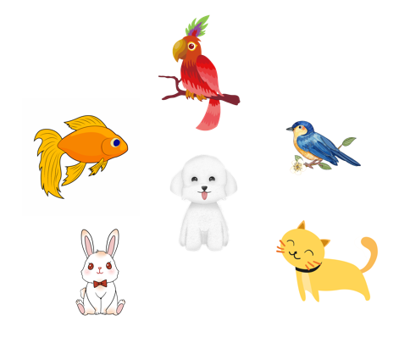
Unit 16
My pets
Lesson 1 (4+5+6)

Slide 8



Contents
Listen and tick.
Look, complete and read.
Let’s sing.

Slide 9

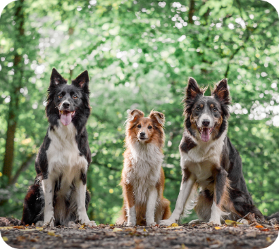
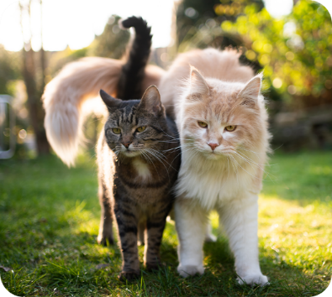


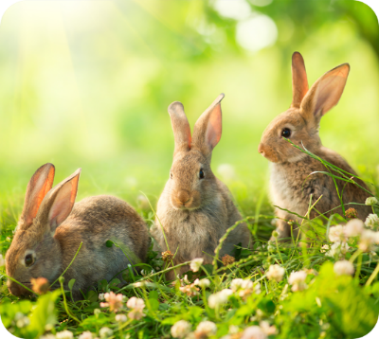
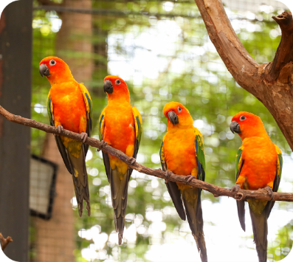

4. Listen and tick.
a
b
1
a
b
2

Slide 10
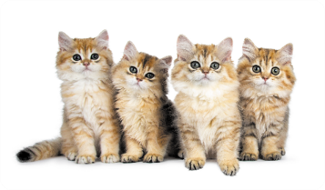
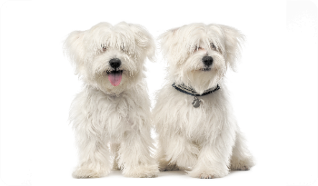
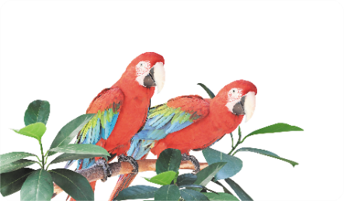
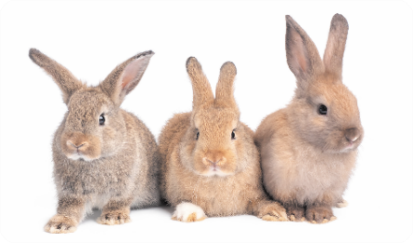
5. Look, complete and read.
1. A: Do you have any _____?
B: Yes, I do.
2. A: Do you have any _____?
B: Yes, I do.
cats
dogs
3. A: Do you _____ any rabbits?
B: No, I don’t. I have two ______.
4. A: Do you have any dogs?
B: No, I _____. I have three ______.
have
parrots
don’t
rabbits

Slide 11








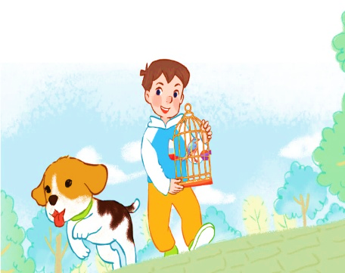


6. Let’s sing.
My pets
Do you have any dogs?
Do you have any cats?
Do you have any dogs?
Do you have any cats?
Yes, I do.
No, I don’t.
Yes, I do.
No, I don’t.
I have one dog.
I have one bird.

Slide 12


6. Let’s sing.
My pets
Do you have any dogs?
Do you have any cats?
Do you have any dogs?
Do you have any cats?
Yes, I do.
No, I don’t.
Yes, I do.
No, I don’t.
I have one dog.
I have one bird.

Slide 13
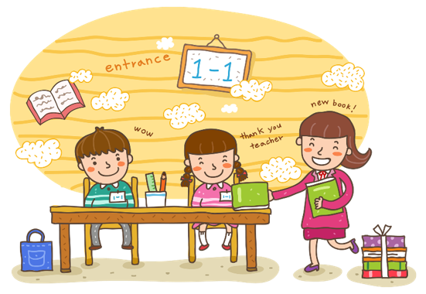
Wrap up

Slide 14

Thank you!

