Slide 1
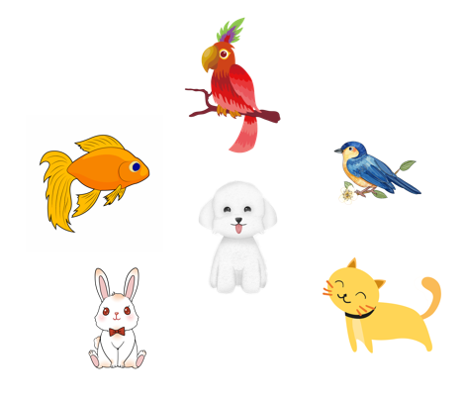
Unit 16
My pets
Lesson 2 (1+2+3)

Slide 2
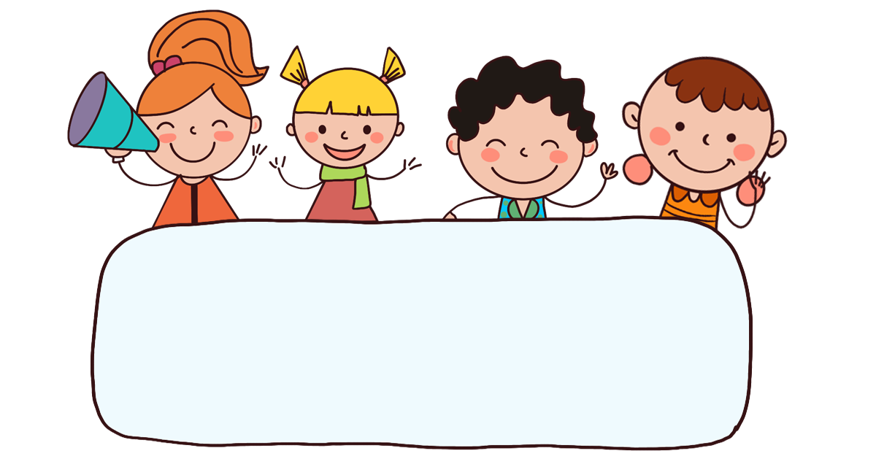
Warm-up

Slide 3

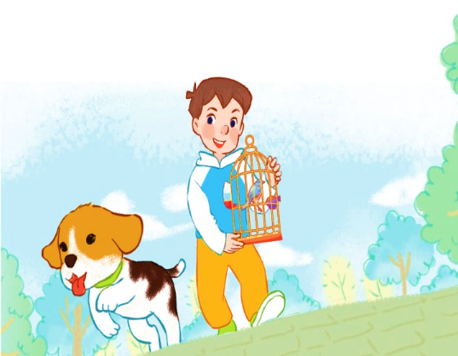
Let’s sing.
My pets
Do you have any dogs?
Do you have any cats?
Do you have any dogs?
Do you have any cats?
Yes, I do.
No, I don’t.
Yes, I do.
No, I don’t.
I have one dog.
I have one bird.

Slide 4



Contents
Look, listen and repeat.
Listen, point and say.
Let’s talk.

Slide 5

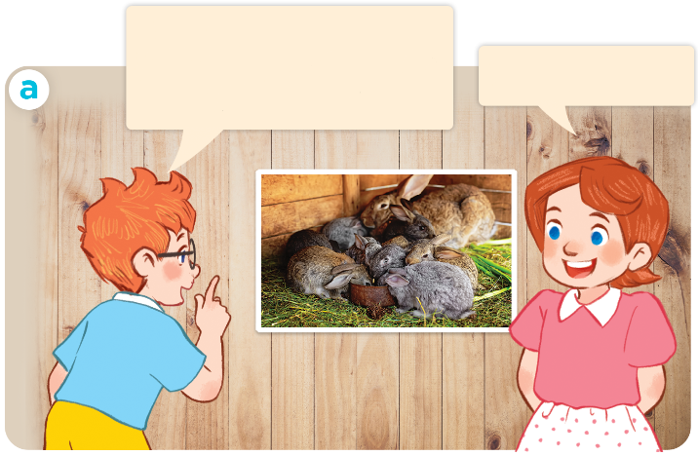
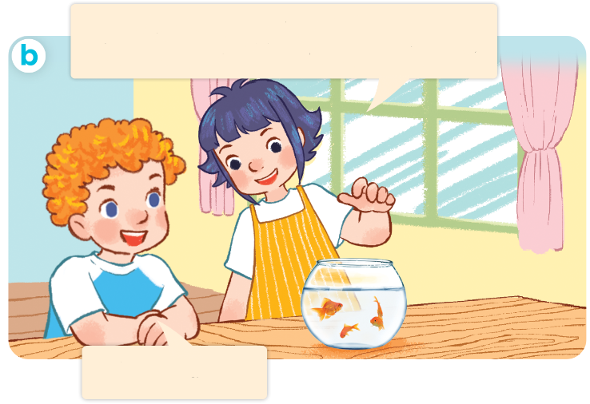
I have two rabbits. How many rabbits do you have?
1. Look, listen and repeat.
I have two rabbits.
How many rabbits do you have?
These are my goldfish. How many goldfish do you have?
I have many.
I have some.
Who are they?
What are they doing?
Where are they?
Click on the speaker / sentences to listen.

Slide 6
Vocabulary

Slide 7
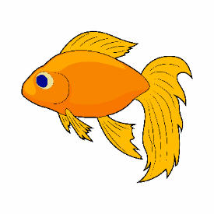
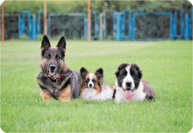
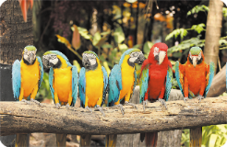
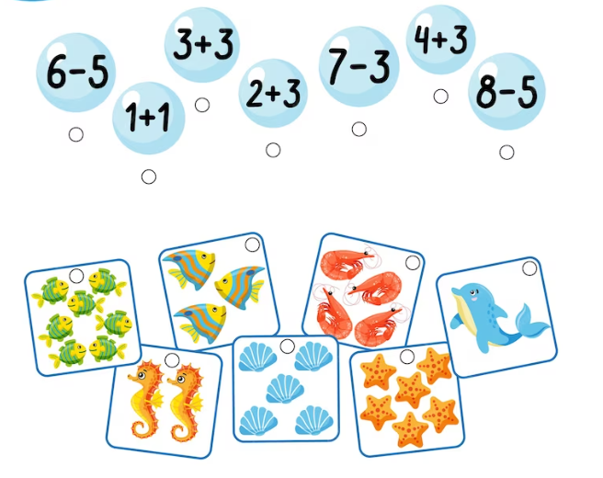
Vocabulary
1. goldfish
: cá vàng
1
2. some
2
3
: một vài
1
2
3
4
5
6
3. many
: nhiều
4. how many
: bao nhiêu
Click on the English words to listen again.

Slide 8
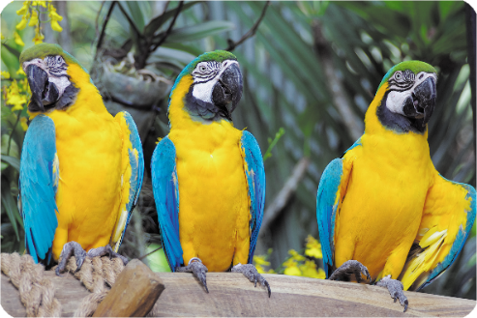


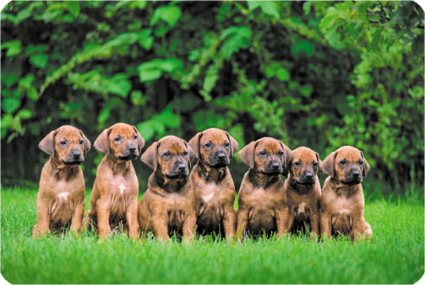
2. Listen, point and say.
a
b
How many _____ do
you have?
parrots / some
parrots / many
I have ____.
c
d
dogs / some
dogs / many

Slide 9



2. Listen, point and say.
a
How many _____ do you have?
I have _____.
parrots / some
How many parrots do you have?
I have some.
Click on the sentences to listen again.

Slide 10
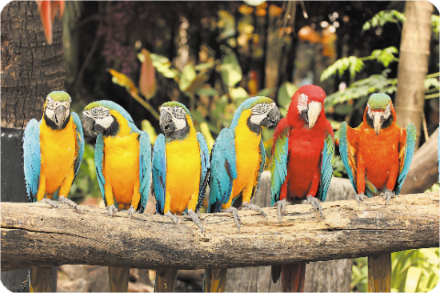


2. Listen, point and say.
b
How many _____ do you have?
I have _____.
parrots / many
How many parrots do you have?
I have many.

Slide 11


2. Listen, point and say.
c
How many _____ do you have?
I have _____.
dogs / some
How many dogs do you have?
I have some.

Slide 12



2. Listen, point and say.
d
How many _____ do you have?
I have _____.
dogs / many
How many dogs do you have?
I have many.

Slide 13
Structures

Slide 14
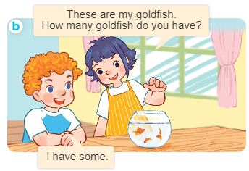
Structures
Cách hỏi và trả lời về số lượng vật nuôi.
- How many _____ do you have?
I have __________.

Slide 15


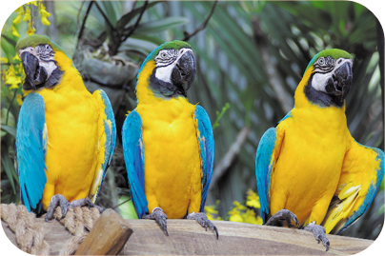
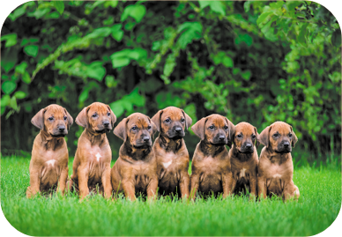
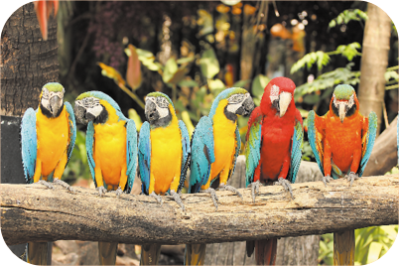
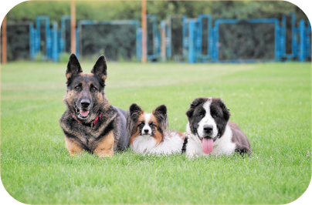
Unit 16 lesson 2
How many _____ do you have?
I have _____.
parrots / some
dogs / many
parrots / many
dogs / some

Slide 16
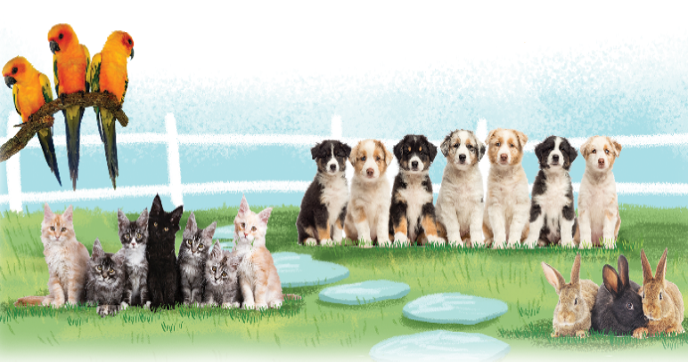
3. Let’s talk
How many ______ do you have?
I have _____.

