Slide 1
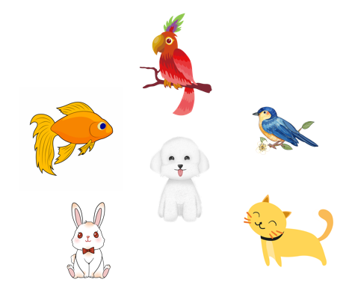
Unit 16
My pets
Lesson 2 (4+5+6)

Slide 2



Contents
Listen and number.
Look, complete and read.
Let’s play.

Slide 3

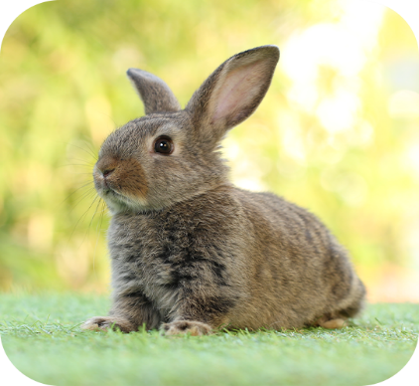
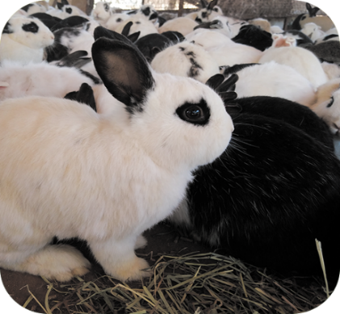
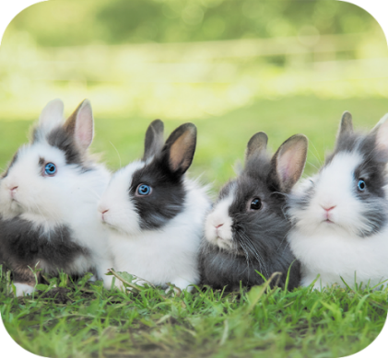
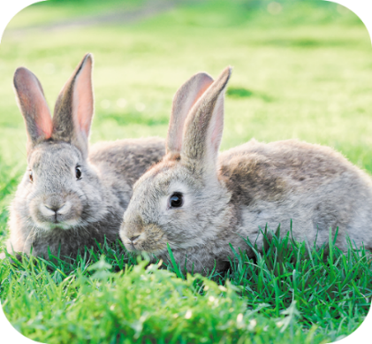




4. Listen and number.
a
b
c
d
4
1
2
3

Slide 4
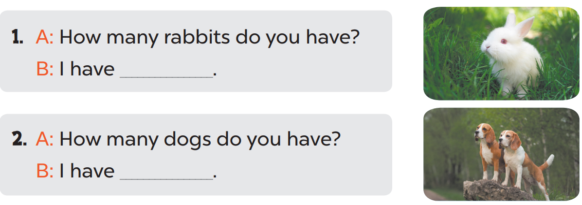
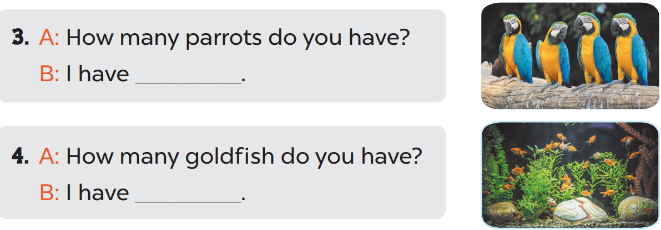
5. Look, complete and read.
1. A: How many rabbits do you have?
B: I have ____.
one
2. A: How many dogs do you have?
B: I have _____.
two
3. A: How many parrots do you have?
B: I have ______.
some
4. A: How many goldfish do you have?
B: I have ______.
many

Slide 5
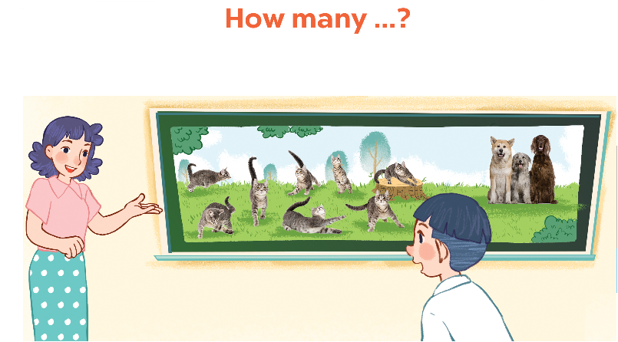
6. Let’s play.

Slide 6
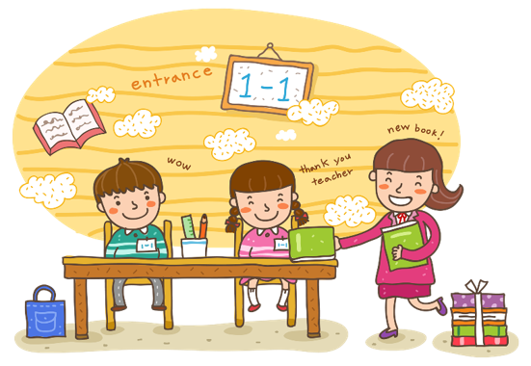
Wrap up

Slide 7


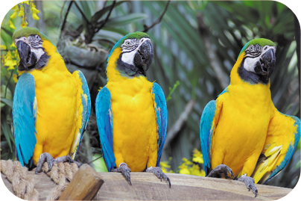
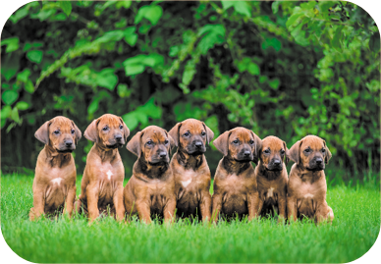
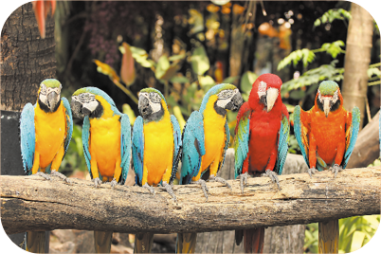
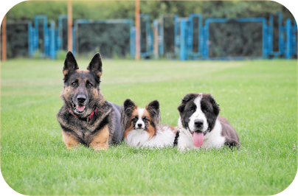
Review
How many _____ do you have?
I have _____.
parrots / some
dogs / many
parrots / many
dogs / some

Slide 8

Thank you!

