Slide 1
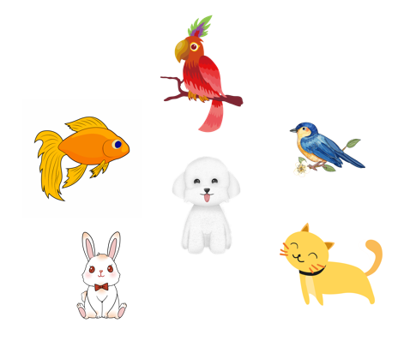
Unit 16
My pets
Lesson 3 (1+2+3)

Slide 2



Contents
Listen and repeat.
Listen and circle.
Let’s chant.

Slide 3
Phonics

Slide 4
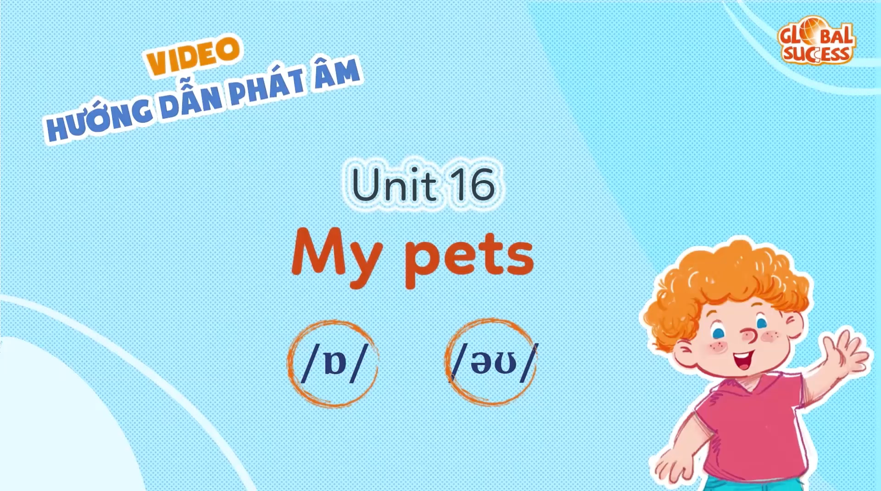

Slide 5
1. Listen and repeat.
o
/ɒ/
dog
Do you have any dogs?
o
/əʊ/
goldfish
How many goldfish do you have?

Slide 6
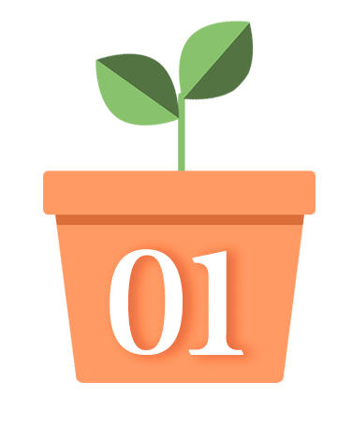
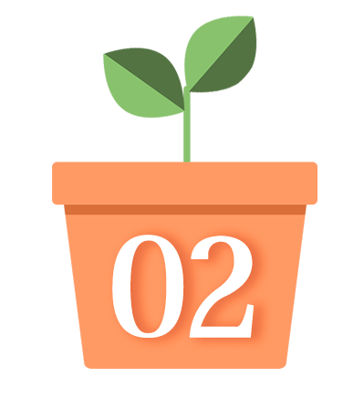
2. Listen and circle.
1. How many ______ do you have?
A. dogs B. goldfish C. parrots
2. Do you have any ______?
A. dogs B. parrots C. goldfish

Slide 7
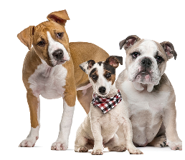







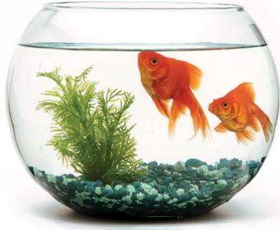

3. Let’s chant.
Dogs, dogs, dogs.
Do you have any dogs?
Do you have any dogs?
Yes, I do.
Goldfish, goldfish, goldfish.
Yes, I do.
How many goldfish do you have?
How many goldfish do you have?
I have some goldfish.
I have some goldfish.

Slide 8

Wrap up

Slide 9


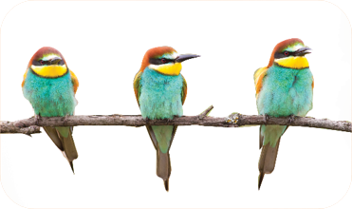
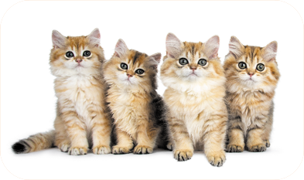
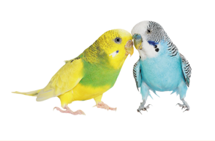
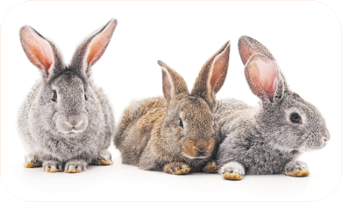
Unit 16 lesson 1
Do you have any ______?
Yes, I do.
don’t = do not
No, I don’t.
birds / yes
cats / no
parrots / no
rabbits / yes

Slide 10
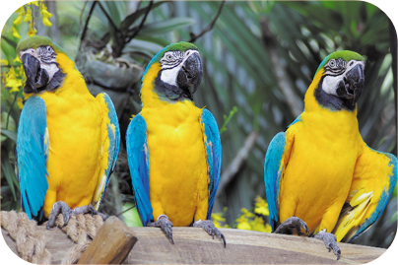
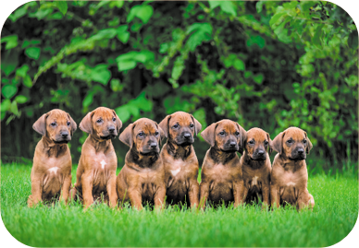
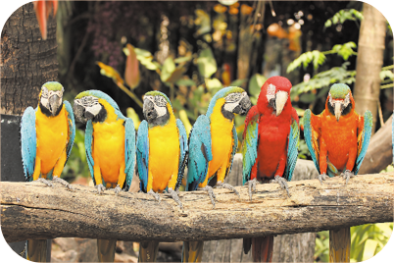
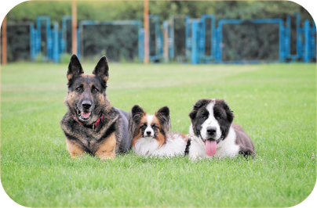
Review
How many _____ do you have?
I have _____.
parrots / some
dogs / many
parrots / many
dogs / some

Slide 11

Thank you!

