Slide 1
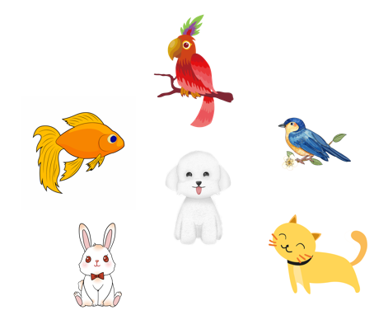
My pets
Unit 16
Lesson 3 (4+5+6)

Slide 2
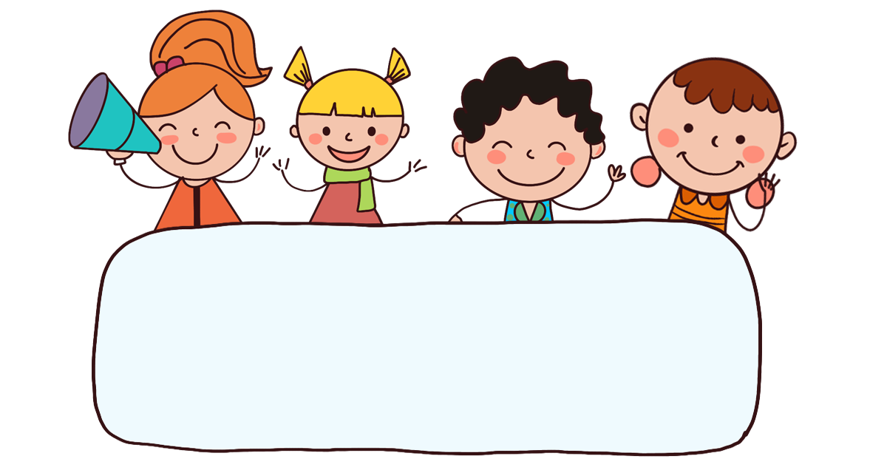
Warm-up

Slide 3

Let’s play!

Slide 4


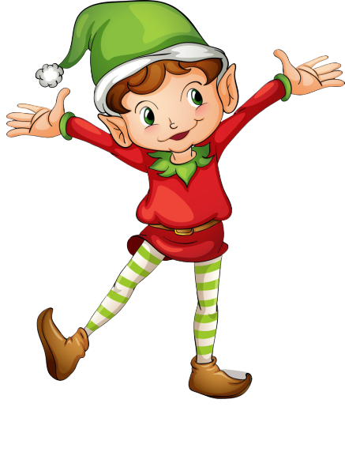
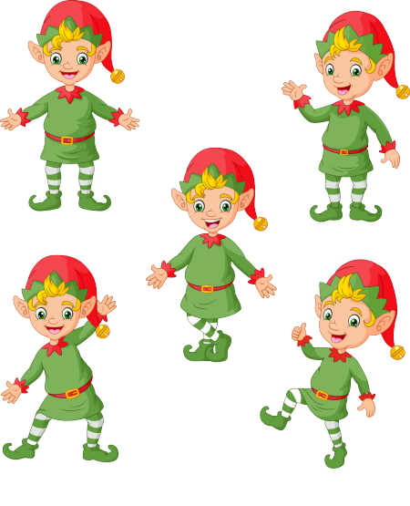
RING THE GOLDEN BELL

Slide 5

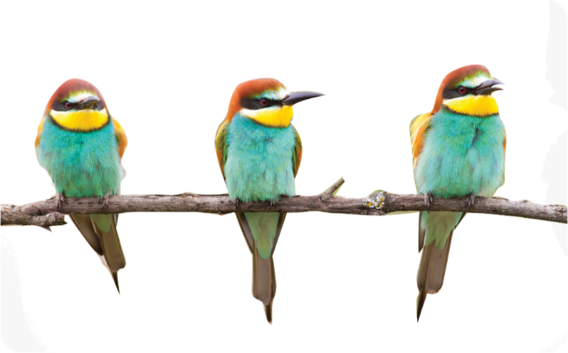

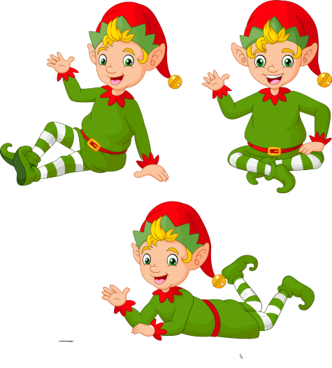
Ring The Golden Bell
Question 1
Answer
birds
3
5
9
1
2
8
10
4
6
7
What are they?
They are ____.

Slide 6
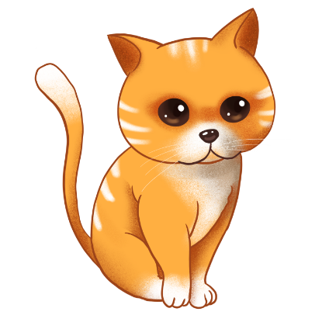
Ring The Golden Bell
Question 2
Answer
cat
3
5
9
1
2
8
10
4
6
7
What’s this?
It’s a ____.

Slide 7
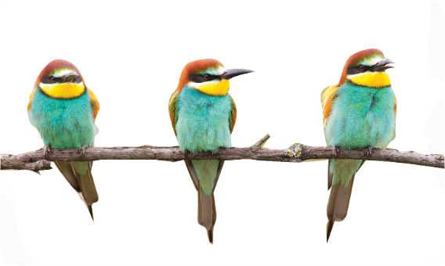
Ring The Golden Bell
Question 8
Answer
______________________?
Yes, I do.
Do you have any birds?
10
3
5
9
1
2
8
4
6
7

Slide 9



Contents
Read and complete.
Let’s write.
Project.

Slide 10

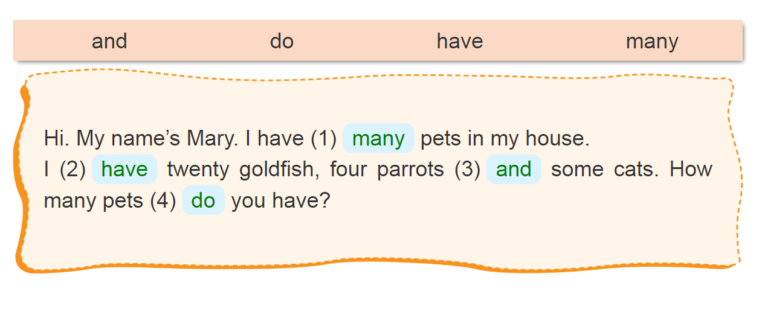
4. Read and complete.
____
____
___
___

Slide 11
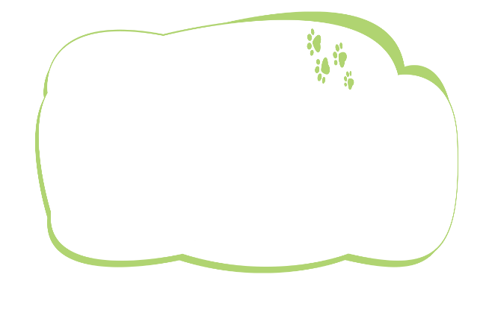

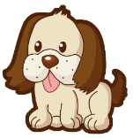
5. Let’s write.
My name is _____. I love pets. I have a cat.
It is big. I have ______. It is _______.
Do you have any ______ ?
Lieu
a dog
small
dogs

Slide 12
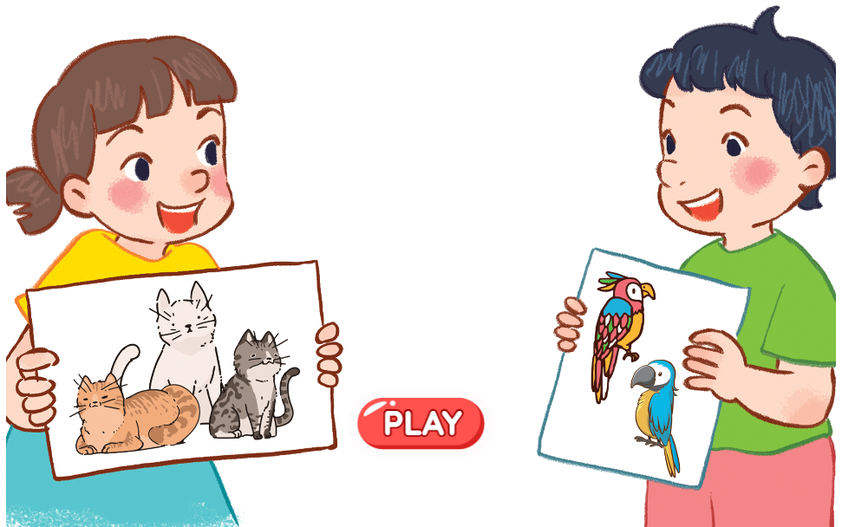
6. Project.
A pet show

Slide 13
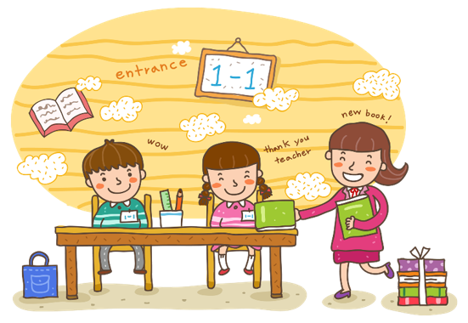
Wrap up

Slide 14
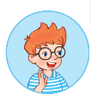
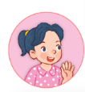
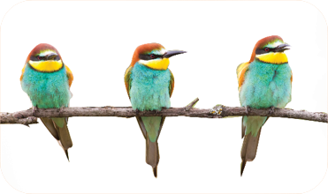
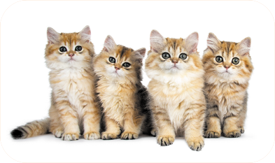
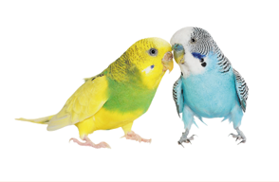
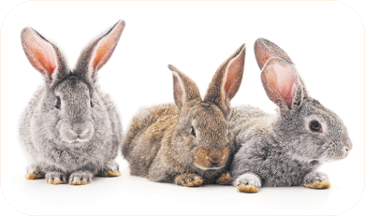
Unit 16 lesson 1
Do you have any ______?
Yes, I do.
don’t = do not
No, I don’t.
birds / yes
cats / no
parrots / no
rabbits / yes

Slide 15
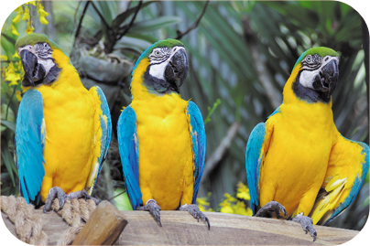
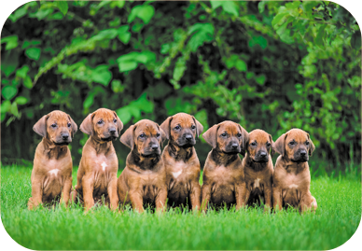
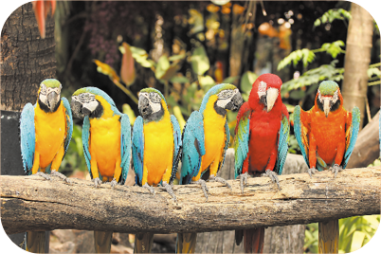
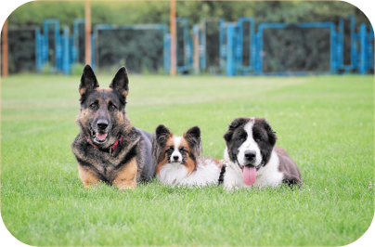
Review
How many _____ do you have?
I have _____.
parrots / some
dogs / many
parrots / many
dogs / some

Slide 16
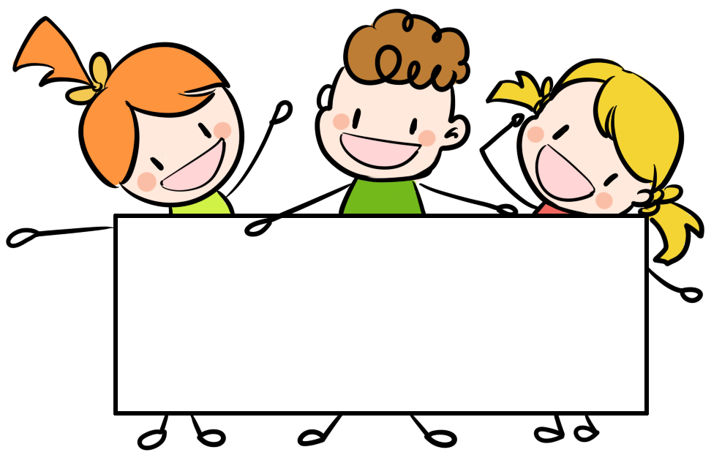
Thank you!

