Slide 1











Unit 17
In the city
Lesson 1 – Period 1

Slide 2
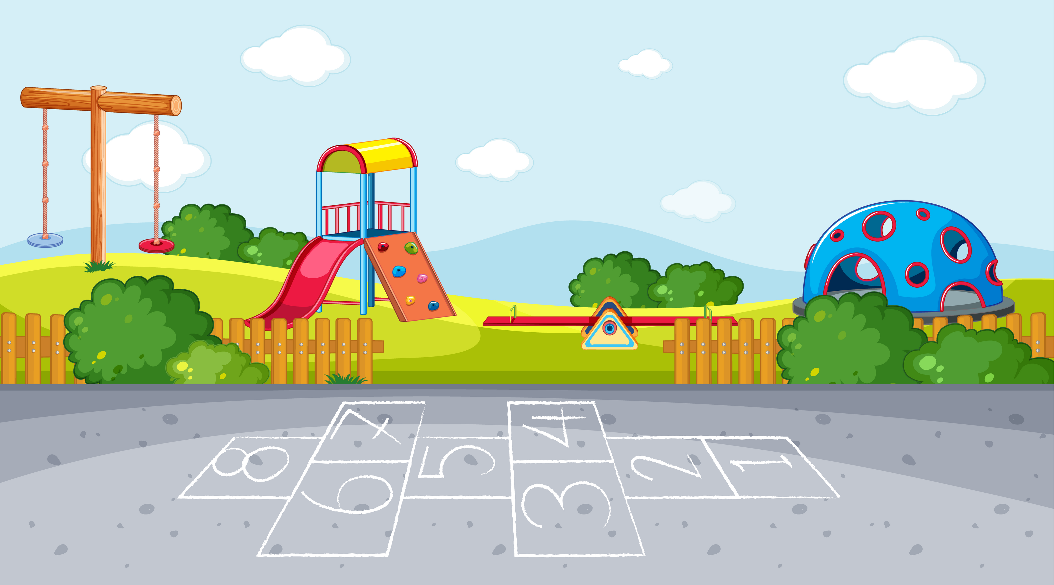




MsPham
0936082789
Warm-up
MsPham
0936082789

Slide 3


stop
/stɒp/
MsPham
0936082789
Dừng lại

Slide 4

go straight
/ɡəʊ streɪt/
MsPham
0936082789
Đi thẳng

Slide 5

turn right
/tɜːn ˈraɪt/
MsPham
0936082789
Rẽ phải

Slide 6

turn left
/tɜːn ˈleft/
MsPham
0936082789
Rẽ trái

Slide 7

Vocabulary
stop
: Dừng lại
MsPham
0936082789
go straight
: Đi thẳng
turn right
: Rẽ phải
turn left
: Rẽ trái

Slide 8
Structure

Slide 9
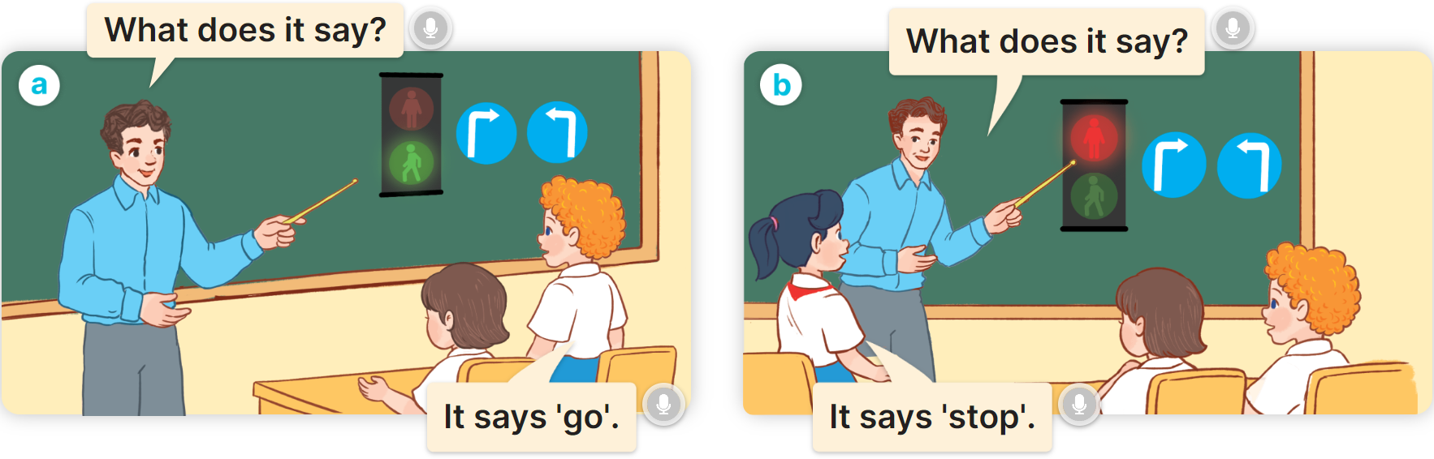
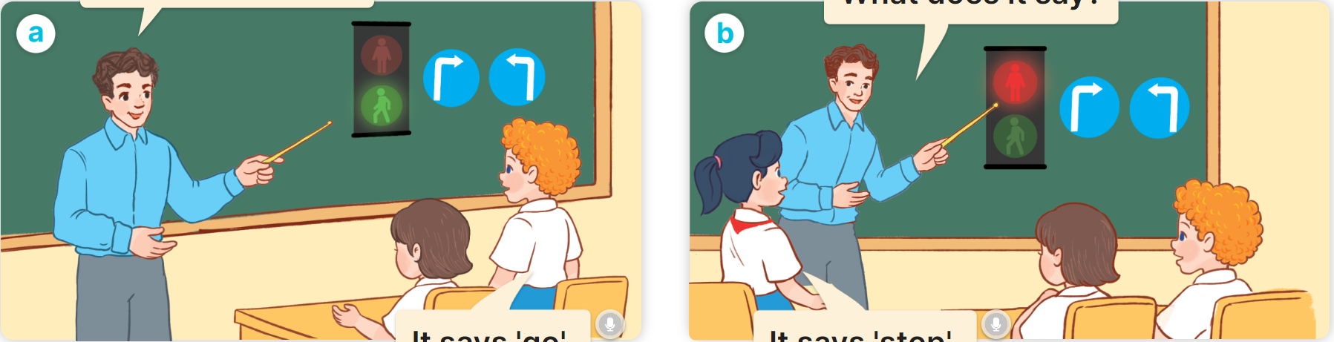

1
Look, listen and repeat.

Slide 10



1
Cách hỏi và trả lời biển hiệu này có nghĩa là gì:
What does it say?
It says: “_____________”.
(Nó có nghĩa là gì?)
(Nó có nghĩa: __________.)
Ex:
What does it say?
MsPham
0936082789
It says: “stop”.

Slide 11
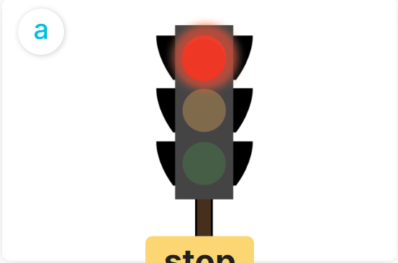
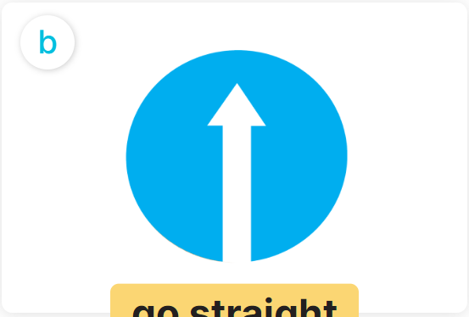
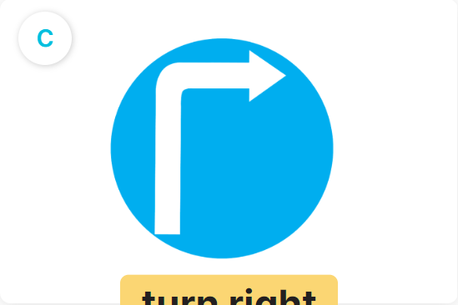
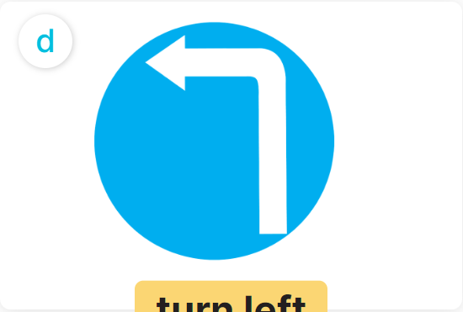
2
Listen, point and say.
What does it say?
a
b
It says: “__________”.
MsPham
0936082789
stop
go straight
c
d
turn right
turn left

Slide 12


2
Listen, point and say.
MsPham
0936082789
stop
What does it say?
It says: “stop”.

Slide 13
2
Listen, point and say.
MsPham
0936082789
go straight
What does it say?
It says: “go straight”.

Slide 14
2
Listen, point and say.
MsPham
0936082789
turn right
What does it say?
It says: “turn right”.

Slide 15
2
Listen, point and say.
What does it say?
a
b
It says: “__________”.
MsPham
0936082789
stop
go straight
c
d
turn right
turn left

Slide 16
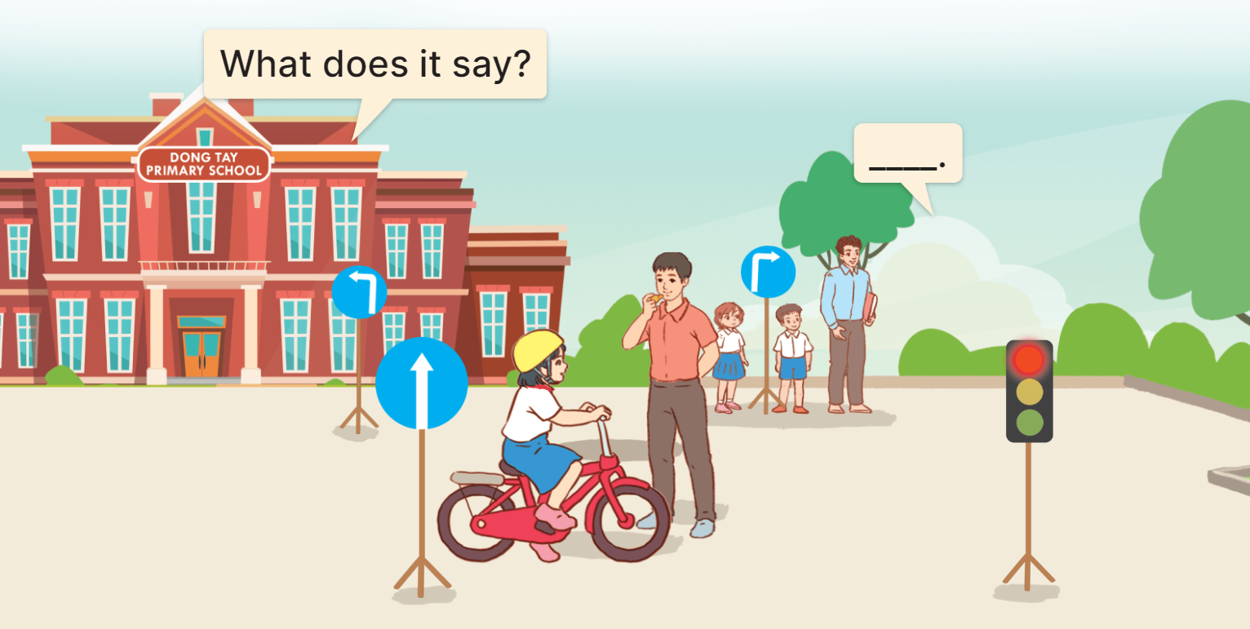

3
Let’s talk.
It says: “go straight”.

Slide 17
3
Let’s talk.
It says: “stop”.

Slide 18
3
Let’s talk.
It says: “turn right”.

Slide 19
3
Let’s talk.
It says: “turn left”.

Slide 20
3
Let’s talk.

Slide 21





THANK YOU!
Caring for life, safe travel

