Slide 1





Unit 16
weather
Lesson 2 – Period 2

Slide 2
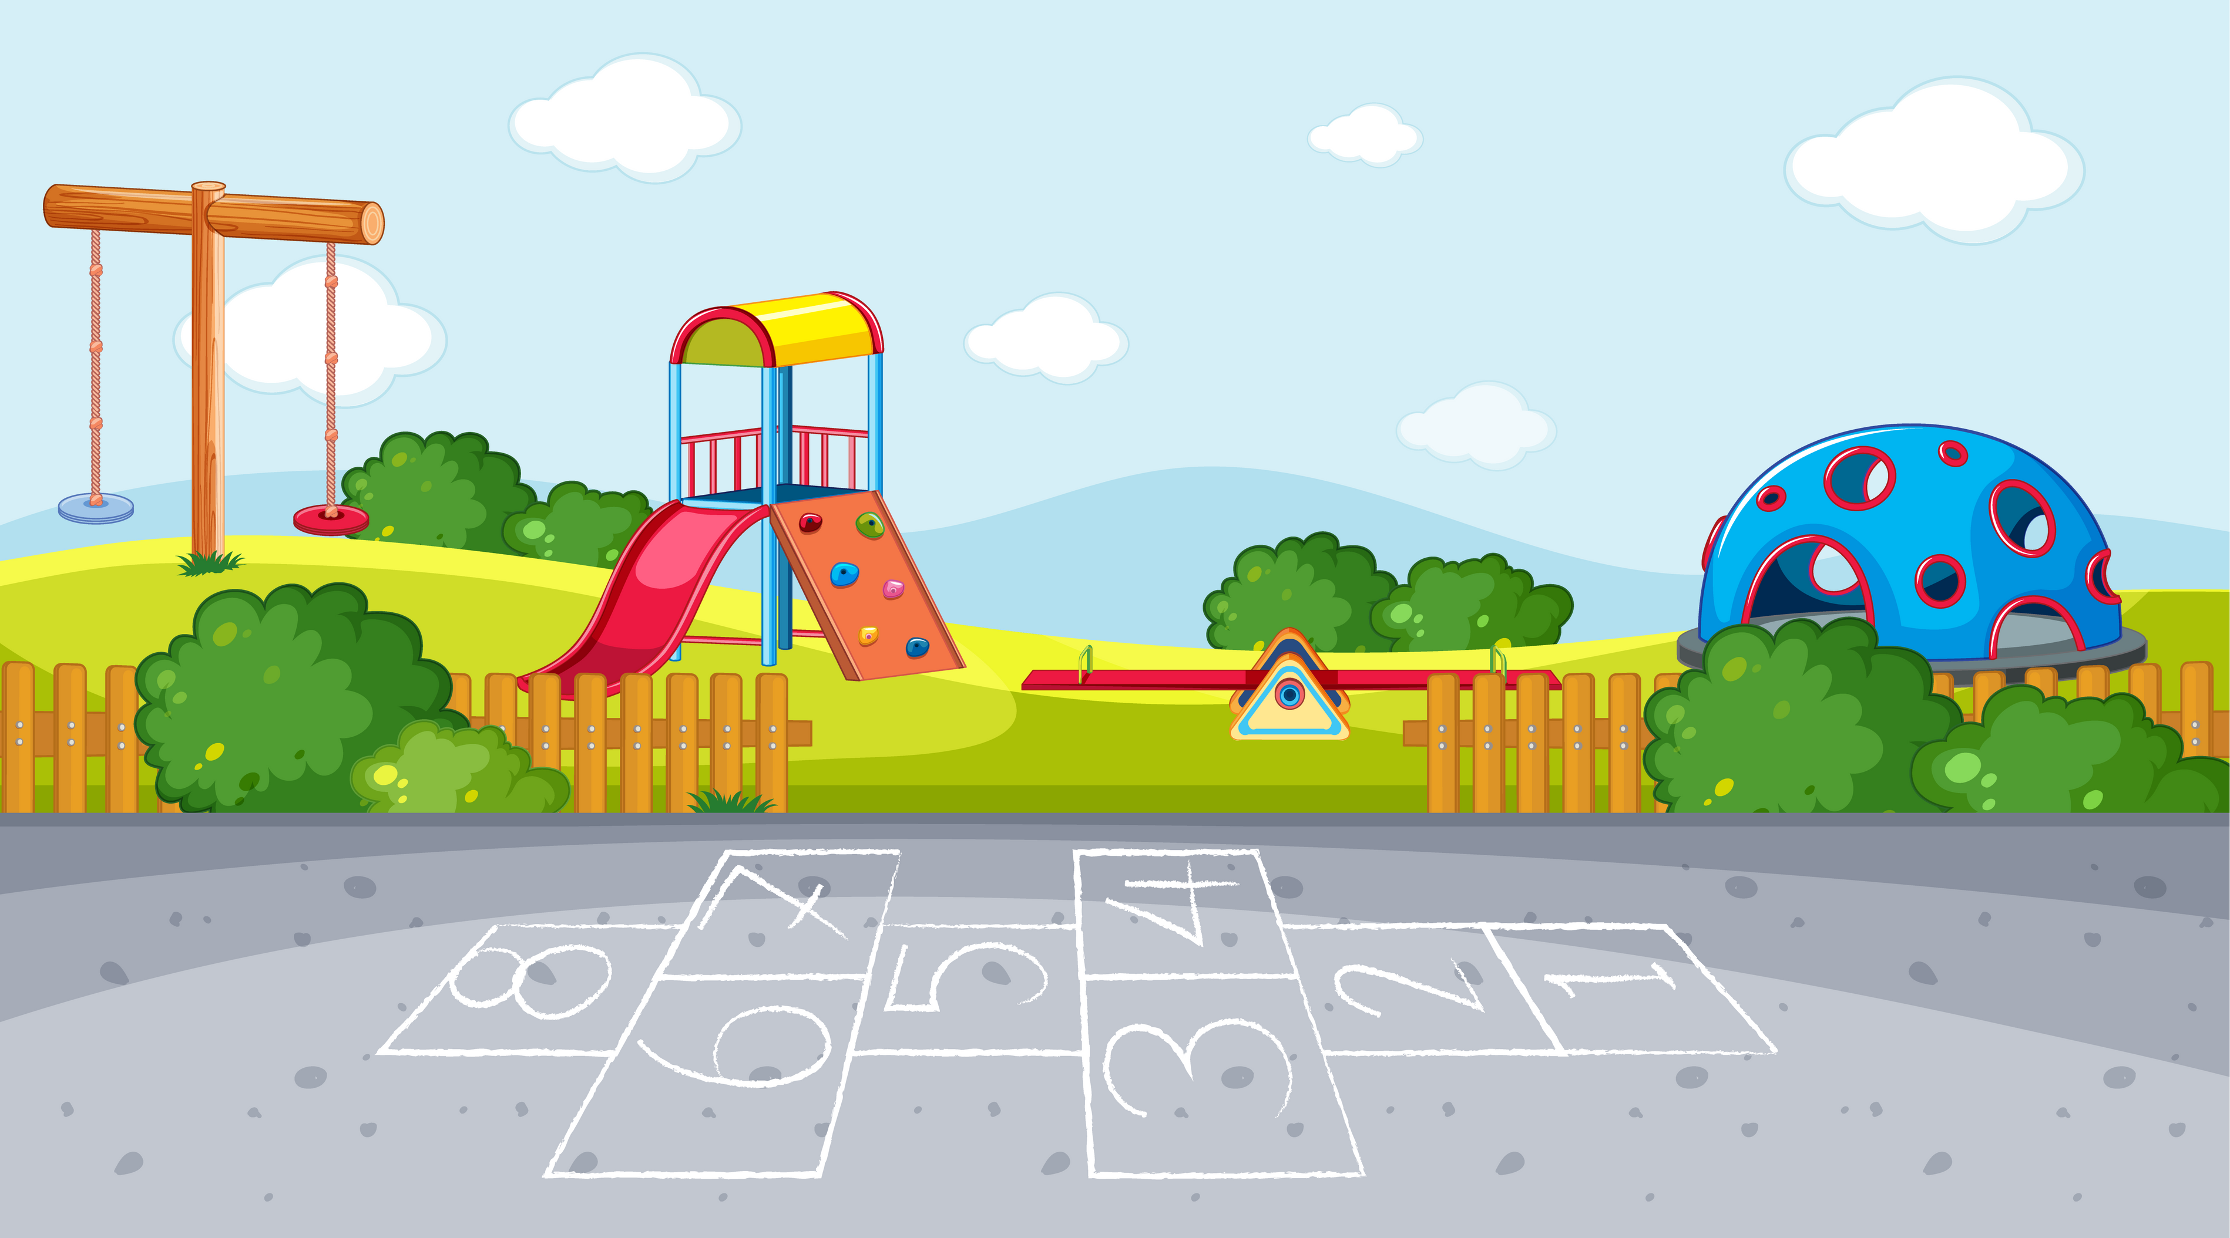
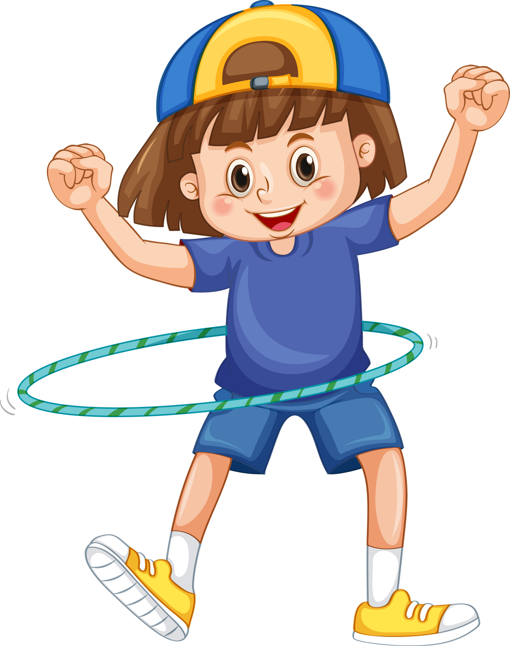
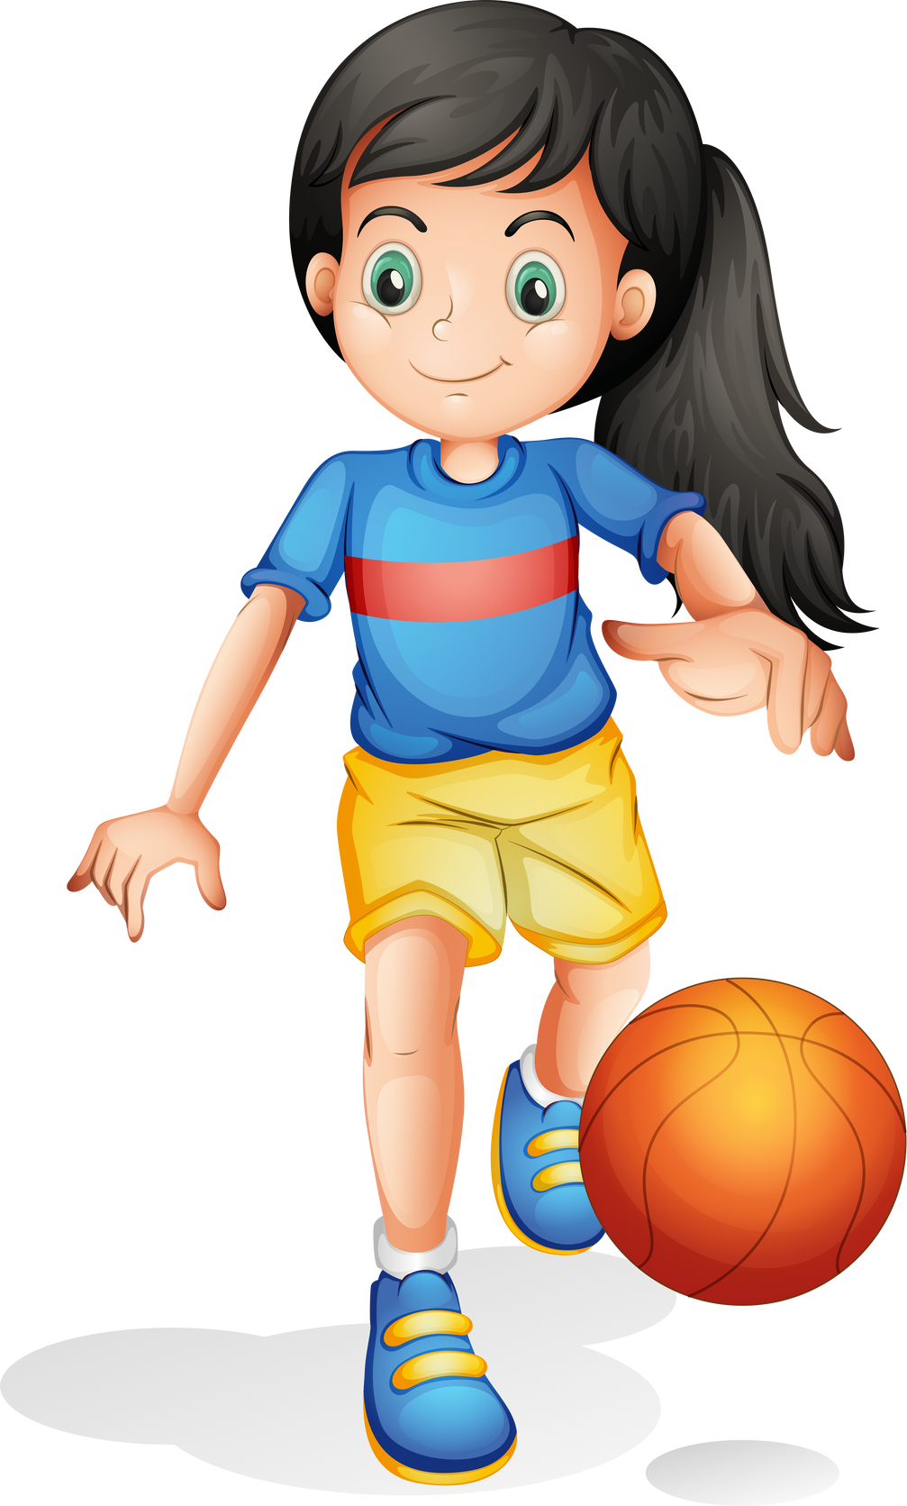
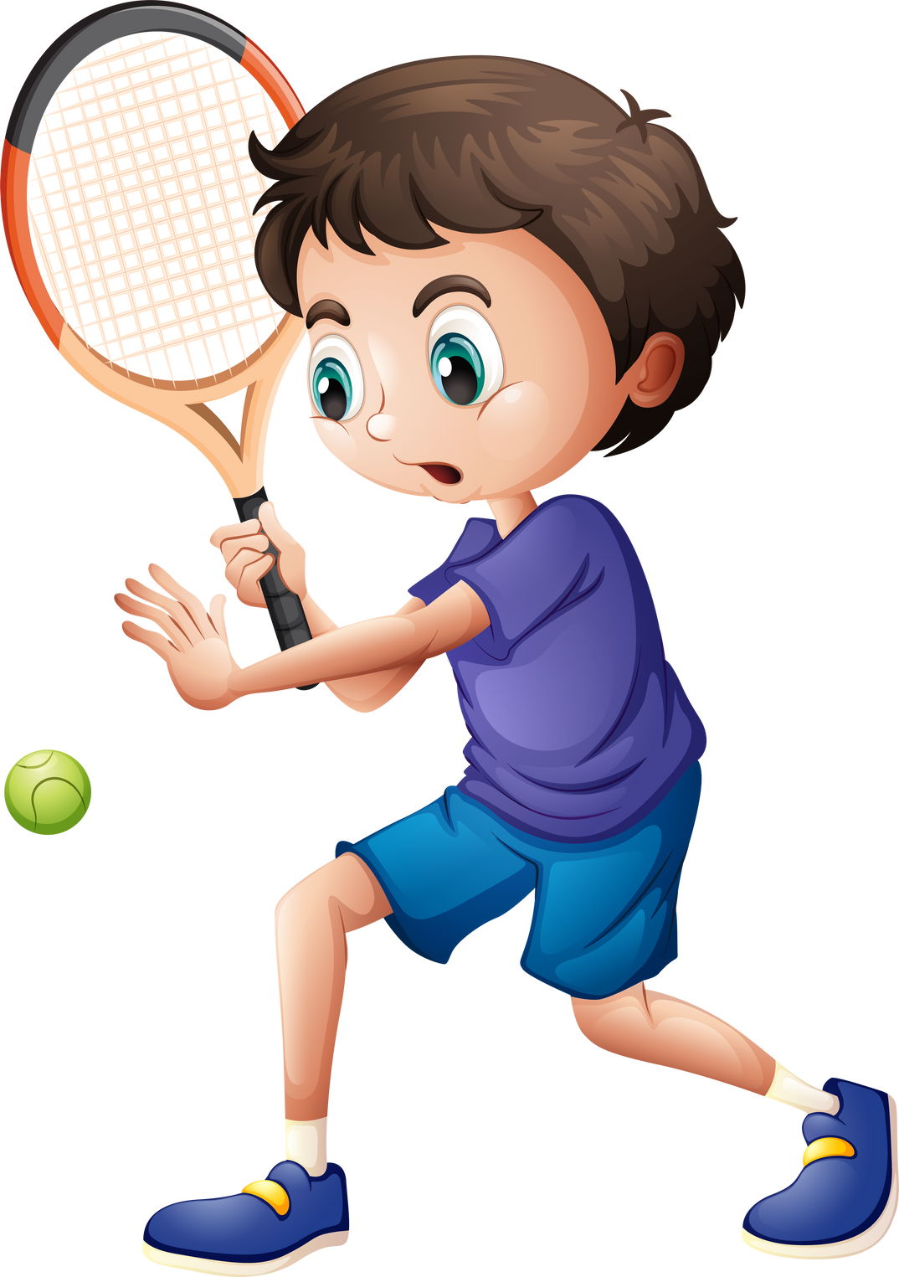
Warm-up

Slide 3

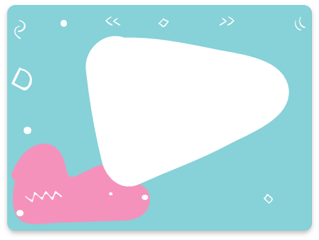
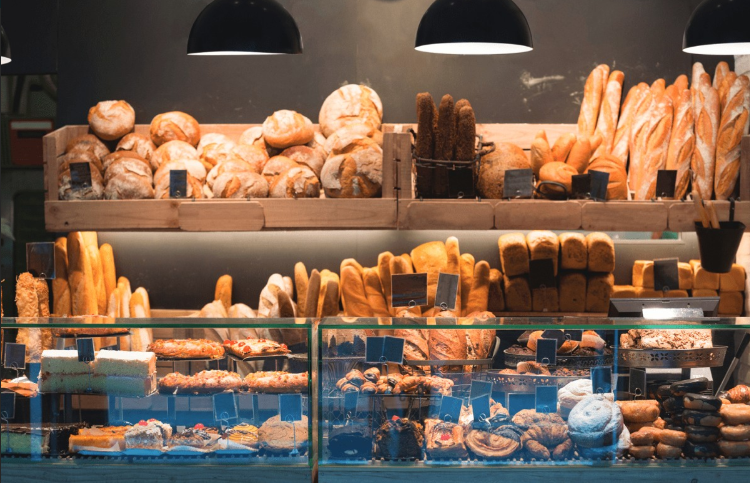
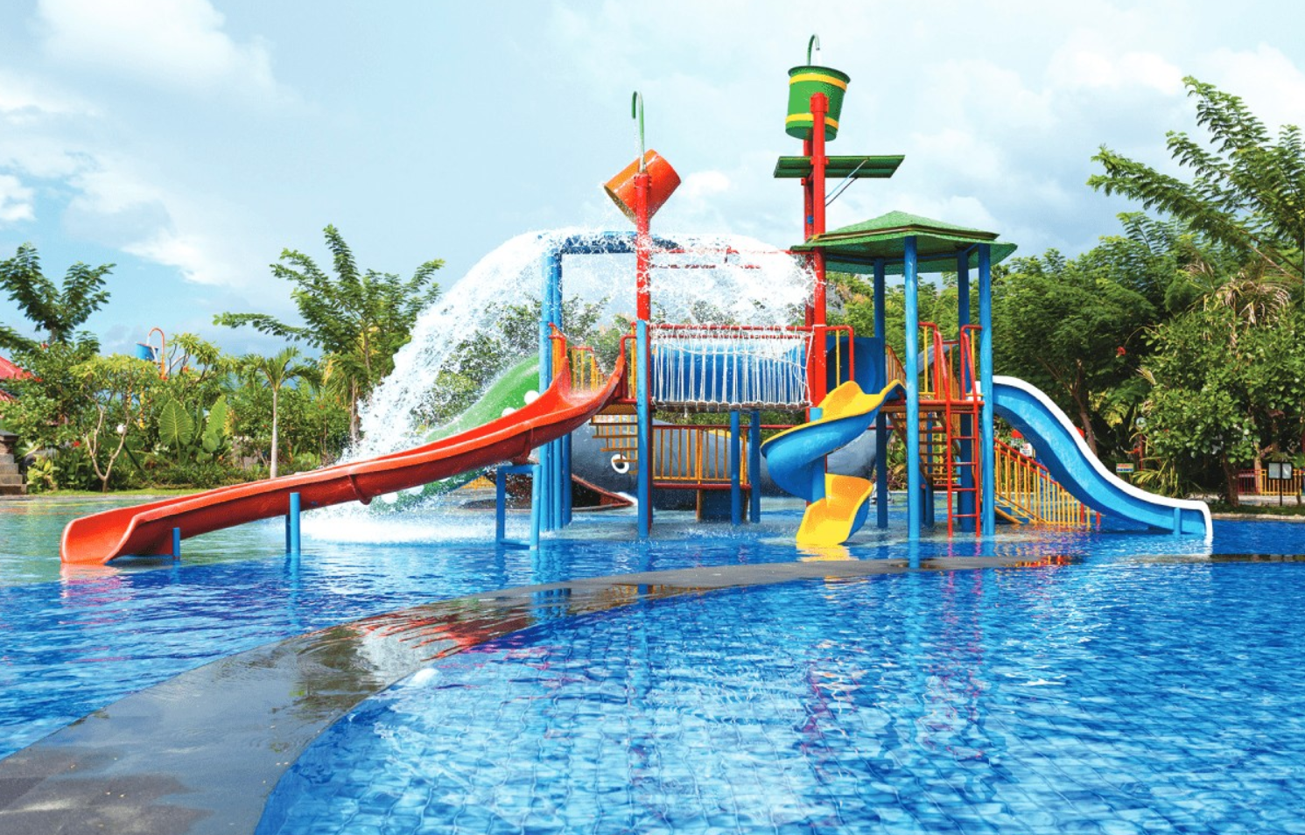

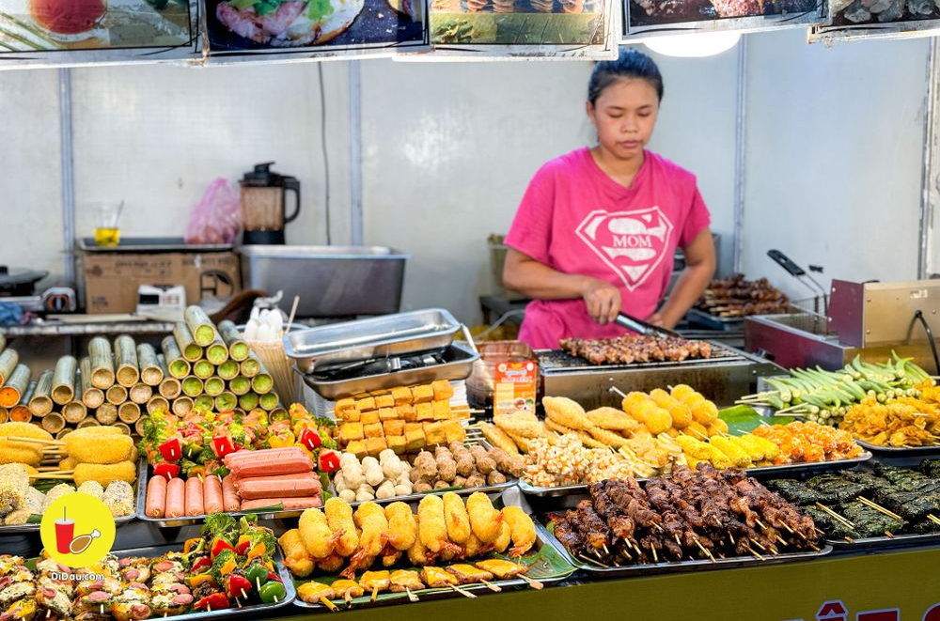

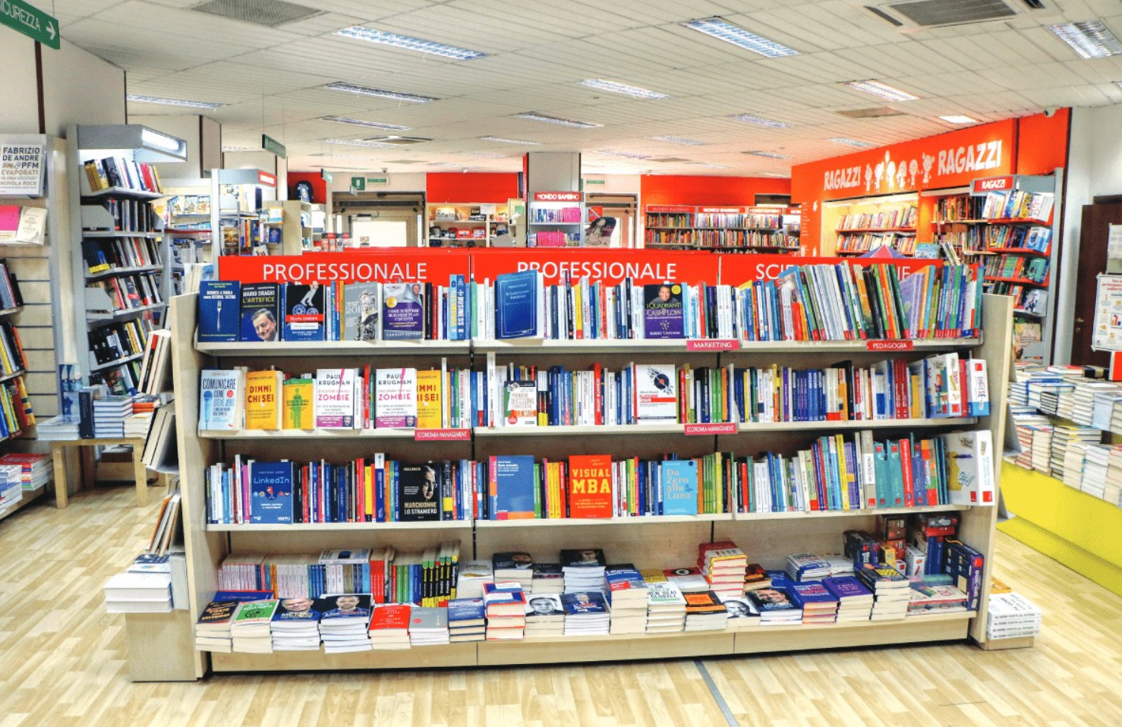

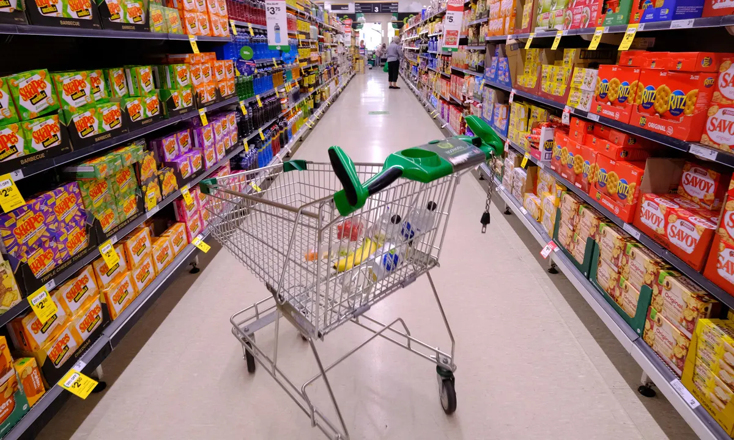
water park
supermarket
1
2
3
4
5
food stall
6
7
8
-1
9
10
bakery
12
+2
11
bookshop

Slide 4


Review
MsPham
0936082789

Slide 5


Great! Let’s go.
Do you want to go to the _________?
MsPham
0936082789
Sorry. I can’t.
MsPham
0936082789
food stall
water park
bakery
supermarket
bookshop

Slide 6
Practice
MsPham
0936082789

Slide 7

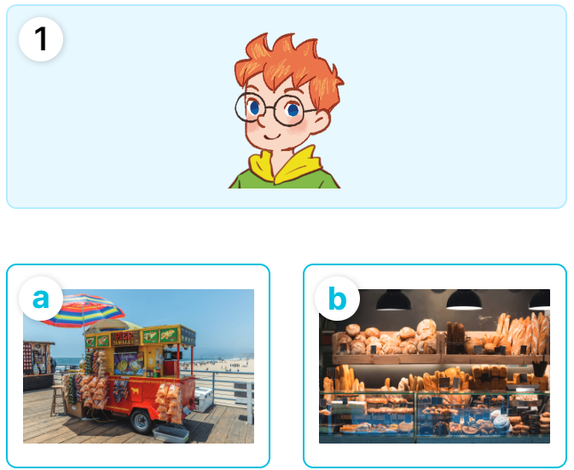
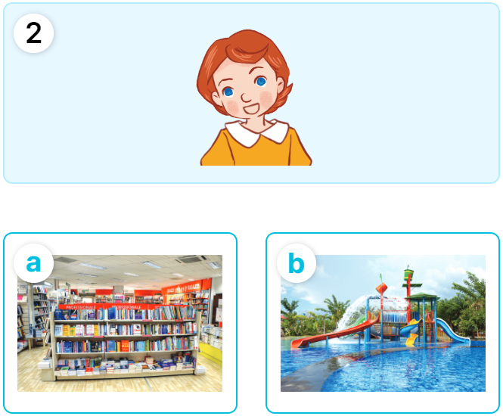
MsPham
0936082789
4
Listen and match.
MsPham
0936082789

Slide 8
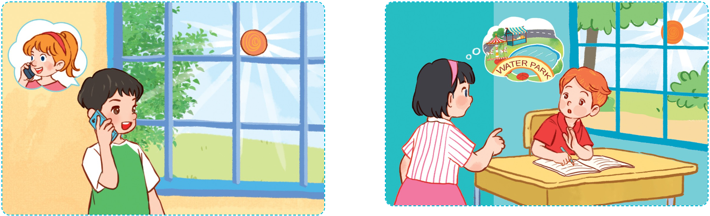
5
Look, complete and read.
MsPham
0936082789
MsPham
0936082789
A: Look! It's sunny today.
B: Yes, it is.
A: Do you want to go to the __________ with me?
B: Sorry, ______. I'm doing
my homework.
A: What's the weather like today?
B: It’s _________.
A: Lovely! Do you want to go to the bookshop?
B: _________! Let's go.
sunny
water park
I can’t
Great

Slide 9
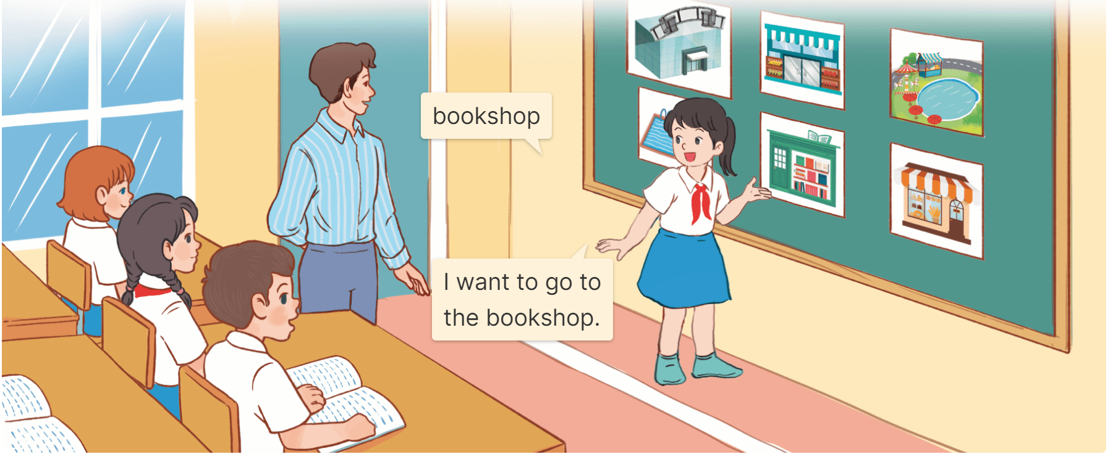
6
Let’s play.
Slap the board and say
MsPham
0936082789

Slide 10
Review
MsPham
0936082789

Slide 11
Great! Let’s go.
Do you want to go to the _________?
MsPham
0936082789
Sorry. I can’t.
MsPham
0936082789
food stall
water park
bakery
supermarket
bookshop

Slide 12
Thank you!

