Slide 1





Unit 16
weather
Lesson 3 – Period 2

Slide 2
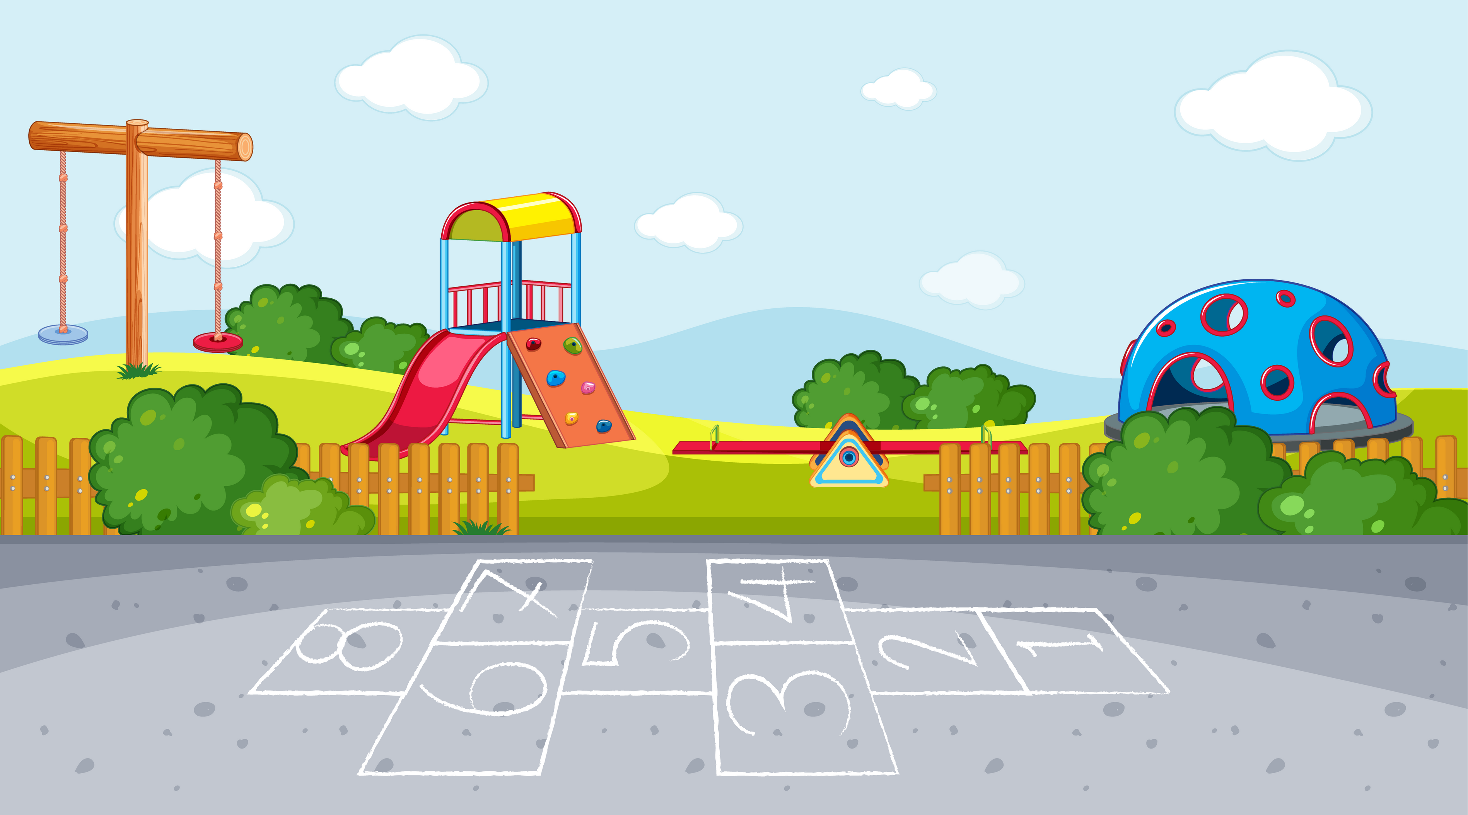
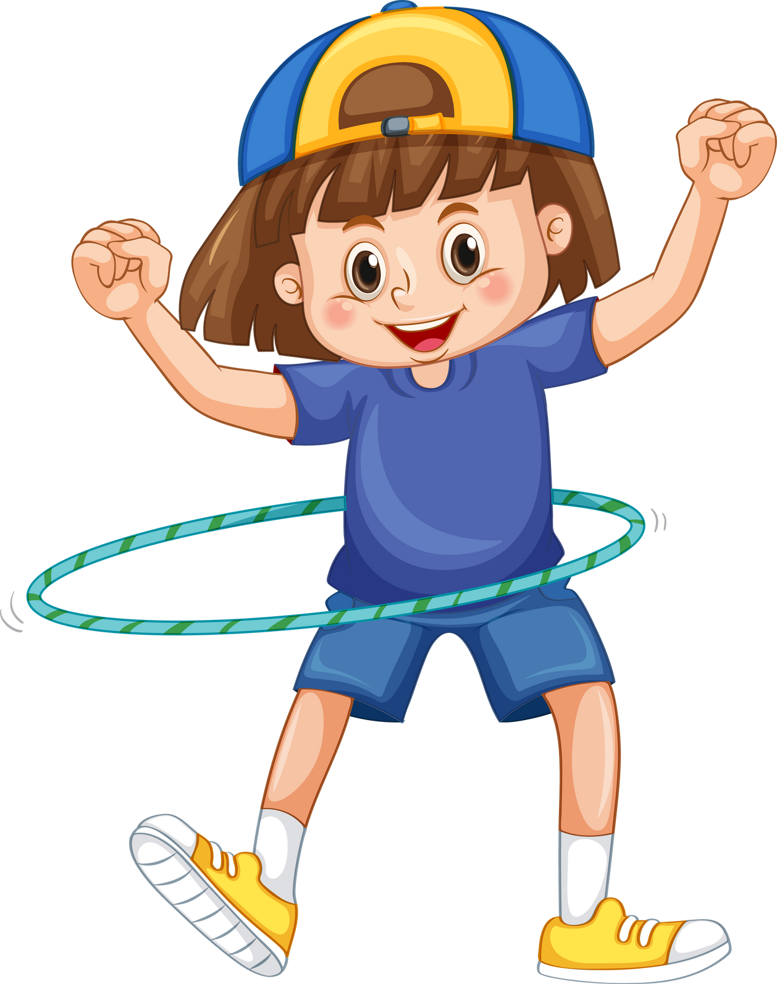
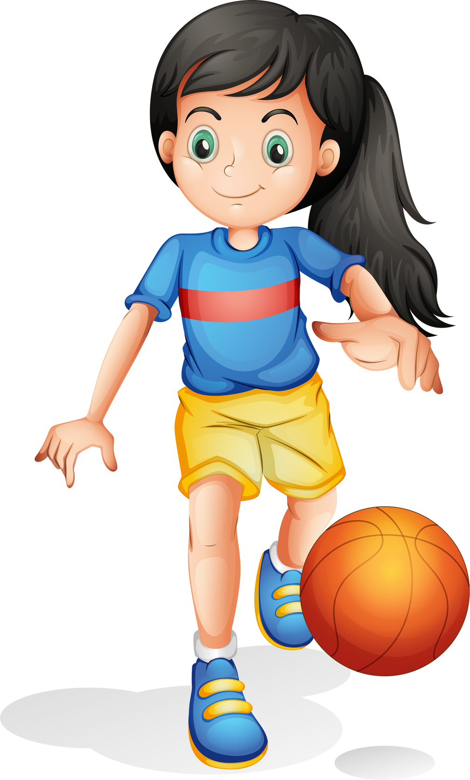
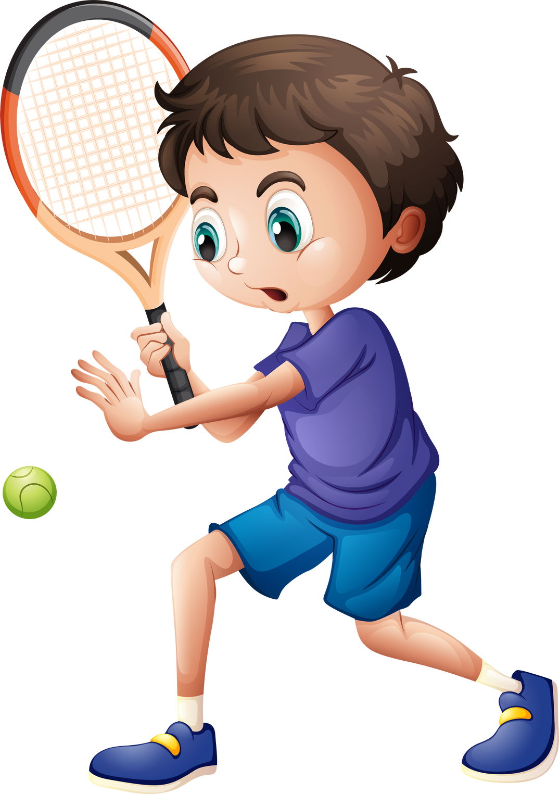
Warm-up

Slide 3


Playing with the seal!
Play

Slide 4
?
is
sunny
today
It
Answer

Slide 5
It
is
sunny
today
.
Next

Slide 6
weekend
.
rainy
It
last
was
Answer

Slide 7
It
was
rainy
last
weekend
.
Next

Slide 8
was
weather
yesterday
the
?
like
What
Answer

Slide 9
What was the weather like yesterday ?
Next

Slide 10
to
want
bakery
?
go
to
you
Do
the
Answer

Slide 11
Do you want to go to the bakery?
Next

Slide 12
Welldone !
Next

Slide 13


Review
MsPham
0936082789

Slide 14





What was the weather like last weekend?
MsPham
0936082789
It was _______.
MsPham
0936082789
rainy
windy
sunny
cloudy

Slide 15

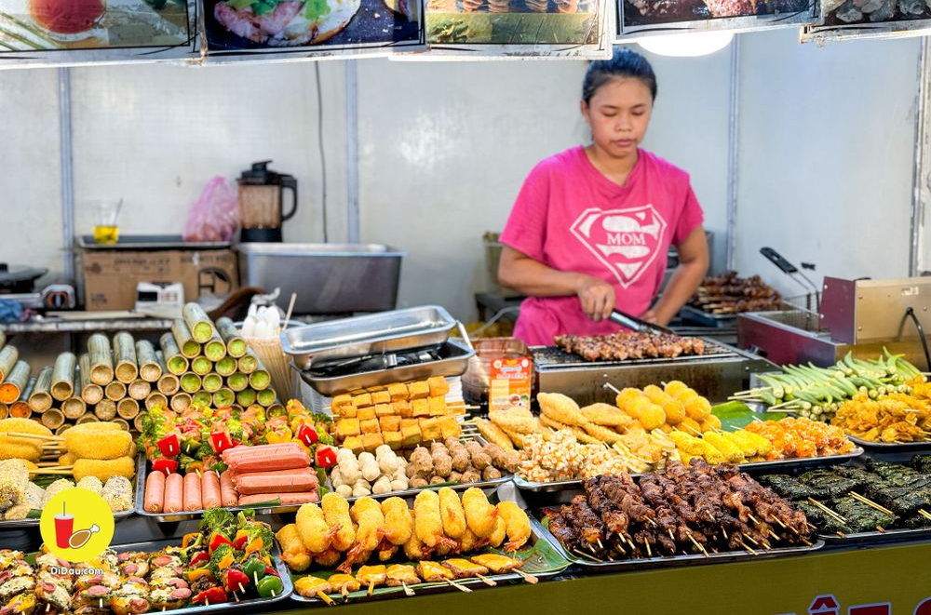
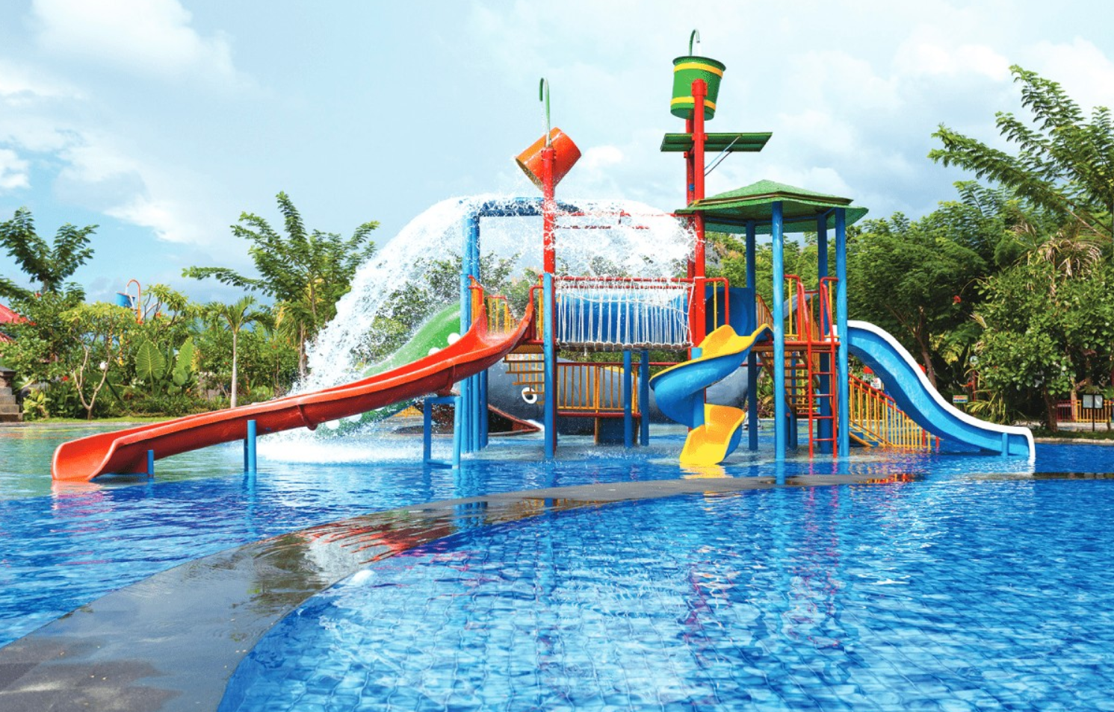
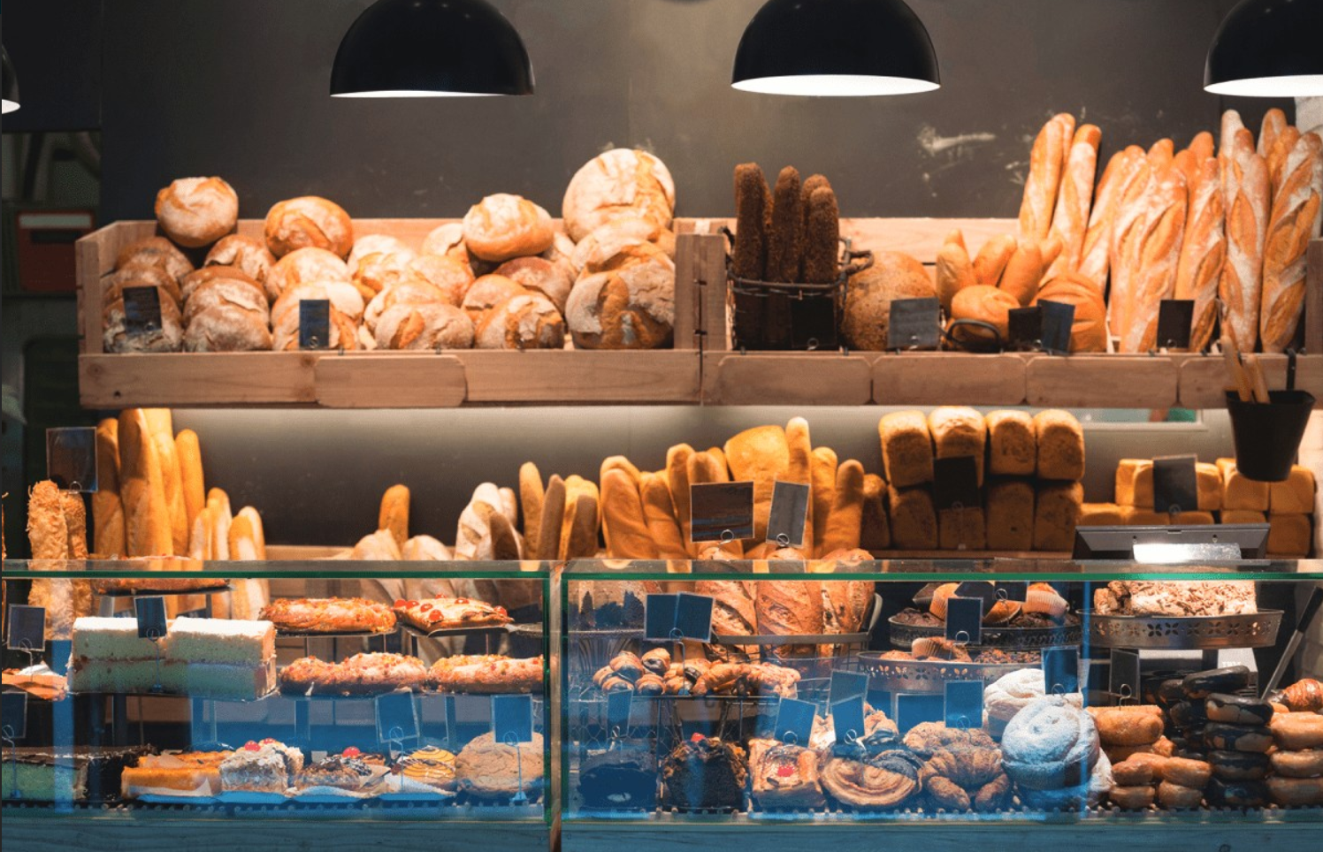
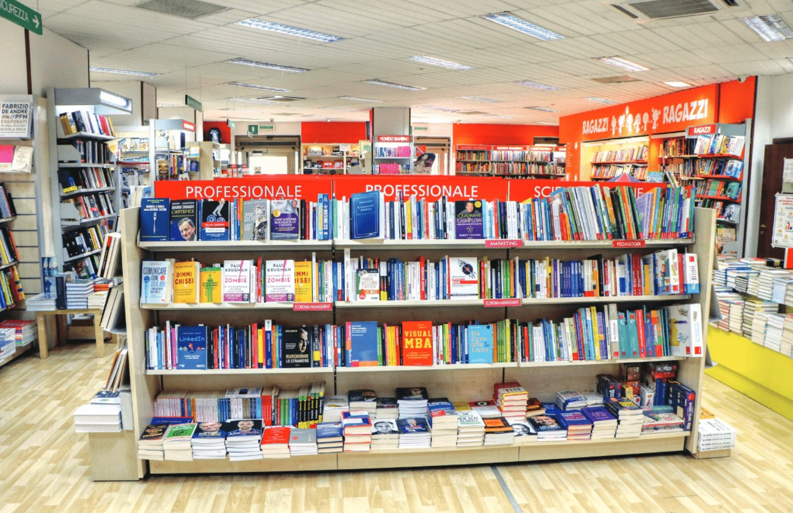
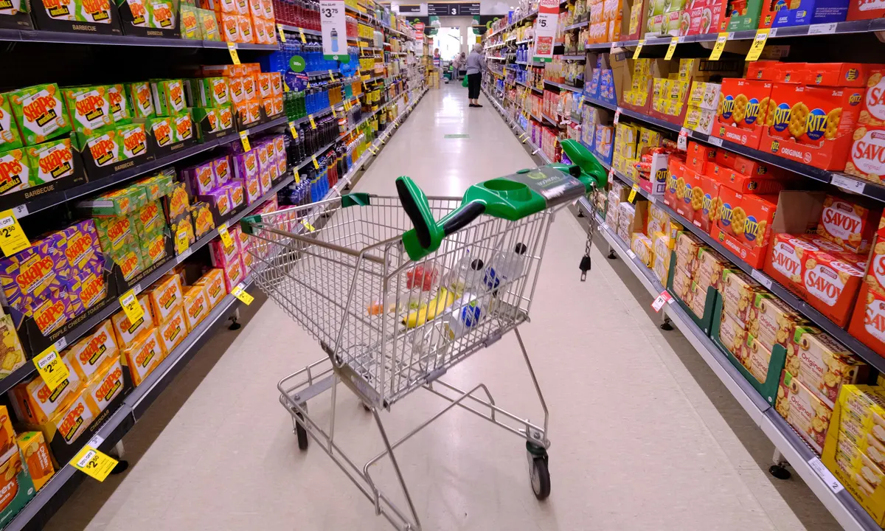
Great! Let’s go.
Do you want to go to the _________?
MsPham
0936082789
Sorry. I can’t.
MsPham
0936082789
food stall
water park
bakery
supermarket
bookshop

Slide 16
Practice
MsPham
0936082789

Slide 17
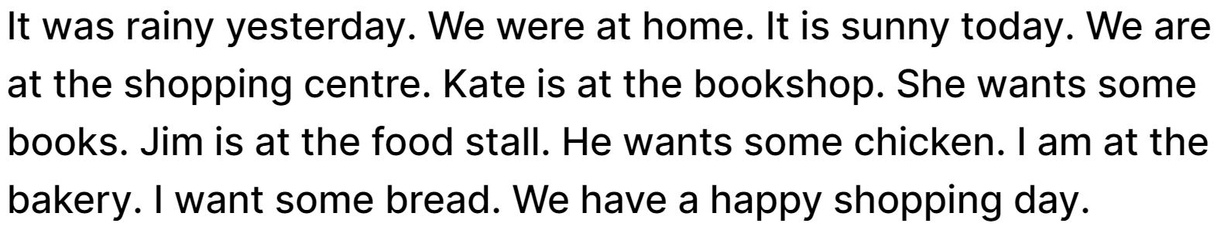
4
Read and circle.
MsPham
0936082789
1. lt was _________yesterday.
a. cloudy b. sunny c. rainy
2. It is _________today.
a. windy b. rainy c. sunny
3. Kate is at the _________.
a. bookshop b. bakery c. food stall
4. Jim is at the _________.
a. food stall b. bookshop c. bakery

Slide 18
5
My family go shopping
Let’s write
- What is the weather like today?
- Where do your family go?
- What do your parents want to buy?
- What do you want to buy?
- What does your brother / sister want to buy?
It is _____________ today.
My family go to the ___________.
My parents want to buy ____________.
I want to buy ____________.
My brother / sister want to buy ____________.
MsPham
0936082789

Slide 19
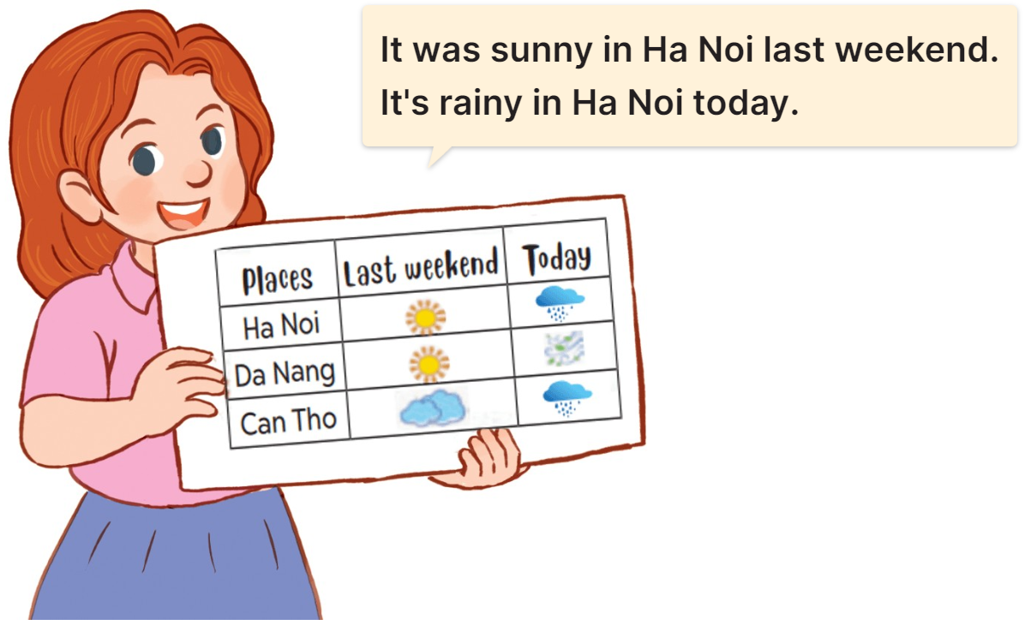
6
Project
MsPham
0936082789

Slide 20
Thank you!

