Slide 1
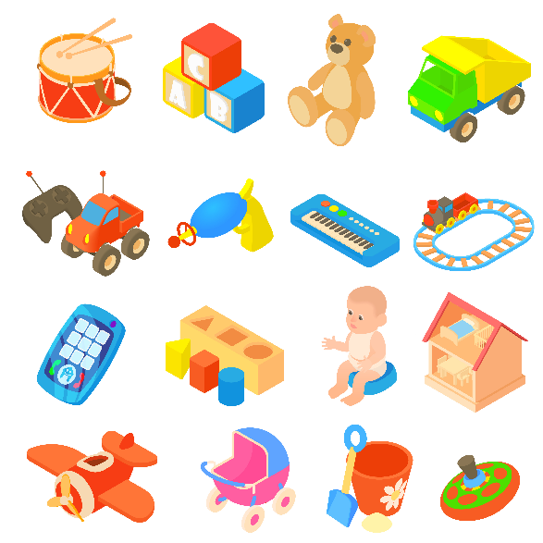
Our toys
Unit 17
Lesson 1 (1+2+3)

Slide 2

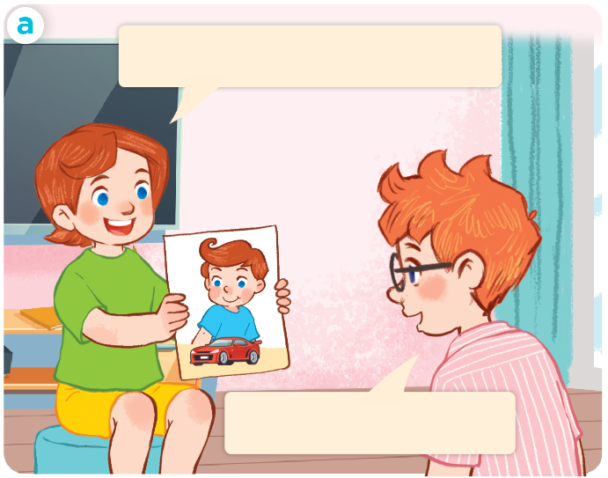
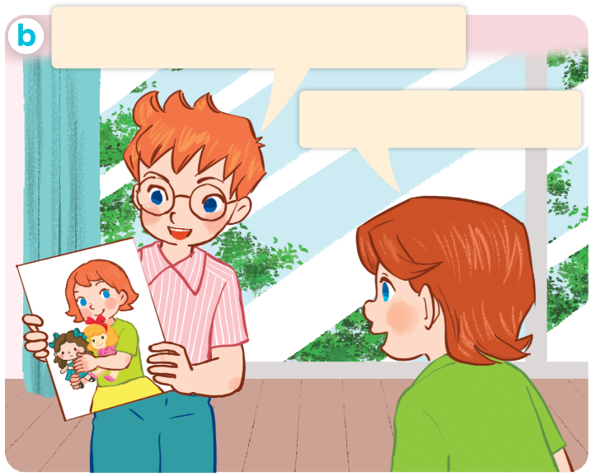
1. Look, listen and repeat.
Click on the speaker / sentences to listen.
My sister has two dolls.
My brother has a car.
Wow! I like dolls!
Wow, I like cars!
Who are they?
What are they doing?
Where are they?
Click on the screen to show 3 questions.

Slide 3
Vocabulary

Slide 4
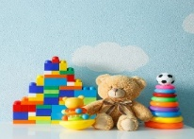




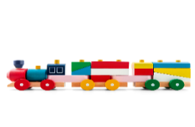
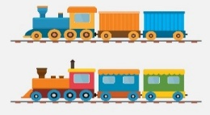

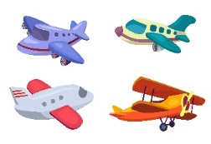
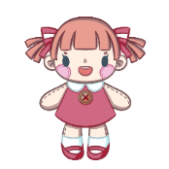

Vocabulary
1. toy
2. car
cars
3. kite
kites
4. train
trains
5. plane
planes
6. doll
dolls
Click on the word to listen again.

Slide 5
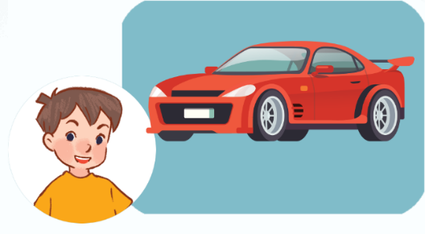
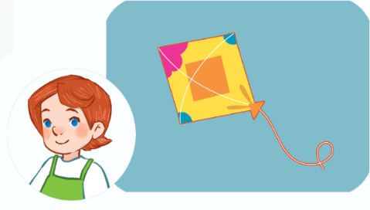
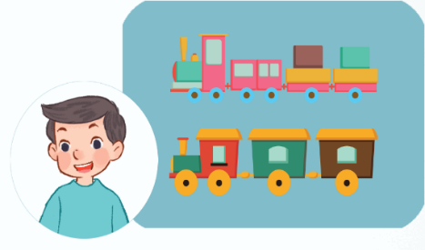
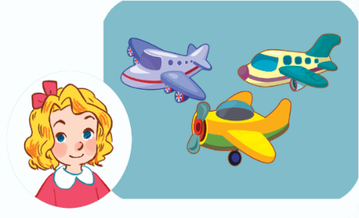
2. Listen, point and say.
a
b
He / She has ______.
a car
a kite
c
d
trains
planes

Slide 6


2. Listen, point and say.
a
He / She has ______.
a car
He has a car.
Click on the sentences to listen.

Slide 7
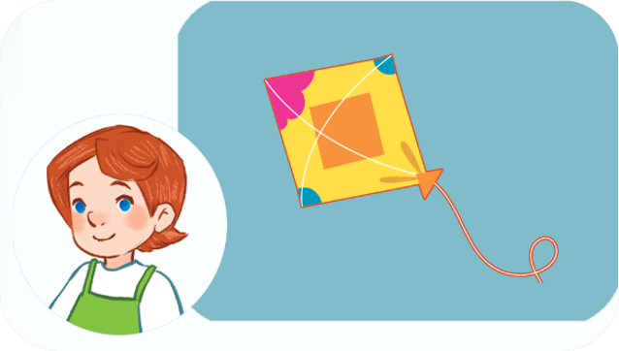

2. Listen, point and say.
b
He / She has ______.
a kite
She has a kite.

Slide 8
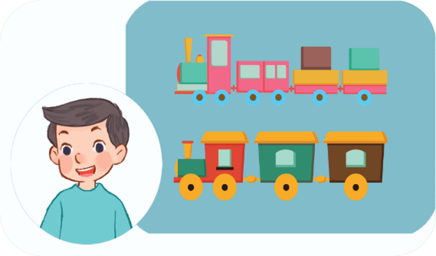

2. Listen, point and say.
c
He / She has ______.
trains
He has trains.

Slide 9
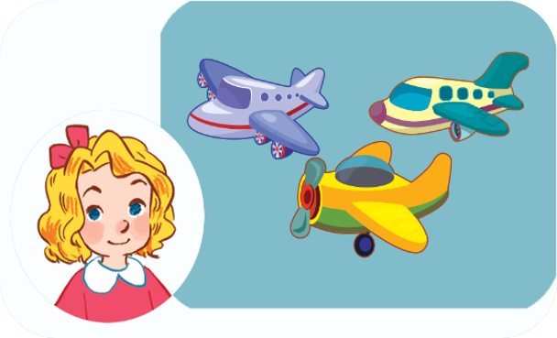

2. Listen, point and say.
d
He / She has ______.
planes
She has planes.

Slide 10
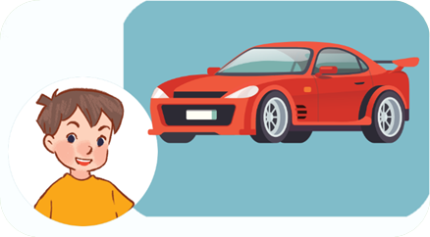
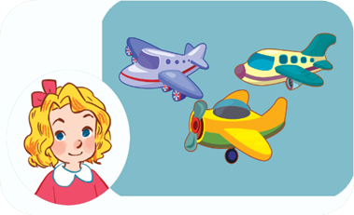
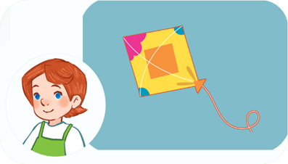
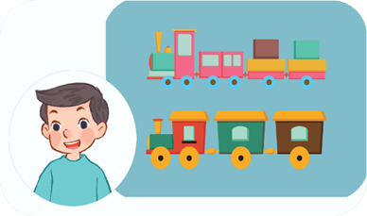
Unit 17 Lesson 1
He / She has ________.
a car
planes
a kite
trains

Slide 11
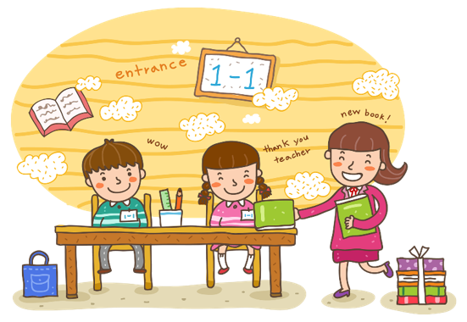
Wrap up

Slide 12
Review
He / She has ________.
a car
planes
a kite
trains

Slide 13

Thank you!

