Slide 1
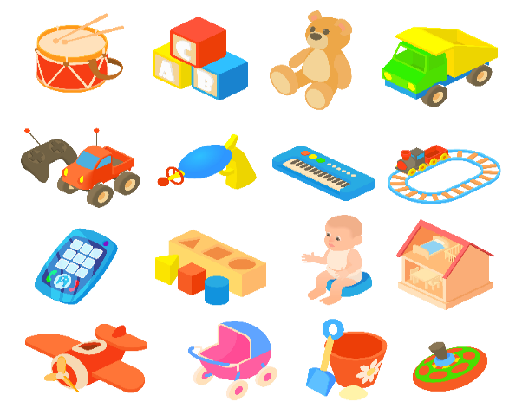
Our toys
Unit 17
Lesson 2 (1+2+3)

Slide 2

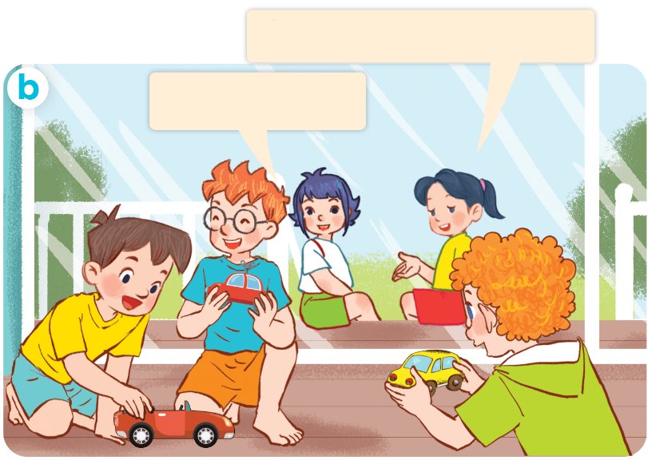
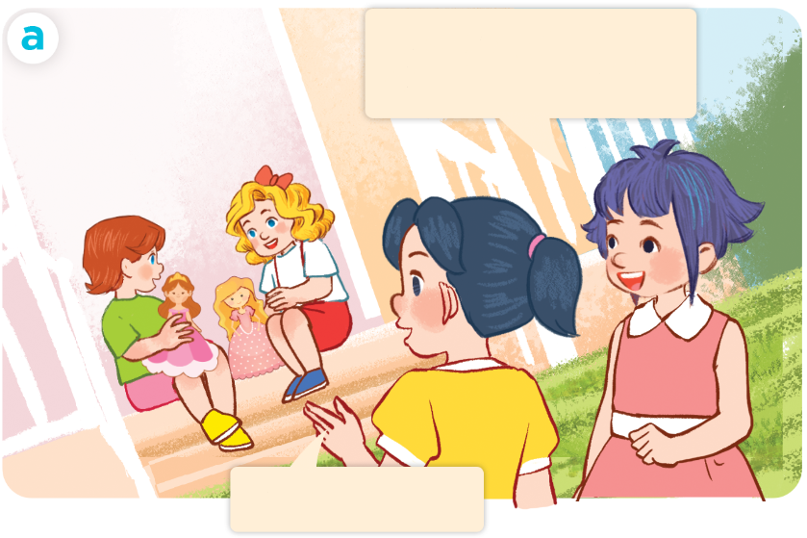
1. Look, listen and repeat.
They have three cars.
Lucy and Mary
have two dolls.
Yes, they do.
Yes, they do.
Who are they?
Where are they?
What are they doing?
Click on the speaker / sentences to listen.

Slide 3

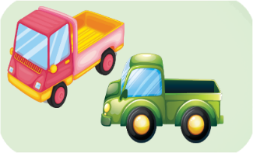
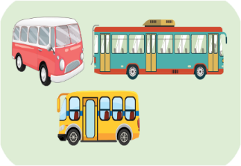
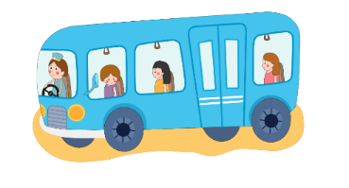

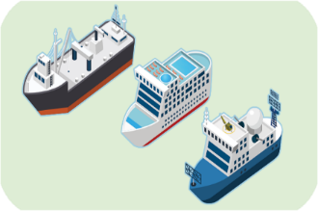
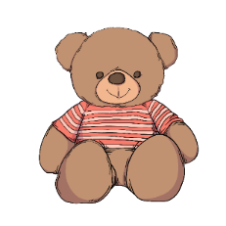
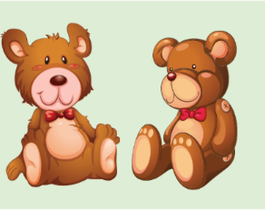
Vocabulary
1. truck
trucks
2. bus
buses
3. ship
ships
4. teddy bear
teddy bears

Slide 4




2. Listen, point and say.
a
b
They have _______.
buses
trucks
c
d
ships
teddy bears

Slide 5
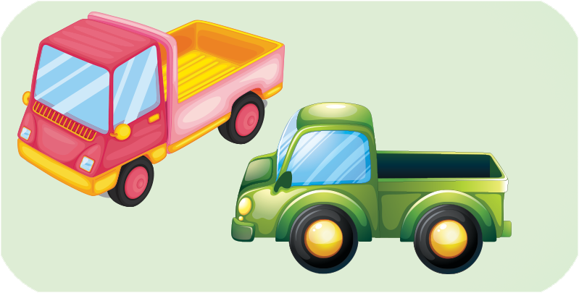

2. Listen, point and say.
a
They have _______.
trucks
They have two trucks.
Click on the sentences to listen.

Slide 6
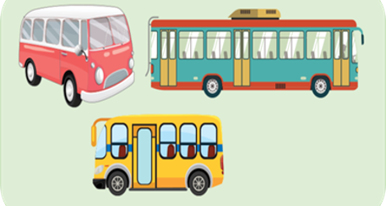

2. Listen, point and say.
b
They have _______.
buses
They have three buses.

Slide 7
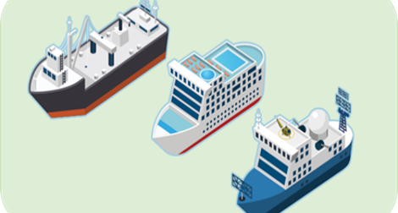
2. Listen, point and say.
c
They have _______.
ships
They have three ships.

Slide 8
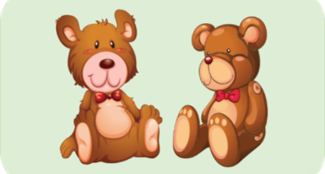

2. Listen, point and say.
d
They have _______.
teddy bears
They have two teddy bears.

Slide 9
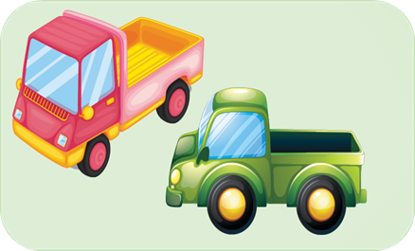
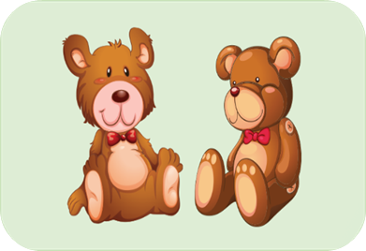


Unit 17 lesson 2
They have ________.
trucks
teddy bears
buses
ships

Slide 10
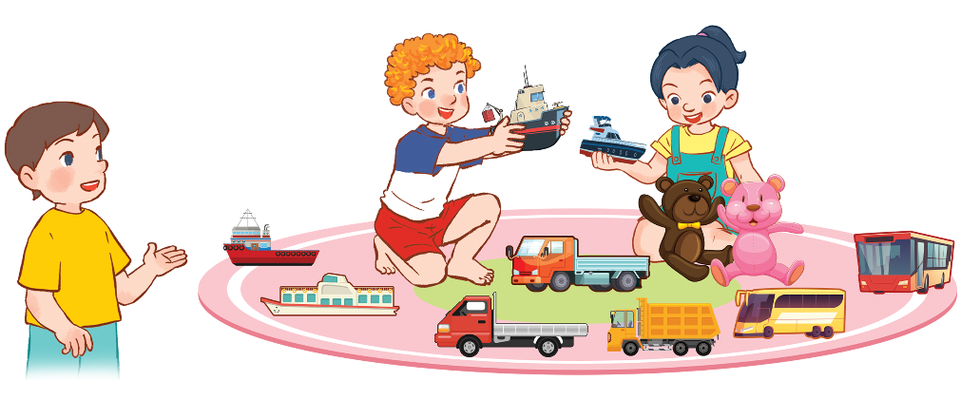
3. Let’s talk.
They have _____________.
two teddy bears
three trucks
four ships
two buses
1
4
2
3

Slide 11
Review
They have ________.
trucks
teddy bears
buses
ships

Slide 12

Thank you!

