Slide 1


Slide 2



Slide 3

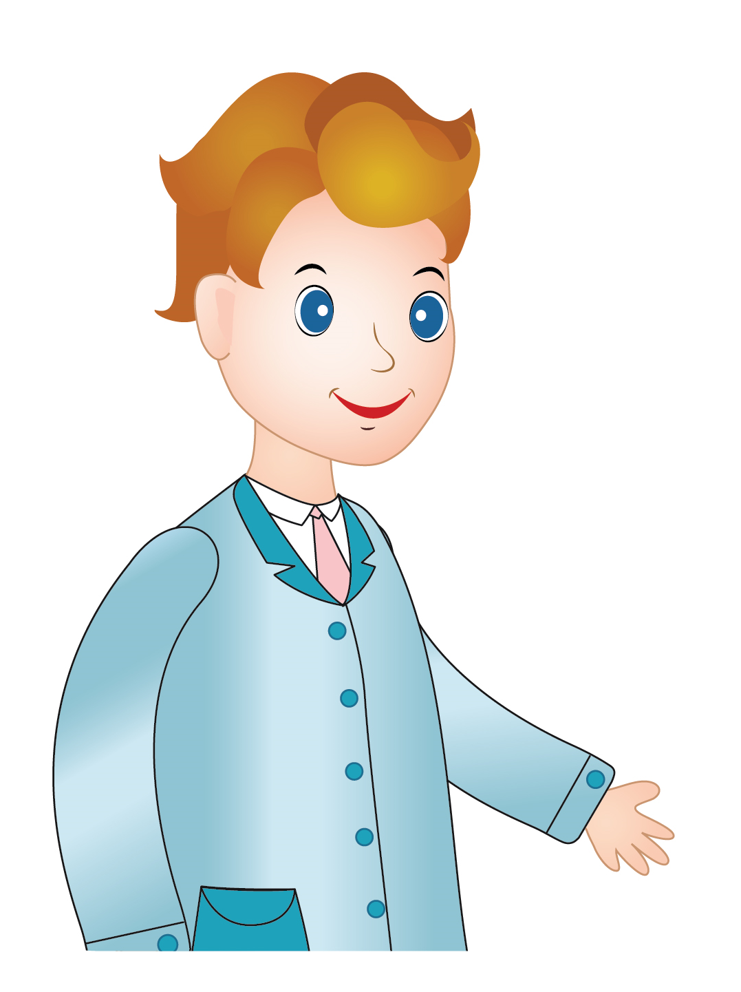
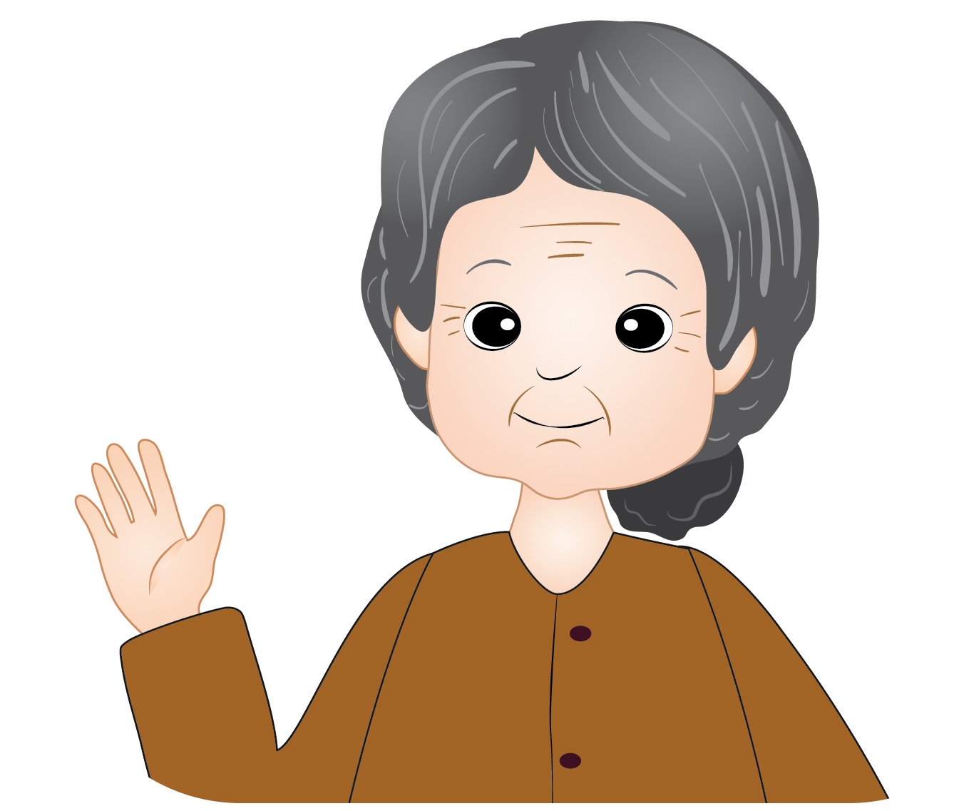
Game: Circle the picture
This is my uncle.
A
B
Notes:
Circle the picture game
T says “look at the two picture. Listen to my sentence: This is my uncle? Which one is uncle? Circle the picture of uncle”
Work in groups
T asks “Group 1, Which one is uncle? A or B?”
Sts answer (each group has 1 turn)
T shows the answer – “Good job! One flower for group 1.”
With one correct answer, each group will have 1 flower.

Slide 4
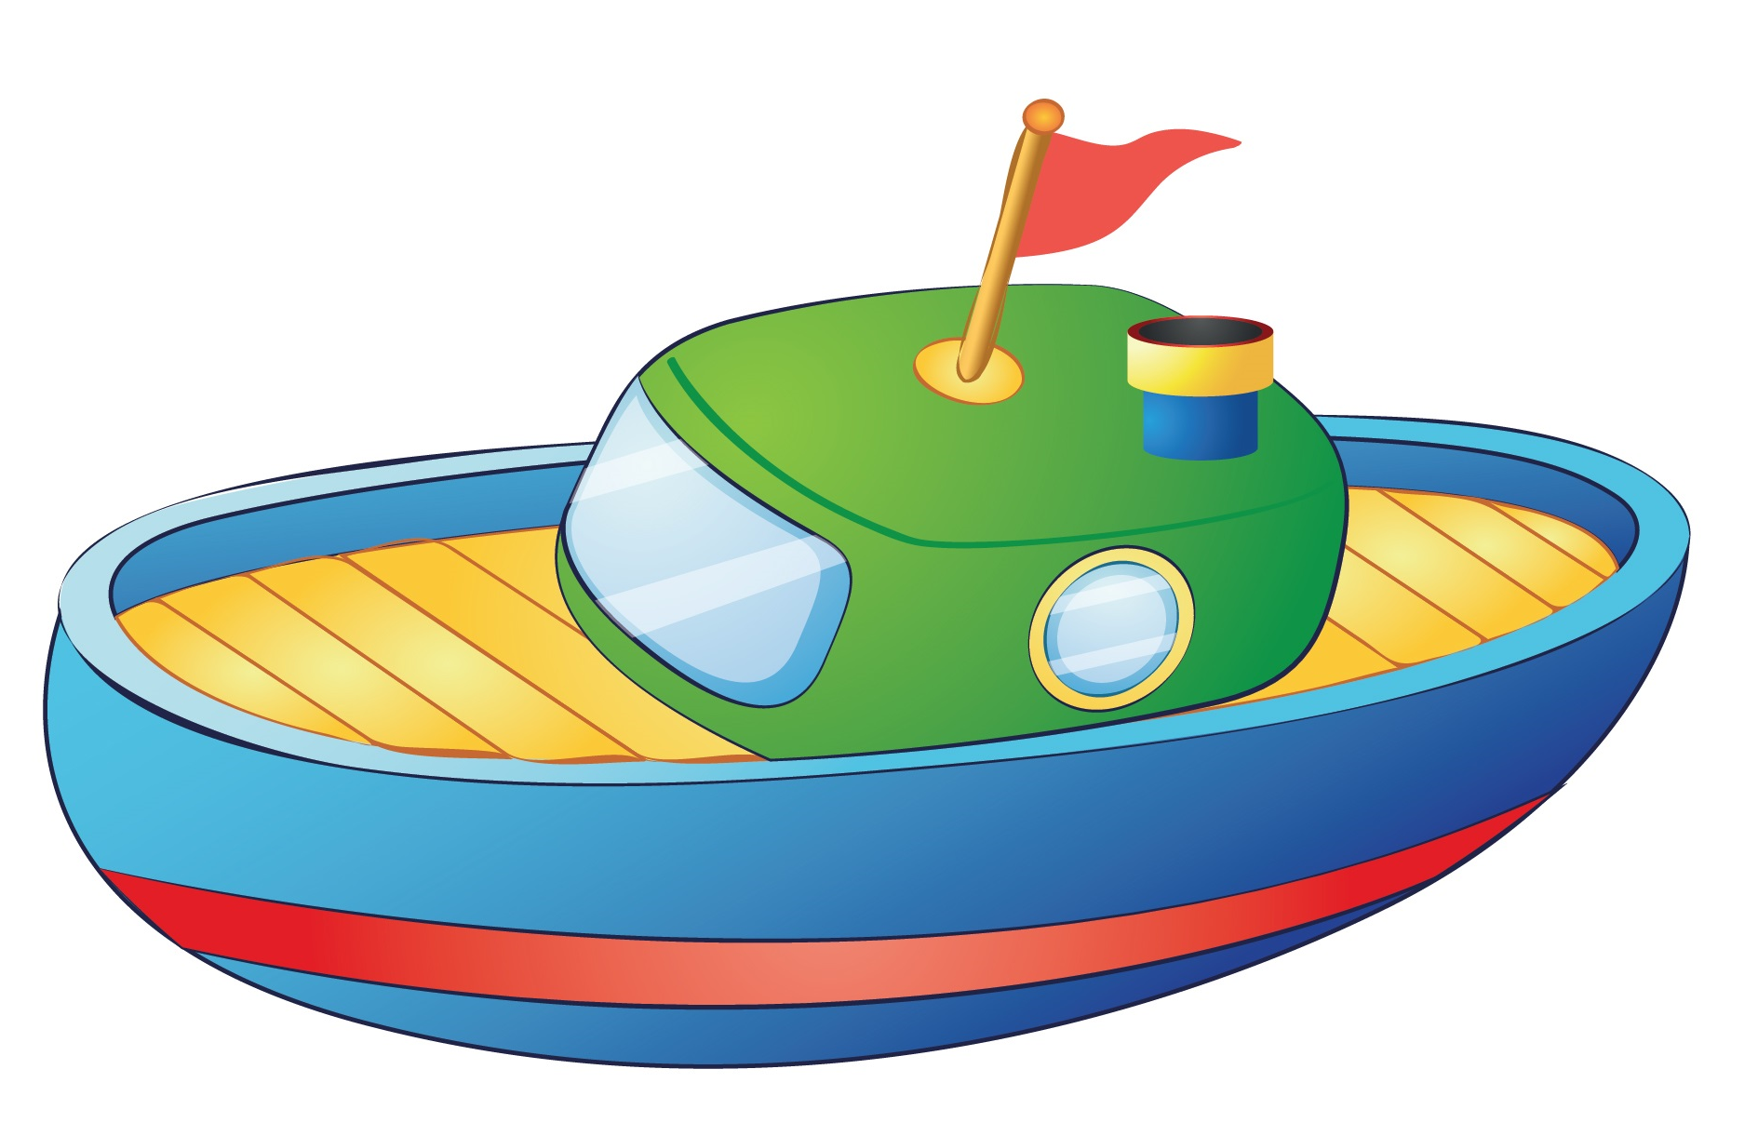

Game: Circle the picture
This is my plane.
A
B
Notes:
Circle the picture game
T says “look at the two picture. Listen to my sentence: This is my plane? Which one is the plane? Circle the picture of plane”
Work in groups
T asks “Group 1, Which one is my plane? A or B?”
Sts answer (each group has 1 turn)
T shows the answer – “Good job! One flower for group 1.”
With one correct answer, each group will have 1 flower.
Continue with the rest of the game.

Slide 5


Game: Circle the picture
It is sunny.
A
B

Slide 6
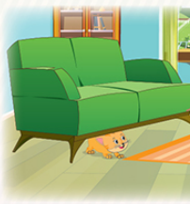
Game: Circle the picture
The cat is under the sofa.
A
B

Slide 7


Game: Circle the picture
This is my picture.
A
B
Notes:
Counting game
T says “I have got a lot of animals. Let’s count them with me.”
Work in groups
T asks “Group 1, how many dogs are there?”
Sts answer (each group has 1 turn)
T shows the answer – “Good job! One flower for group 1.”
With one correct answer, each group will have 1 flower.

Slide 8

Notes:
“Excellent, class! Let’s move to our lesson today.”

Slide 9

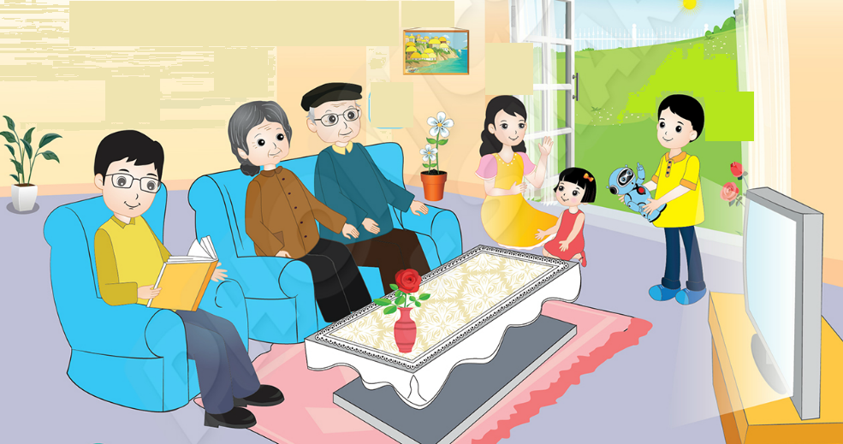
Unit 8: Lesson 4 Uu
Notes:
1. Introduce new lesson “Today, we will learn Unit 8 – Lesson 4. We will learn the members in family. Who are they? Now, look and listen.”

Slide 10

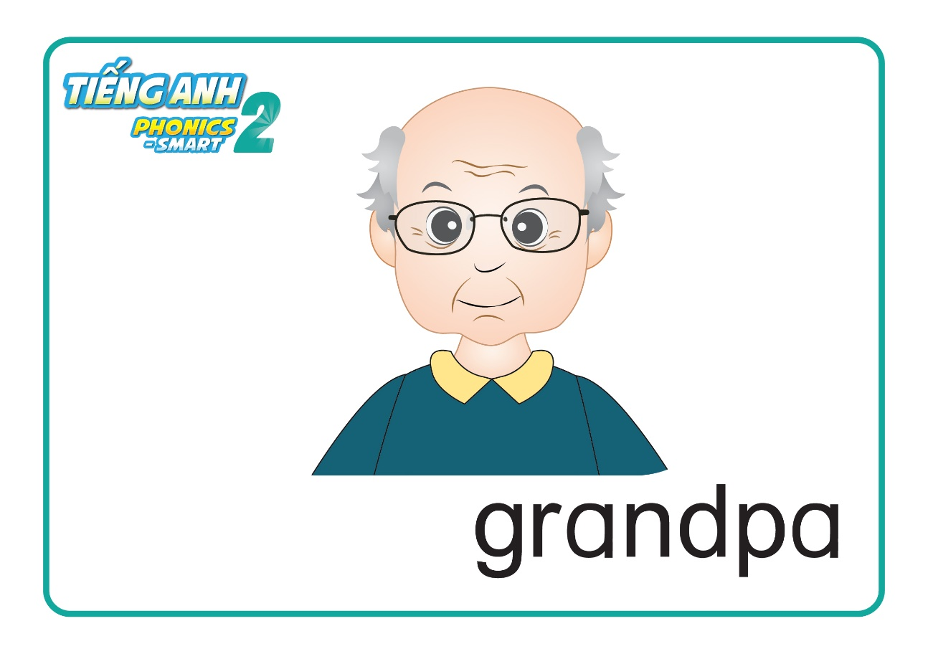
Unit 8: Lesson 4 Uu
1. Listen and repeat.
Notes:
Introduce picture “Class, who is it? OK! Now, listen 3 times”
Ask sts to listen 3 times
Ask sts to listen and repeat (class, group, individual) - “Listen and repeat. Class! Group 1, please! Group 2, please! You, you and you!
T can use body language to describe the word. - “Look at me and listen. Box! Class, what is it? Good!”
Click to make the word “box” disappear – Ask “Who is it?”
T can use body language to check sts’ understanding - “Look and tell me who it is.”

Slide 11
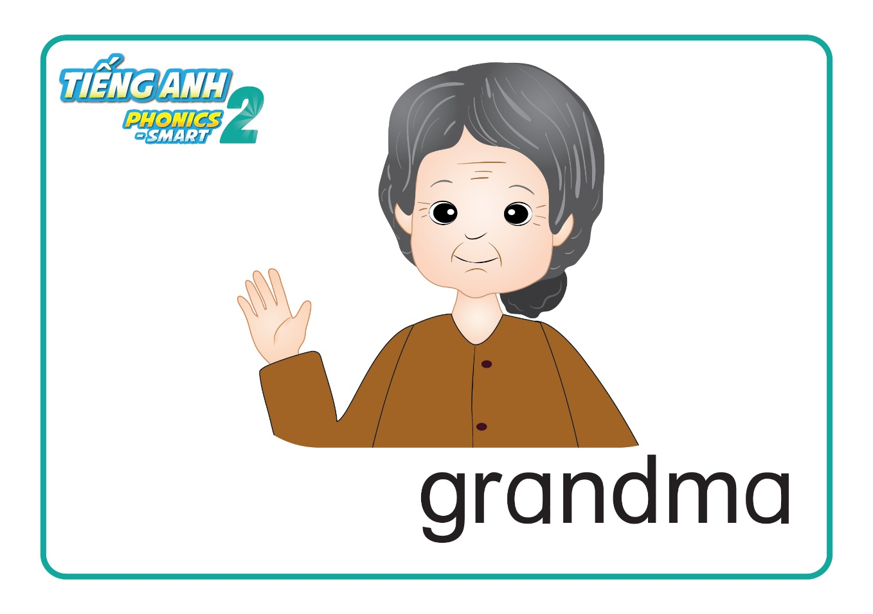
Unit 8: Lesson 4 Uu
1. Listen and repeat.
Notes:
Introduce picture “Class, who is it? OK! Now, listen 3 times”
Ask sts to listen 3 times
Ask sts to listen and repeat (class, group, individual) - “Listen and repeat. Class! Group 1, please! Group 2, please! You, you and you!
T can use body language to describe the word. - “Look at me and listen. Box! Class, what is it? Good!”
Click to make the word “box” disappear – Ask “Who is it?”
T can use body language to check sts’ understanding - “Look and tell me who it is.”

Slide 12
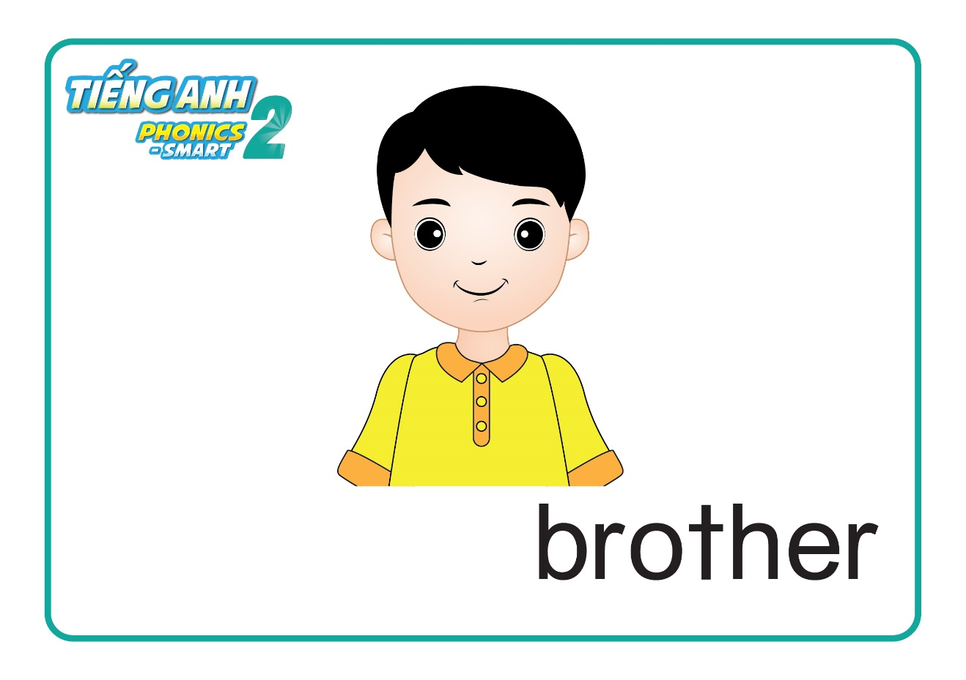
Unit 8: Lesson 4 Uu
1. Listen and repeat.

Slide 13
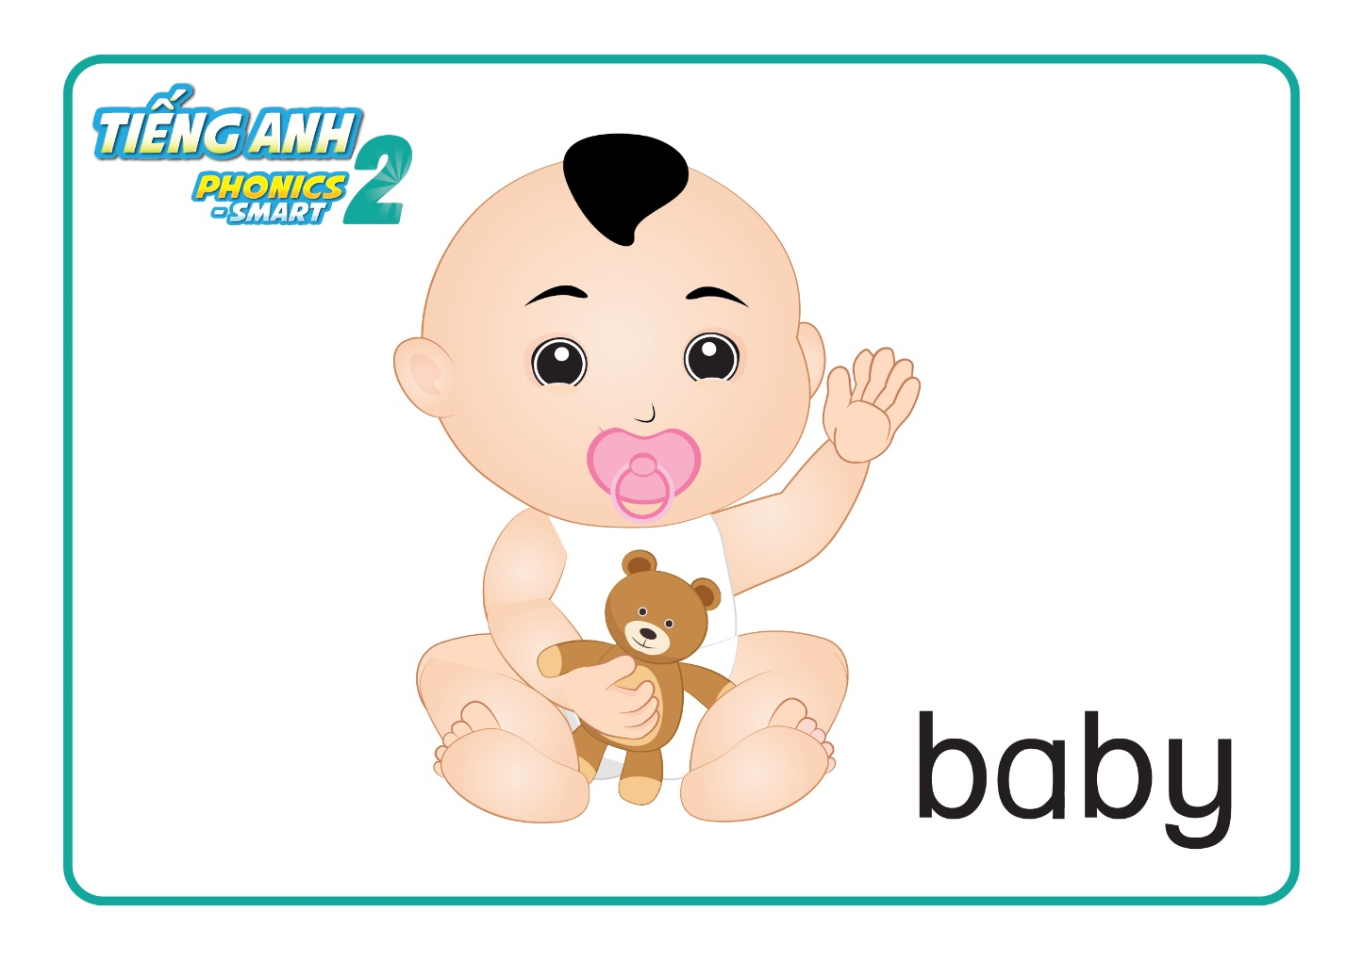
1. Listen and repeat.

Slide 14
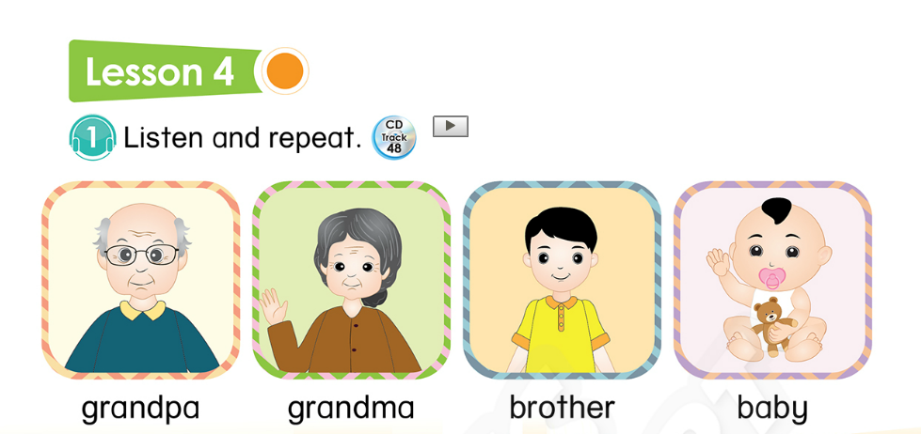
Page 41
Notes:
Book using – Look, point and say
1. T says “Class, open your book page 41. Let’s look, point and tell me who it is.”
2. T points at the picture and asks “Who is it?”
3. T gives 1 flower to each group -“Great! One flower for each group.”

Slide 15

Unit 8:
Lesson 4:
H h
1. Listen and repeat.
Game: Who is this?
Notes:
Game: Who is it?
T says “ You will see a balloon with one person on it. The balloon moves so fast. You’ll try to guess “Who is this?”
Stt work in group to play the game and raise their hands to answer.
T shows the answer and asks stt to repeat.”
Give the stars for the correct answers.

Slide 16
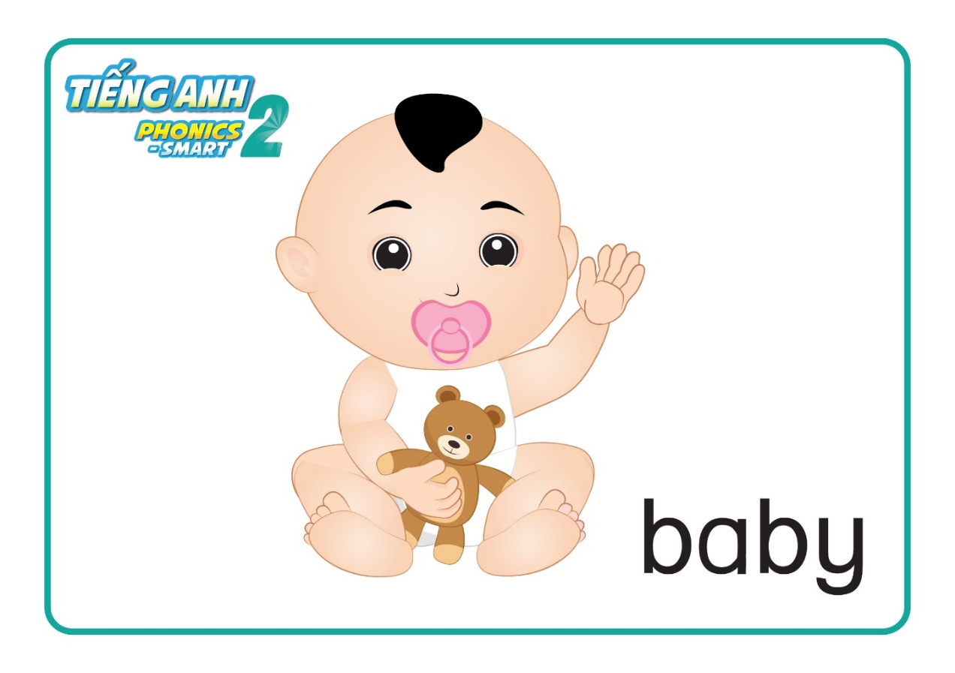

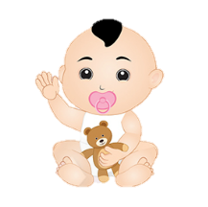
Unit 8:
Lesson 4:
H h
1. Listen and repeat.
Who is this?
Notes:
Game: Who is it?
T says “ You will see a balloon with one person on it. The balloon moves so fast. You’ll try to guess “Who is this?”
Stt work in group to play the game and raise their hands to answer.
T shows the answer and asks stt to repeat.”
Give the stars for the correct answers.

Slide 17
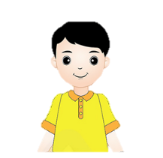
Unit 8:
Lesson 4:
H h
1. Listen and repeat.
Who is this?
Notes:
Game: Who is it?
T says “ You will see a balloon with one person on it. The balloon moves so fast. You’ll try to guess “Who is this?”
Stt work in group to play the game and raise their hands to answer.
T shows the answer and asks stt to repeat.”
Give the stars for the correct answers.

Slide 18
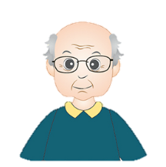
Unit 8:
Lesson 4:
H h
1. Listen and repeat.
Who is this?

Slide 19

Unit 8:
Lesson 4:
H h
1. Listen and repeat.
Who is this?

Slide 20

Notes:
“Well done. You did very well.”

Slide 21
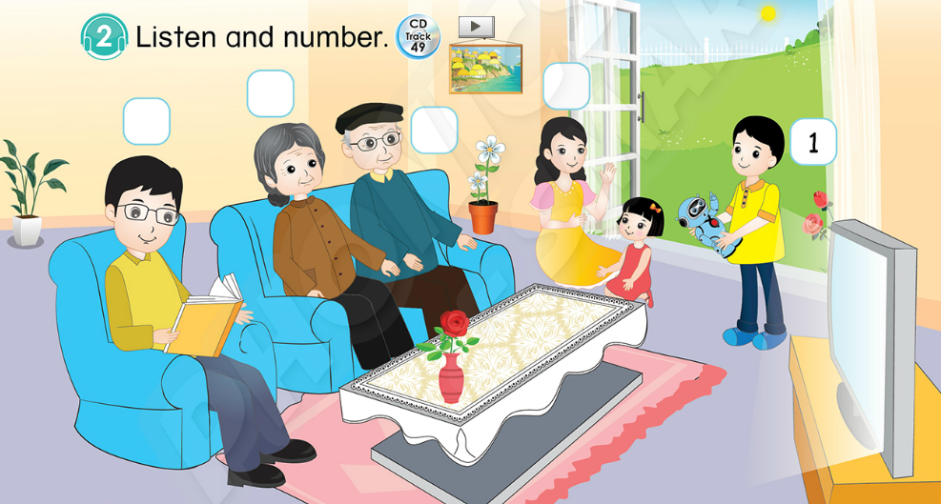

Unit 8:
Lesson 4:
H h
Page 41
Notes:
T says “ Let’s listen and number.”
Play the audio and do an example number 1, What can you hear? Point at the brother. Yes, this is my brother.”
T says “So, we write number 1 in the box here.

Slide 22

Unit 8:
Lesson 4:
H h
3
2
4
5
1
Page 39
Notes:
T asks sts to open their book and do task. – “Now, open your book page 39. Let’s listen and number.”
T play the audio for students to do the task. T plays the audio two times.
T plays the audio again for students to listen and check the answers.
T clicks the number to review the sentences which they heard.

Slide 23
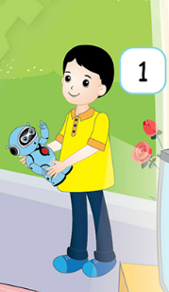
1
Notes:
“Well done. One flower for each group. Let’s move to next part.”

Slide 24

2
Notes:
“Well done. One flower for each group. Let’s move to next part.”

Slide 25

3
Notes:
“Well done. One flower for each group. Let’s move to next part.”

Slide 26
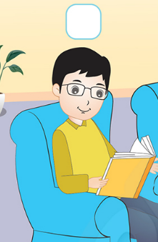
4
Notes:
“Well done. One flower for each group. Let’s move to next part.”

Slide 27
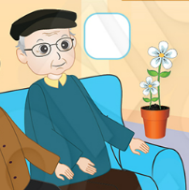
5
Notes:
“Well done. One flower for each group. Let’s move to next part.”

Slide 28
Notes:
“Good job. Now, Let’s draw with me.”

Slide 29
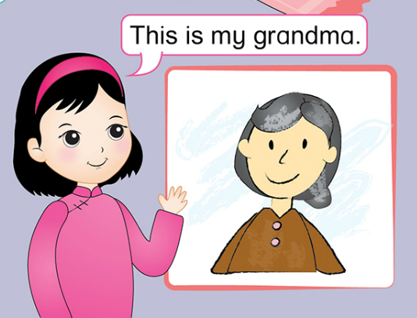
Unit 8:
Lesson 4:
U u
1. Listen and repeat.
2. Listen and number.
3. Draw and say.
Notes:
T asks “Class, who is it? Great.”
T says “This is my picture of my grandma.”

Slide 30

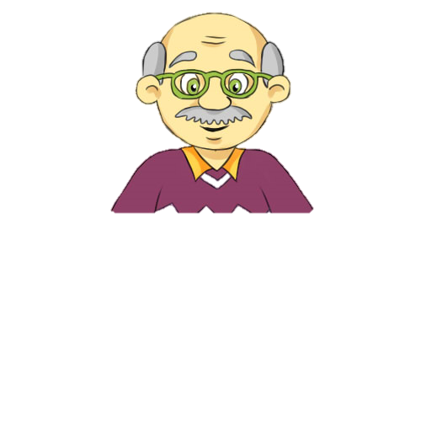
Unit 8:
Lesson 4:
U u
3. Draw and say.
This is my grandpa.
Notes:
“Now, let’s draw your picture of one member in your family and then talk about the picture.”

Slide 31
Notes:
“You are so good. One flower for each group.”

Slide 32

Unit 8:
Lesson 4:
H h
Sum up.
Notes:
Let’s sum up.

Slide 33
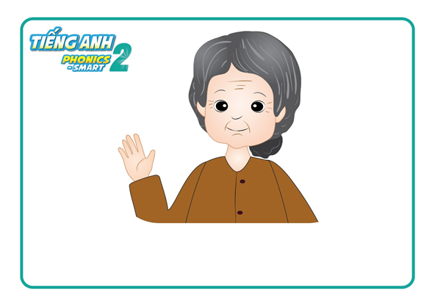
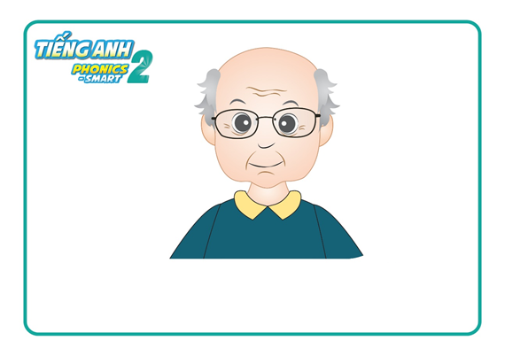
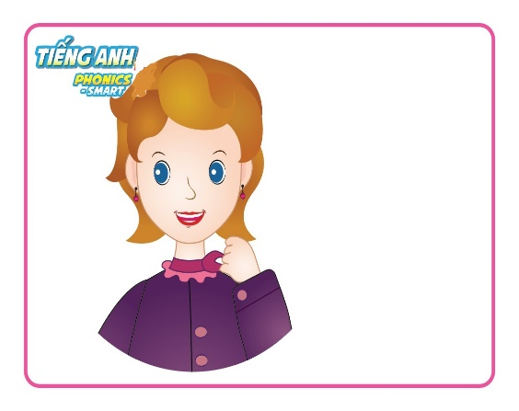
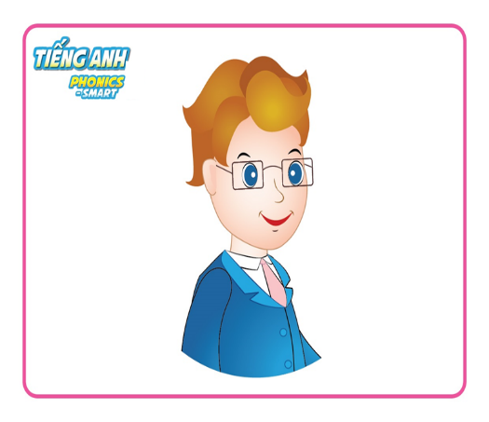
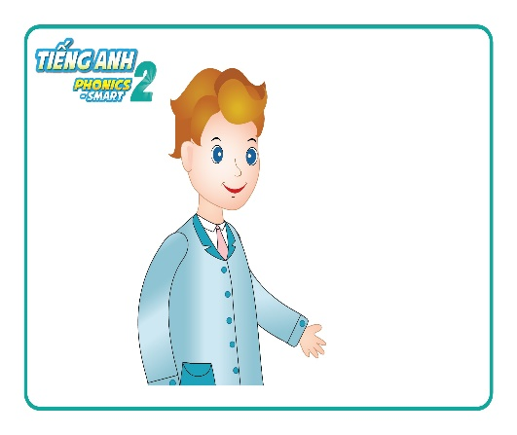
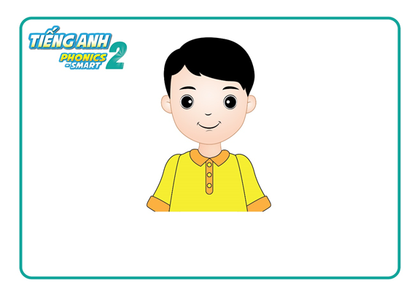
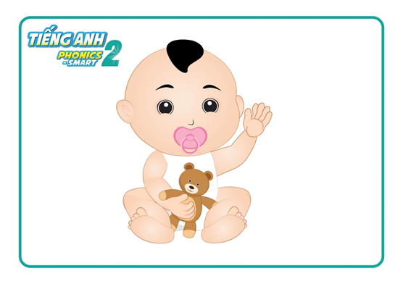
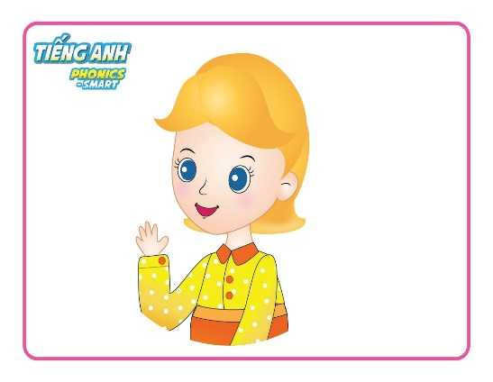
Unit 8:
Lesson 4:
Uu
Notes:
T asks “Look at these pictures again, who is it? Good!”
Count the flowers of each groups – “Let’s count your flowers.”
Group having more flowers will be the winner. – “So the winner is group …. Group …, you also good, too.”
Say goodbye “ Now, let’s say ‘Goodbye egg, Goodbye elephant”. Now, Goodbye class.”

Slide 34


CÔNG TY CỔ PHẦN PHÁT TRIỂN GIÁO DỤC
VIỆT NAM VPBOX
Hà Nội
Biệt thự G2&G28, Làng Quốc Tế Thăng Long,
Quận Cầu Giấy, Hà Nội.
ĐT: (024) 3 3793 2405
phonics.hanoi@vpbox.edu.vn
Thành Phố Hồ Chí Minh
Số 29 Mai Thị Lựu, Quận 1, TP. HCM.
ĐT: (028) 3 820 5934
phonics.hcm@vpbox.edu.vn
www.vpbox.edu.vn

