Slide 3
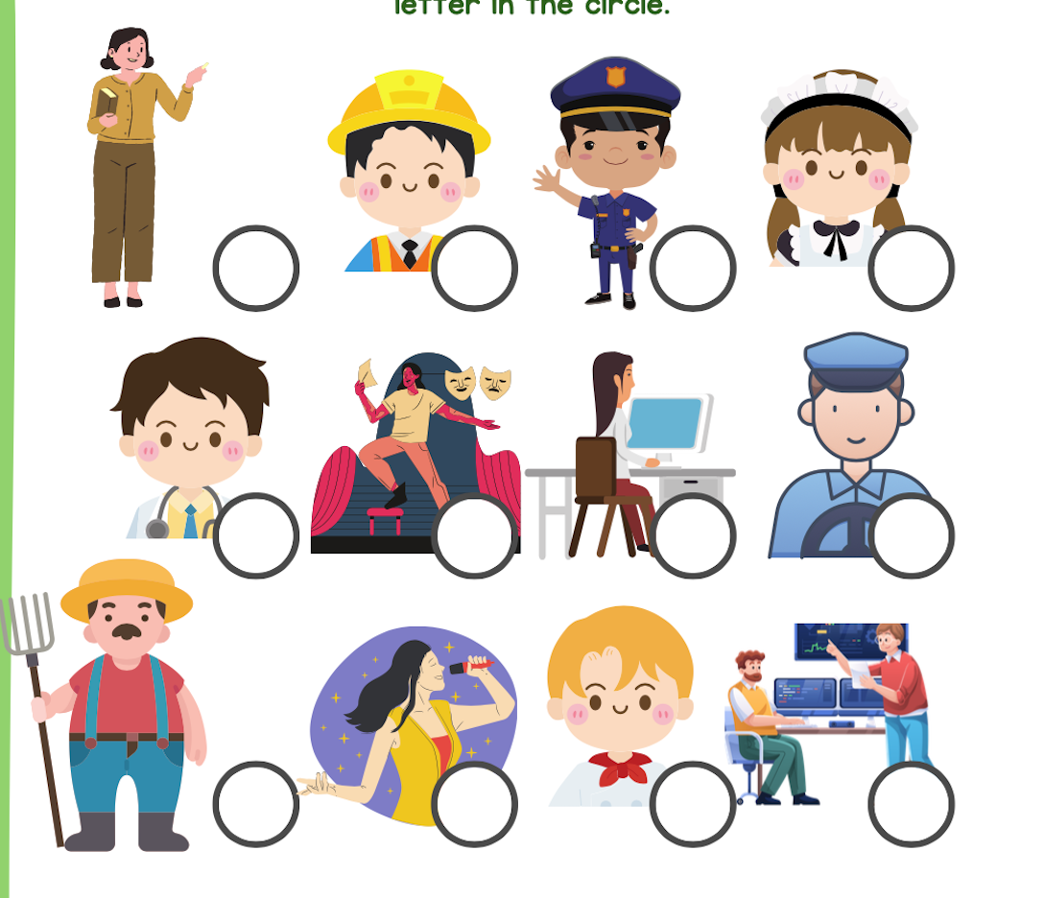
WARM-UP: GUESS THE JOBS
Notes:
ask pupils to think fast and guess the jobs of the people in the picture.

Slide 4
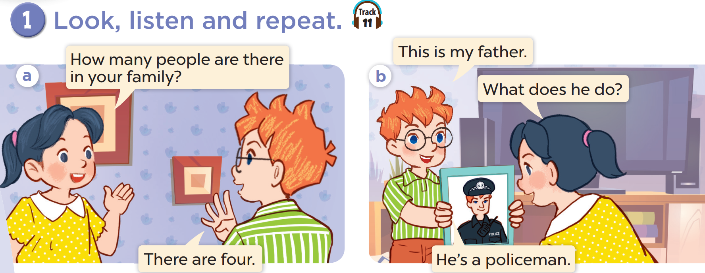

Slide 5


Slide 6
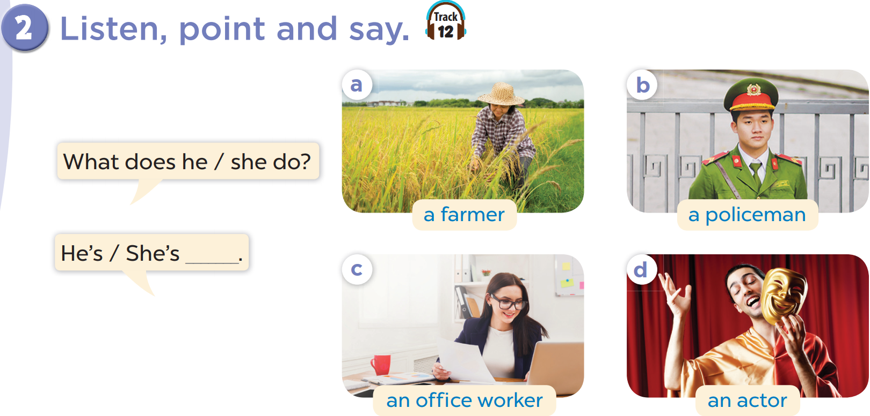

Slide 7
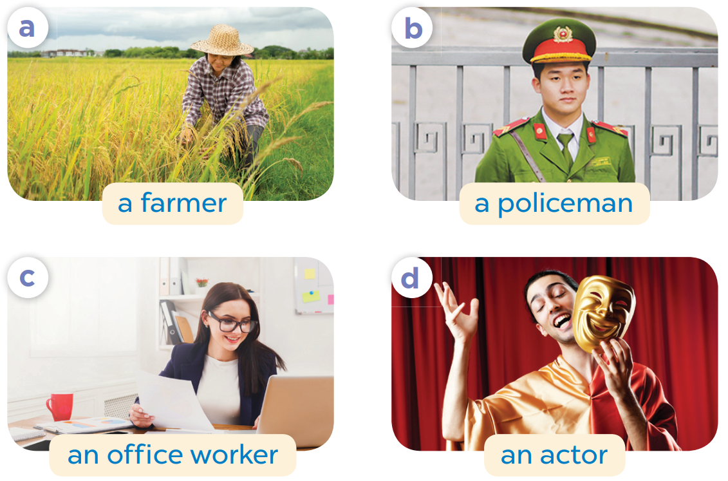

Slide 8
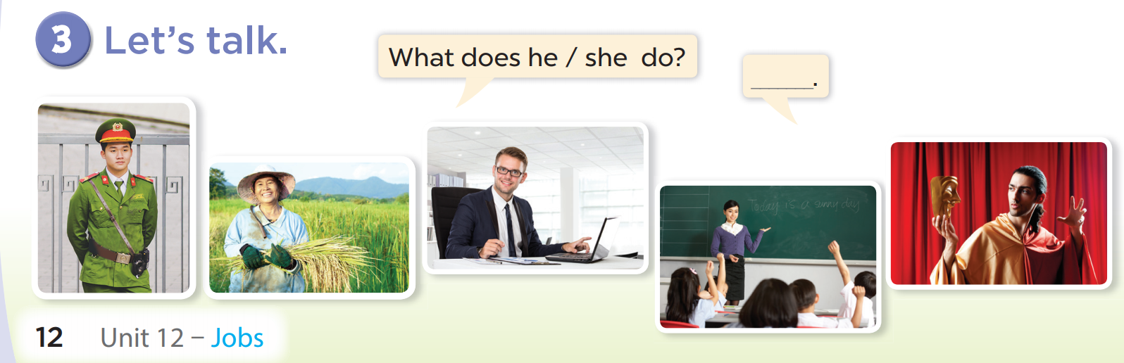

Slide 9



Slide 10
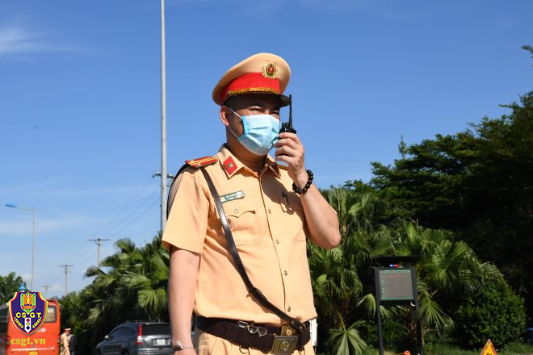
What does he do?
a policeman
He’s a farmer.
He’s a policeman.
A:
B:
A:
He’s an office worker.
He’s an actor.
C:
D:

Slide 11
What does he do?
He’s a policeman.
He’s a farmer.
A:
B:
an office worker
an actor
He’s an office worker.
He’s an actor.
:
D
C:
D:

Slide 12
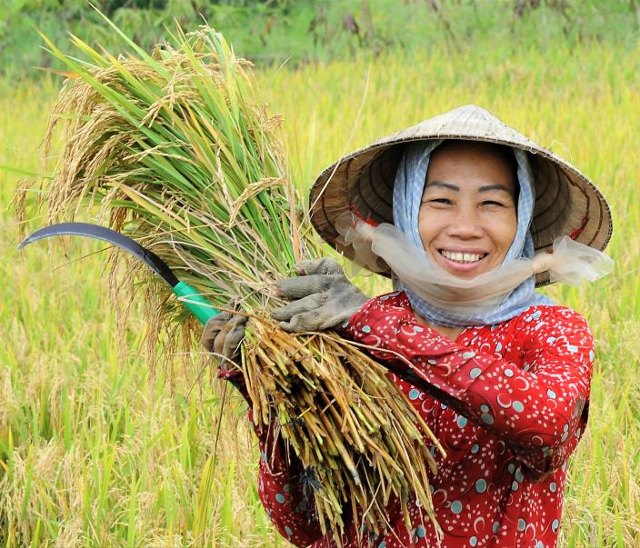
What does she do?
She’s a nurse.
She’s an office worker.
A:
B:
She’s a farmer.
She‘s a teacher.
C:
D:

Slide 13
What does she do?
She’s an office worker.
A:
She’s a nurse.
B:
She’s a farmer.
She‘s a teacher.
C:
D:

Slide 14

What does she do?
She‘s a teacher.
She‘s an office worker.
A:
B:
She‘s a farmer.
She‘s a nurse.
C:
D:

Slide 15
What does she do?
She‘s a teacher.
She‘s an office worker.
A:
B:
C:
She‘s a farmer.
She‘s a nurse.
D:

Slide 16
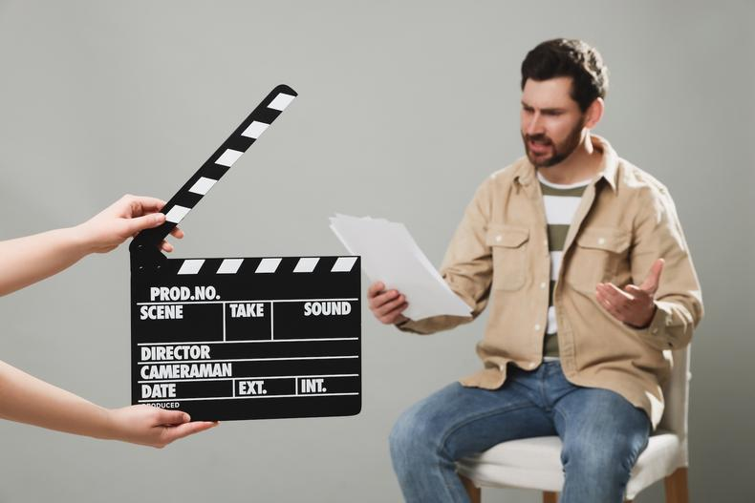
What does he do?
He’s a policeman.
He’s a farmer.
A:
B:
A:
He’s an office worker.
He’s an actor.
C:
C:
D:
D:

Slide 17
What does he do?
He’s a policeman.
He’s a farmer.
A:
B:
He’s an office worker.
He’s an actor.
C:
D:

