Slide 1



Playing and doing
Ms Saida

Slide 2
Vocabulary

Slide 3
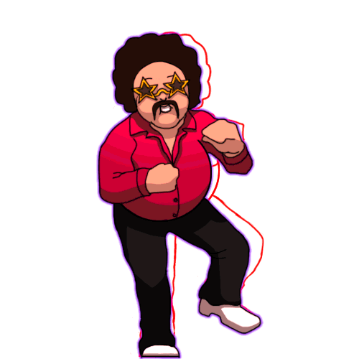
Dancing

Slide 4
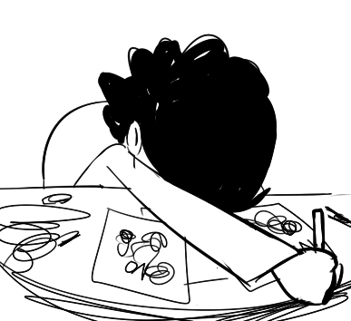
Drawing pictures

Slide 5

Listening to music

Slide 6
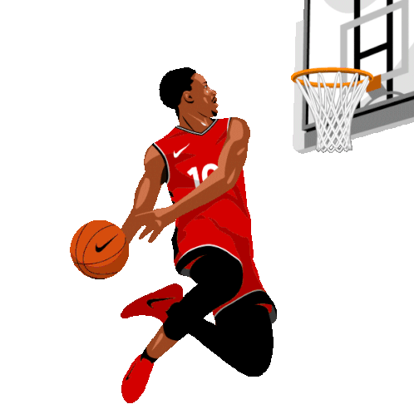
Playing basketball

Slide 7

Reading

Slide 8
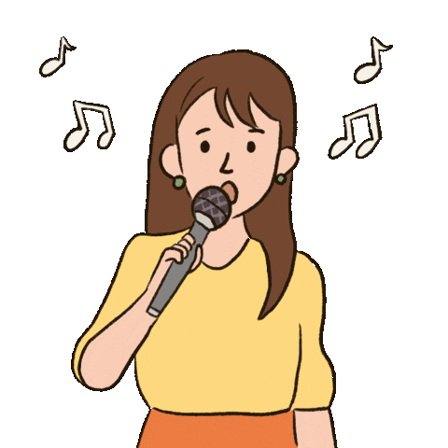
Singing

Slide 9

Watching Tv

Slide 10
Structure

Slide 11
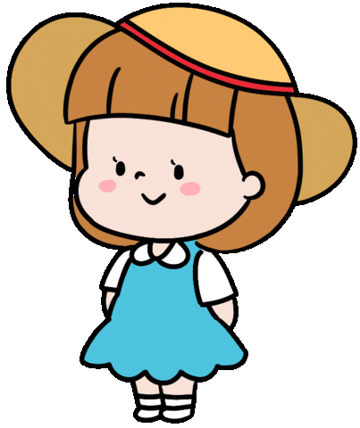
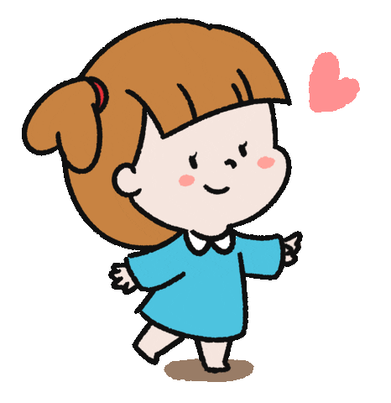
What are you doing!?
I’m……..

Slide 12
What are you doing!?
I’m……..

Slide 13
What are you doing!?
I’m……..

Slide 14
What are you doing!?
I’m……..

Slide 15



