Slide 1
Grade 3 REVIEW unit 15 At the dining table
Teacher Saida

Slide 2
Vocabulary

Slide 3
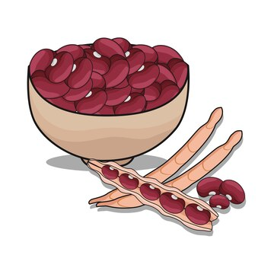
Bean

Slide 4

Bread

Slide 5

Chicken

Slide 6
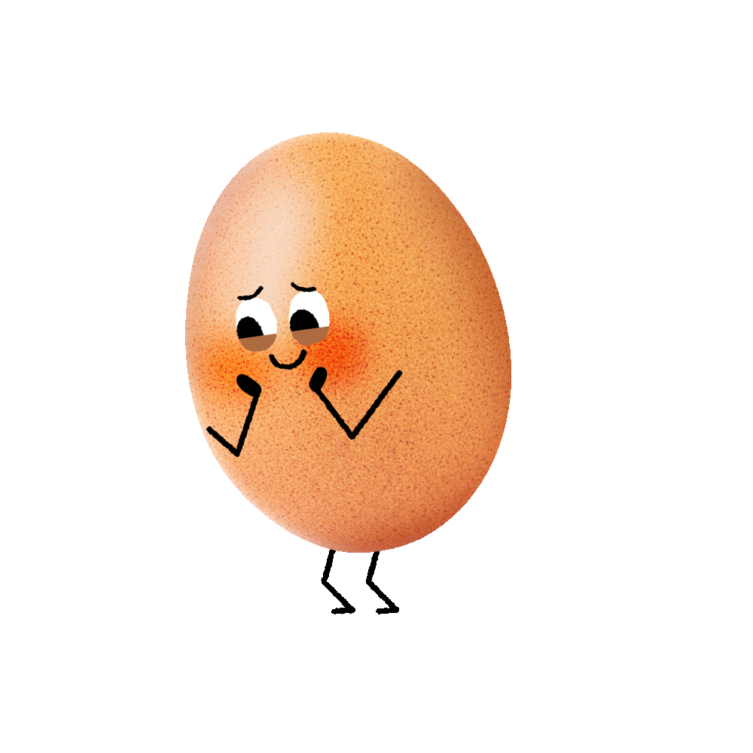
Egg

Slide 7

Fish

Slide 8
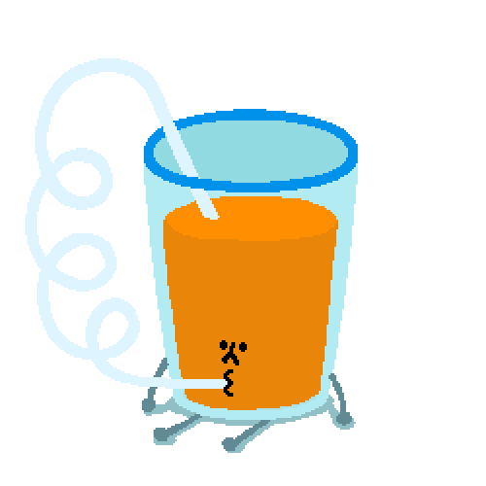
Juice

Slide 9

Meat

Slide 10

Milk

Slide 11

Rice

Slide 12

Water

Slide 13
Bean
Bread
Egg
Juice
Meat
Fish

Slide 14
Milk
Chicken
Water
Rice

Slide 15
Structure

Slide 16
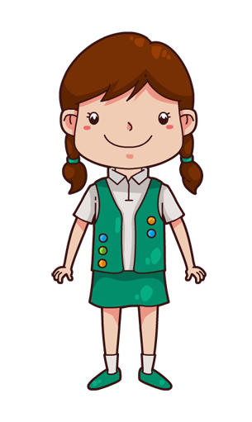
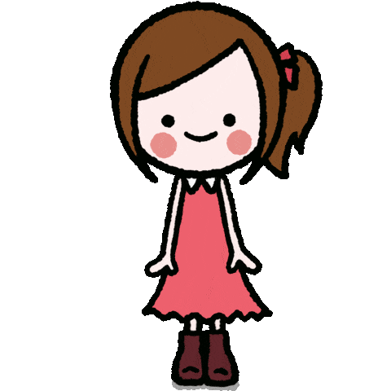
Would you like some….?
Yes , please
No, thanks

Slide 17
Would you like some….?
Yes , please
No, thanks

Slide 18
Would you like some….?
Yes , please
No, thanks

Slide 19
What would you like to drink/eat ?
I’d like some….. ,please

Slide 20
What would you like to drink/eat ?
I’d like some….. ,pleas

Slide 21
What would you like to drink/eat ?
I’d like some….. ,pleas

Slide 22


