Slide 1
Grade 3 unit 16 My pets
Teacher Saida

Slide 2
Vocabulary

Slide 3
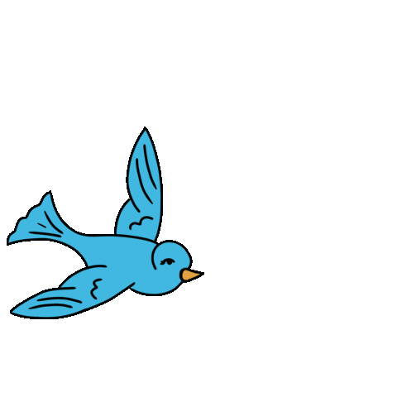
Bird

Slide 4
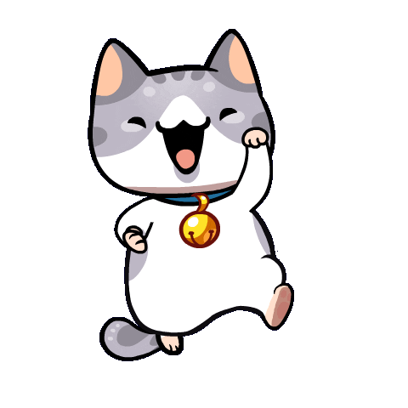
Cat

Slide 5
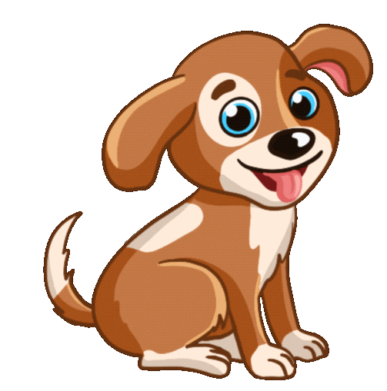
Dog

Slide 6
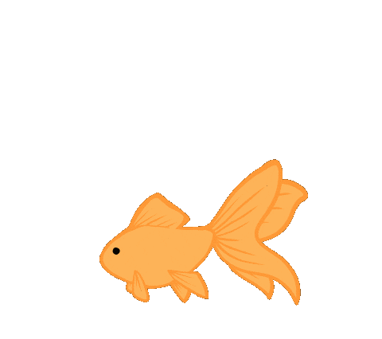
Gold fish

Slide 7
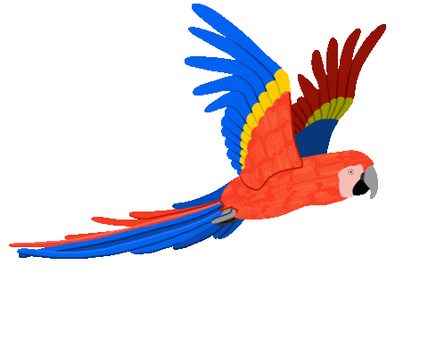
Parrot

Slide 8
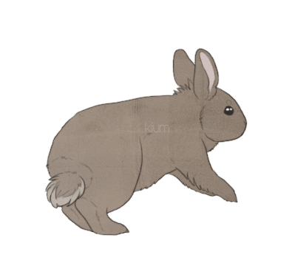
Rabbit

Slide 9
Cat
Parrot
Dog
Rabbit
Gold fish
Bird

Slide 10
Structure

Slide 11
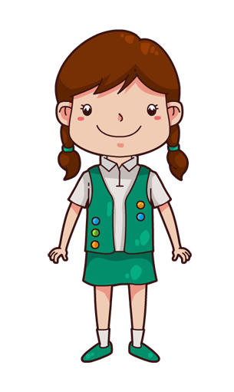
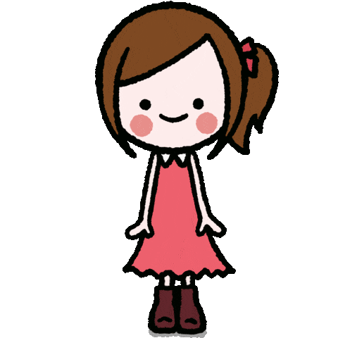
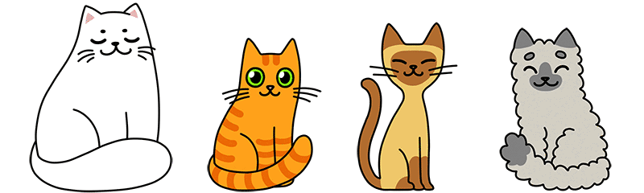
Do you have any…?
Yes, I do
No, I don’t

Slide 12
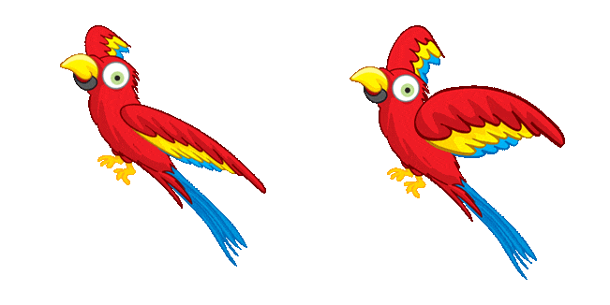
Do you have any…?
Yes, I do
No, I don’t

Slide 13
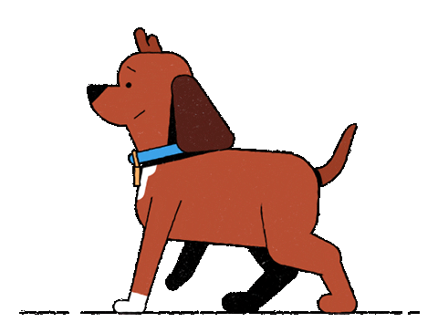
Do you have any…?
Yes, I do
No, I don’t

Slide 14
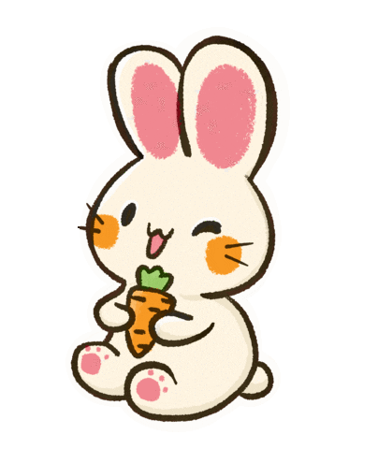
Do you have any…?
Yes, I do
No, I don’t

Slide 15
Cat
Parrot
Dog
Rabbit
Gold fish
Bird

Slide 16


