Slide 1
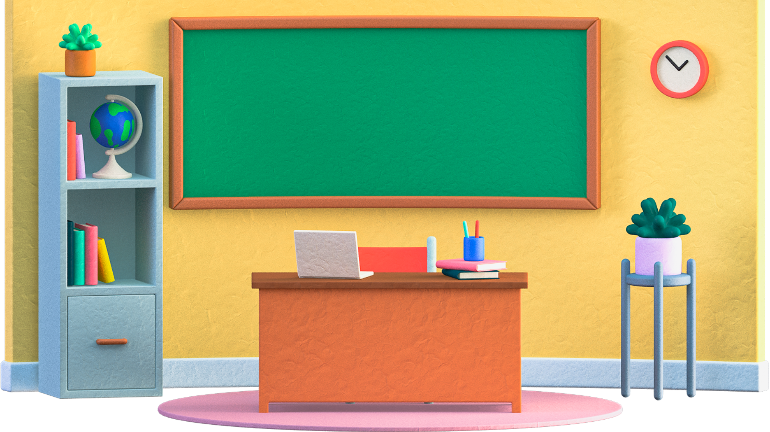
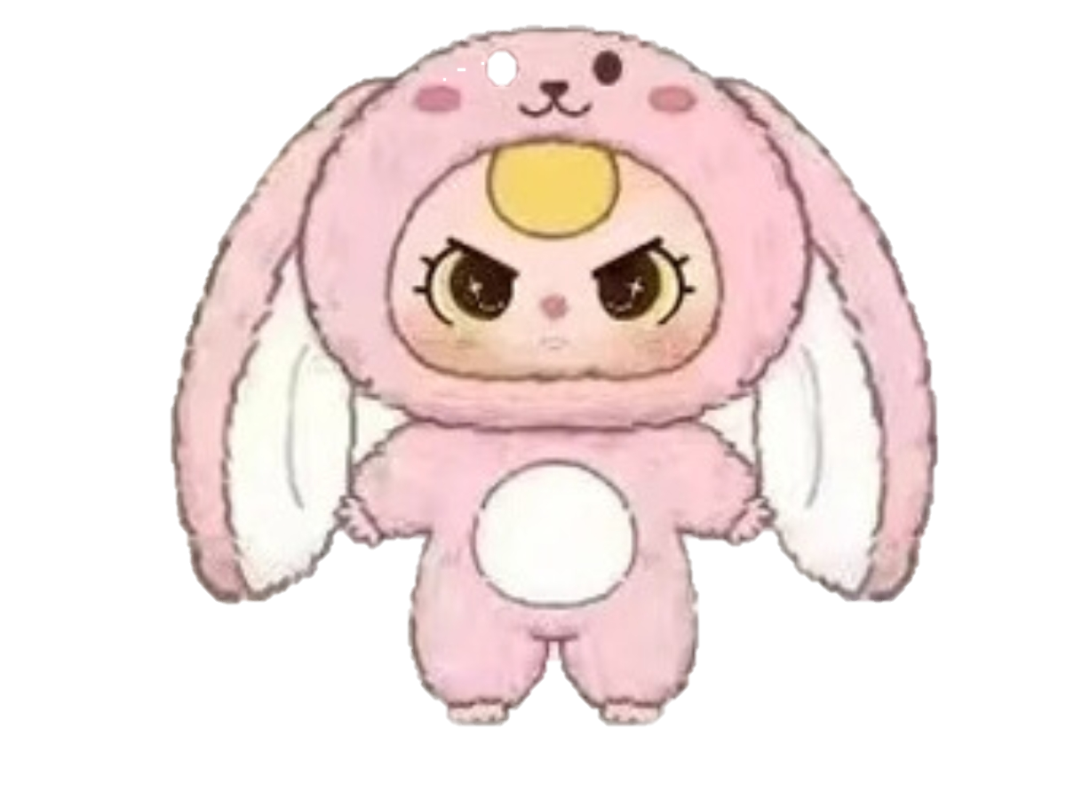

Slide 2


Hello class. My name's Baby Three. I'm here with a special gift for the class! But there’s a little twist – to earn your gift, you’ll have to face Baby Three’s fun challenges. Are you ready, class?

Slide 4
Group 1
Group 2
Group 3

Slide 5

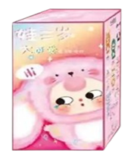

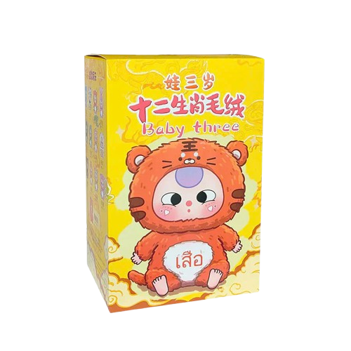
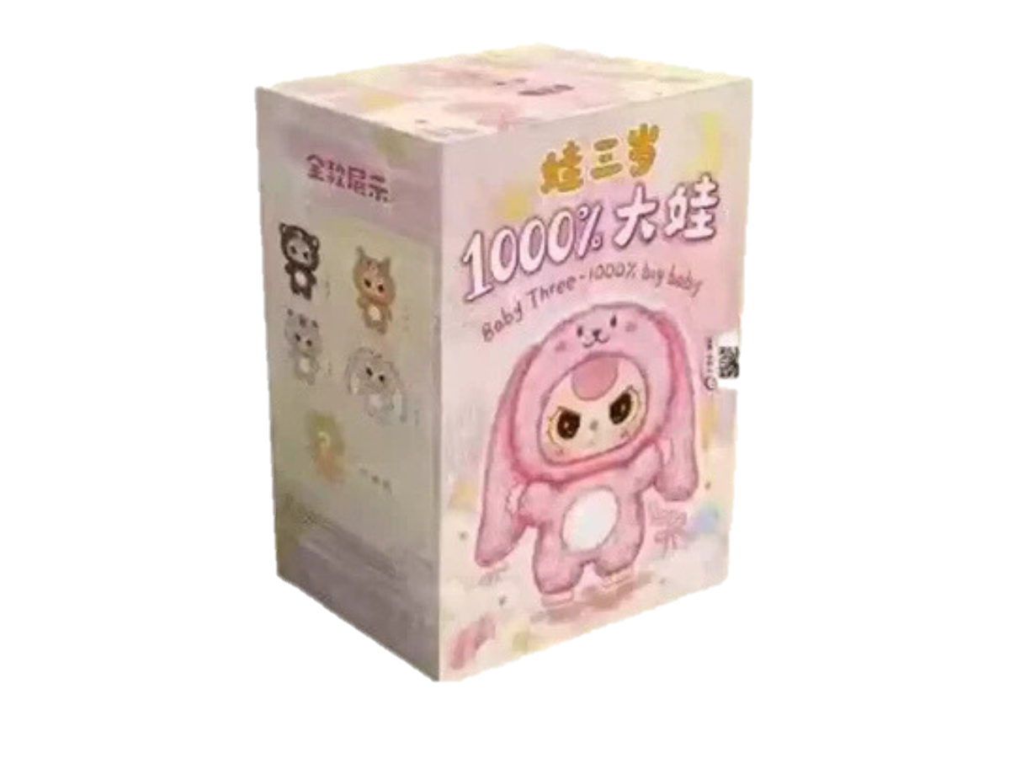
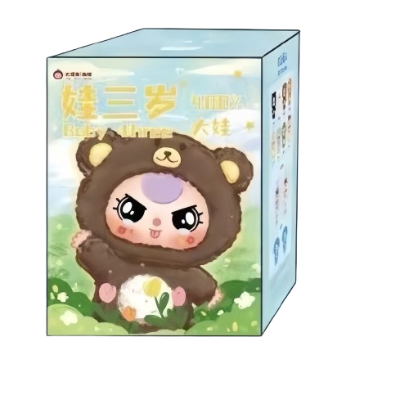
Second challenge
First challenge
Fourth challenge
Third challenge

Slide 6
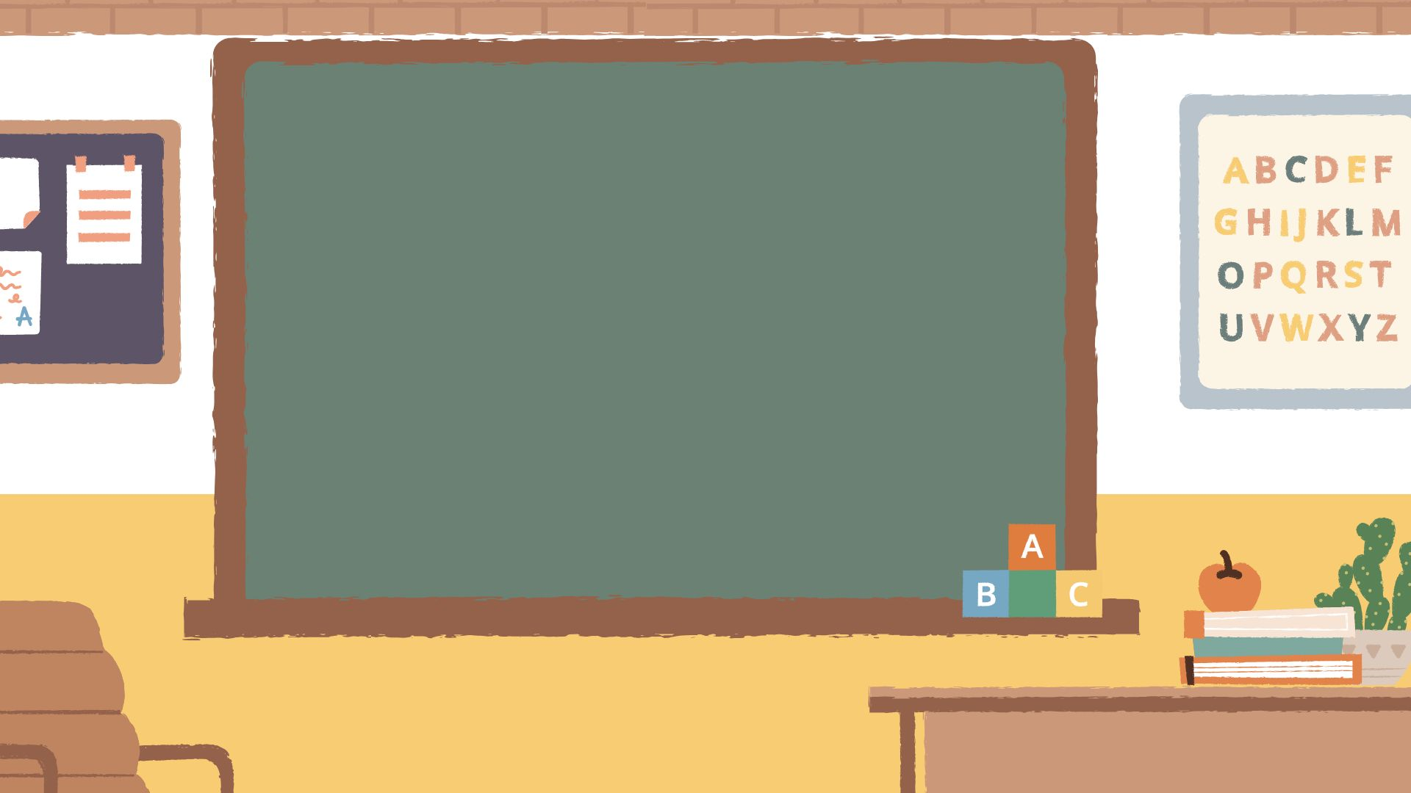
REVIEW

Slide 7
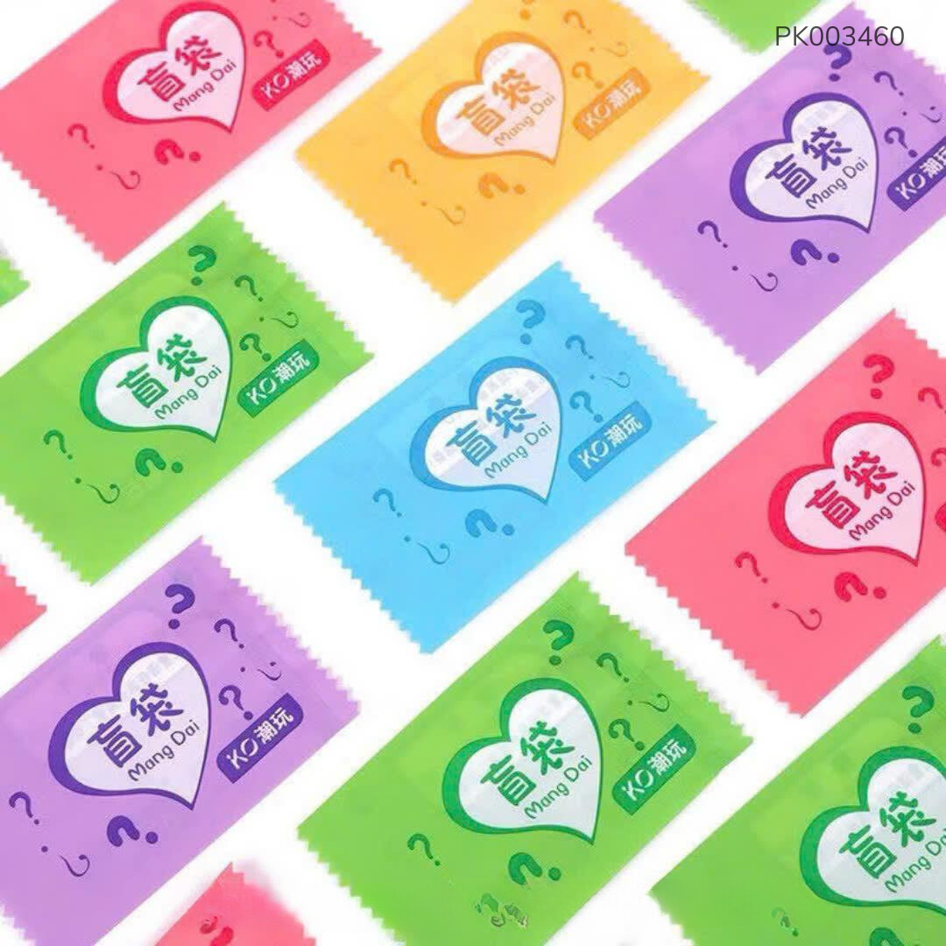
Blind box

Slide 8
Great job!
We have just reviewed old lesson. Now we will move on to today's new lesson.

Slide 9
What lesson do we learn today, teacher?

Slide 10
Unit 10: Break time activities.
Lesson 1: Activity 4 - 6

Slide 11
Second challenge
First challenge
Fourth challenge
Third challenge

Slide 12
4. Listen and tick

Slide 13
Second challenge
First challenge
Fourth challenge
Third challenge

Slide 14
5. Look, complete and read

Slide 15
Second challenge
First challenge
Fourth challenge
Third challenge

Slide 16
6. Let’s sing

Slide 17
You have overcome the challenge excellently. I have a magic box. Can the teacher help deliver my gift to the children?

Slide 18


Slide 19


Magic box

Slide 20
Goodbye! See you later.

Slide 22


