Slide 1





Unit 9. Places in town
Lesson 1. Task 1, 2, 3

Slide 2











TOY SHOP
Notes:
Toy shop

Slide 3



CINEMA
Notes:
cinema

Slide 4



Tower
Buildings
Notes:
Building , tower

Slide 5
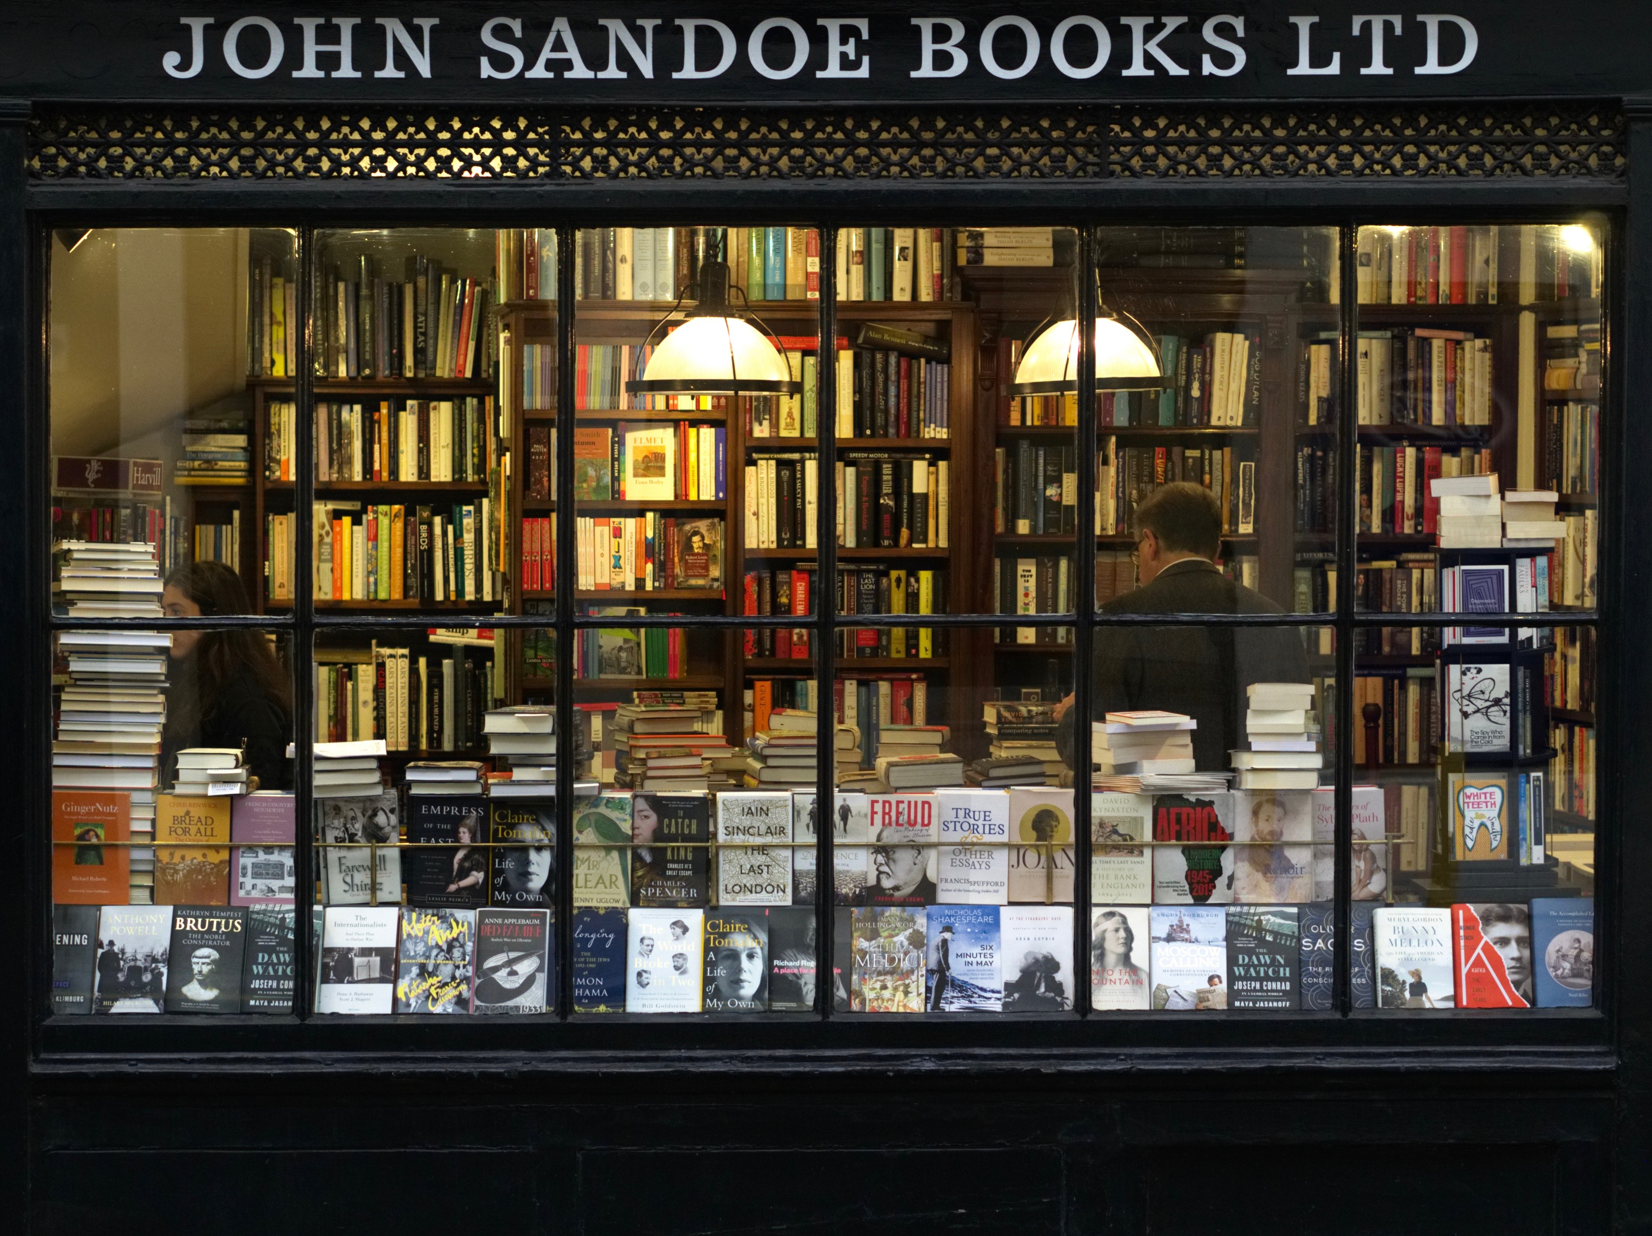
bookshop
Notes:
Nhấn vào khung chữ để nghe lại từ .

Slide 6
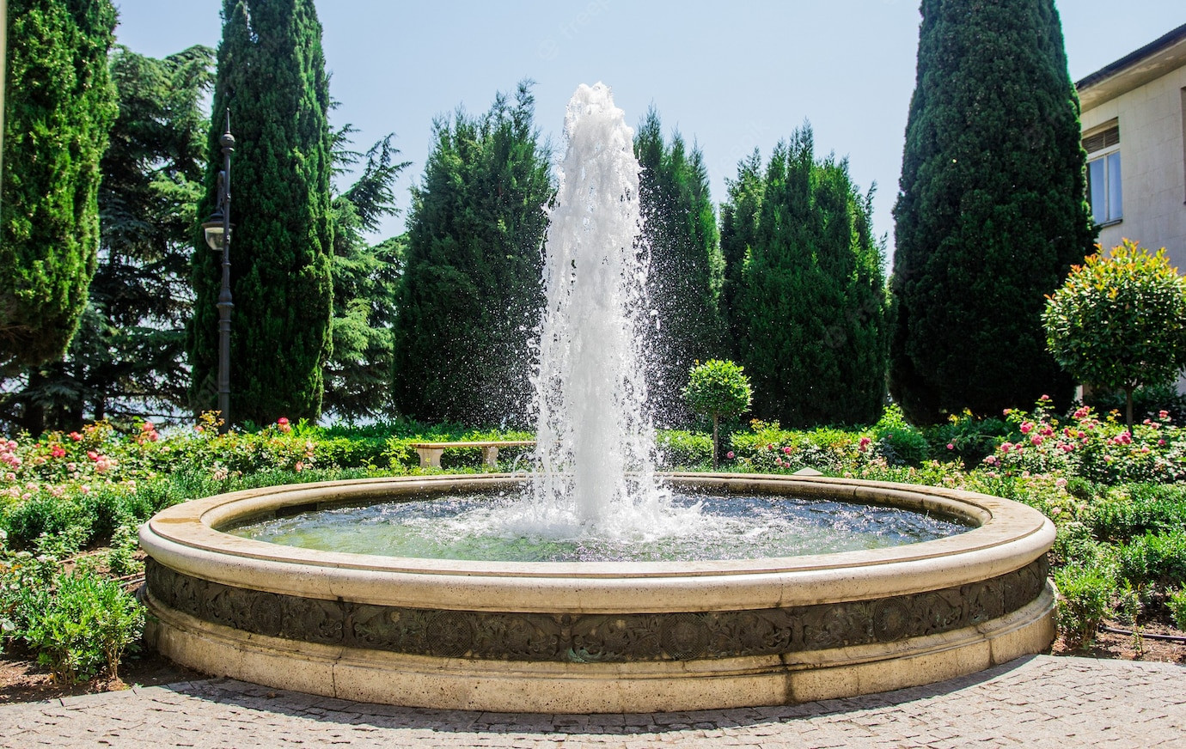

fountain

Slide 7
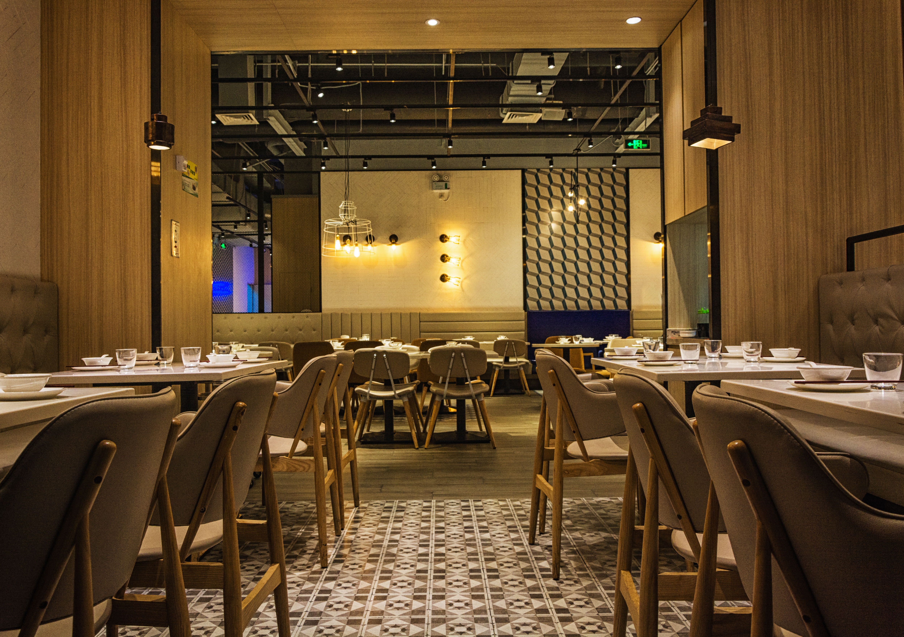
restaurant

Slide 8
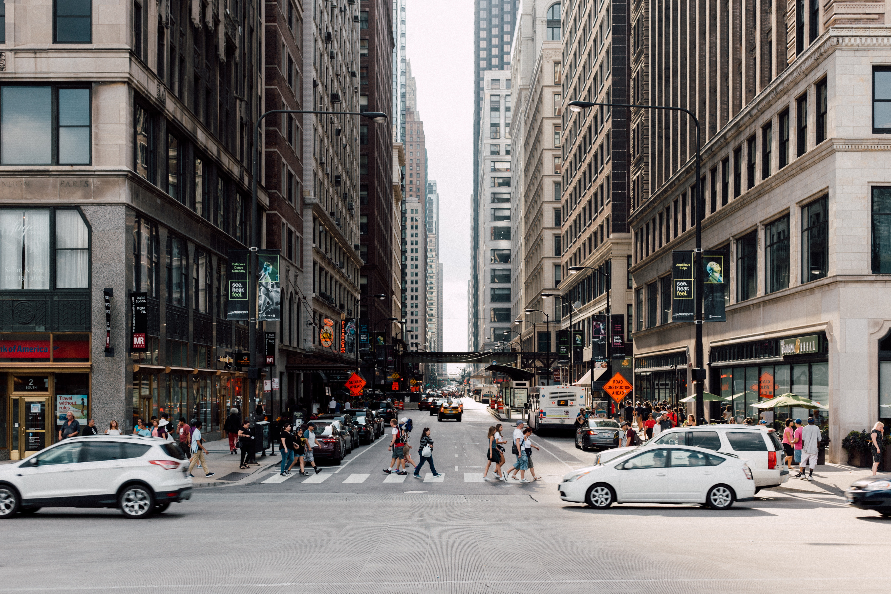
street

Slide 9

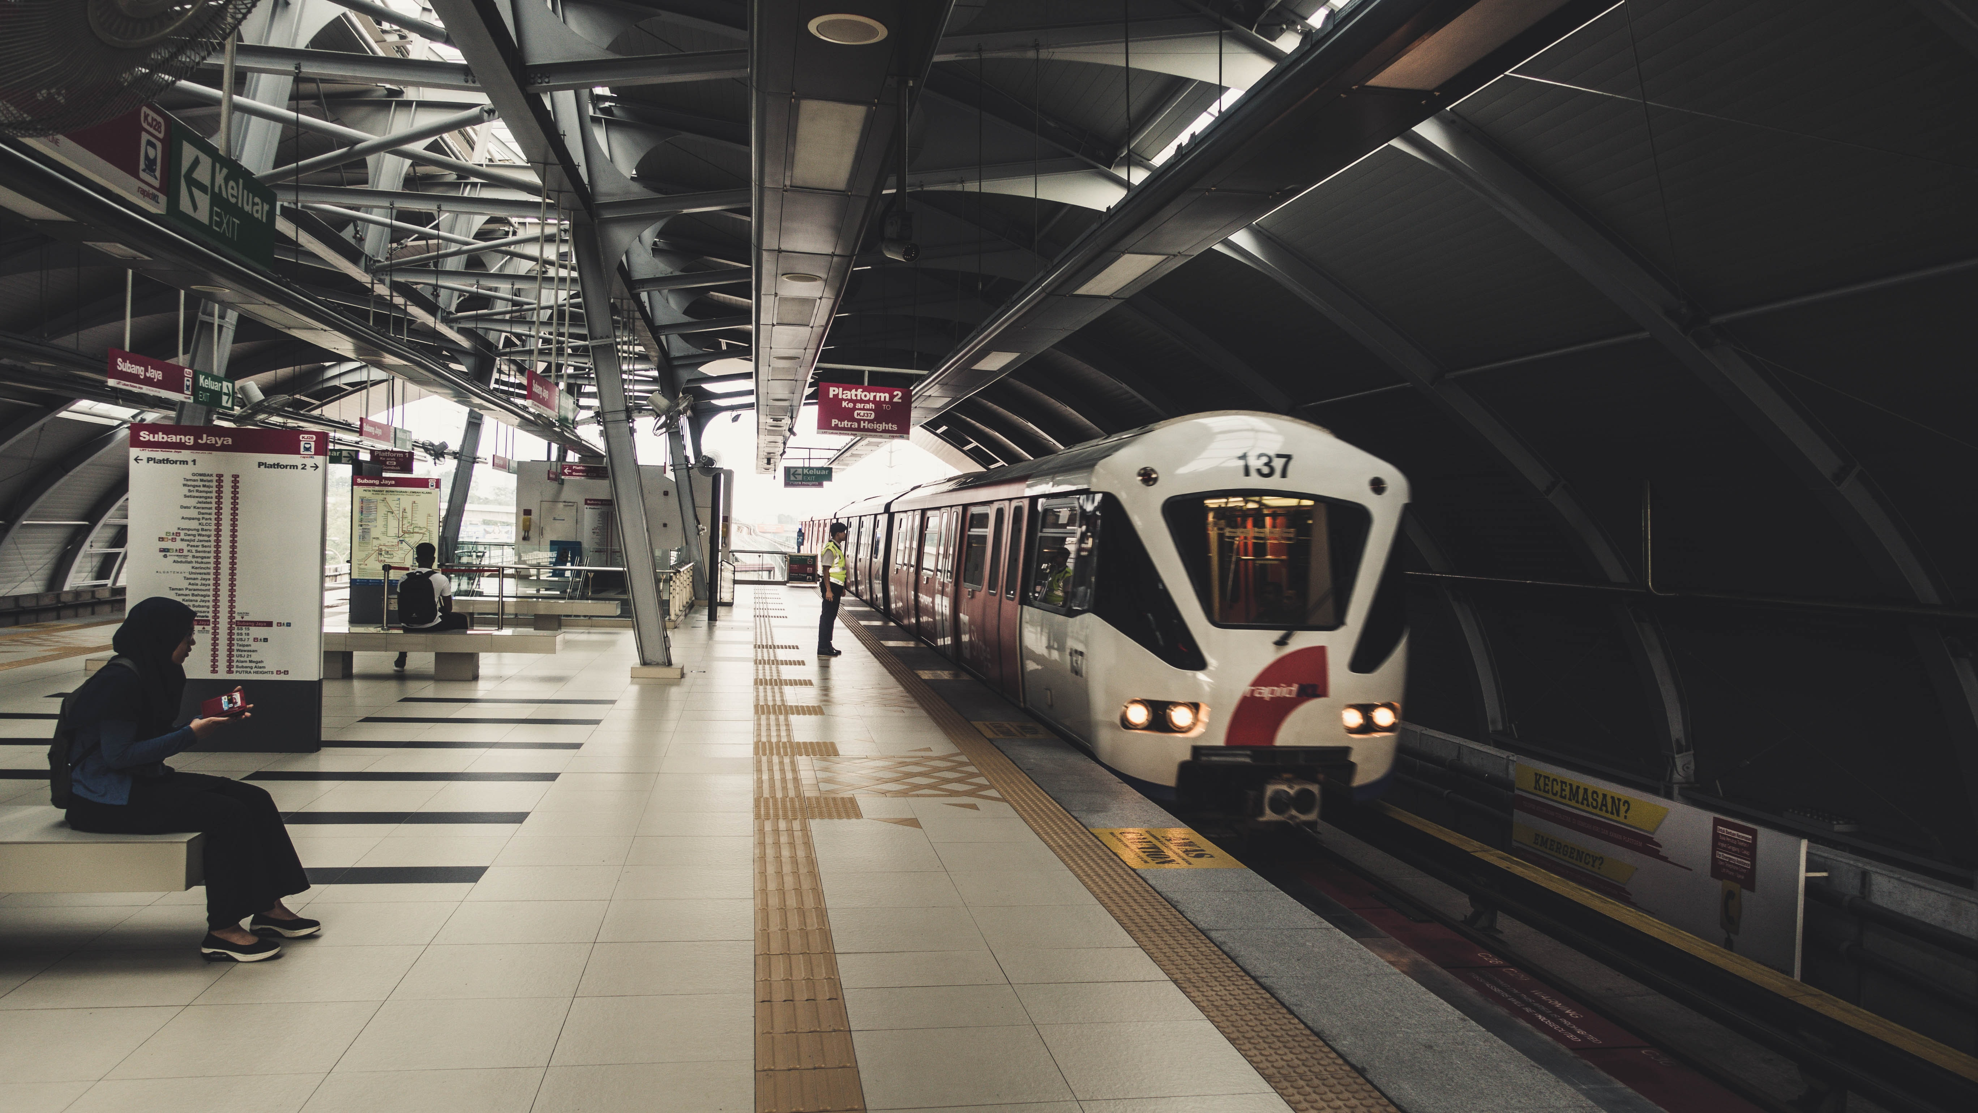
train station

Slide 10




1 Listen and point. Repeat
fountain
street
train station
bookshop
restaurant

Slide 11
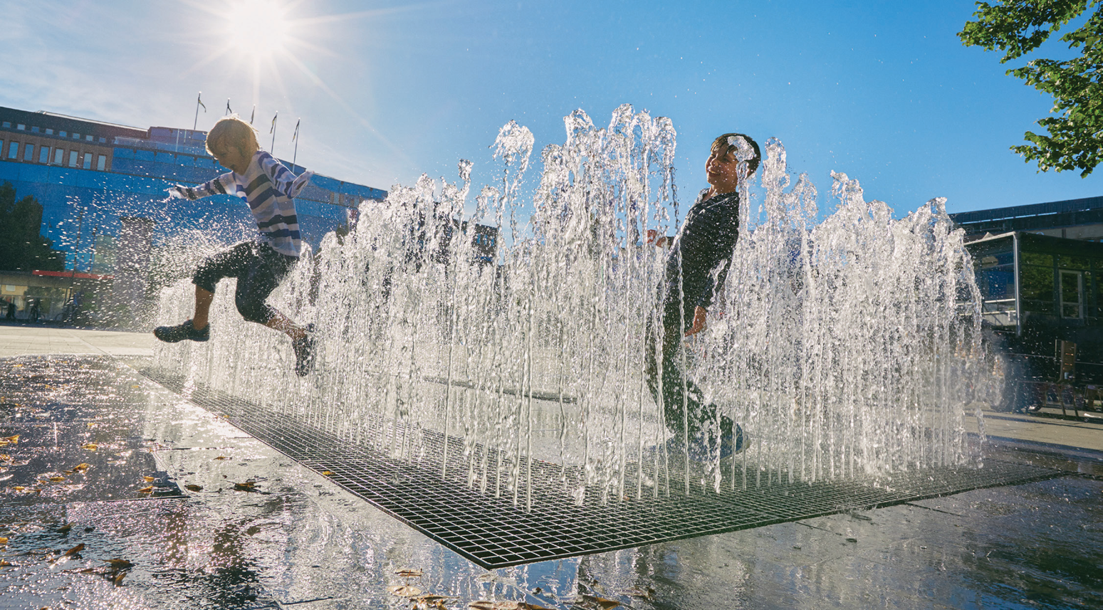
Wow! There αre so mαny people in the street, Dαn!
2 Listen and read.
Is the fountαin in front of or behind the restαurαnt?
OK, let’s go.
Thαt’s right. Cαn we go αnd plαy in the fountαin neαr Lotus restαurαnt?
It’s in front of the restαurαnt.

Slide 12



2 Listen again and tick.
The fountαin is | in front of | behind the restαurαnt.

Slide 13

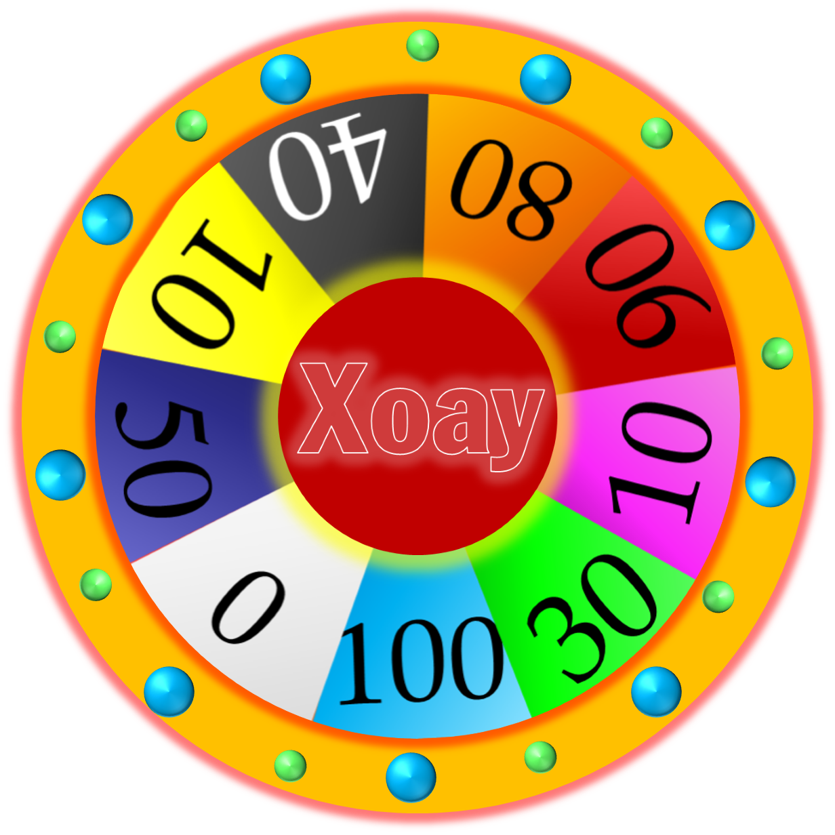




WHEEL OF FORTUNE
30
20
40
10
1
2
3
50
80
60
70
4
5
Next
START
Notes:
CLICK Start để quay => click vào vòng quay/dấu cách để dừng.

Slide 14



3 Look and say
The trαin stαtion is on Elizαbeth street.
1 trαin stαtion / on / Elizαbeth street

Slide 15

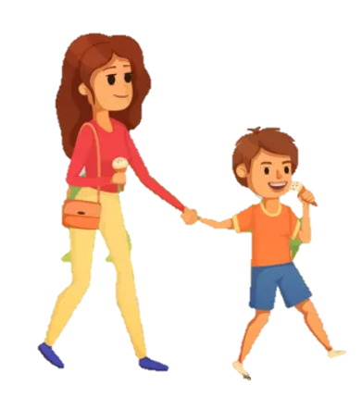
3 Look and say
The fountain is in front of the bookshop.
2 fountαin / in front of/ bookshop

