Slide 1

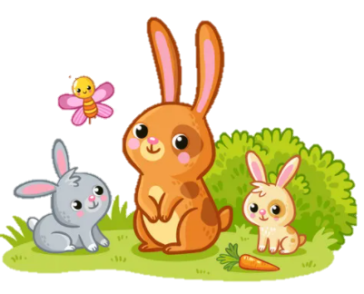
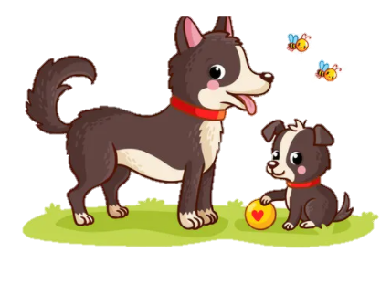
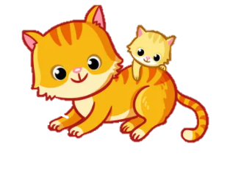
Tuesday, November 4th 2024 Unit 3: Animals (Part 1,2,3)

Slide 2
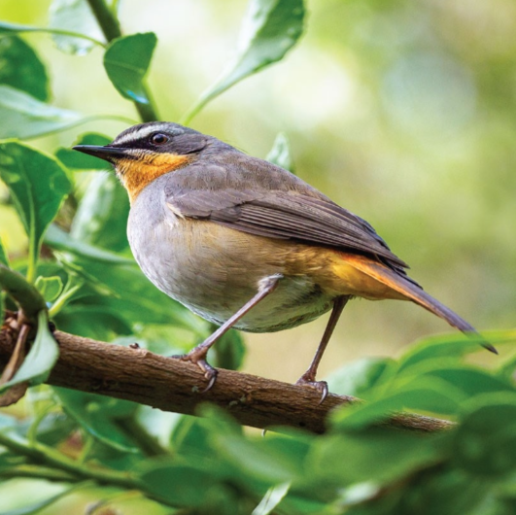

bird
Notes:
Bấm vào phần âm thanh nghe sound trước, sau đó hỏi hs “ What animal is it?

Slide 3
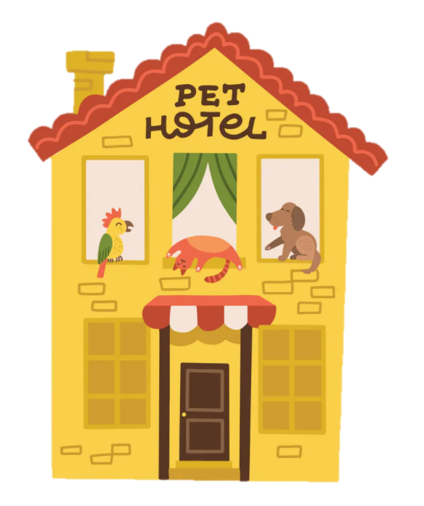
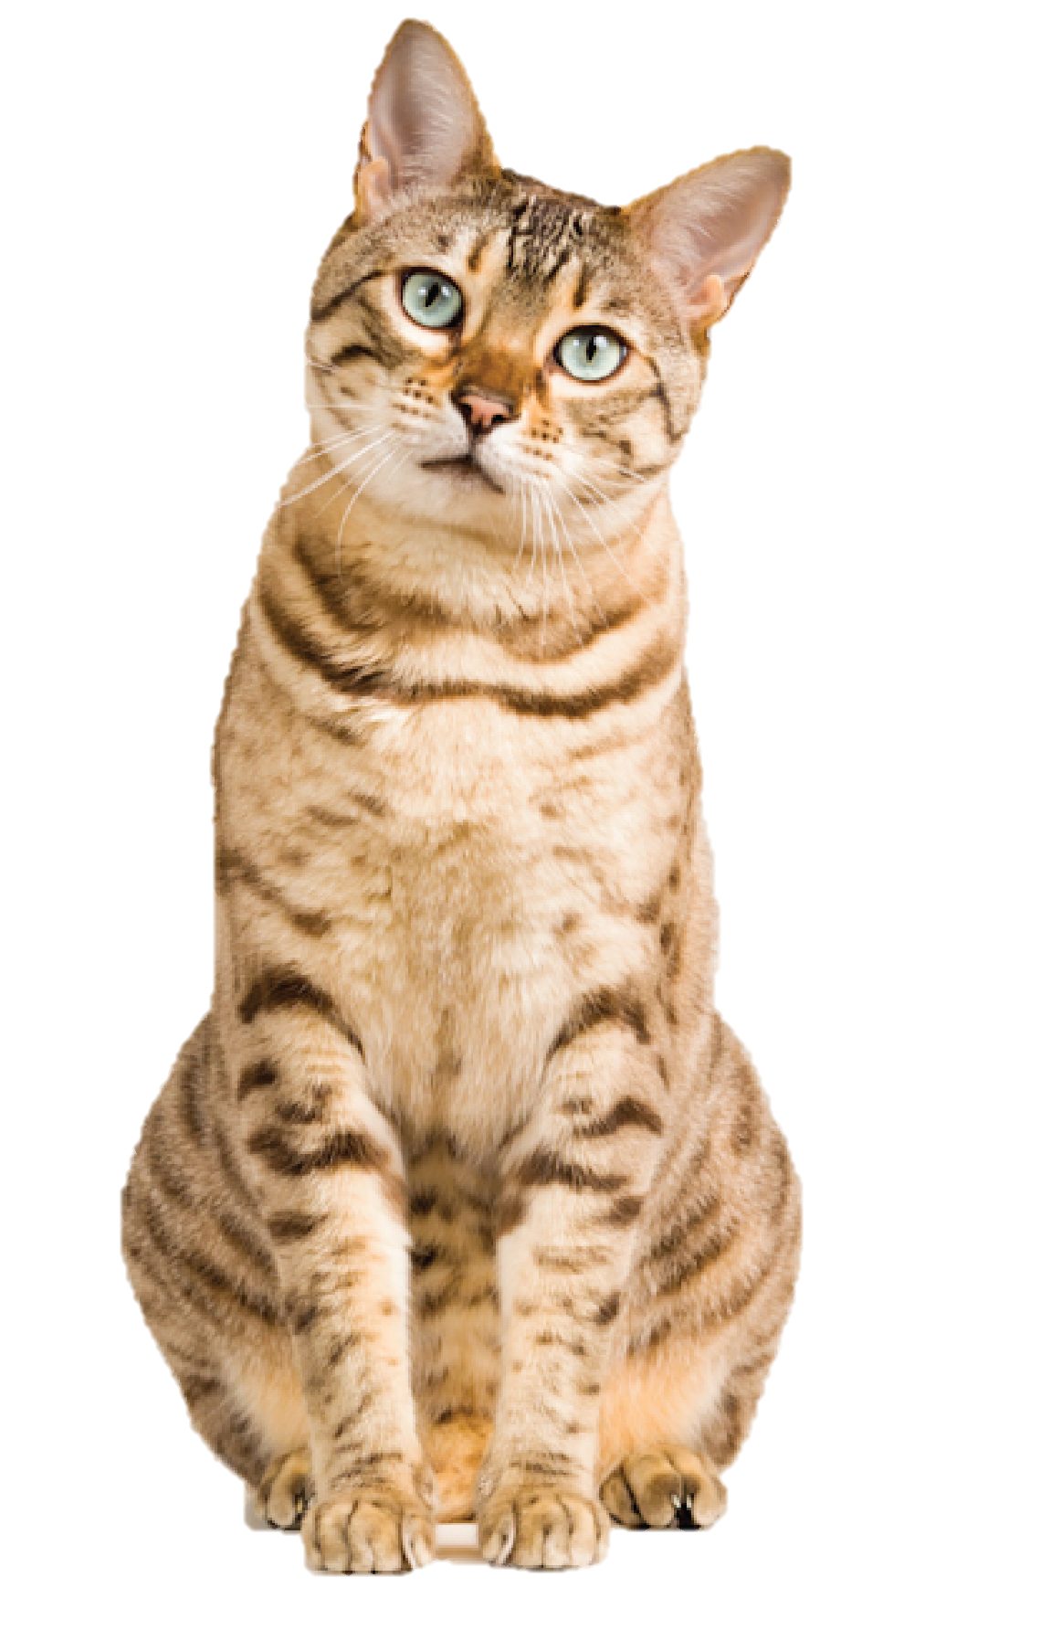

cat
Notes:
Bấm vào phần âm thanh nghe sound trước, sau đó hỏi hs “ What animal is it?

Slide 4
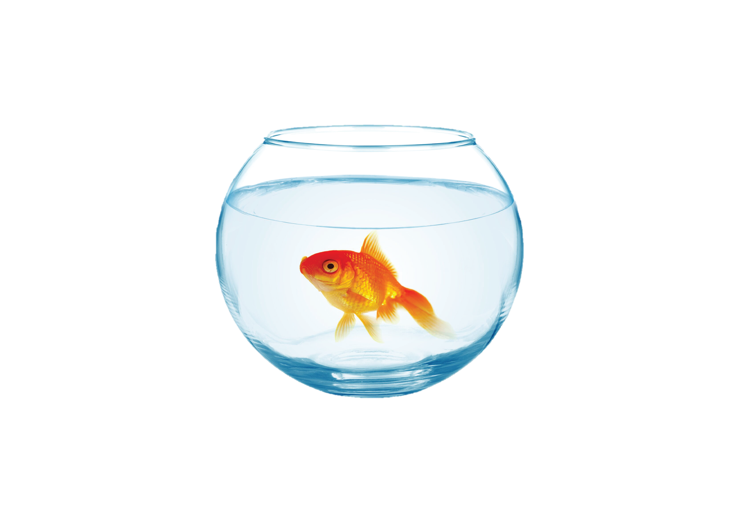
fish

Slide 5
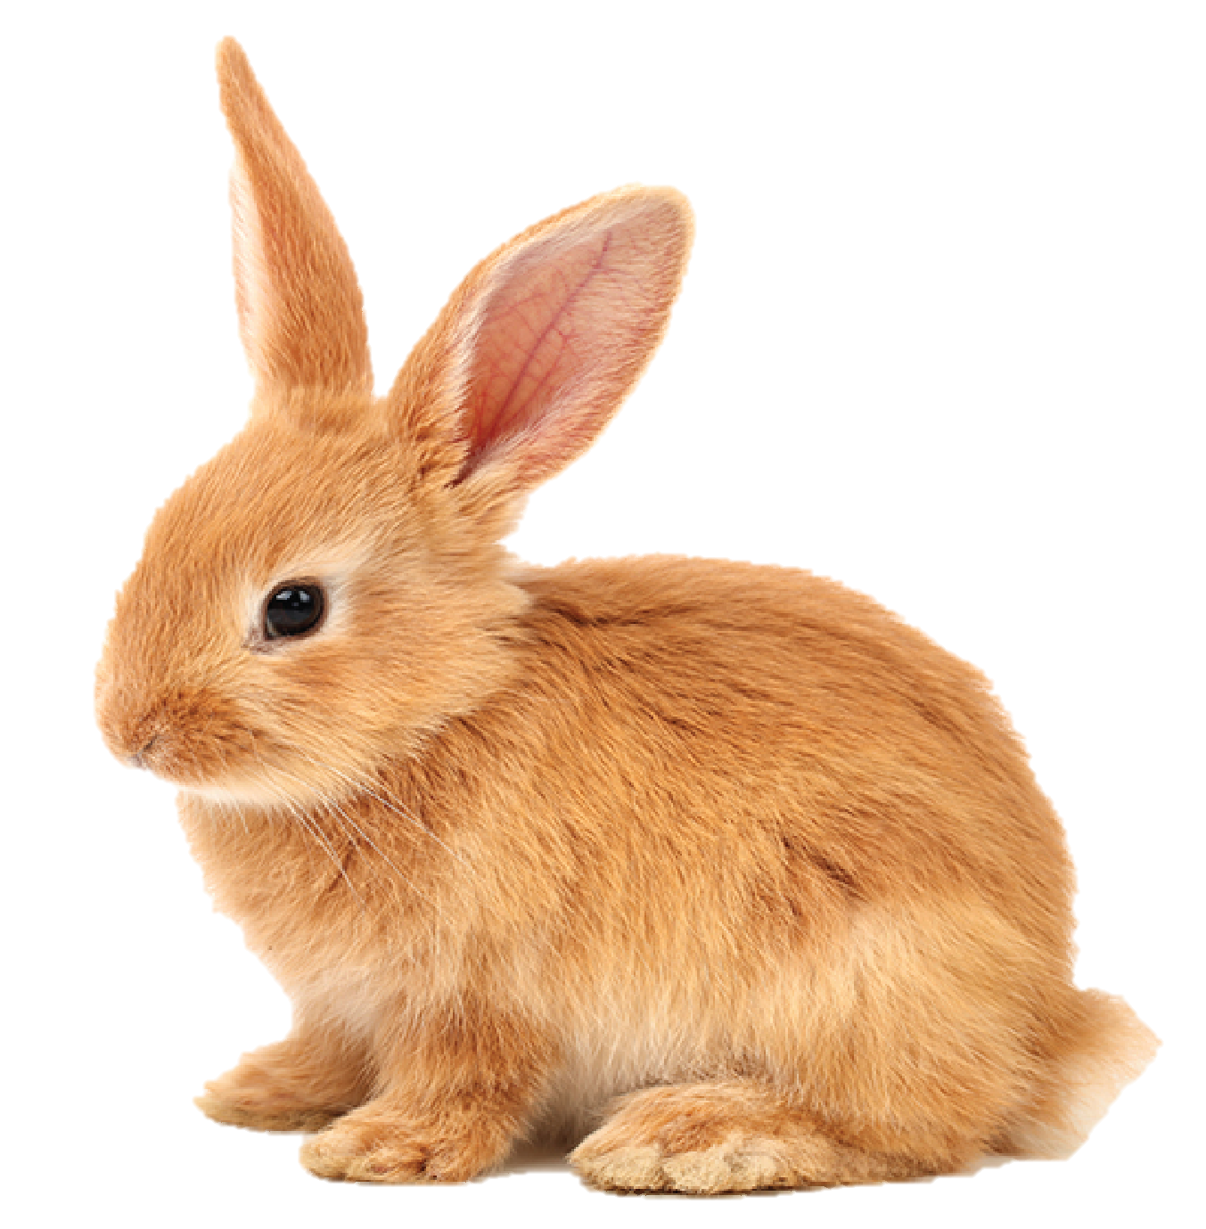
rabbit

Slide 6
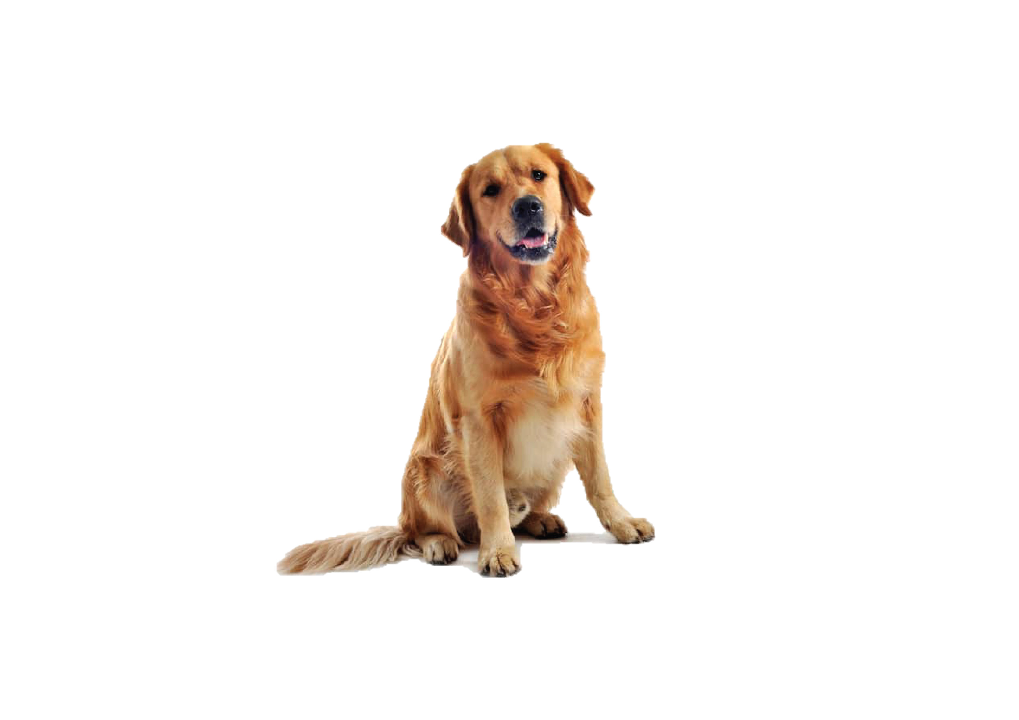
dog

Slide 7



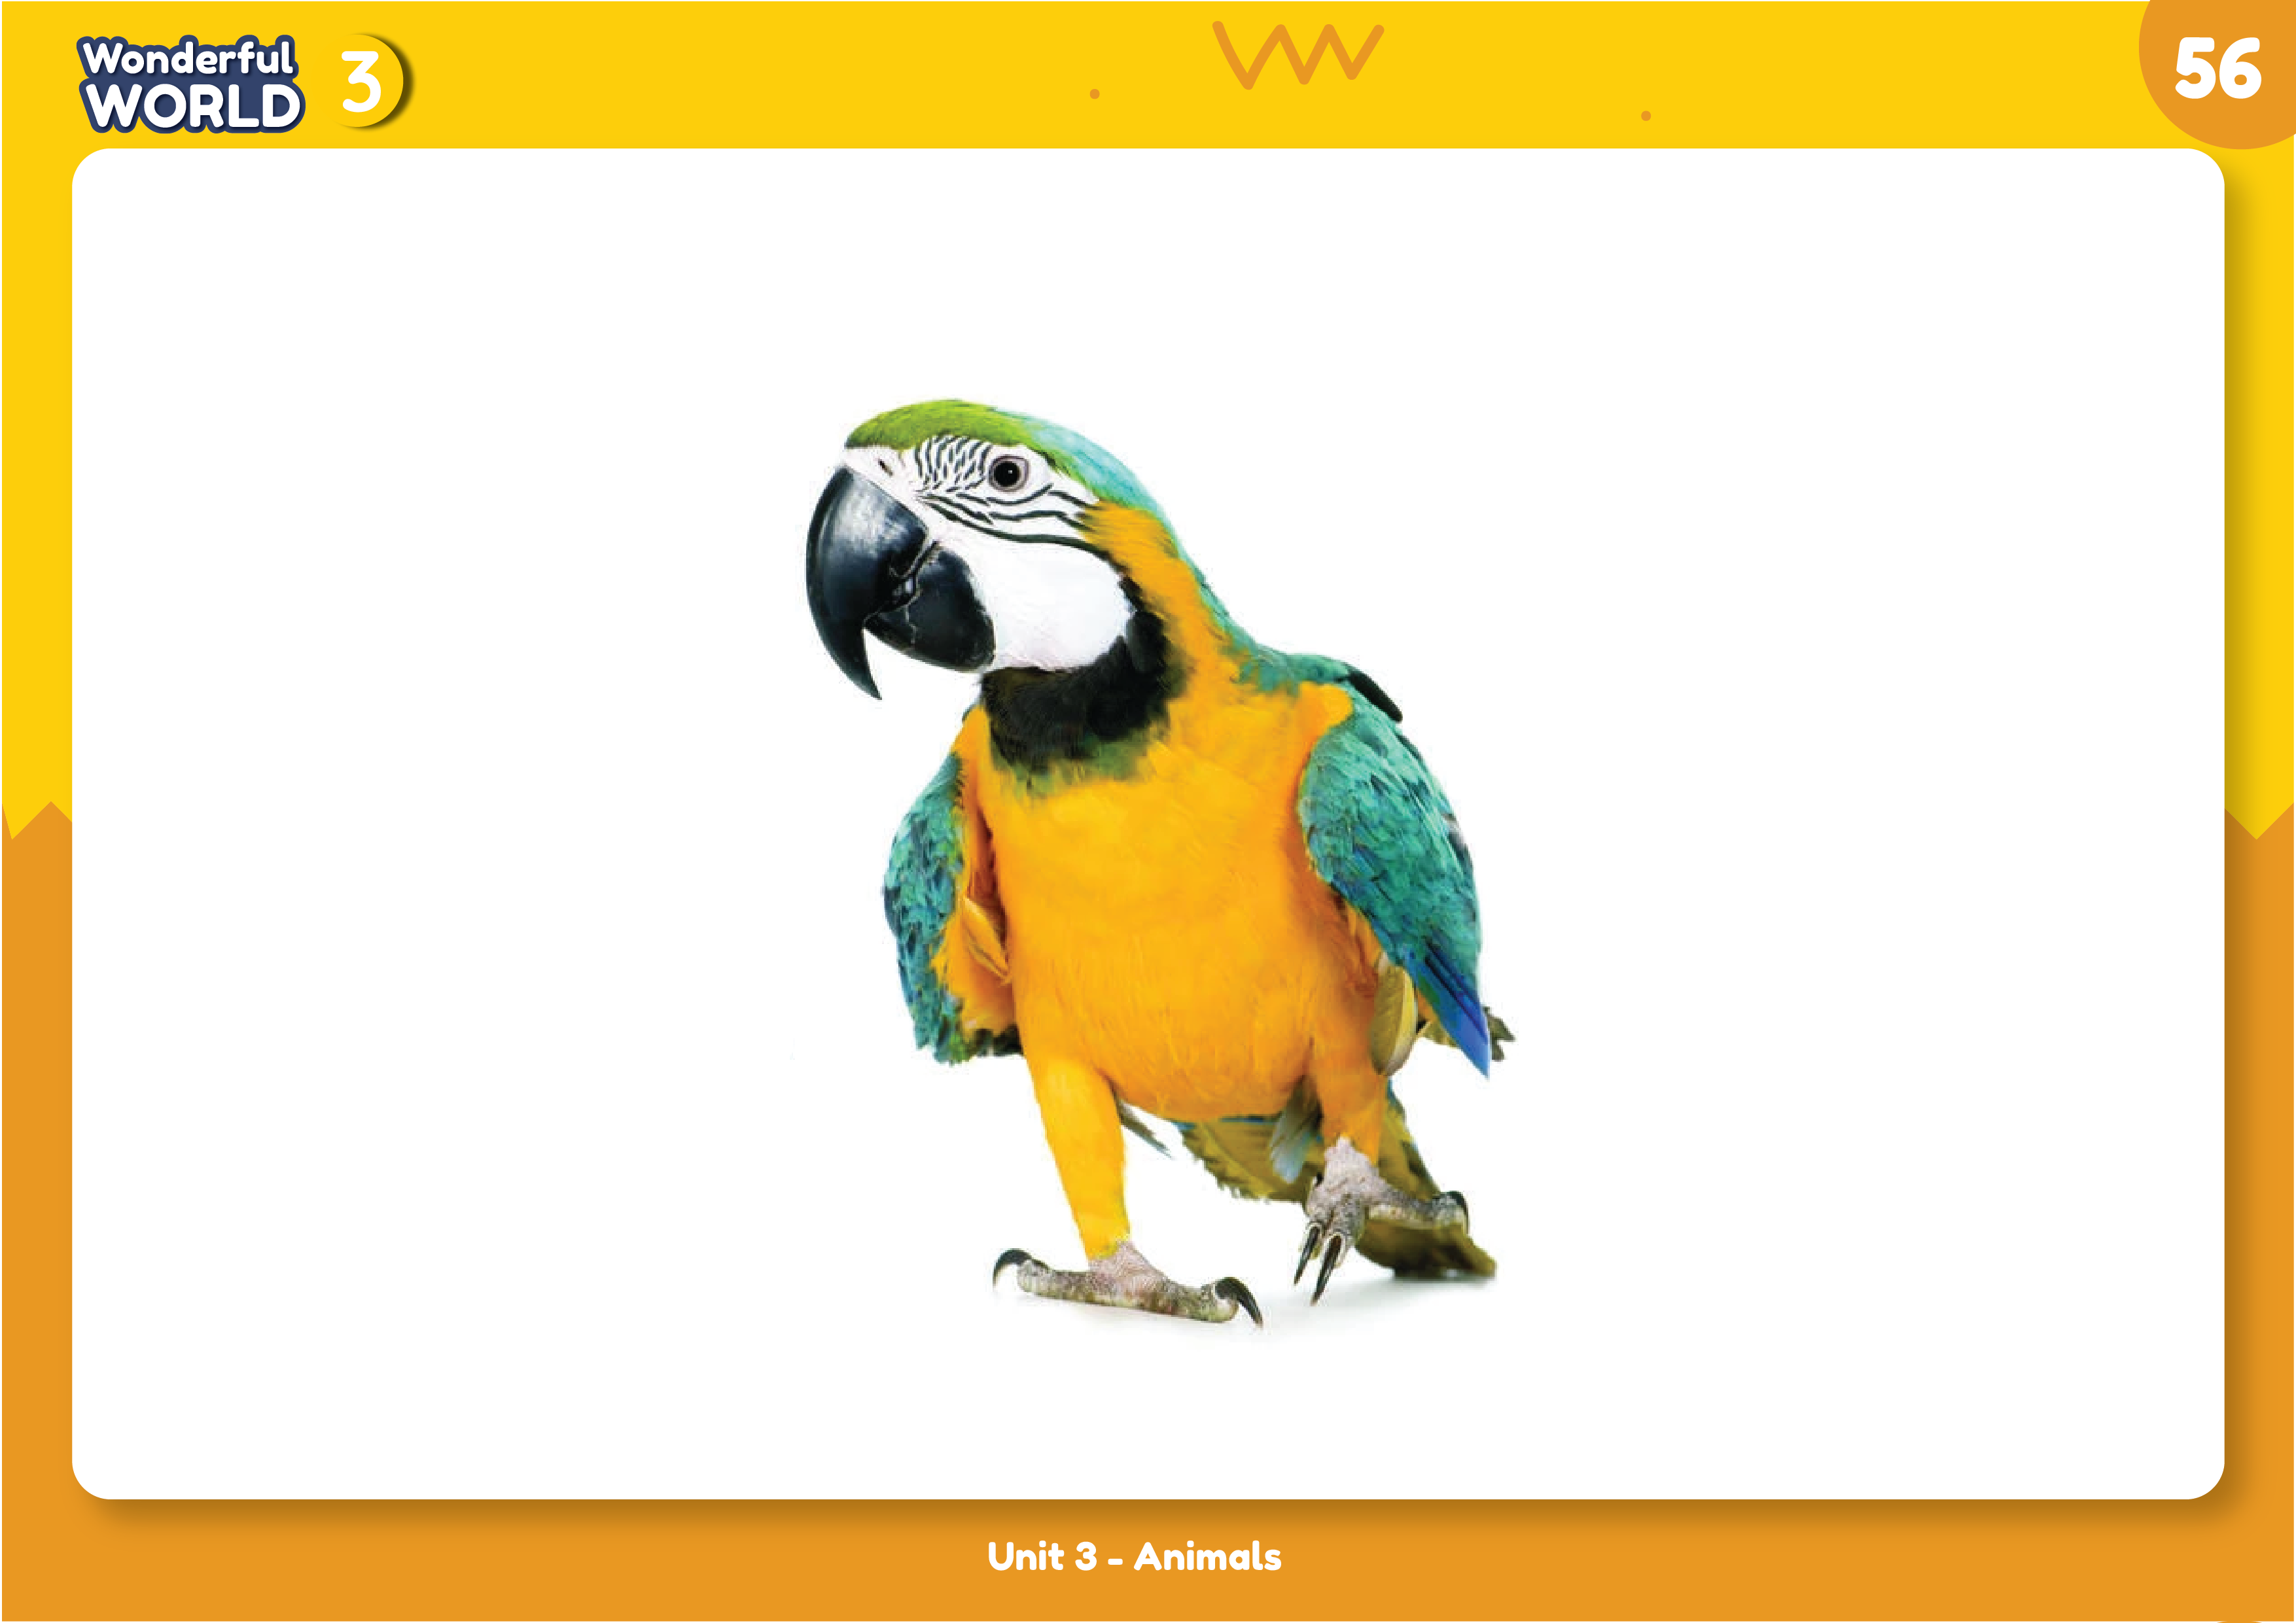
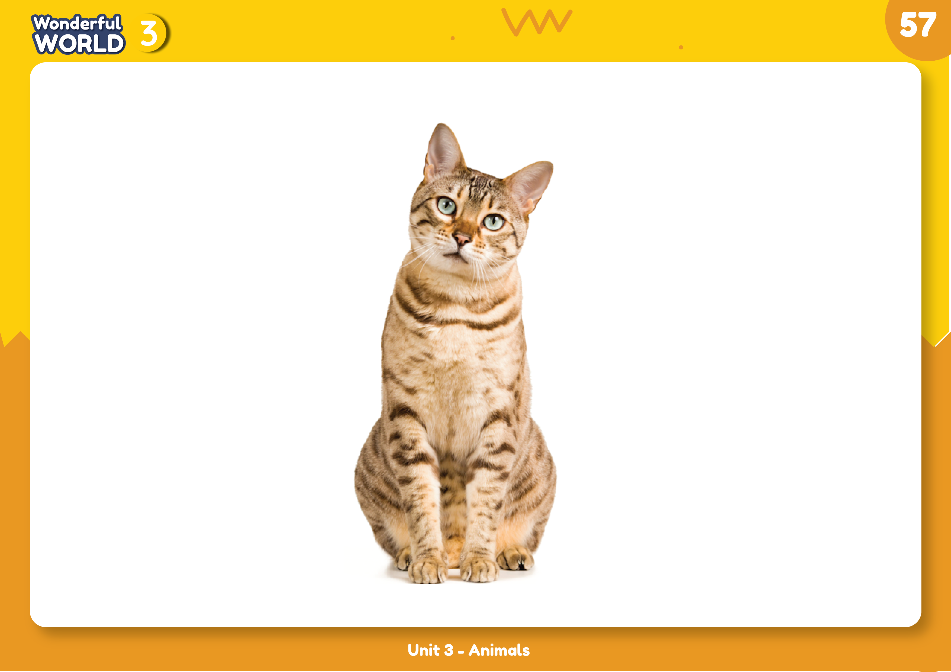
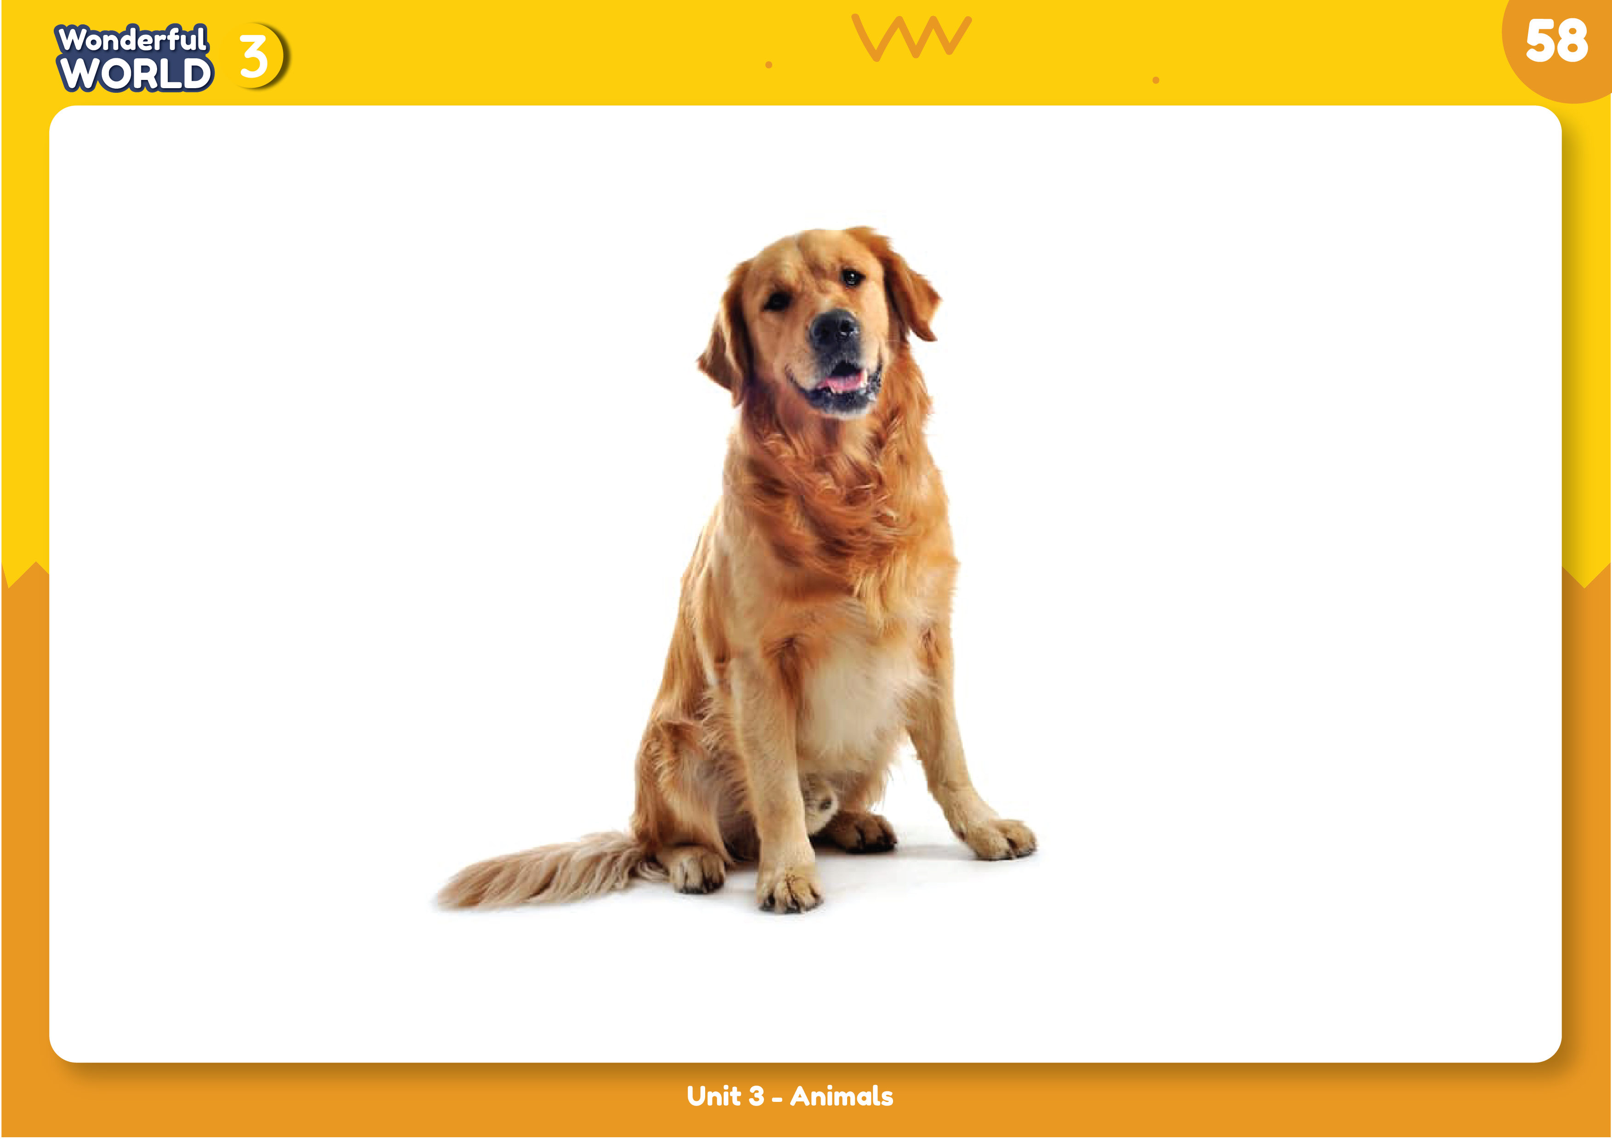
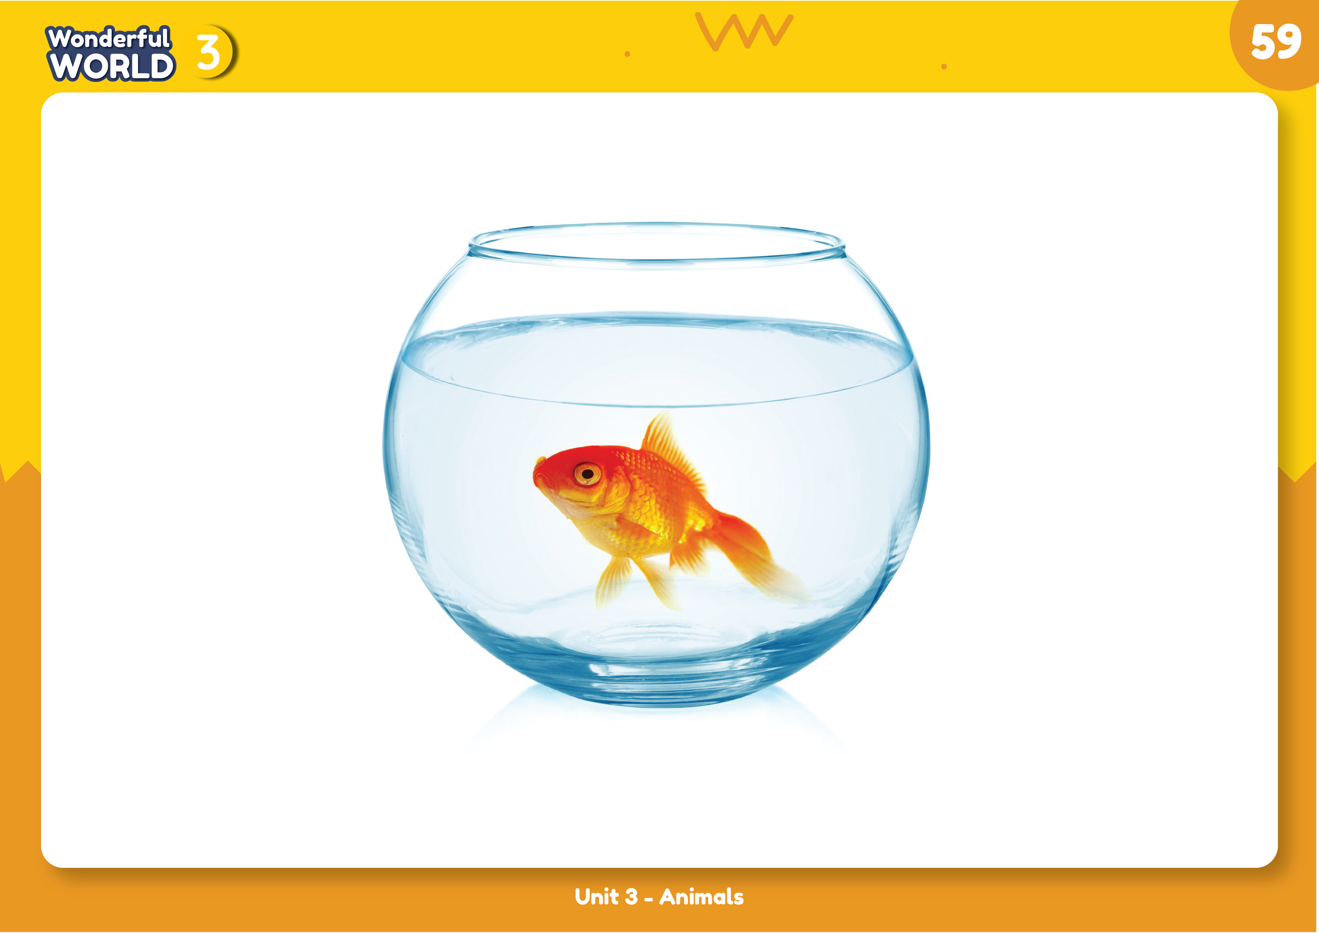
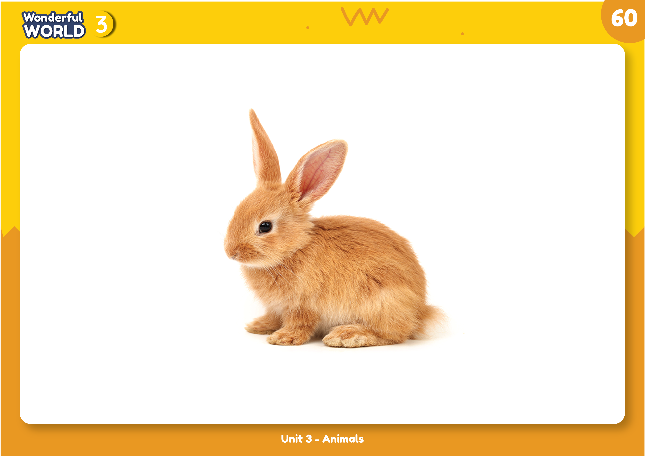

1. Listen and point. Repeat
dog
bird
cat
fish
rabbit

Slide 8

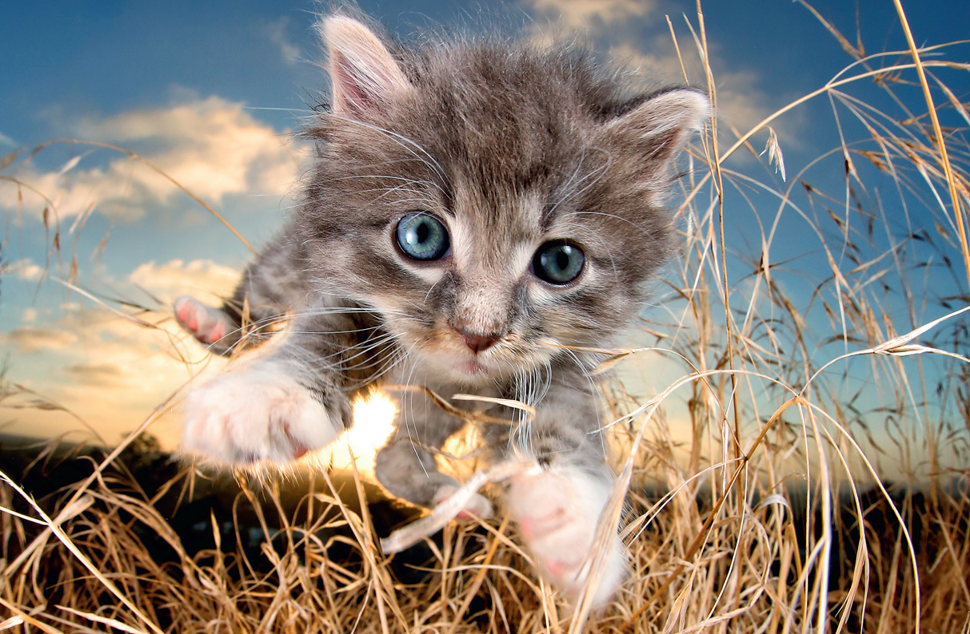
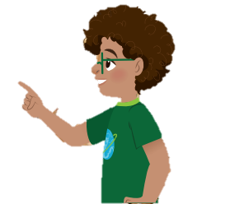

2. Listen and tick
Look! A cat!
Yeah. It’s a cat. It’s in the garden.
Oh, it’s funny

Slide 9
Listen and tick
✓
Look. It’s a
✓
It’s
cool
funny
Notes:
THIẾT KẾ HOẠT ĐỘNG TƯƠNG TÁC KÈM FILE NGHE:
CÂU HỎI:
Look. It’s a ____. It’s ____.
cat/ funny
dog/ cool

Slide 10
2. Listen and tick
Look! A cat!
Yeah. It’s a cat. It’s in the garden.
Oh, it’s funny

Slide 11
3. Look and say
Look! It’s a bird. It’s green and yellow. It’s nice.
Notes:
Gv chỉ vào con vật & hỏi theo thứ tự sau:
What is it? It’s a………
What color is the…….? It’s …… and ……
How is the …….? It’s cute / nice.

Slide 12
3. Look and say
Look! It’s a ..................
It’s ......, ...... and ..........
It’s ...............................
Notes:
Gv chỉ vào con vật & hỏi theo thứ tự sau:
What is it? It’s a………
What color is the…….? It’s …… and ……
How is the …….? It’s cute / nice.

Slide 13
3. Look and say
Look! It’s .....................
It’s ........ and ..............
It’s ..............................
Notes:
Gv chỉ vào con vật & hỏi theo thứ tự sau:
What is it? It’s a………
What color is the…….? It’s …… and ……
How is the …….? It’s cute / nice.

Slide 14
3. Look and say
Look! It’s a ...................
It’s ...... and ..................
It’s ................................
Notes:
Gv chỉ vào con vật & hỏi theo thứ tự sau:
What is it? It’s a………
What color is the…….? It’s …… and ……
How is the …….? It’s cute / nice.

Slide 15
3. Look and say
Look! It’s ............... It’s ......... and ........ It’s .........................
Notes:
Gv chỉ vào con vật & hỏi theo thứ tự sau:
What is it? It’s a………
What color is the…….? It’s …… and ……
How is the …….? It’s cute / nice.

Slide 16
3. Look and say
Look! It’s a bird. It’s green and yellow. It’s nice.
Notes:
Gv chỉ vào con vật & hỏi theo thứ tự sau:
What is it? It’s a………
What color is the…….? It’s …… and ……
How is the …….? It’s cute / nice.

Slide 17




Good bye.
See you again!

