Slide 1




















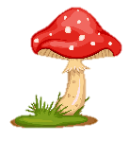
Notes:
Để nguyên trang bìa như này, chỉ thay đổi tên bài trong quá trình làm. Logo của sách Wonderful World

Slide 2
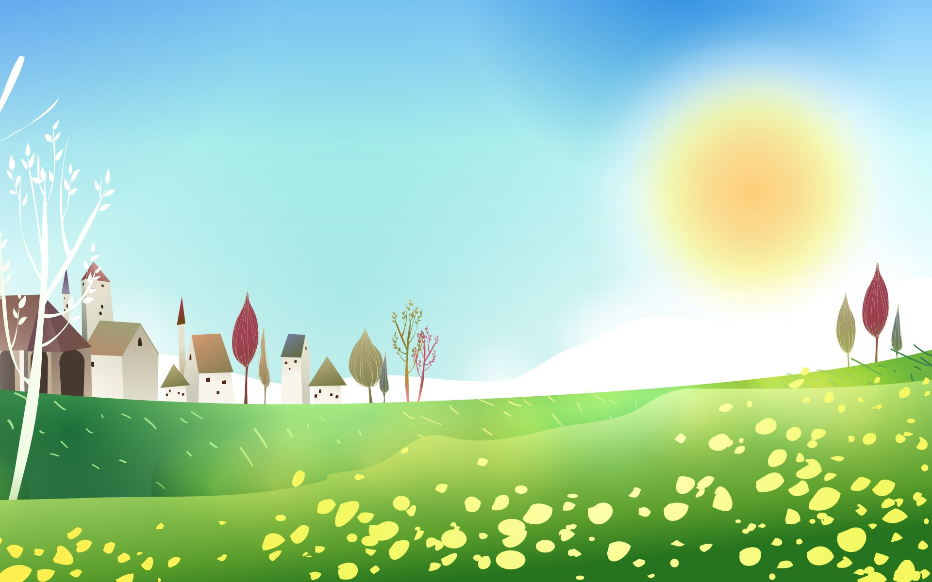
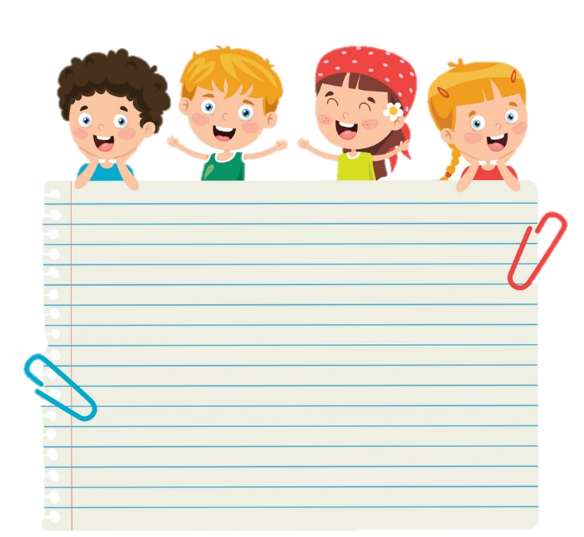



1 Warm-up
Let’s sing and dance

Slide 3


Slide 4

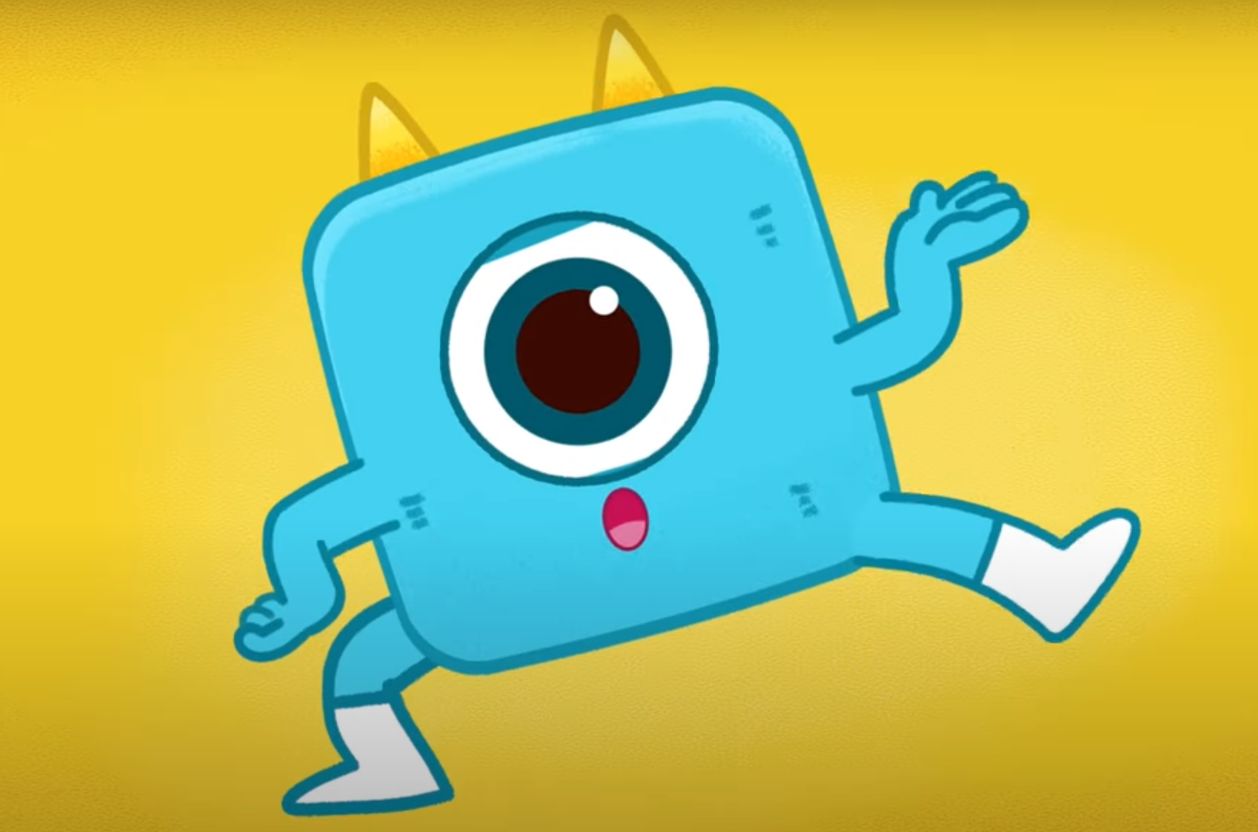
List all hobbies in the video!
Playing guitar
Swimming
Cooking
Singing
Listening to hip-hop music
Playing soccer
Surfing
Drawing
Reading books

Slide 5
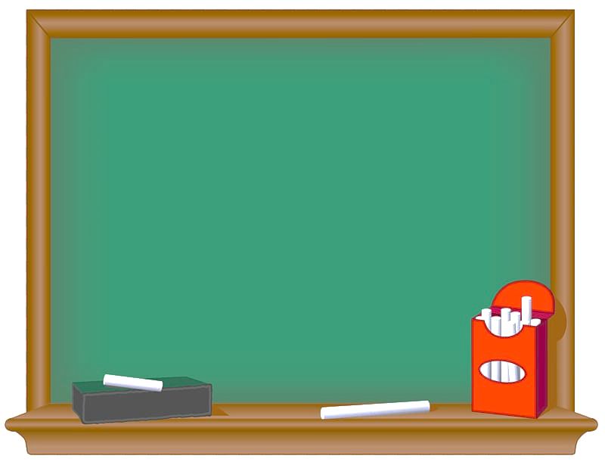

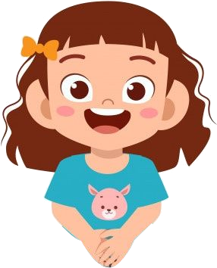
Grammar
đ
Verb forms (gerund and infinitive).
Gerunds
like
good at + V-ing
enjoy
Examples
1. I like (play) ______ sports.
2. She is good at (dance) _____.
3. I enjoy (go) _____ fishing.
playing
dancing
going

Slide 6
Grammar
đ
Verb forms (gerund and infinitive).
Infinitive
can + V
Examples
1. I can (do) _______ my homework.
2. She can (sing) _______ well.
do
sing

Slide 7




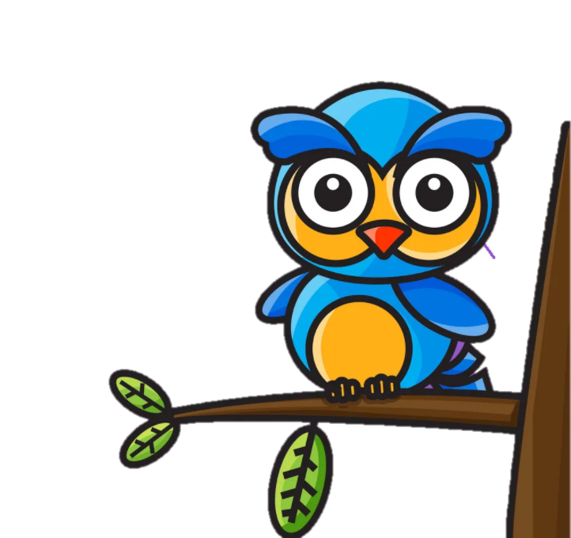


UNIT 4
Lesson 3: Part 4,5,6

Slide 8
Task 4
Read and circle the correct answer. Then listen and check. (track 4.9)

Slide 9
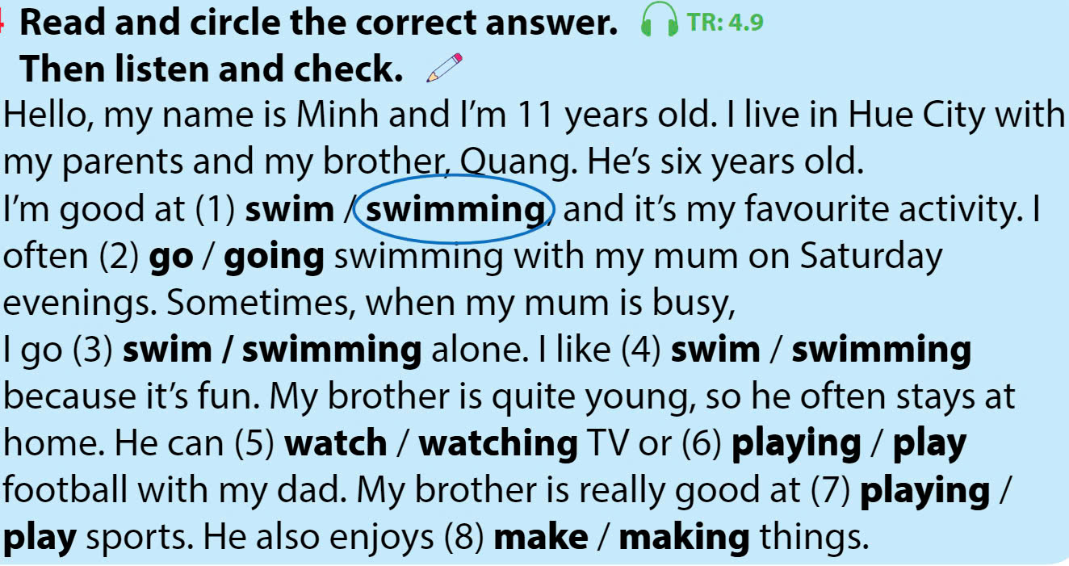

Slide 10
Game

Slide 11


Hello, my name is Minh and I’m 11 years old. I live in Hue City with my parents and my brother, Quang. He’s six years old
I’m good at (1) swim / swimming, and it’s my favourite activity. I often (2) go / going swimming with my mum on Saturday evenings. Sometimes, when my mum is busy, I go (3) swim / swimming alone. I like (4) swim / swimming because it’s fun.

Slide 12
My brother is quite young, so he often stays at home. He can (5) watch / watching TV or
(6) playing / play football with my dad. My brother is really good at (7) playing / play sports. He also enjoys (8) make / making things.

Slide 13
Task 5
Read the text in Activity 4 again.
Ask and answer

Slide 14
Hello, my name is Minh and I’m 11 years old. I live in Hue City with my parents and my brother, Quang. He’s six years old.
I’m good at swimming, and it’s my favourite activity. I often go swimming with my mum on Saturday evenings. Sometimes, when my mum is busy, I go swimming alone. I like swimming because it’s fun.
My brother is quite young, so he often stays at home. He can watch TV or play football with my dad. My brother is really good at playing sports. He also enjoys making things.

Slide 15
Game

Slide 16
đ
How old is Minh?
- He’s 11 years old.
2 Where does he live?
He lives in ___________________________.
3 What is Minh’s hobby?
He likes _____________________________.
4 When does he go swimming?
He often ____________________________.
5 Who does he often go swimming with?
___________________________________.
6 Why does he like swimming?
- Because _____________________________.
Hue City
swimming
goes swimming on Saturday evenings
He often goes swimming with his Mom
it is fun

Slide 17

TASK 3 WRITE
đ
My hobby
Write about your hobby.
Use the questions to help you.
• What’s your name?
• How old are you?
• Where do you live?
• What’s your hobby?
• When do you do that activity?
• Are you good at it?
• Why do you like it?

Slide 18

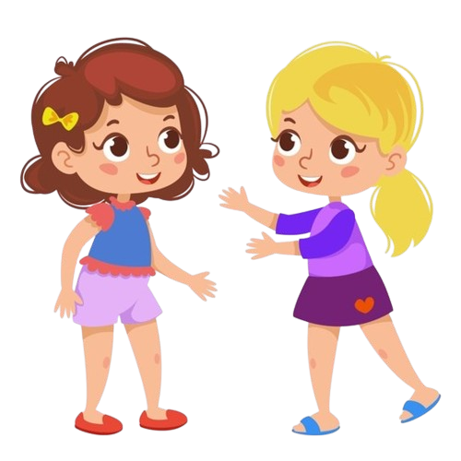
Reintroduce about your hobbies

Slide 19
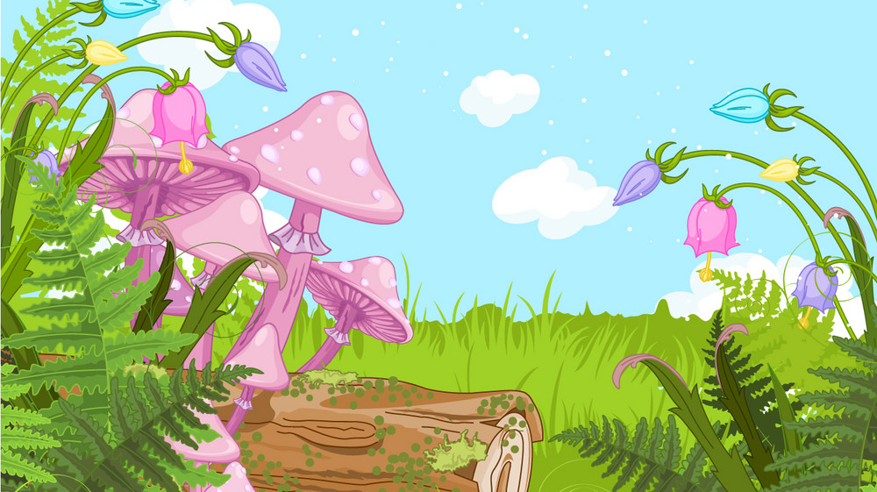
Wrap-up
What we have learnt today:

Slide 20




Thank you & goodbye!

