Slide 1


Slide 2


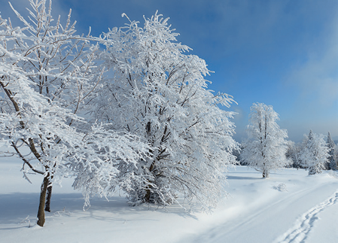
w
Next
Notes:
Do you want to play game? Its name’s FIND THE LETTER
Do you know this game?
We find the letter missing in the words.

Slide 3

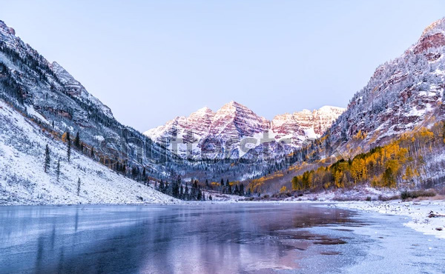

1. What is the missing letter?
M
L
W
W
I
N
T
E
R
Next

Slide 4
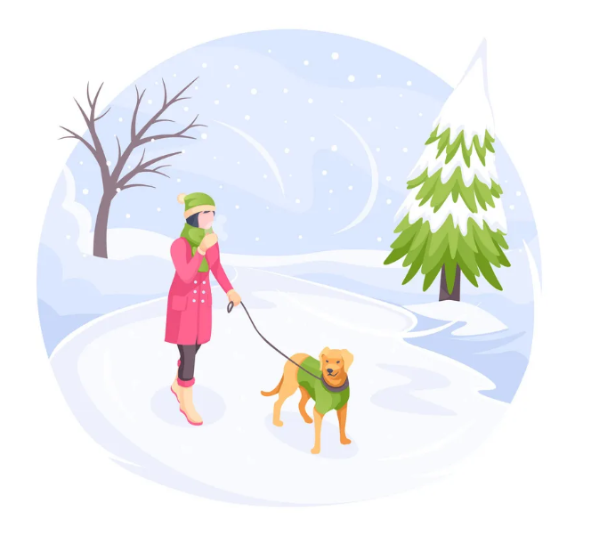
2. What is the missing letter?
U
A
O
C
O
L
D
Next

Slide 5
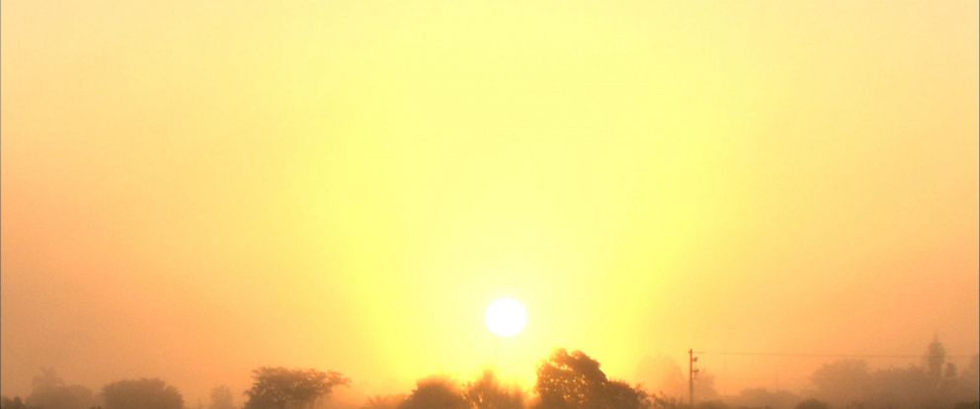
3. What is the missing letter?
U
O
A
W
A
R
M

Slide 6


Unit 10
Our World
Lesson 3 – Task 7,8,9
Notes:
Look at the screen, we will meet a new friend.

Slide 7



02
Presentation

Slide 8



/w/
wet

Slide 9
/əʊ/
cold

Slide 10

Part 7. Listen and repeat.
wet
cold
It’s wet and cold in winter.

Slide 11
Listen and say
wet
cold
Words
/w/
/əʊ/
Sounds

Slide 12

Sound checking
/w/
winter
hot
cold

Slide 13
Sound checking
/əʊ/
cool
summer
cold

Slide 14
Sound checking
/əʊ/
hot
tour
old

Slide 15
Sound checking
/w/
rainy
autumn
what

Slide 16
03
Practice

Slide 17
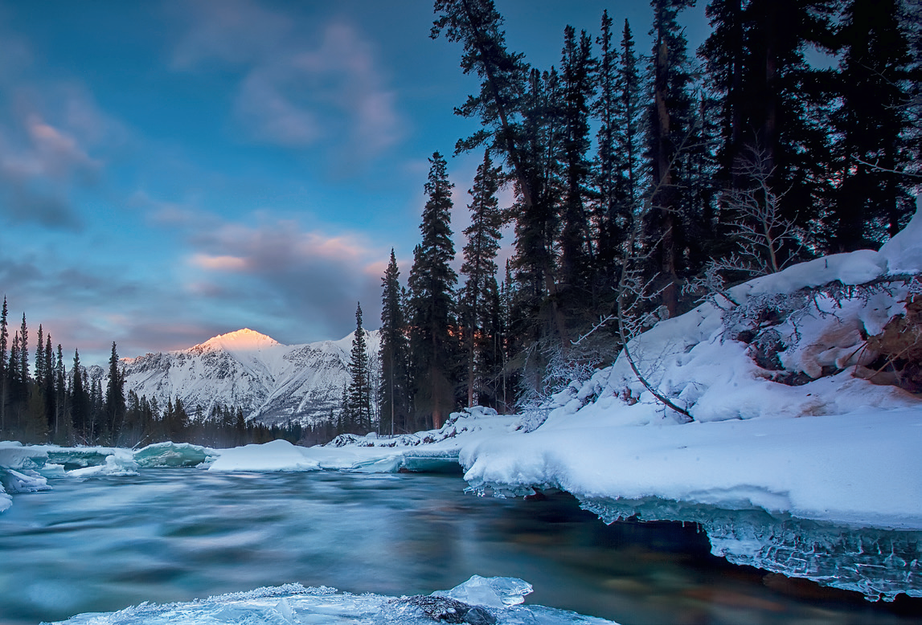
Part 8. Listen and chant.
W, w, w!
Wet, wet, wet.
In winter, the weather is wet!
O, o, o!
Cold, cold, cold.
In winter, the water is cold!

Slide 19
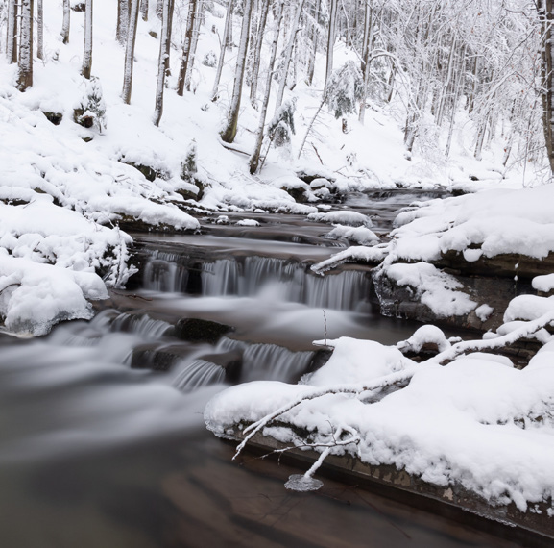

Slide 20


Slide 21
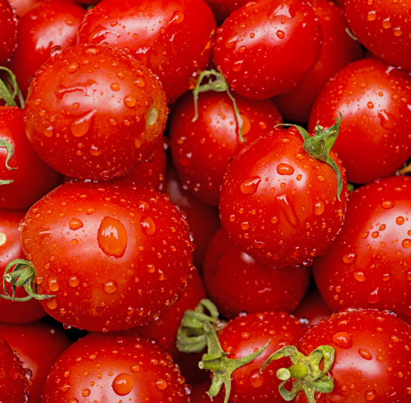

Slide 22
Part 9. Say it

Slide 23
The water in the river is cold.
It’s summer. The water is warm.
The tomatoes are wet.

Slide 24
4
Production

Slide 25


Let’s compose the chant!

Slide 26
SUGGESTION
W, w, w!
Warm, warm, warm.
It's summer.
The water is warm!

Slide 27
5
Assessment

Slide 28
Find the words with the sound /w/ and /əʊ/ and circle
summer cold hot warm
autumn rock water hello
Notes:
HOẠT ĐỘNG TƯƠNG TÁC

Slide 29




Thank you & goodbye!

