Slide 1





















Slide 2

Unit 9: My Favourite Food
Lesson 3 – Task 1, 2, 3

Slide 3







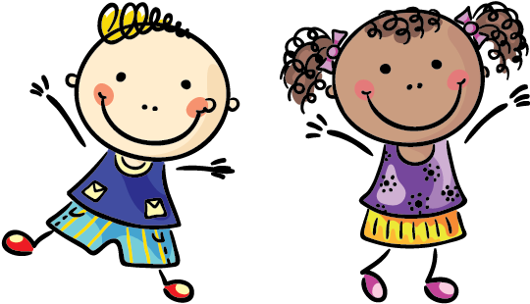
to Our Class
Teacher: Nguyen Thiem Tay
School: Tien Thanh Primary school

Slide 4


Slide 5

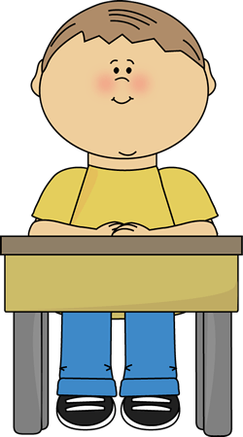
1. Sit nicely!

Slide 6
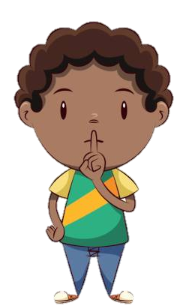
2. Be quiet!

Slide 7
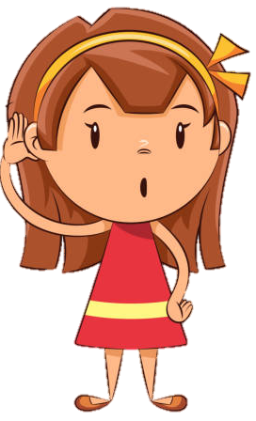
3. Listen to the teacher!

Slide 8
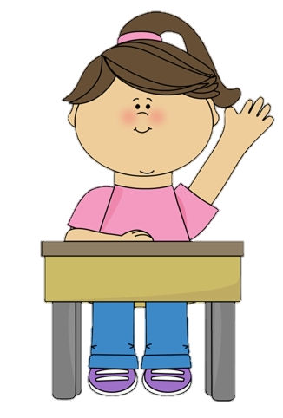
4. Raise your hand!

Slide 9
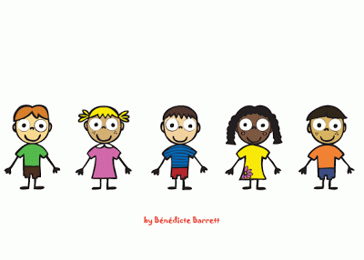
WARM UP AND REVIEW

Slide 10
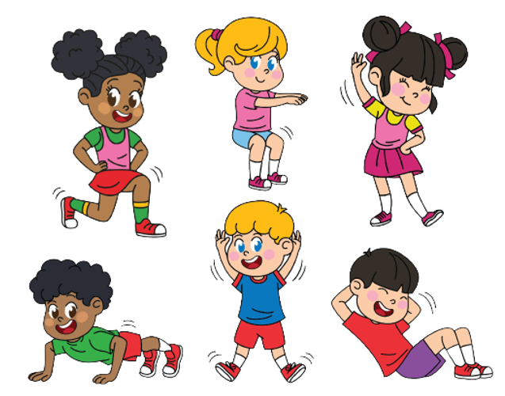
1 WARM UP
Challenge: 2 at once

Slide 11
1 WARM UP
Let’s sing.
https://www.youtube.com/watch?v=0VLxWIHRD4E

Slide 12


Slide 13


2 PRESENTATION
Task 4 Listen and repeat.

Slide 14
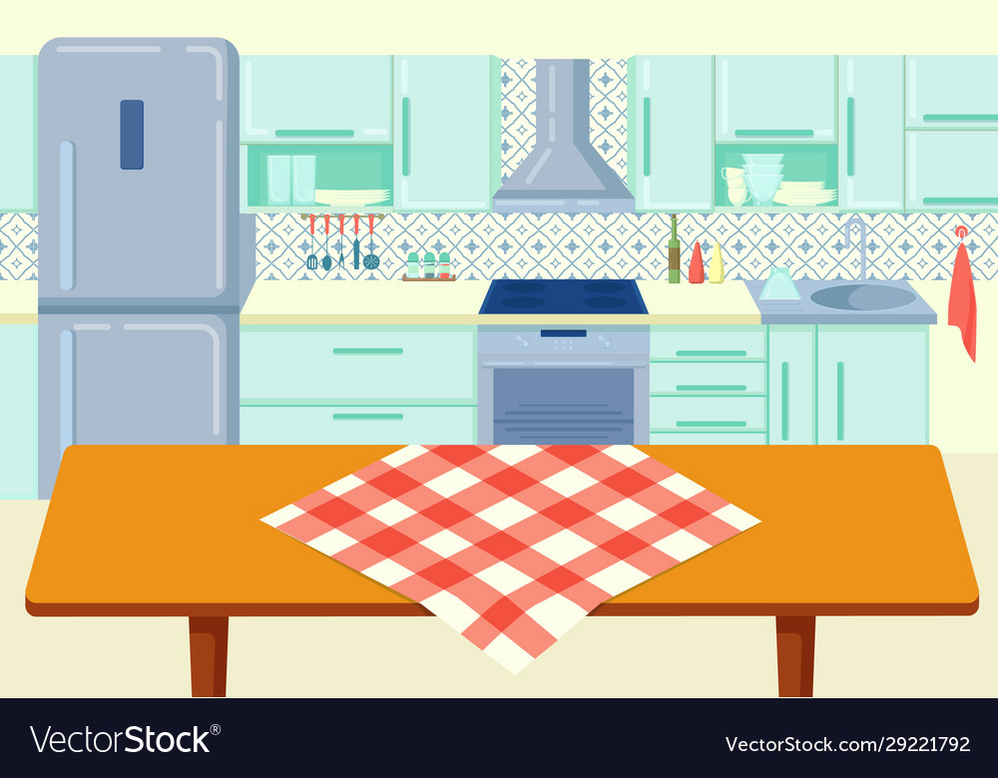


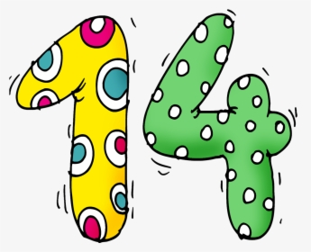

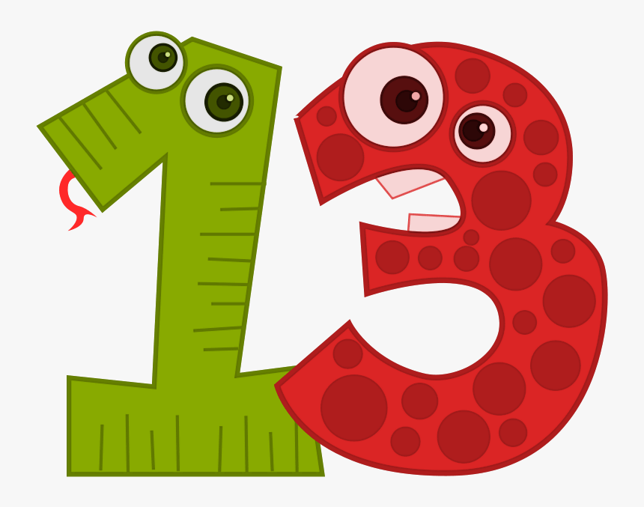

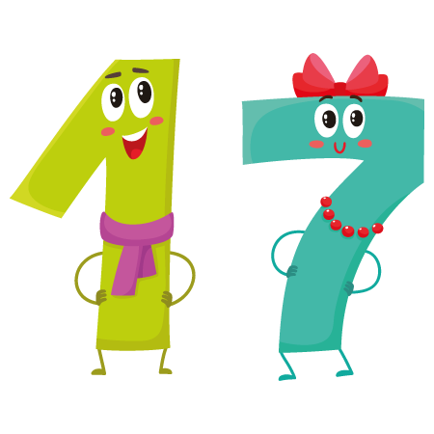
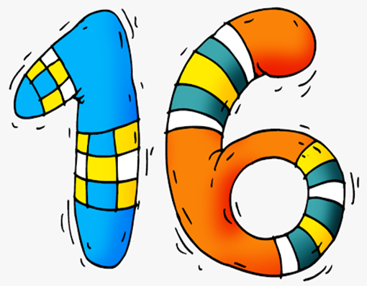

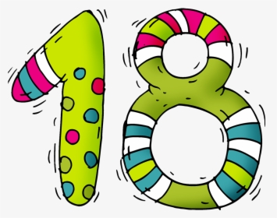



fifteen
twelve
sixteen
eleven
thirteen
seventeen
nineteen
twenty
fourteen
eighteen
QUICK CHECK

Slide 15
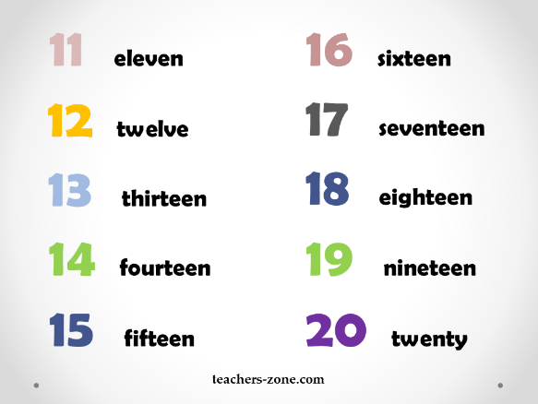
Listen and repeat.

Slide 16




Let’s check.
11
GO
15
20
18
- How many apples are there?
- Fifteen.

Slide 17
Let’s check.
11
GO
19
12
16
- How many apples are there?
- Eleven.

Slide 18
Let’s check.
11
GO
13
12
15
- How many apples are there?
- Thirteen.

Slide 19
Let’s check.
16
GO
19
15
20
- How many apples are there?
- Sixteen.

Slide 20
Let’s check.
14
GO
18
20
11
- How many apples are there?
- Eighteen.

Slide 21

3 PRACTICE
Task 5 Look and say.

Slide 22
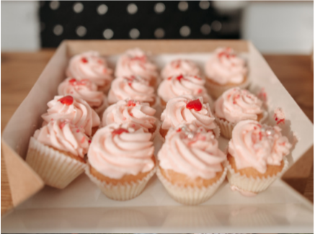
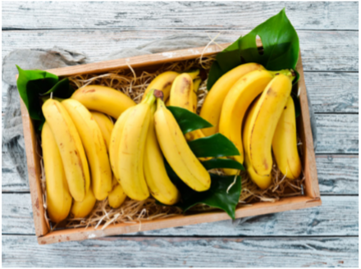
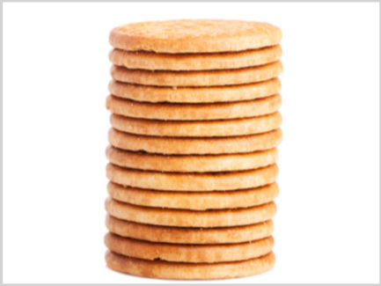
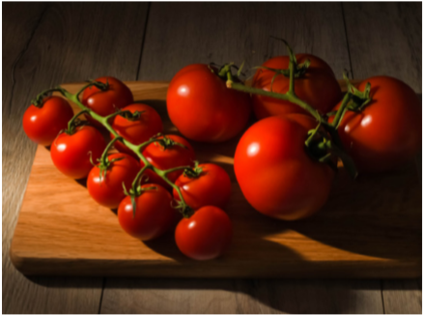
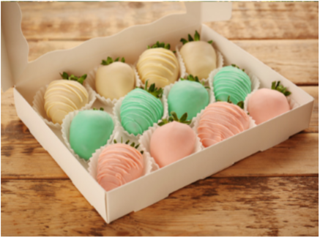
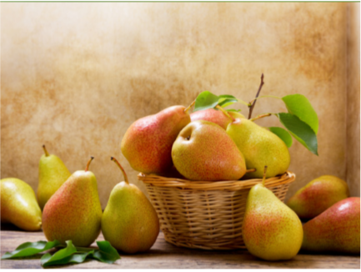
1. sweets / 15
2. bananas /16
3. biscuits /14
4. tomatoes /13
5. sweets / 12
6. pears / 11

Slide 23

1. sweets / 15
How many sweets are there?
Fifteen.

Slide 24
2. bananas /16
How many bananas are there?
Sixteen.

Slide 25
3. biscuits /14
How many biscuits are there?
Fourteen.

Slide 26
4. tomatoes /13
How many tomatoes are there?
Thirteen.

Slide 27
5. sweets / 12
How many sweets are there?
Twelve.

Slide 28
6. pears / 11
How many pears are there?
Eleven.

Slide 29

4 PRODUCTION
Task 6 Listen and chant.

Slide 30

Let’s go to the market!
Let’s buy some food!
Let’s buy 12 apples and 15 pears!
How many apples?
How many pears?
Let’s buy 12 apples and 15 pears!

Slide 31

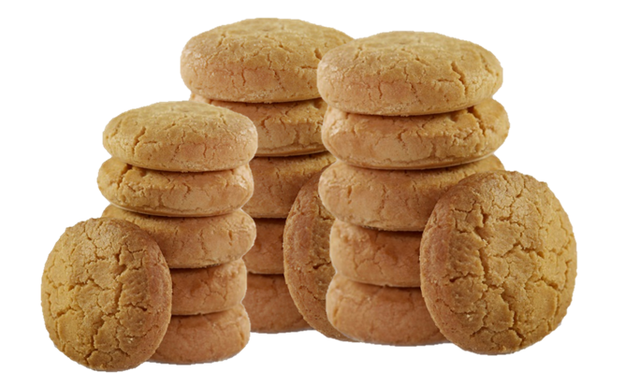
Make a new chant
Let’s go to the market!
Let’s buy some food!
Let’s buy 11 sweets and 16 biscuits!
How many sweets?
How many biscuits?
Let’s buy 11 sweets and 16 biscuits!

Slide 32
5 ASSESSMENT
Look and circle
the correct answer.

Slide 33
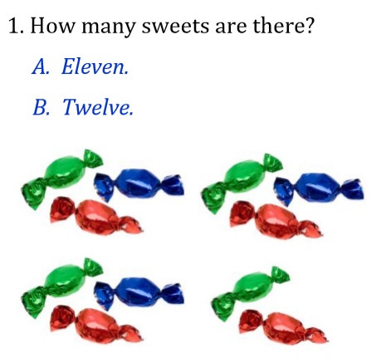
Look and circle the correct answer.

Slide 34
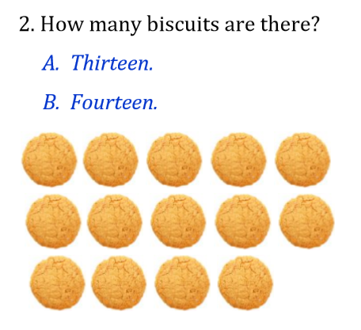
Look and circle the correct answer.

Slide 35
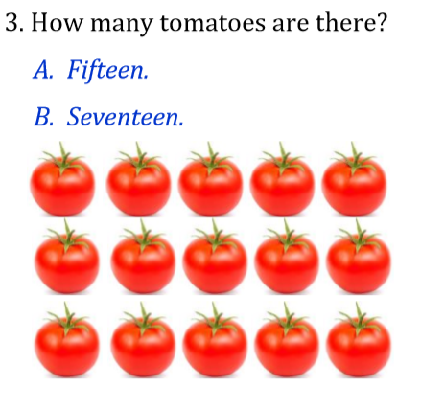
Look and circle the correct answer.

Slide 36
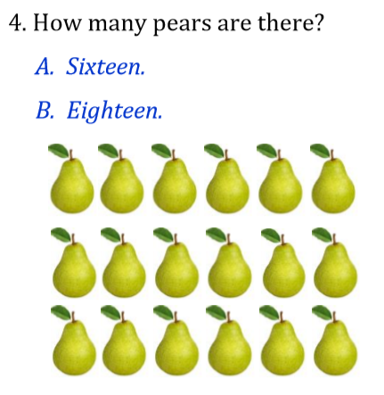
Look and circle the correct answer.

Slide 37
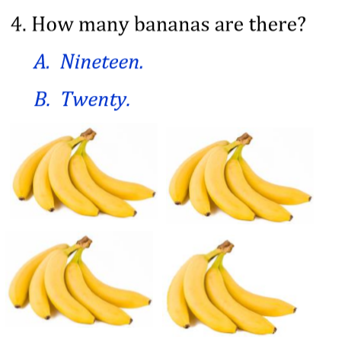
Look and circle the correct answer.
5.

Slide 38




Thank you & goodbye!

