Slide 1







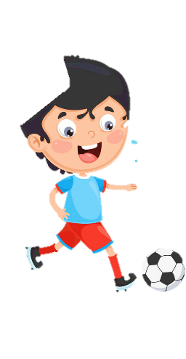













Slide 2


Slide 3

1 WARM UP
Piking Apples

Slide 4







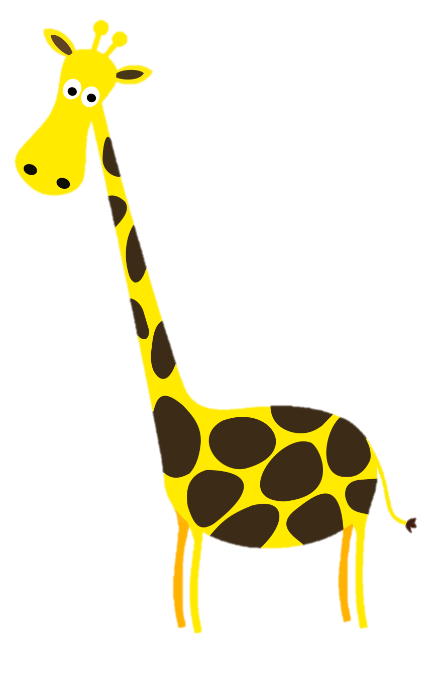







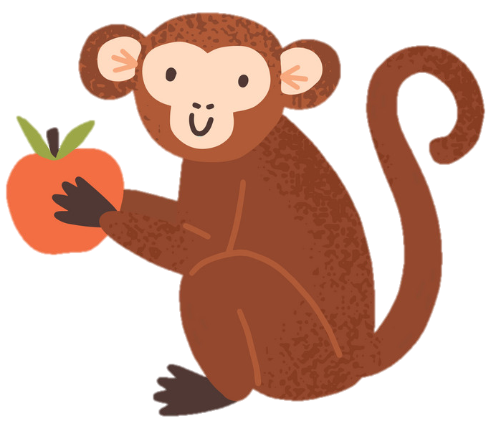

Picking apples
Notes:
GV chọn bất kỳ 1 quả táo. Mỗi quả táo tượng trưng cho câu hỏi

Slide 5

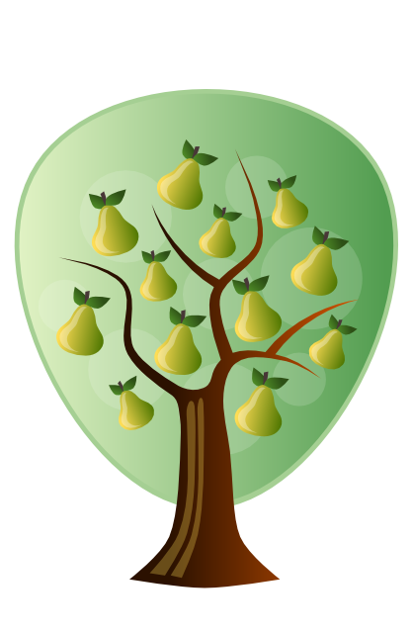
How many pears are there?
Twelve.
Back
Notes:
Bấm vào back để quay về trang chủ

Slide 6

How many tomatoes are there?
Fifteen.
Back
Notes:
Bấm vào back để quay về trang chủ

Slide 7
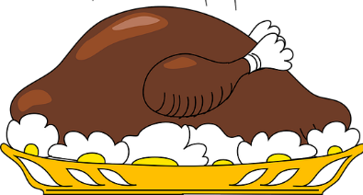

Where is the chicken?
It’s on the table.
Back
Notes:
Bấm vào back để quay về trang chủ

Slide 8

What is it?
It’s juice.
Back
Notes:
Bấm vào back để quay về trang chủ

Slide 9
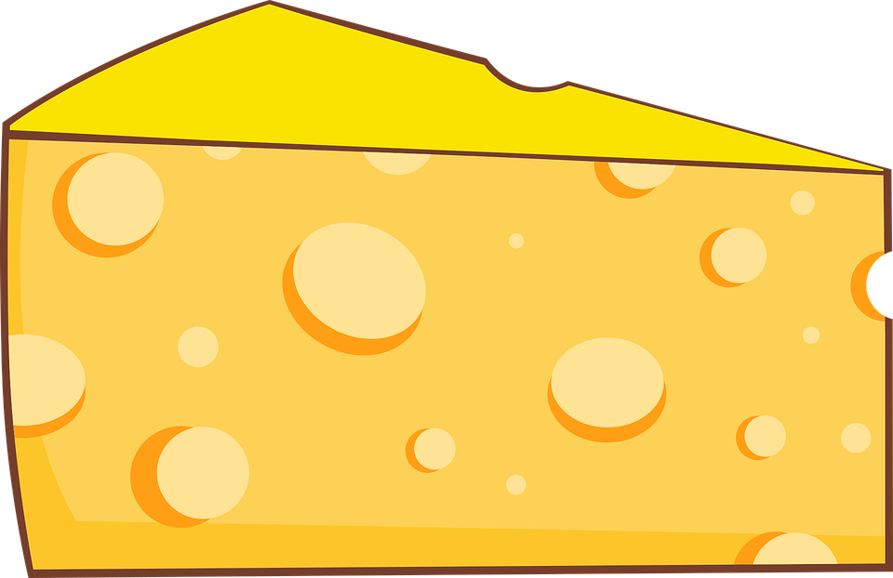
What is it?
It’s cheese.
Back
Notes:
Bấm vào back để quay về trang chủ

Slide 10

What is it?
It’s rice.
Back
Notes:
Bấm vào back để quay về trang chủ

Slide 11
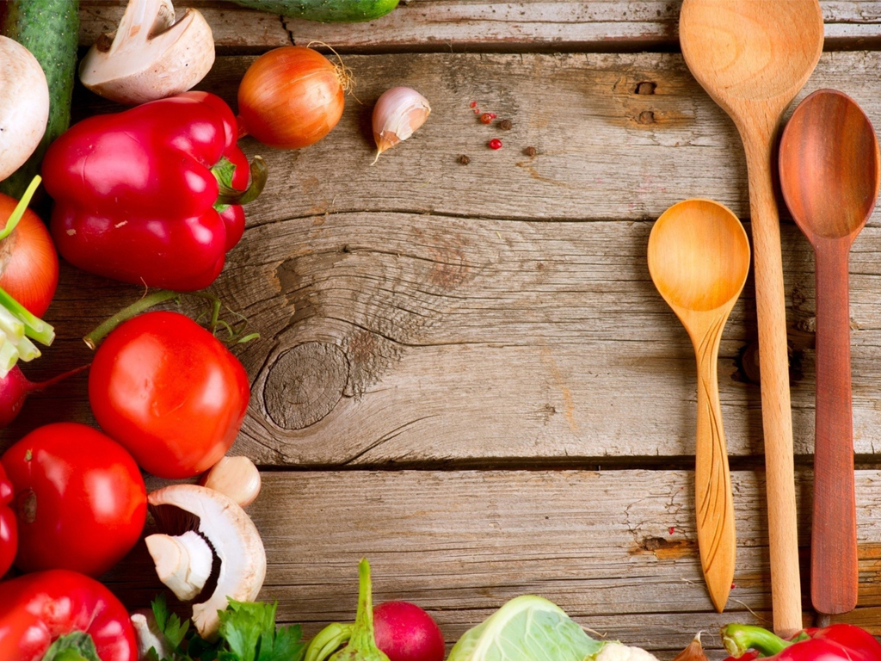

Unit 9:
My Favourite Food
FUN TIME & PROJECT

Slide 12

2 REVIEW
Task 1 Read and match.

Slide 13
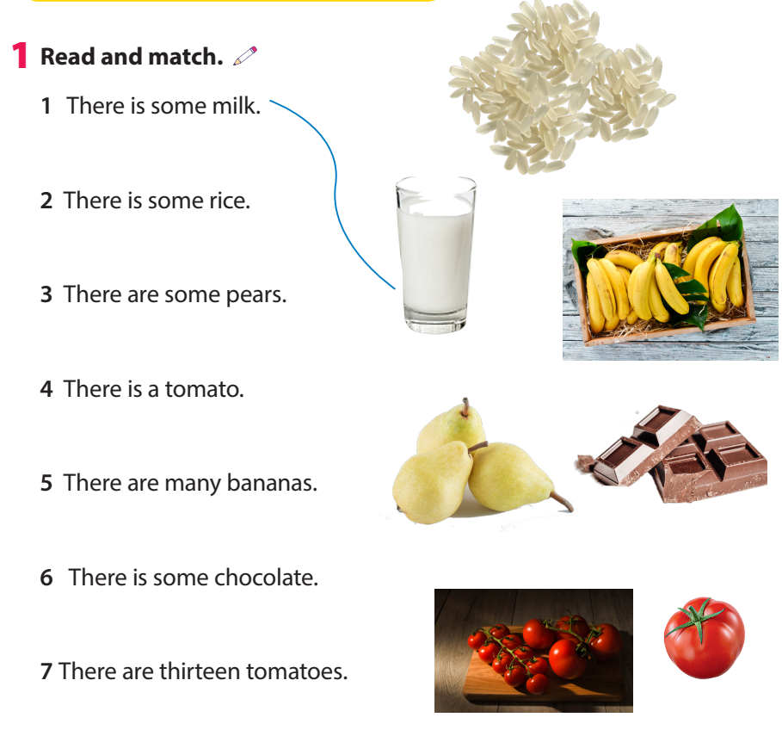
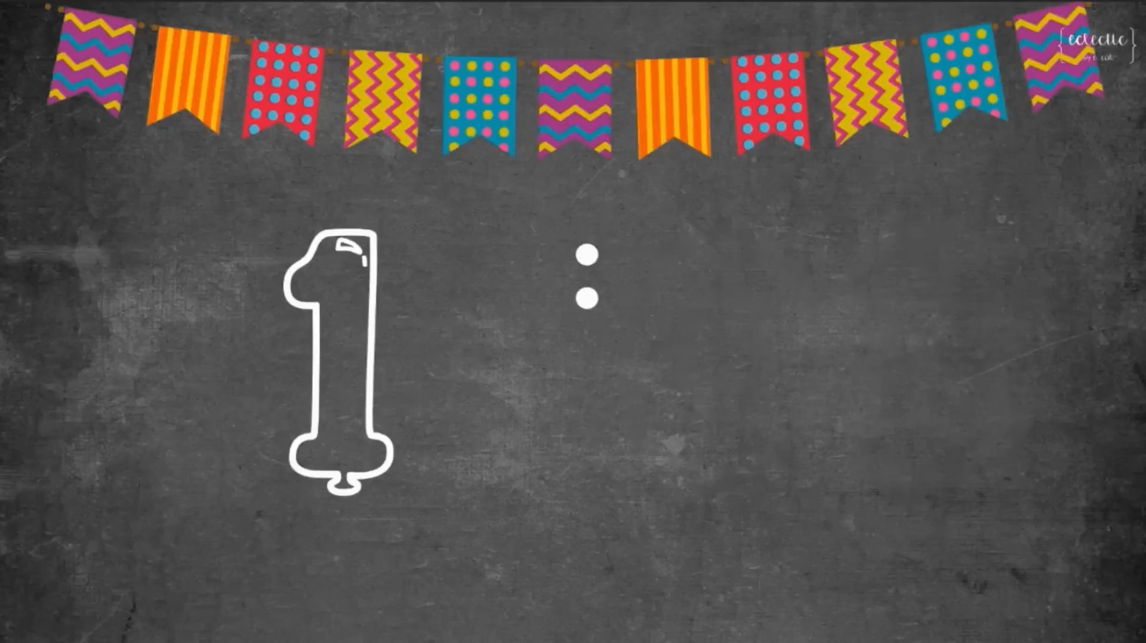
Task 1 Read and match.

Slide 14
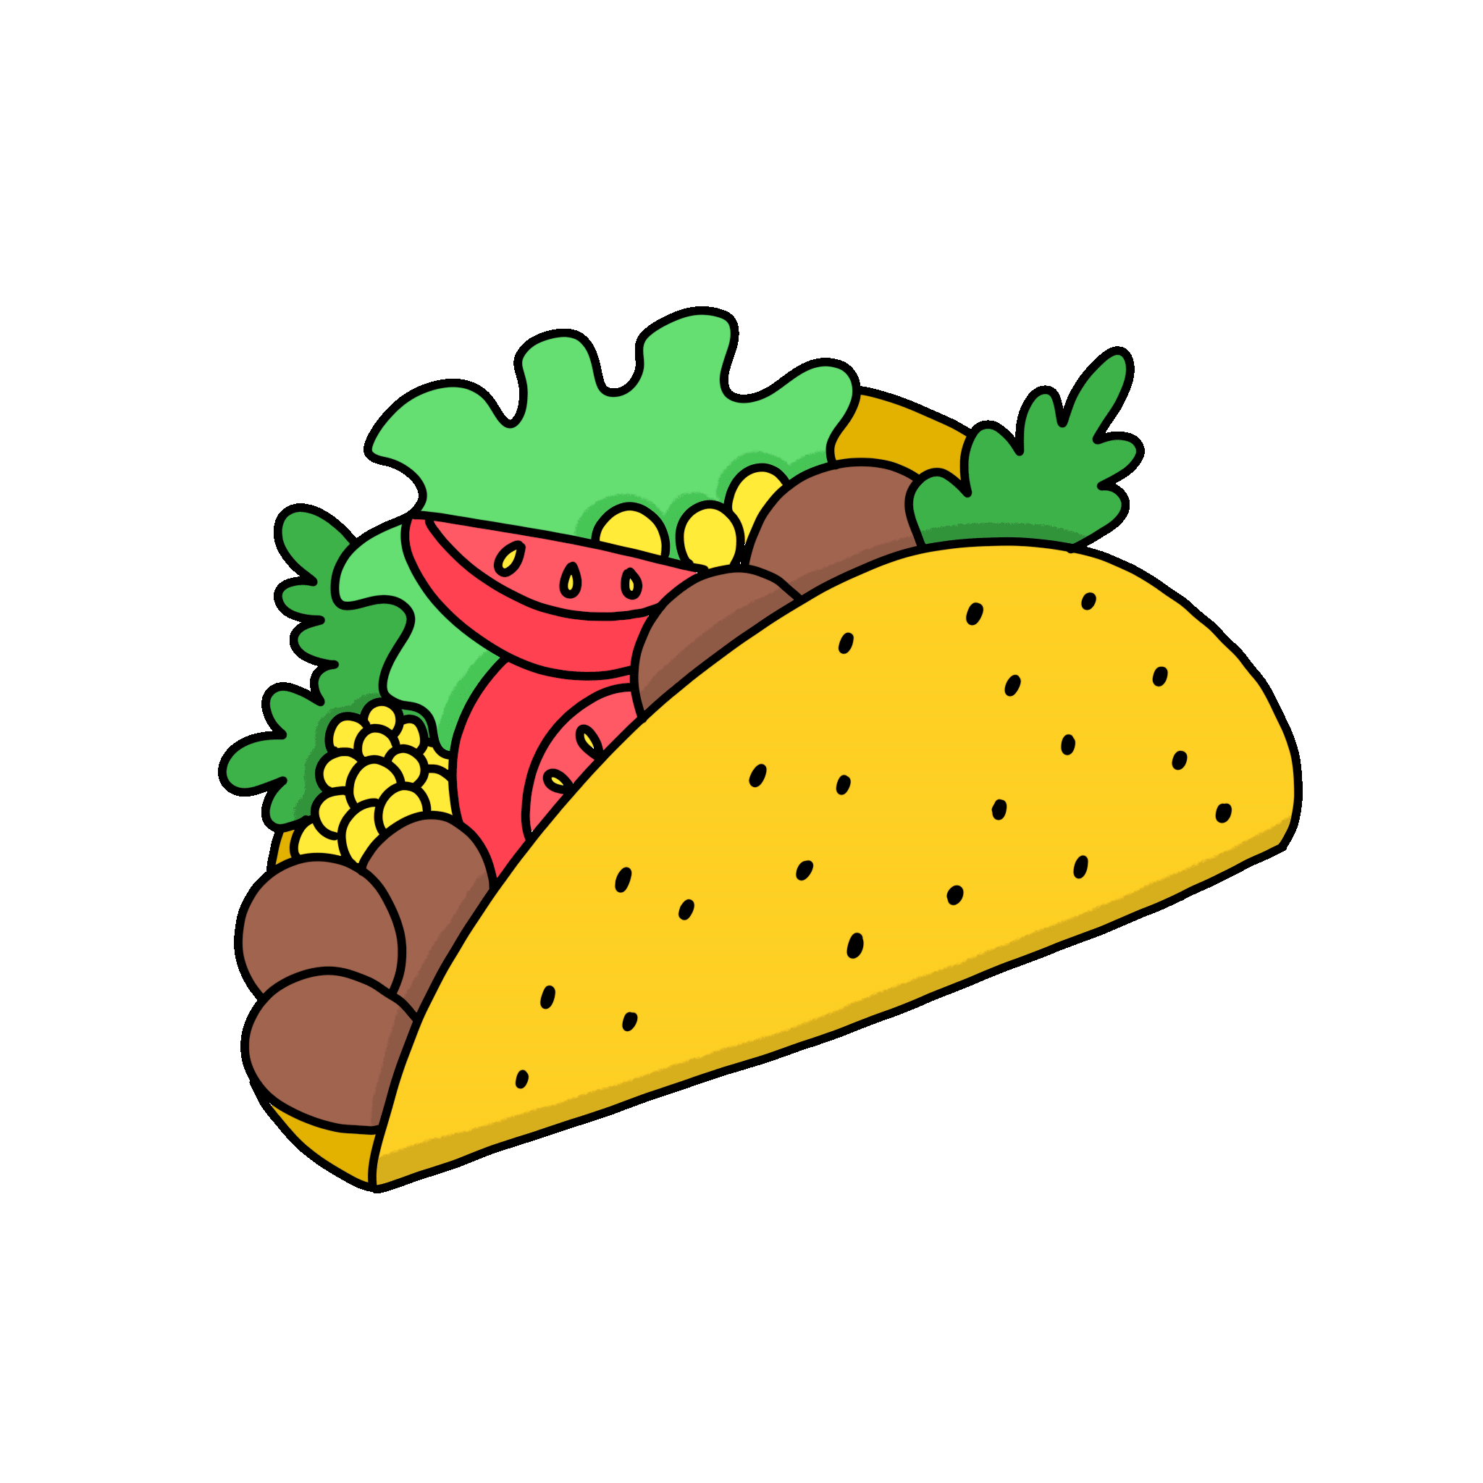
3 PROJECT
My favourite food.

Slide 15

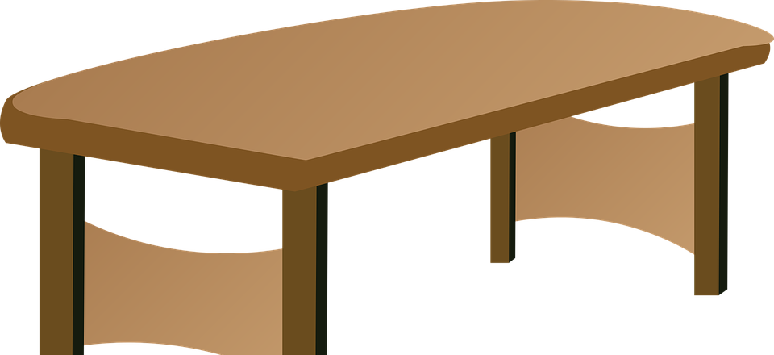
Draw a picture of food in your kitchen.
Tell your class about it.

Slide 16
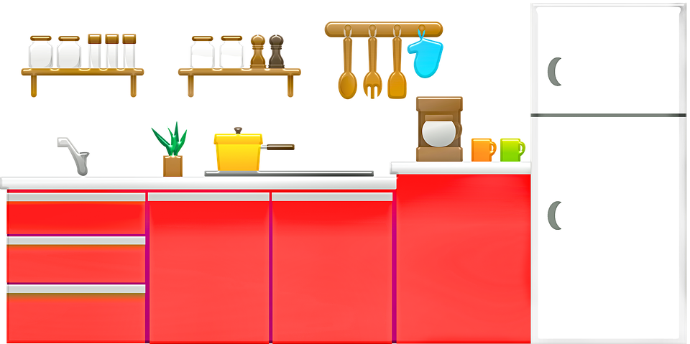
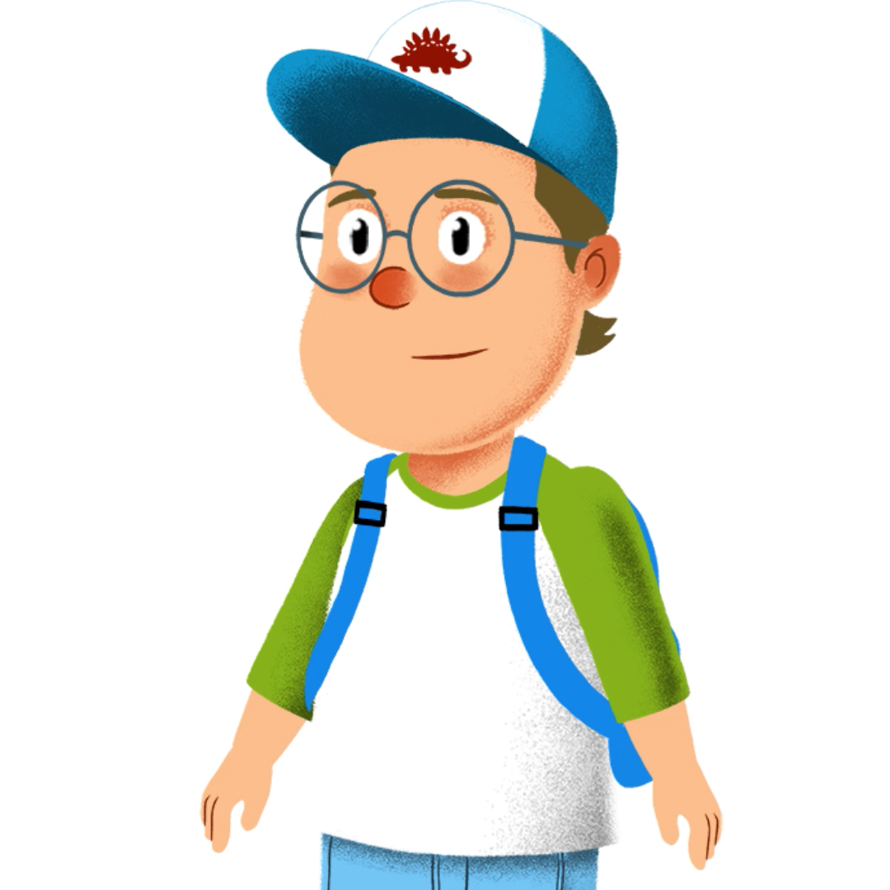

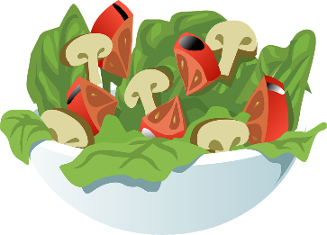


This is my kitchen. There is a lot of food. There are some biscuits on the table.

Slide 17
4 ASSESSMENT
Look and circle

Slide 18
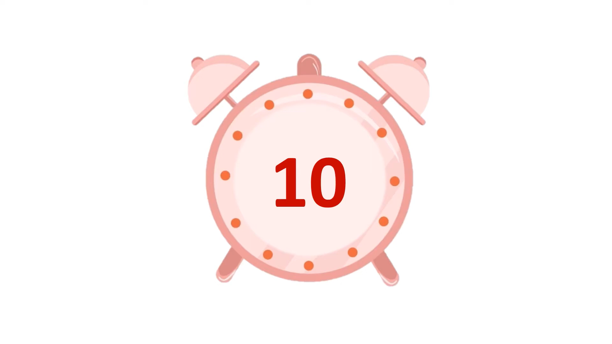
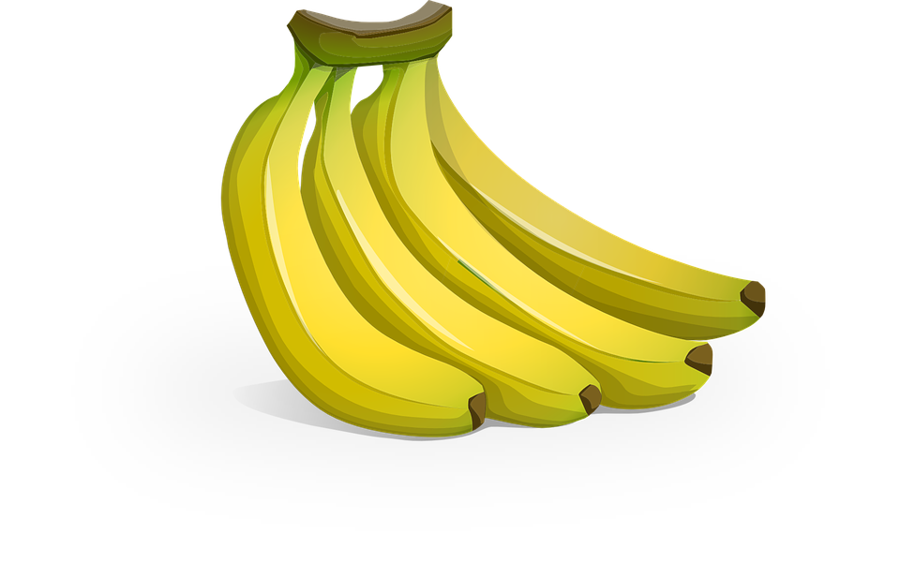
1 How many bananas are there?
A Nineteen.
B Sixteen.
C Twenty.

Slide 19
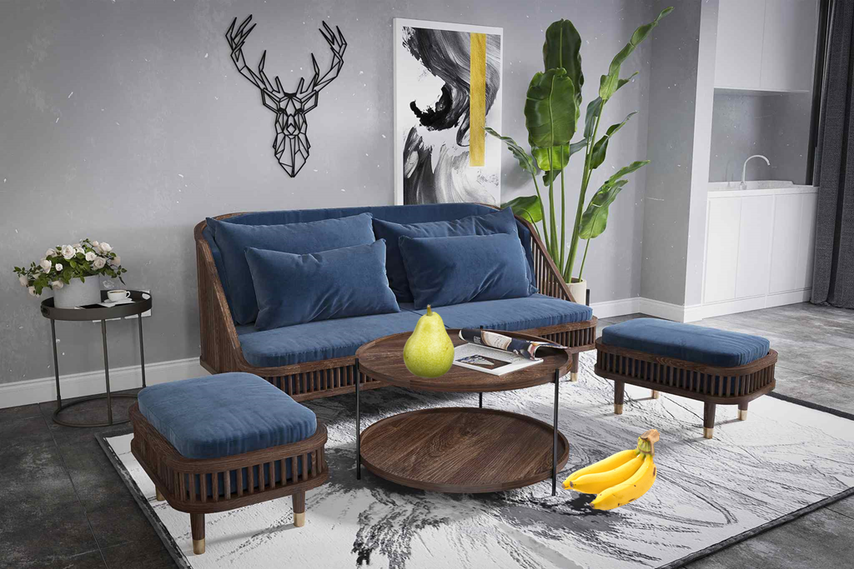
2 Where’s the pear?
A It’s on the table.
B It’s under the table.
C It’s in the table.

Slide 20
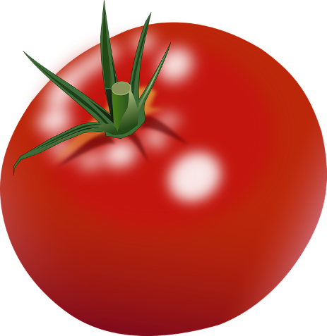
3 There are ______ tomatoes.
A many
B some
C a lot of

Slide 21
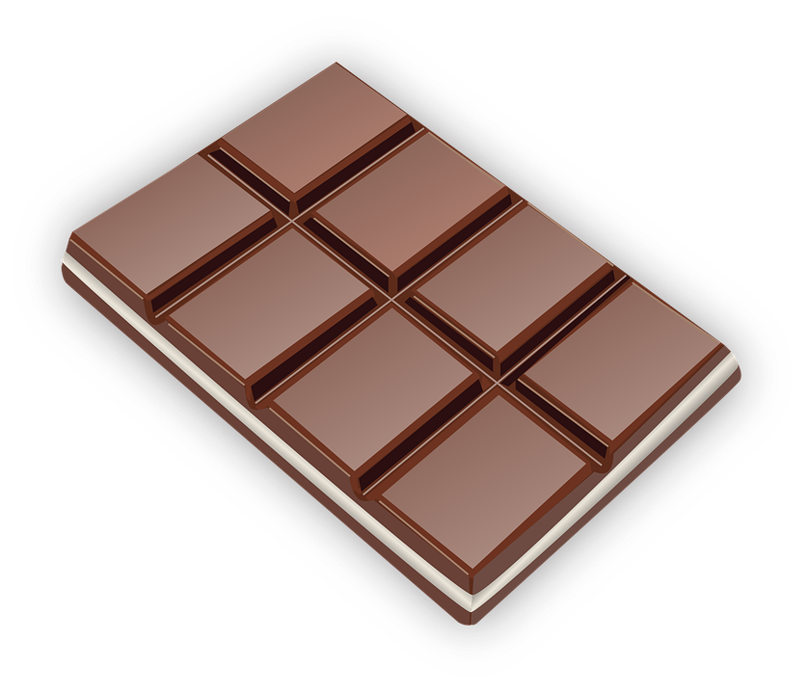
4 There is some _______.
A milk
B chocolate
C rice

Slide 22

5 There are ______ sweets.
A sixteen
B some
C a lot of

Slide 23





Thank you
& goodbye!

