Slide 1


Slide 2



Slide 3
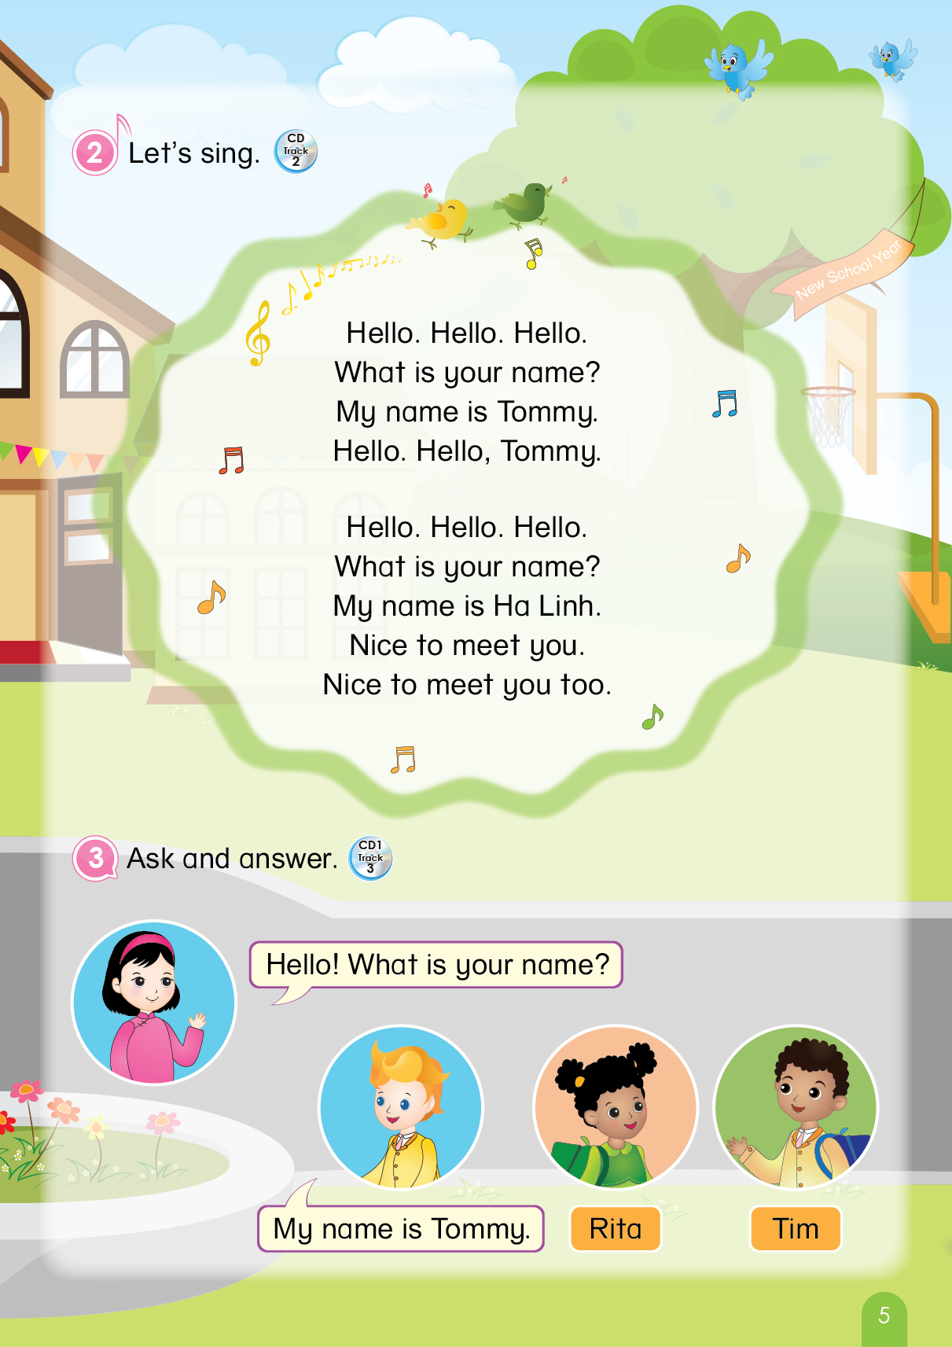

Notes:
T says “ Hello, everyone. How are you? How’s the weather? Is it sunny? Great! Now, let’s sing a song with me.”
Warm up: Sing “Hello song” – “Excellent! You sing very well.”
Divide class into 2 groups (optional) – “Today, we will have 2 groups – Group 1 and Group 2. You are Group 1, you are Group 2.”

Slide 4



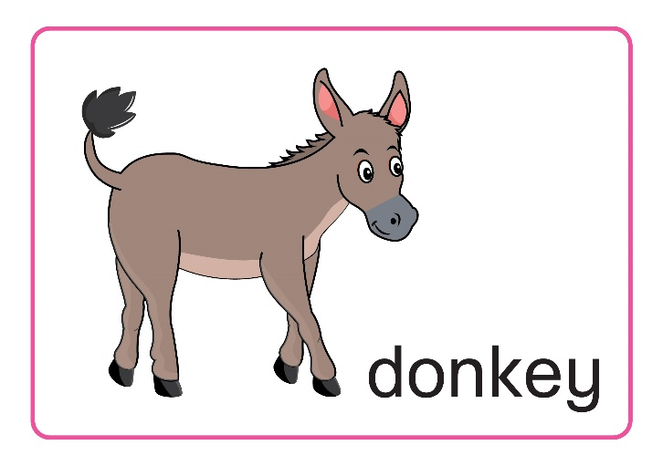
Let’s review!
Dd
d
Game:
what’s missing?
Notes:
- Teacher gives instructions of this activity:
+ review the cards and have them look at each card for 1 minute.
+ once one card is removed, ask them to say the removed card in memory.
Teacher makes sure all students understand the game’s rule.
“Let’s play missing game. Class, what is it? Great! Now, look and tell me what missing.”

Slide 5


d
?
Game:
what’s missing?
Notes:
“Class, what’s missing?”

Slide 6


Dd
Notes:
“Great!”

Slide 7


Dd
d
Game:
what’s missing?
?
Notes:
“Oh no, what’s missing?”

Slide 8

Notes:
“Good job.”

Slide 9



Game:
what’s missing?
?
d
?
Notes:
“Next, what are missing?”

Slide 10


Dd
Notes:
“Yeah, well done.”

Slide 11


?
?
?
Game:
what’s missing?
Notes:
“Wow, what are missing?”

Slide 12


Dd
d
Notes:
Teacher gives praises to the whole class. – “Excellent”

Slide 13
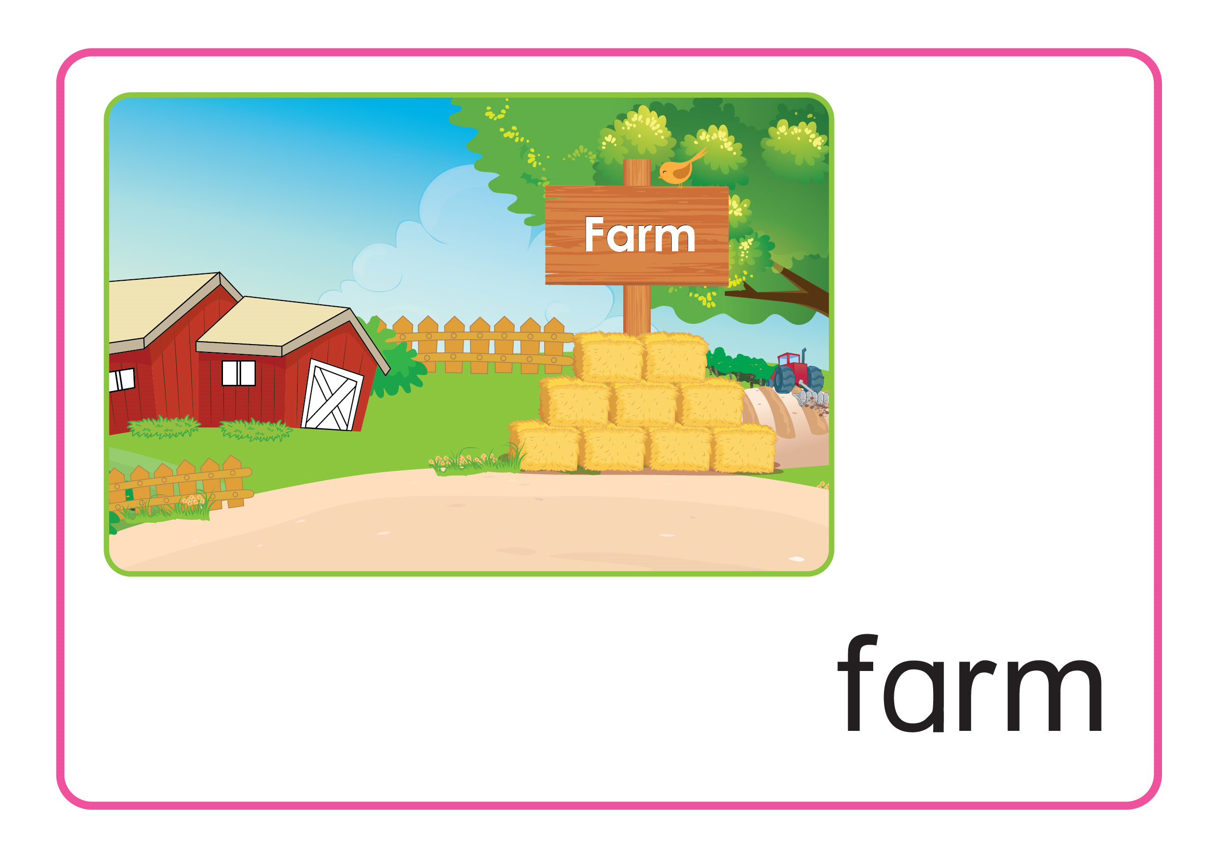

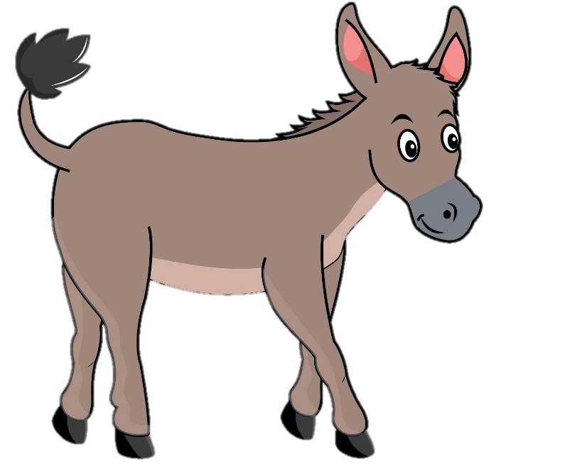
Unit 4
Lesson 2
Notes:
Teacher gives students some hints of today’s lesson by pointing the duck and donkey, possibly saying “Let’s meet our old friends. Do you know them?”
- “Yes, great! They are duck and donkey.”
- “Let’s move to the first part – Listen and repeat.”

Slide 14

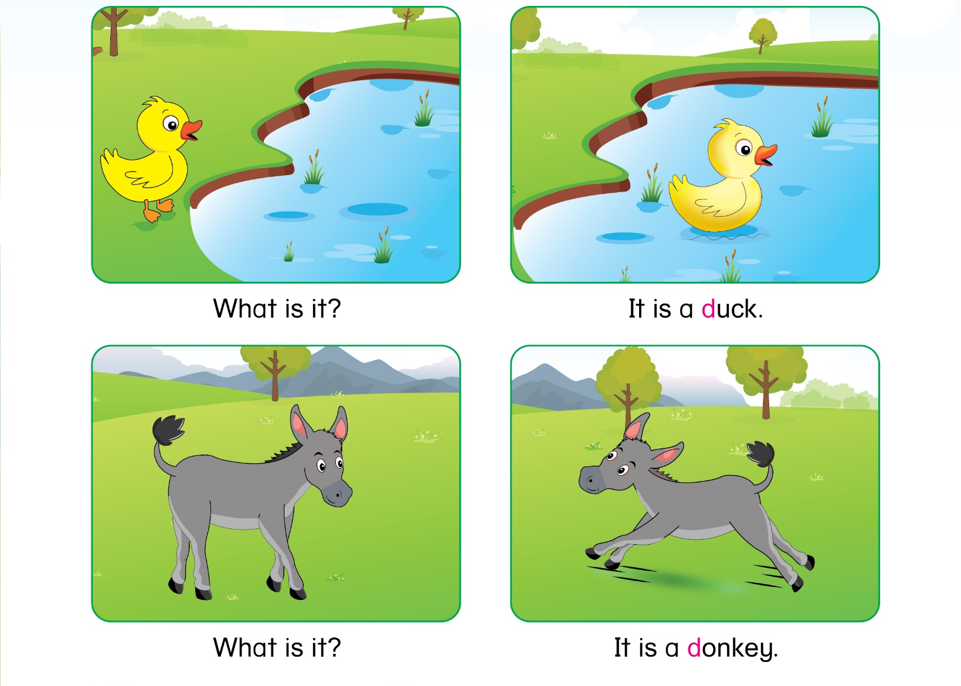
Unit 4:
Lesson 2:
D d
1. Listen and repeat.
Notes:
Teacher asks students to listen twice. – “Listen 2 times”
Teacher asks students to repeat once after one-by-one listening, and check pronunciation. – “Listen and repeat.”
Teacher may ask one team to ask and the other team answer, or vice versa. – “Now, group 1 asks and group 2 answers.”

Slide 15


Unit 4:
Lesson 2:
D d
Let’s practice with
✗
What _ _ ?
What is it
Notes:
Teacher mutes the sound and asks the class say it out loud. – “Now, look and say.”

Slide 16
Unit 4:
Lesson 2:
D d
Let’s practice with
✗
__ __ a duck.
It is a duck.
Notes:
Teacher mutes the sound and asks the class to say it out loud. – “Next”

Slide 17
Unit 4:
Lesson 2:
D d
Let’s practice with
✗
What is it
What _ _?
Notes:
Teacher mutes the sound and ask the class to say it out loud. – “This one. Good job.”

Slide 18
Unit 4:
Lesson 2:
D d
Let’s practice with
✗
It is a donkey.
_ _ a donkey.
Notes:
Teacher mutes the sound and ask the class to say it out loud. – “Last one. Good”

Slide 19
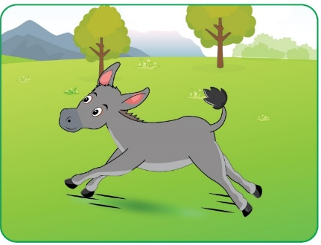

☞ What is it?
☞ What is it?
It is a donkey.
It is a duck.
Notes:
Teacher gives praises. – “Good”

Slide 20
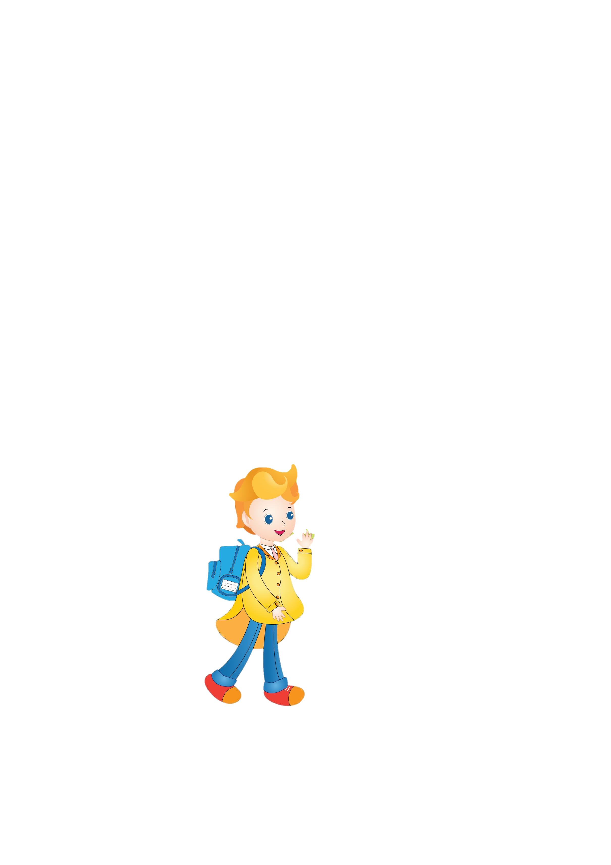

Unit 4:
Lesson 2:
D d
2. Ask and answer.
DO YOU REMEMBER?
Tommy
Hà Linh
Notes:
- Teacher leads in the new part and say that they are going to meet their friends. – “Let’s move to next part. Do you remember them? Yes, They are Tommy and Ha Linh.”

Slide 21

Unit 4:
Lesson 2:
D d
2. Ask and answer.
WHAT
ARE
THEY
TALKING?
Notes:
- Teacher leads in the part and ask students to listen twice. – “Now, look and listen 2 times.”

Slide 22
Unit 4:
Lesson 2:
D d
2. Ask and answer.
Activity: Role play
Student
Teacher
ARE
YOU
READY?
Notes:
Teacher gives instructions of the activity:
+ teacher plays the role of Hà Linh, and students play the role of Tommy. – “Now, I’m Ha Linh, you are Tommy. Let’s do it.”
+ teacher repeats after Ha Linh, and students repeat after Tommy.

Slide 23




Activity: Role play
What
is it?
It is
a bird.

Slide 24


Activity: Role play
What
is it?
It is
a cow.

Slide 25

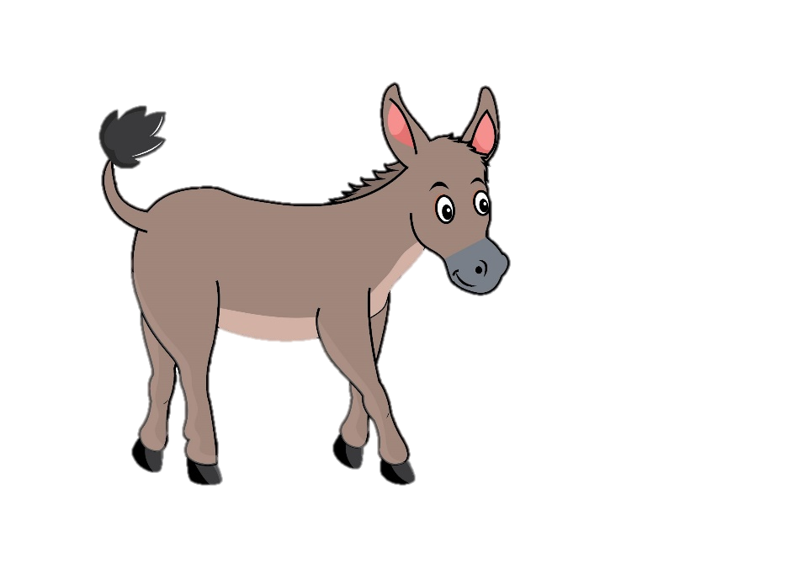
Activity: Role play
What
is it?
It is a donkey.

Slide 26


Activity: Role play
It is
a duck.
What
is it?

Slide 27

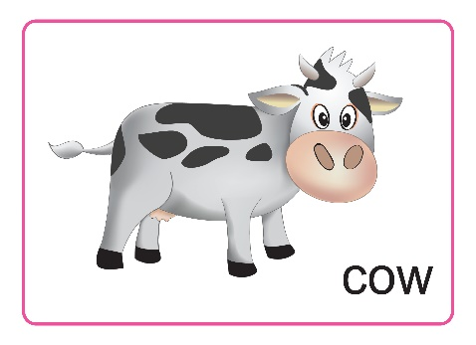


Notes:
Teacher gives praises to the whole class. – “Good job”

Slide 28

Unit 4:
Lesson 2:
D d
Activity: Work in pairs
LOOK
AT
YOUR
BOOK!
ASK
AND
ANSWER.
Notes:
Teacher asks students to look at the book – part 2. – “Now, open your book page 19.”
Teacher asks students to work in pairs: one student asks, one student answers in 3 minutes. – “Now, work in pairs. One asks and one answers.”
Teacher may invite one or two pairs of students to come to the board and ask and answer out loud. – “Have you finished? Now, you please.”
Teacher corrects and checks pronunciation.

Slide 29

Unit 4:
Lesson 2:
D d
What have we learned?
What
is it ?
It is
a cow.
Notes:
Teacher reviews the lesson, and leads in the revision section.

Slide 30

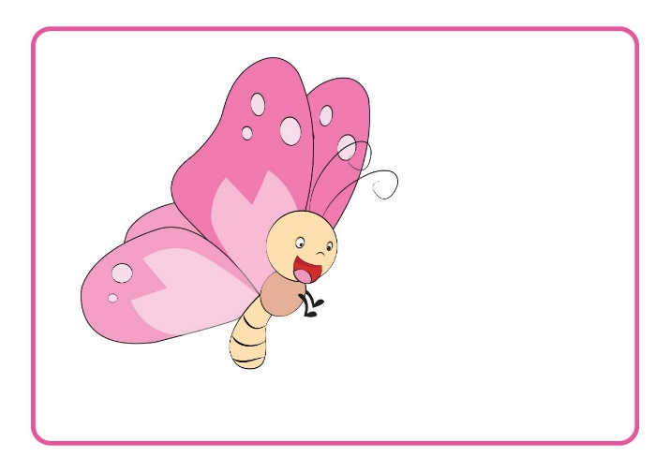

What have we learned?
What
is it?
?
It is a butterfly.
A.
B.
Notes:
Teacher says the questions and asks students to think in few minutes. – “Class, what is it? Yes, so we choose A or B? Great. A”
Teacher asks for their answers, collects and confirms, and shows the correct answer.

Slide 31

What have we learned?
It is a bee.
?
What
is it?
A.
B.
C.
Notes:
Teacher says the questions and asks students to think in few minutes. – “Class, what is it? Yes, so we choose A, B or C? Great. C”
Teacher asks for their answers, collects and confirms, and shows the correct answer.

Slide 32
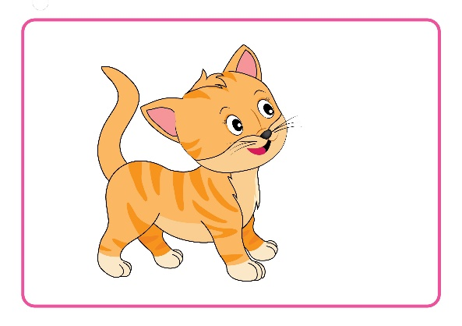
What have we learned?
?
What
is it?
A.
B.
It is a cat .
It is
a duck.
Notes:
Teacher says the questions and asks students to think in few minutes. – “Class, what is it? Yes, so we choose A or B? Great. A”
Teacher asks for their answers, collects and confirms, and shows the correct answer.

Slide 33
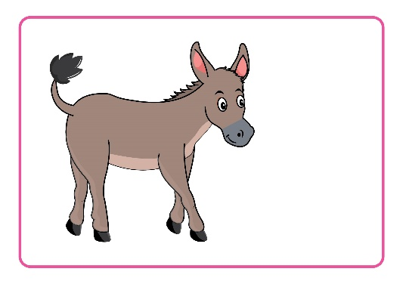
What have we learned?
?
What
is it?
A.
B.
C.
It is a cow .
It is
a donkey.
It is an ant.
Notes:
Teacher says the questions and asks students to think in few minutes. – “Class, what is it? Yes, so we choose A, B or C? Great. B”
Teacher asks for their answers, collects and confirms, and shows the correct answer.

Slide 34
Unit 4:
Lesson 2:
D d
What have we learned?
Notes:
Teacher gives praises: “Good job.”

Slide 35

Unit 4:
Lesson 2:
D d
1. Listen and repeat.
2. Ask and answer.
Notes:
Teacher asks students to ask and answer again: “So class, can you ask? Good. And can you answer? Good.”
Teacher gives comments of the class’s performance: “Class, you did so well today.”

Slide 36

Unit 4:
Lesson 2:
D d
Notes:
Teacher says Goodbye. – “It’s time to say Goodbye. Goodbye, and see you.”

Slide 37


CÔNG TY CỔ PHẦN PHÁT TRIỂN GIÁO DỤC
VIỆT NAM VPBOX
Hà Nội
Biệt thự G2&G28, Làng Quốc Tế Thăng Long,
Quận Cầu Giấy, Hà Nội.
ĐT: (024) 3 3793 2405
phonics.hanoi@vpbox.edu.vn
Thành Phố Hồ Chí Minh
Số 29 Mai Thị Lựu, Quận 1, TP. HCM.
ĐT: (028) 3 820 5934
phonics.hcm@vpbox.edu.vn
www.vpbox.edu.vn

