Slide 1













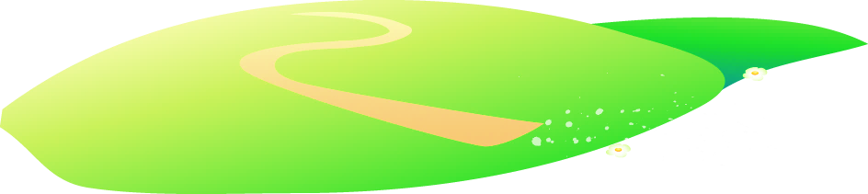







Unit 3
Animals
Lesson 1 – Task 4,5,6
Notes:
Để nguyên trang bìa như này, chỉ thay đổi tên bài trong quá trình làm. Logo của sách Wonderful World

Slide 2

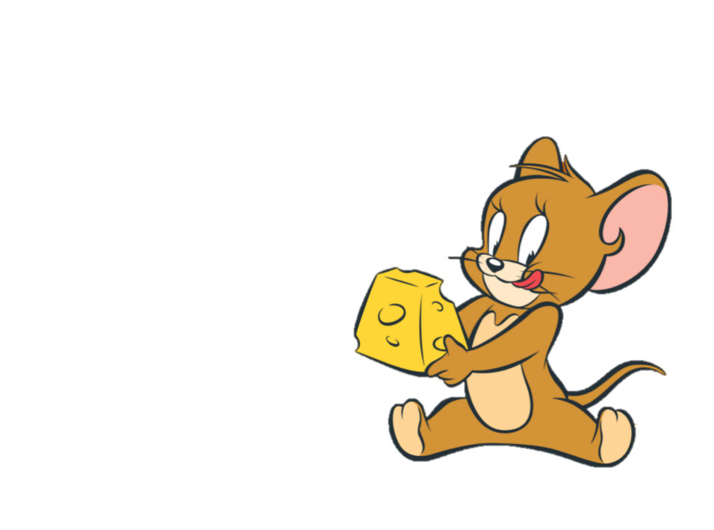
Warm Up
01.
GAME : JERRY’S GUESS

Slide 3

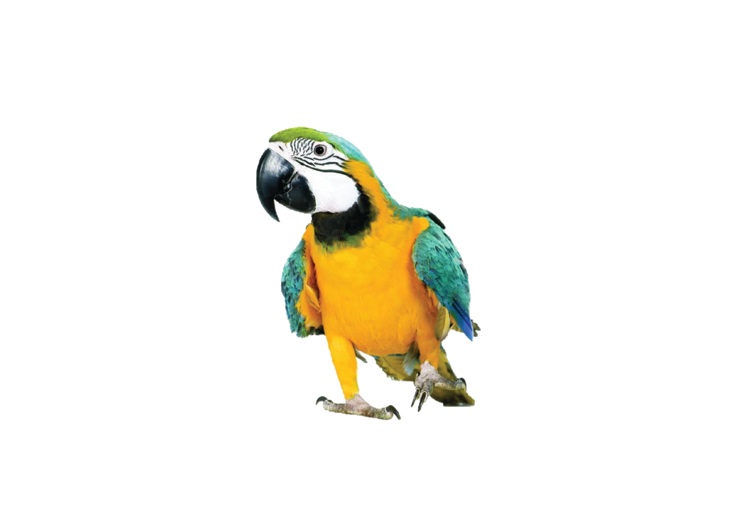

Challenge 1
CHECK
Notes:
GV hỏi hs CAN YOU GUESS WHAT ANIMALS IS IT?
IT’S A BIRD.

Slide 4
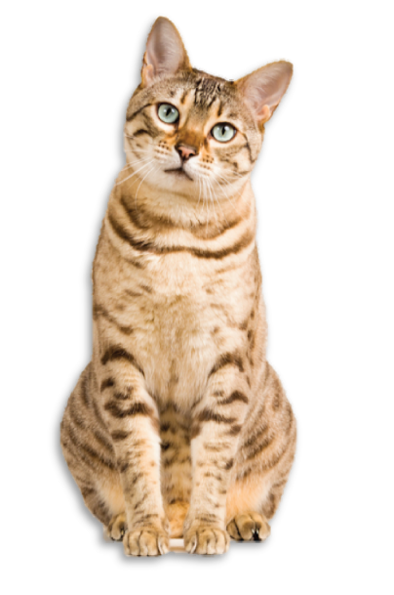
Challenge 2
CHECK
Notes:
GV hỏi hs CAN YOU GUESS WHAT ANIMALS IS IT?
IT’S A CAT.

Slide 5
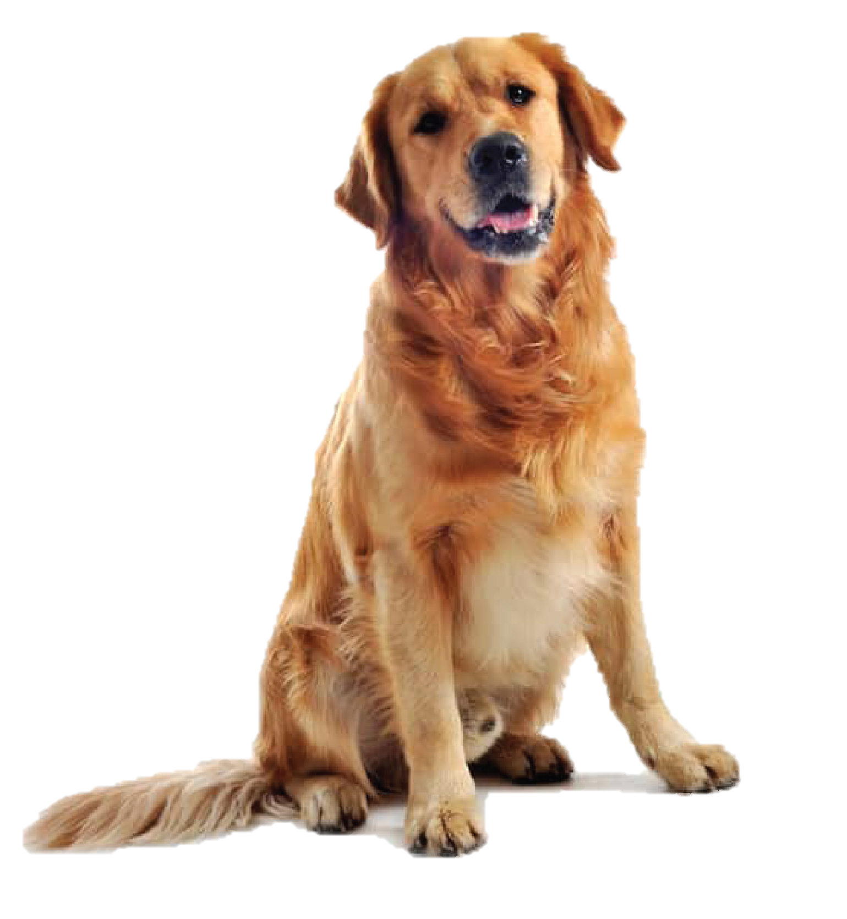
Challenge 3
CHECK
Notes:
GV hỏi hs CAN YOU GUESS WHAT ANIMALS IS IT?
IT’S A DOG.

Slide 6
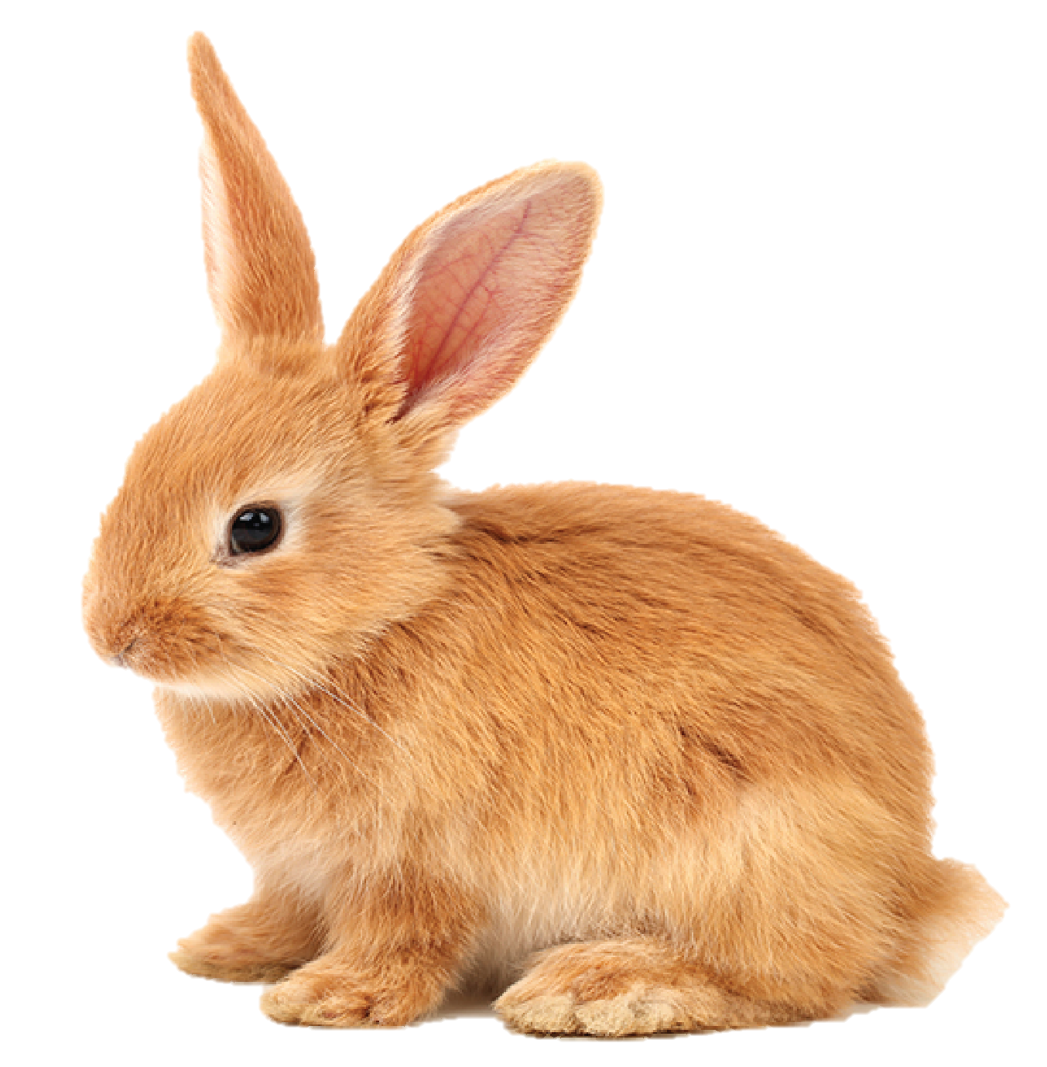
Challenge 4
CHECK
Notes:
GV hỏi hs CAN YOU GUESS WHAT ANIMALS IS IT?
IT’S A RABBIT.

Slide 7
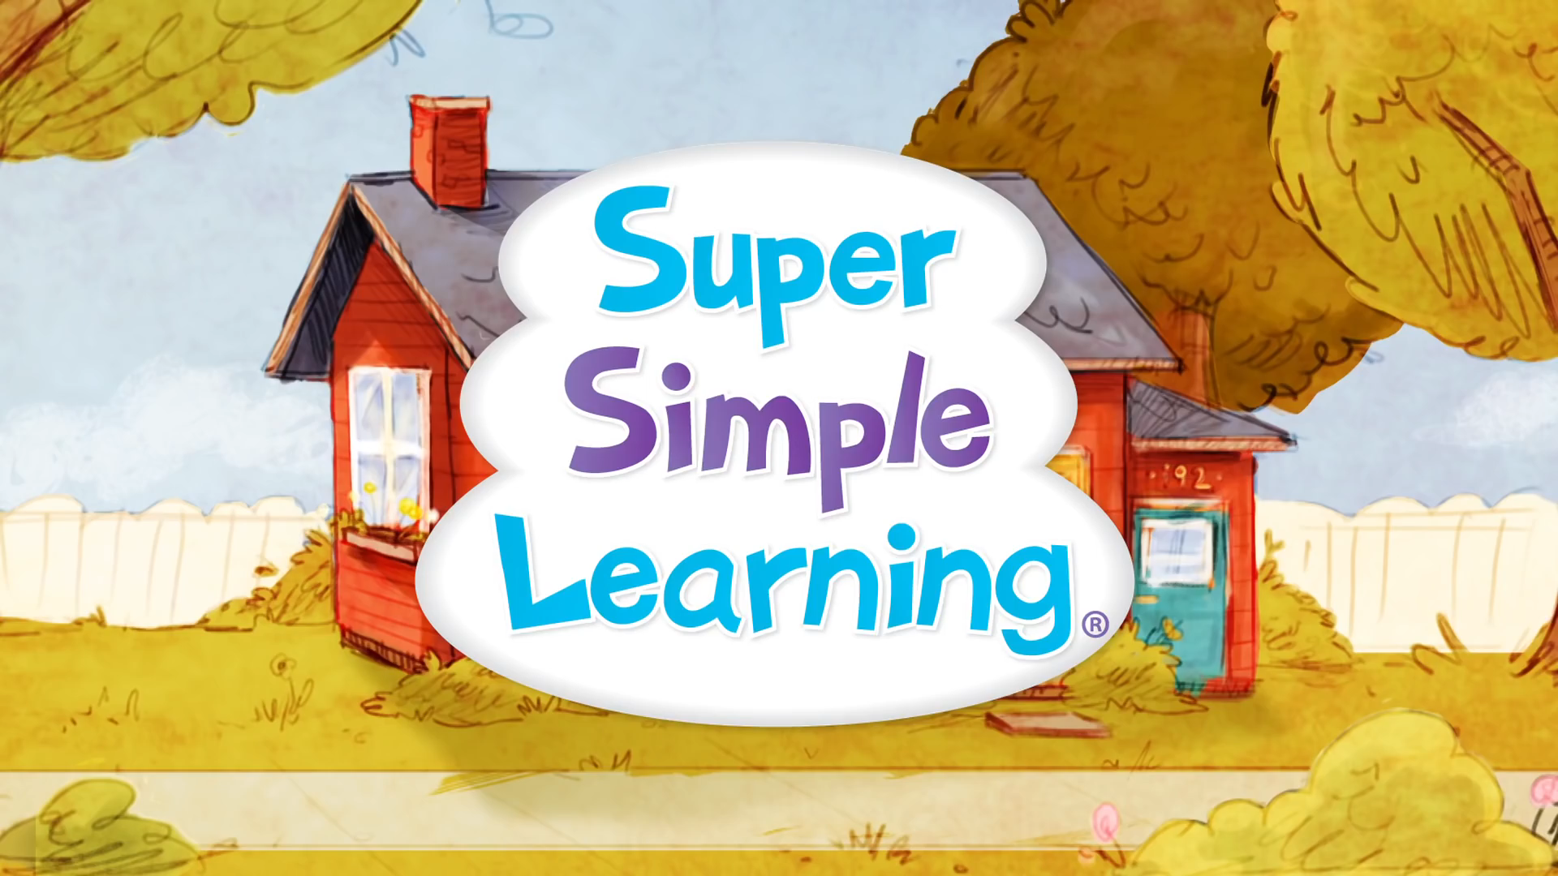
I HAVE A PET

Slide 8
2 Presentation
Notes:
Stop here

Slide 9

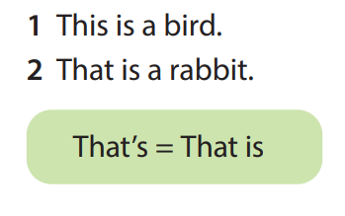
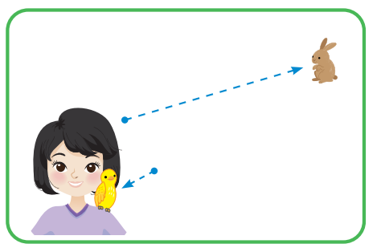
4 Listen and repeat
That’s
This is

Slide 10
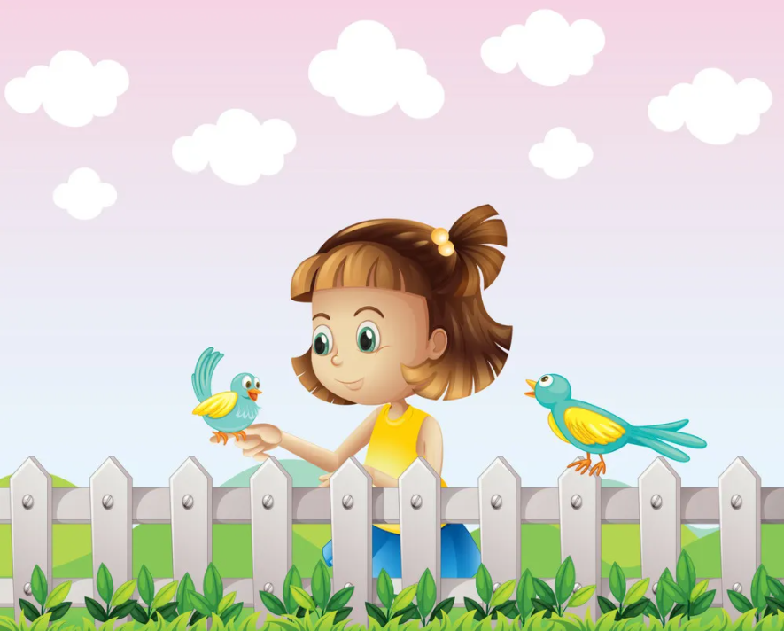
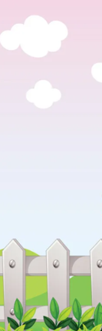
This is a bird .

Slide 11
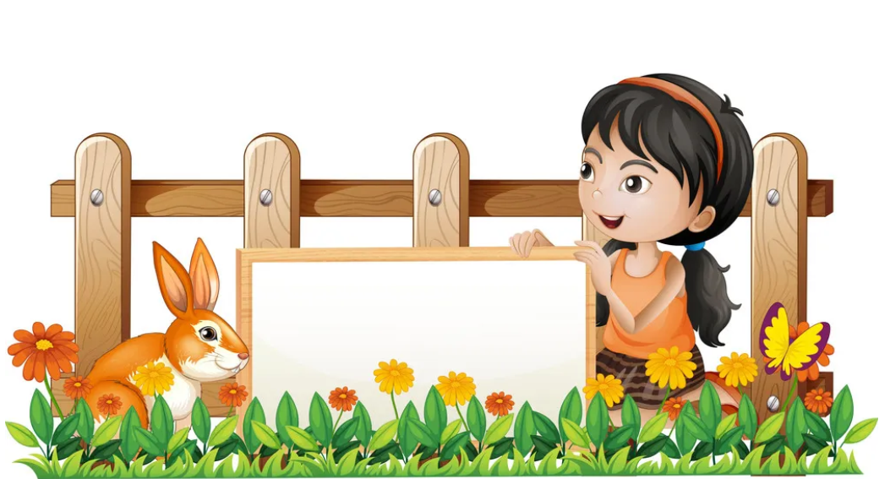
That is a rabbit.

Slide 12
LISTEN AND TICK

Slide 13
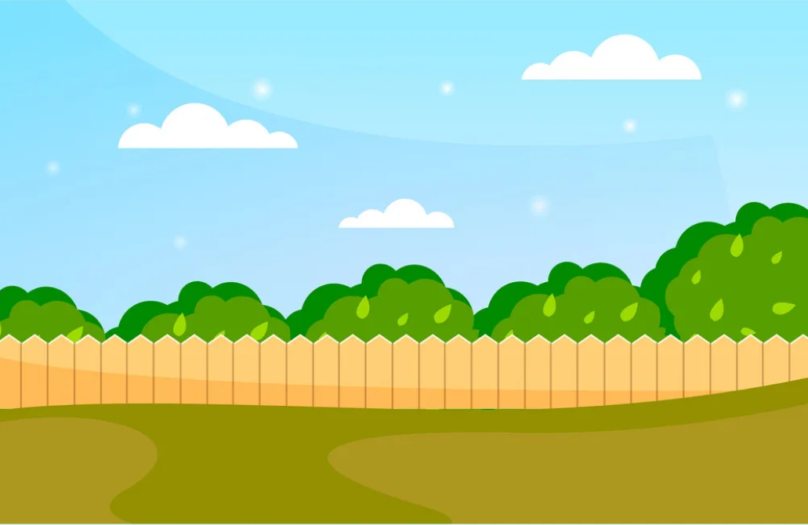
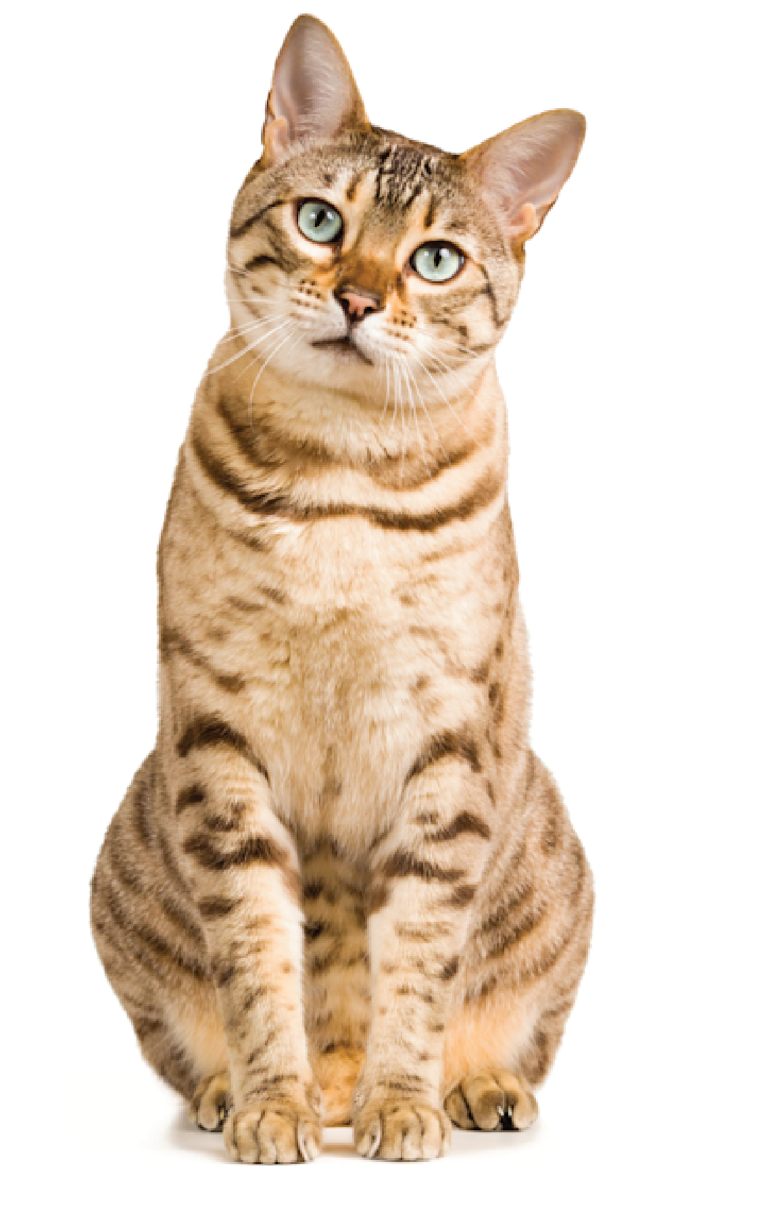
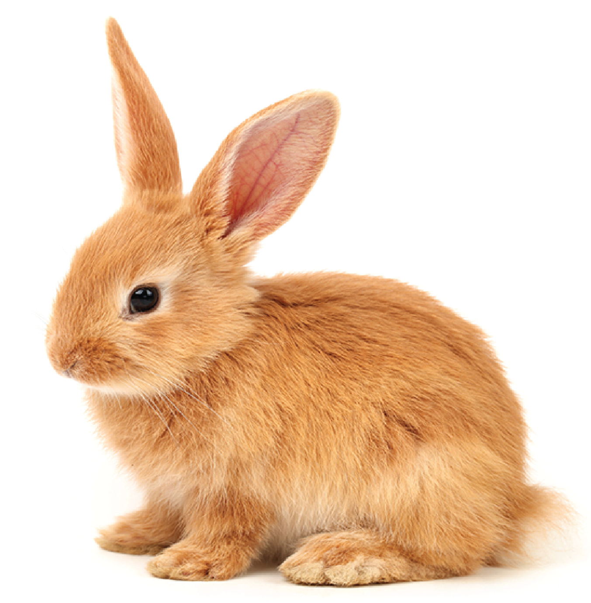
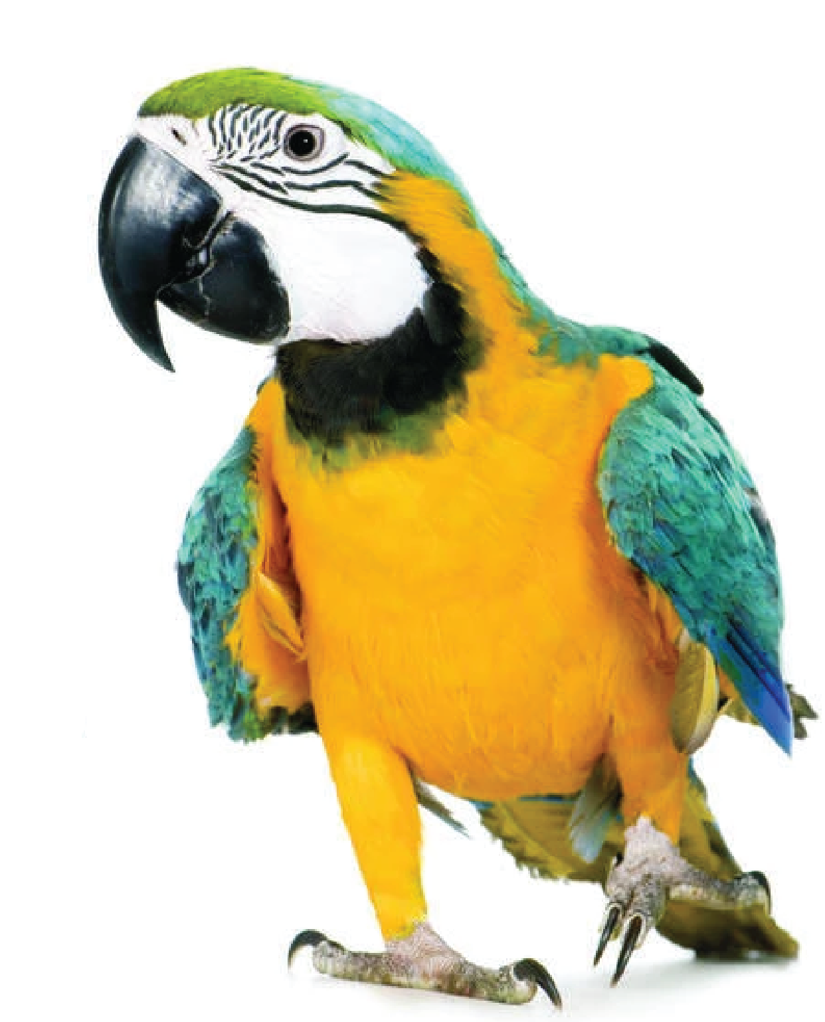
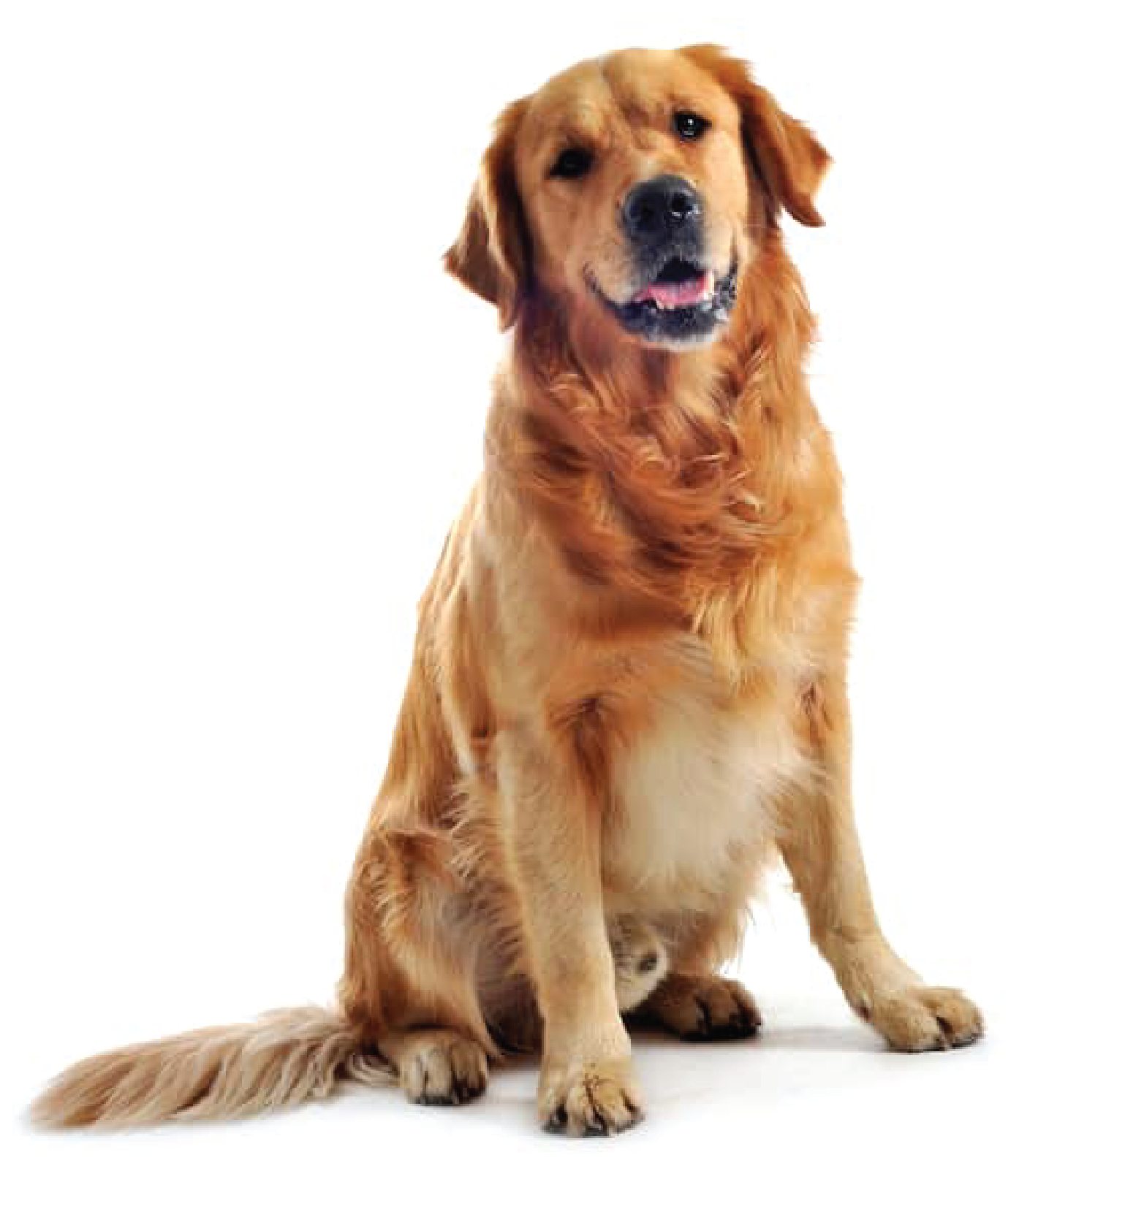
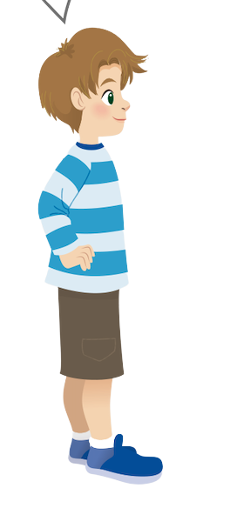
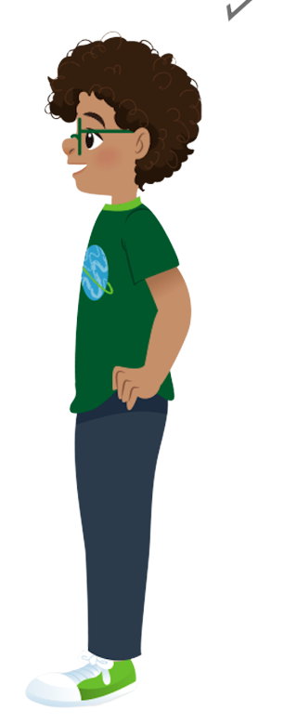
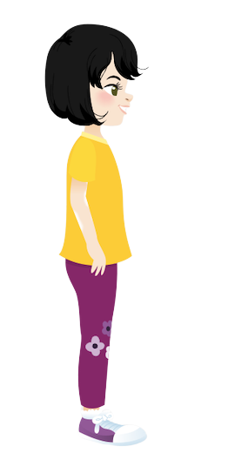
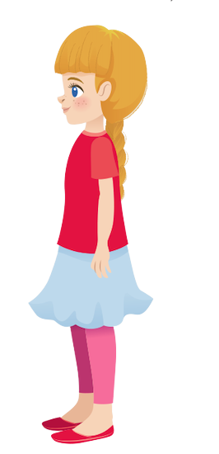
Listen and tick
✓
2. That is a
✓
1.This is a
That’s
Sophie
This is
Ana
Alex
Tomas

Slide 14
03.
Practice

Slide 15



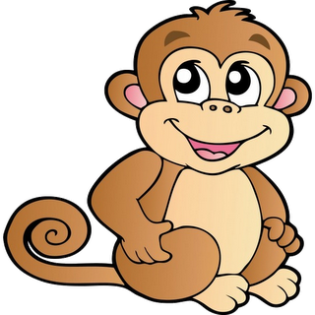
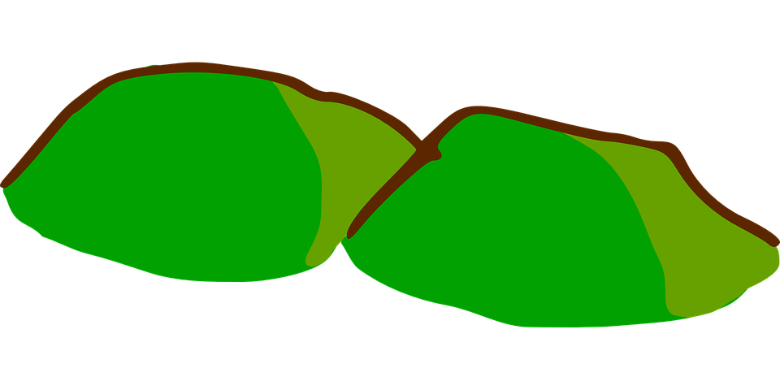
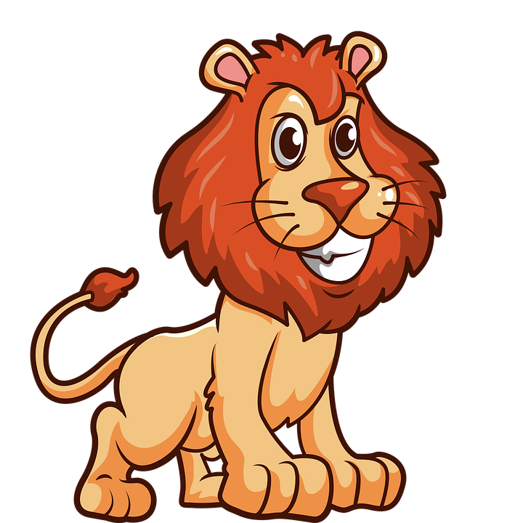
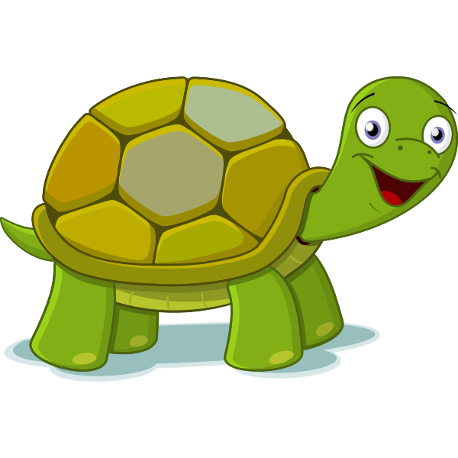
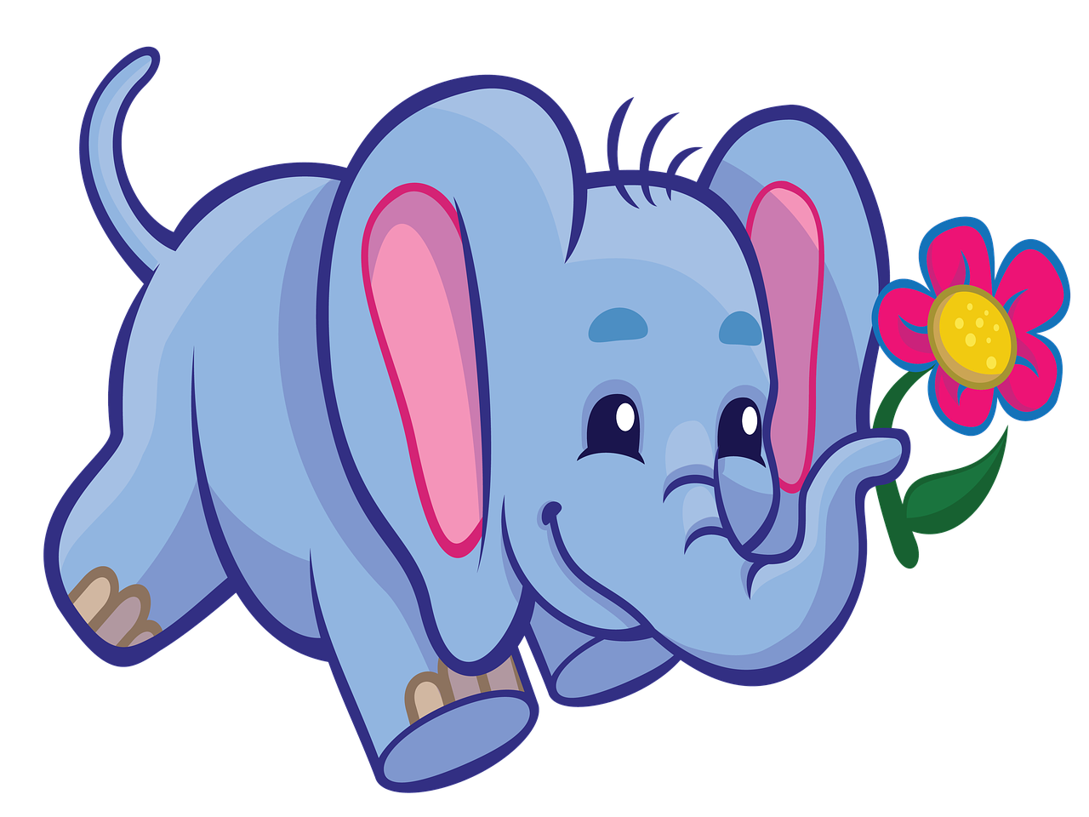

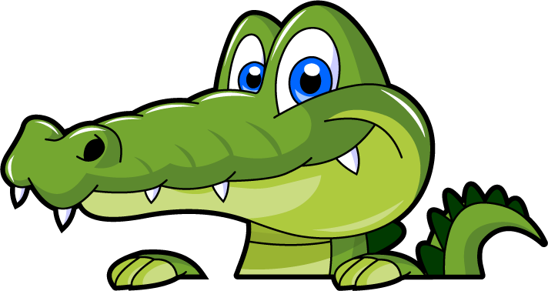
Build Bridge Game
1
2
3
4
5
Next
Notes:
Bấm các viên gạch để xuất hiện câu hỏi
Bấm Next để qua phần kế tiếp

Slide 16
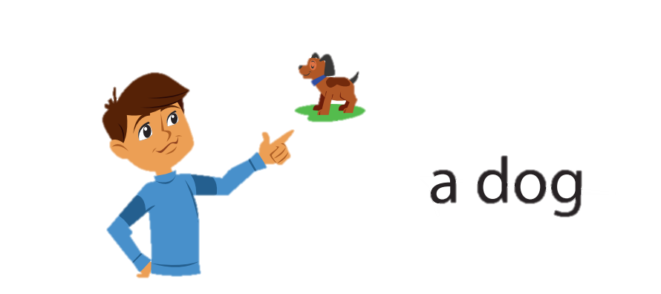
That’s a dog.
back

Slide 17
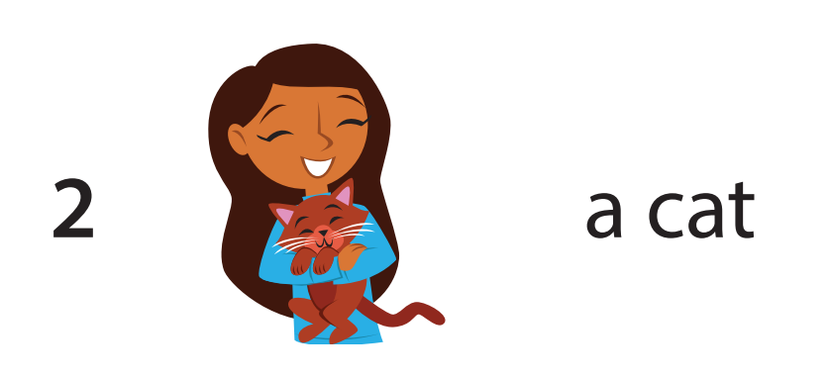
This is a cat.
back

Slide 18
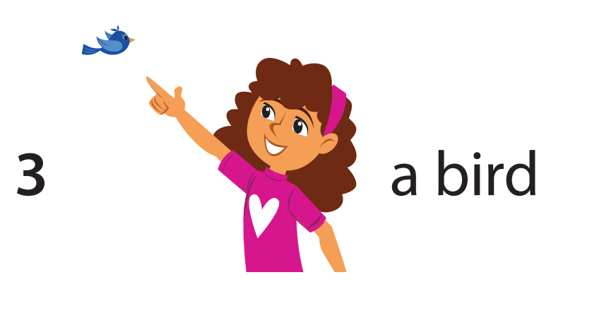
That’s a bird.
back

Slide 19
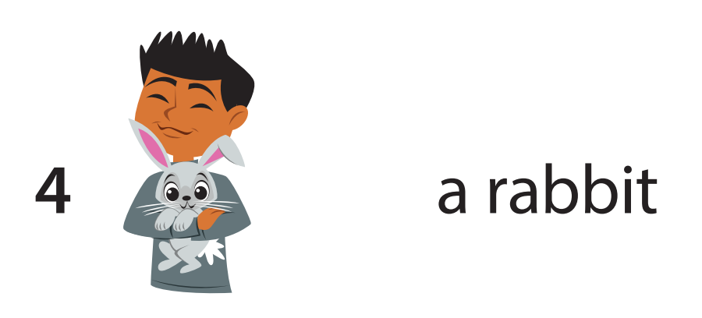
This is a rabbit.
back

Slide 20
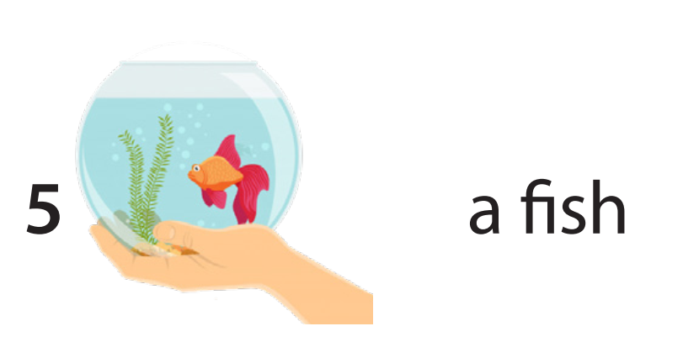
This is a fish.
back

Slide 21
04.
Production

Slide 22

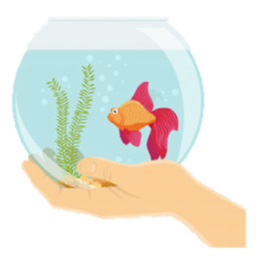
Draw your pets. Talk
My pets
That’s …
This is …

Slide 23
05.
Assessment

Slide 24

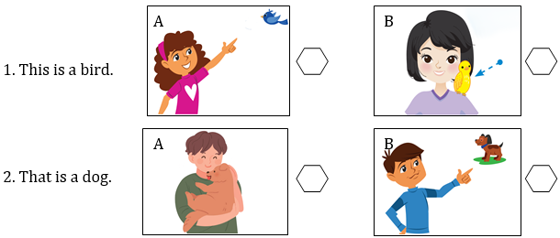
Tick the correct picture

Slide 25
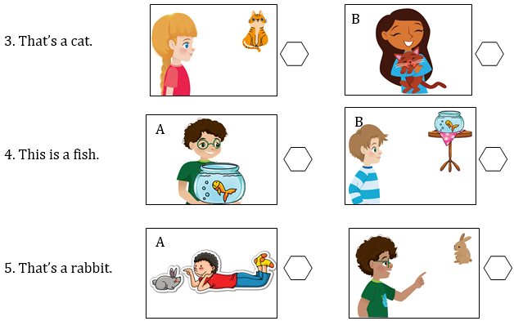
Notes:
THIẾT KẾ HOẠT ĐỘNG TƯƠNG TÁC 2 SLIDE 27 VÀ 28

Slide 26
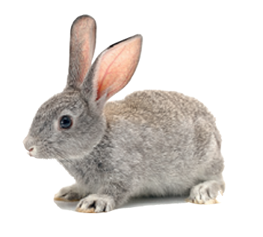
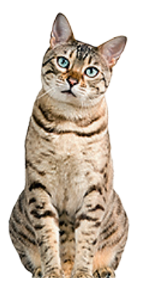

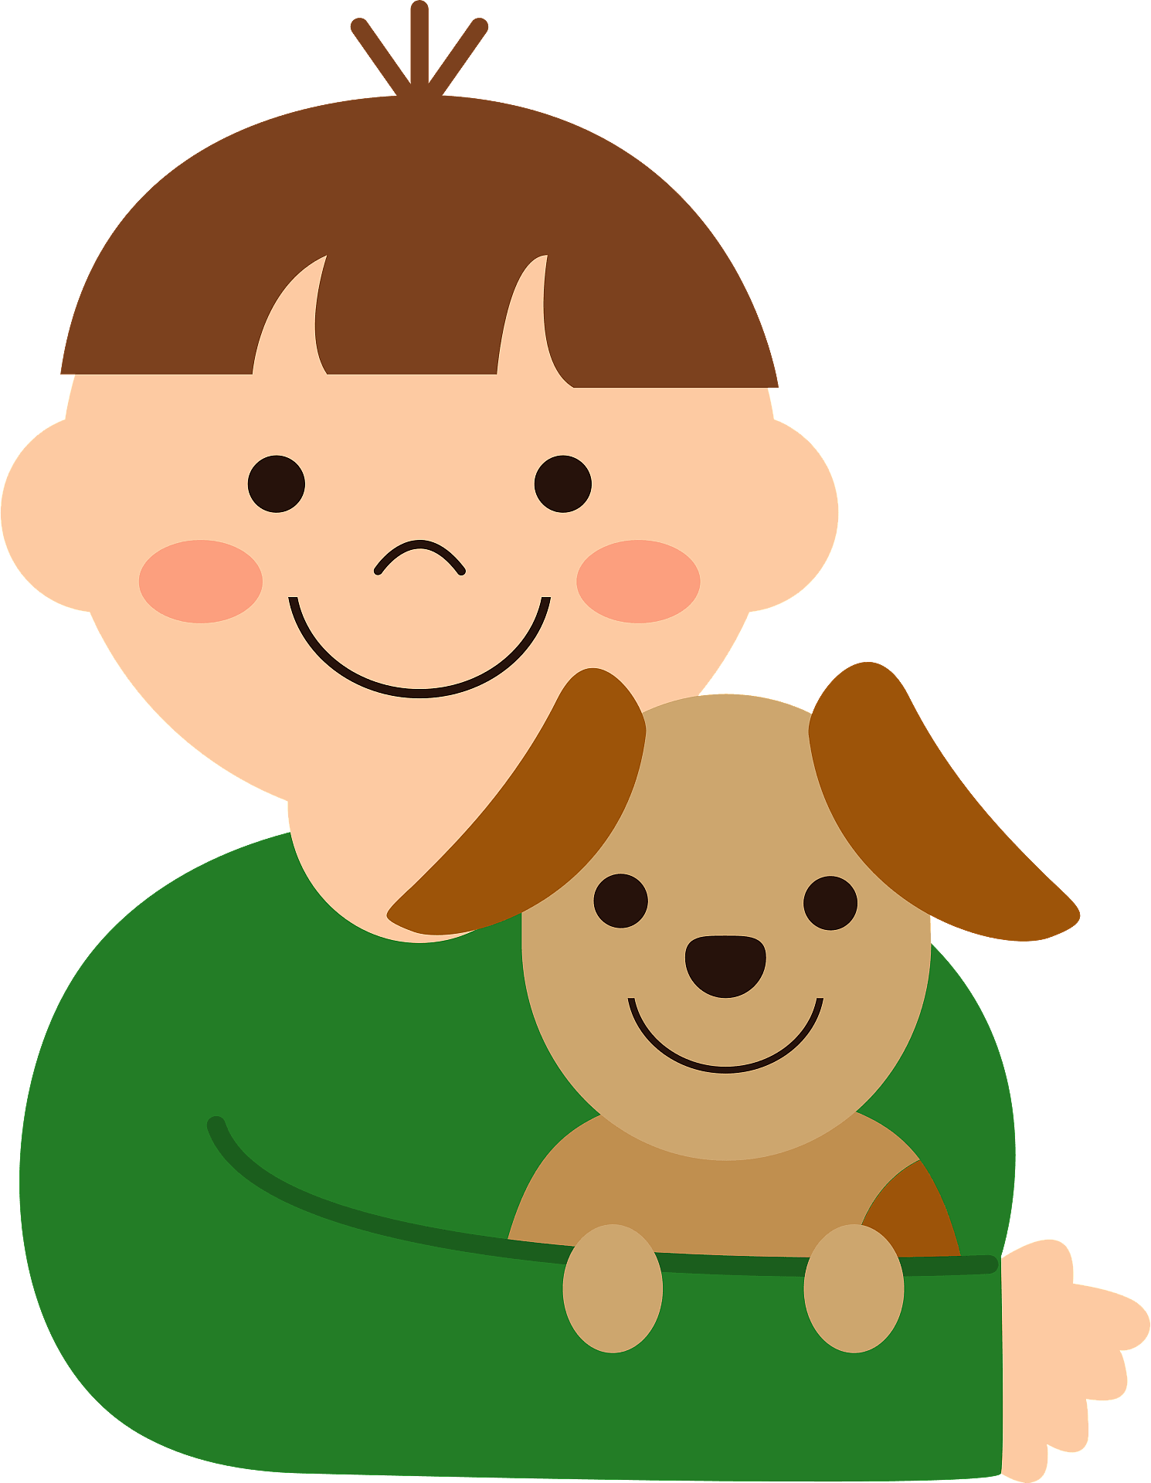
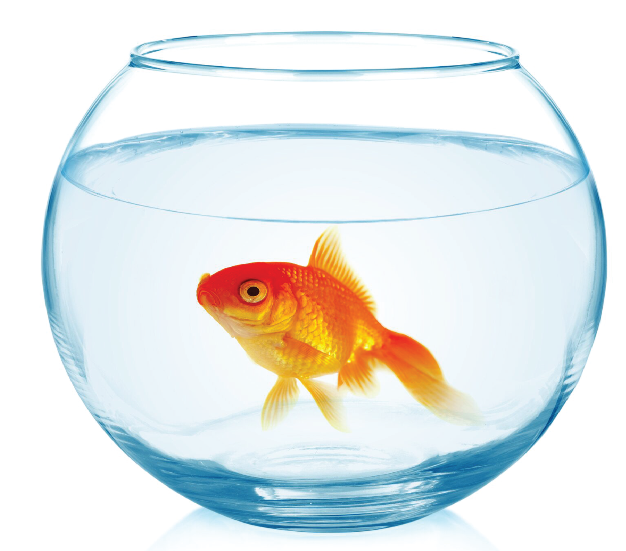

Look, read and write
1. This is a ………………..
2. That’s a ………………..
3. …………….. is a bird.
4. …………….. is a dog.
5. That’s a …………………
rabbit
cat
That
This
fish

Slide 27


Monday, November, 4th, 2024
Unit 3: ANIMALS
Lesson 1 ( Period 2)
4. Listen and repeat.
That’s = That is
5. Look and say.
2)
3)
4)
5)
6. Let’s talk.

Slide 28



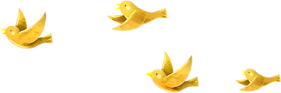
Good bye.
See you again!

