Slide 1


Slide 2



Slide 3




Teacher says

Slide 4




Unit 2
Lesson 3

Slide 5

Unit 2:
Lesson 3
1. Trace the letters.
a. How to write Big B
2
1
3
Notes:
How to write big B?

Slide 6

Unit 2:
Lesson 3
1. Trace the letters.
a. How to write Big B
WHERE’S YOUR FINGER?
Notes:
T asks Ss “ Where your finger?”
- Intructs Ss to raise index finger and response “ Here here here”

Slide 7




Unit 2:
Lesson 3
1. Trace the letters.
WHERE’S YOUR FINGER?
a. How to write Big B
2
Let’s write in the air
1
3
Notes:
Has Ss practice writing letter B in the air
Calls each team to practice

Slide 8

Unit 2:
Lesson 3
1. Trace the letters.
WHERE’S YOUR FINGER?
a. How to write Big B
2
Let’s write in the palm
1
3
Notes:
Has Ss practice writing letter B in the air
Calls each team to practice

Slide 9

Unit 2:
Lesson 3
1. Trace the letters.
a. How to write Small b
1
2
Notes:
How to write small b?

Slide 10
Unit 2:
Lesson 3
1. Trace the letters.
a. How to write Small b
WHERE’S YOUR FINGER?
Notes:
T asks Ss “ Where your finger?”
- Intructs Ss to raise index finger and response “ Here here here”

Slide 11

Unit 2:
Lesson 3
1. Trace the letters.
WHERE’S YOUR FINGER?
a. How to write Small b
Let’s write in the air
1
2
Notes:
Has Ss practice writing small b in the air
Calls each team to practice

Slide 12
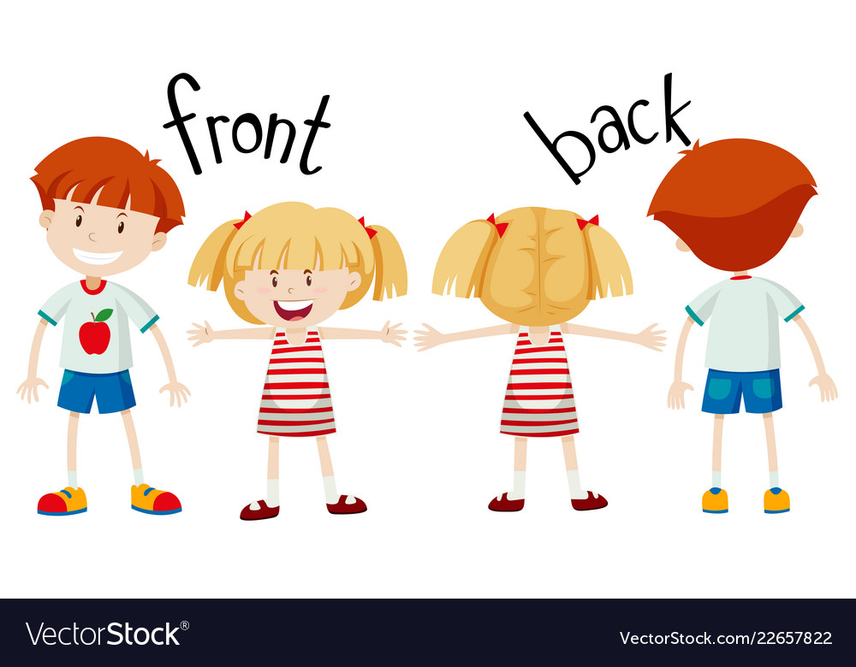
Unit 2:
Lesson 3
1. Trace the letters.
WHERE’S YOUR FINGER?
a. How to write Small b
Let’s write in the
1
2
Notes:
Ss write small B in the back’s friend

Slide 13

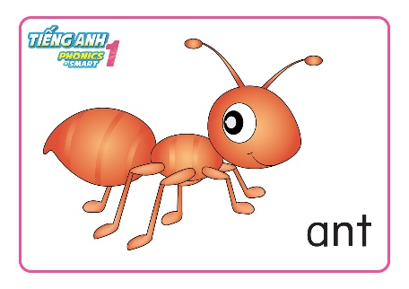
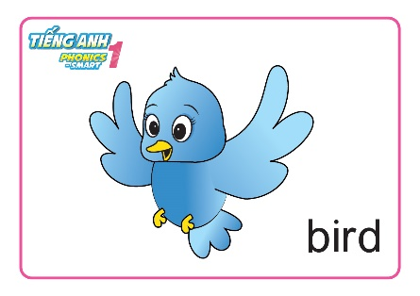


Unit 2:
Lesson 3
1. Trace the letters.
WHAT’S LETTER?
Notes:
GAME: “What’s letter”
- T reviews quickly those words : Bird, Butterfly, Apple, Ant
- Calls one student from each team to come and turn his/her back to the flashcards
- Explains the rules:
+ T show a flashcard and each group has to shout out the flashcard
+ Then the students in the board need to listen turn back to write the first letter of the word in flashcards ( capital and small letters are both acceptable). With each correct answer, each group gain 1 star.
Play the demo with whole class

Slide 14


WHAT’S LETTER?

Slide 15
WHAT’S LETTER?
A
a

Slide 16
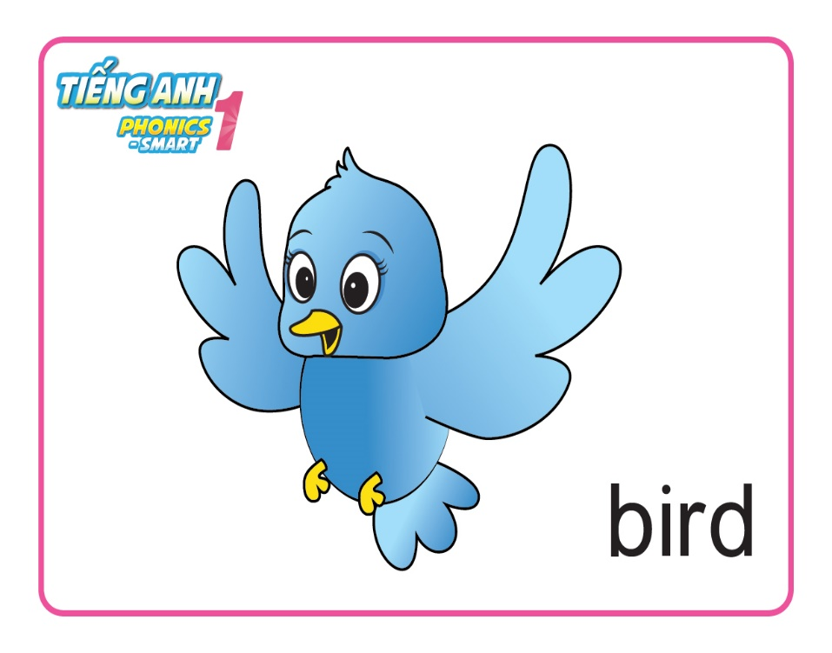
WHAT’S LETTER?

Slide 17
WHAT’S LETTER?
B
b

Slide 18

WHAT’S LETTER?

Slide 19
WHAT’S LETTER?
A
a

Slide 20

WHAT’S LETTER?

Slide 21
WHAT’S LETTER?
B
b

Slide 22

GOOD JOB

Slide 23
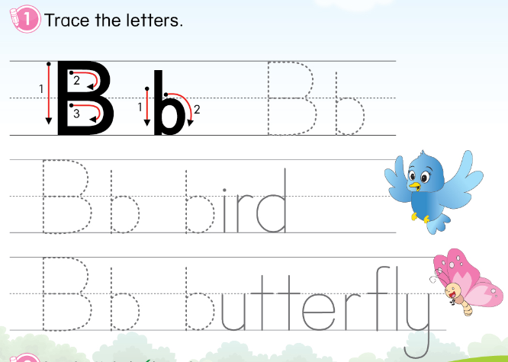
Unit 2:
Lesson 3
1. Trace the letters.

Slide 24
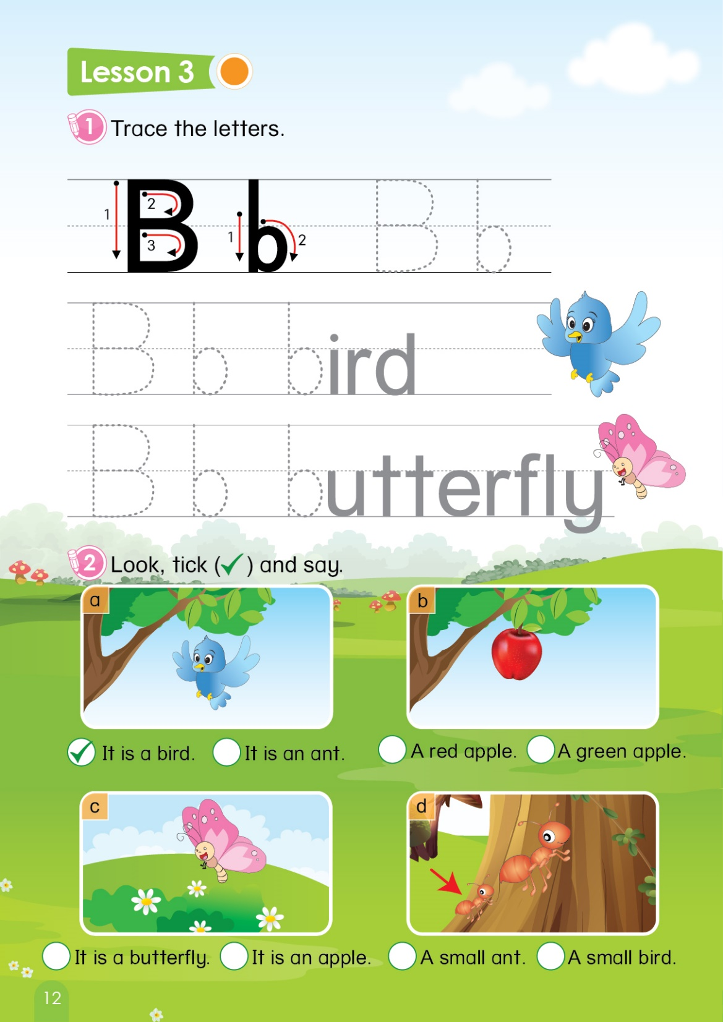
Unit 2:
Lesson 3
1. Trace the letters.
2. Look, tick and say.
Notes:
Asks Ss to open the book page 12

Slide 25

Unit 2:
Lesson 3
1. Trace the letters.
2. Look, tick and say.




It is a bird.
It is an ant.
Notes:
- T does an example of picture a.
Asks Ss to choose the answer by saying “ Is it a bird or an ant?” along with pointing to each sentence.
After the Ss choose the answer, teacher click to choose the answer.

Slide 26
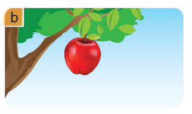
Unit 2:
Lesson 3
1. Trace the letters.
2. Look, tick and say.




A red apple.
A green apple.

Slide 27
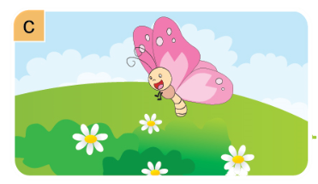
Unit 2:
Lesson 3
1. Trace the letters.
2. Look, tick and say.




It is butterfly.
It is an apple.

Slide 28
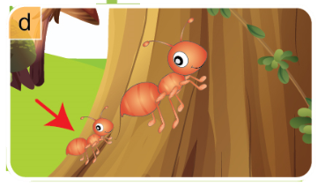
Unit 2:
Lesson 3
1. Trace the letters.
2. Look, tick and say.




A small ant.
A small bird.

Slide 29

Unit 2:
Lesson 3
1. Trace the letters.
2. Look, tick and say.
Notes:
- T makes sure Ss have put the tick in their book
- Asks Ss to point and say the correct sentence.

Slide 30
Unit 2:
Lesson 3
1. Trace the letters.
2. Look, tick and say.

Slide 31


CÔNG TY CỔ PHẦN PHÁT TRIỂN GIÁO DỤC
VIỆT NAM VPBOX
Hà Nội
Biệt thự G2&G28, Làng Quốc Tế Thăng Long,
Quận Cầu Giấy, Hà Nội.
ĐT: (024) 3 3793 2405
phonics.hanoi@vpbox.edu.vn
Thành Phố Hồ Chí Minh
Số 29 Mai Thị Lựu, Quận 1, TP. HCM.
ĐT: (028) 3 820 5934
phonics.hcm@vpbox.edu.vn
www.vpbox.edu.vn

